Slide 1
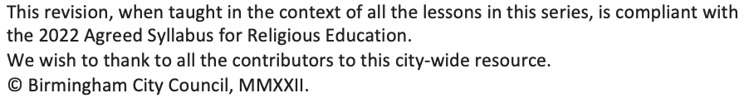
Sukkah
KS1_Y2_Unit_04_Aut_Wk_01_of_03_R123_Resource_1_v1
In the next slide, download 4 pictures of sukkahs for pupils to be able to compare and contrast

Slide 2
4 pictures of Sukkah
KS1_Y2_Unit_04_Aut_Wk_01_of_03_R123_Resource_1_v1
https://globaljews.org/jewishand/sukkot-and-chinese-moon-festival/
https://pjlibrary.org/beyond-books/pjblog/september-2017/build-a-sukkah-with-your-family
https://toriavey.com/sukkot-sukkah/
https://blog.bham.ac.uk/culturalcalendar/wp-content/uploads/sites/70/2021/09/sukkah.jpg

Slide 3
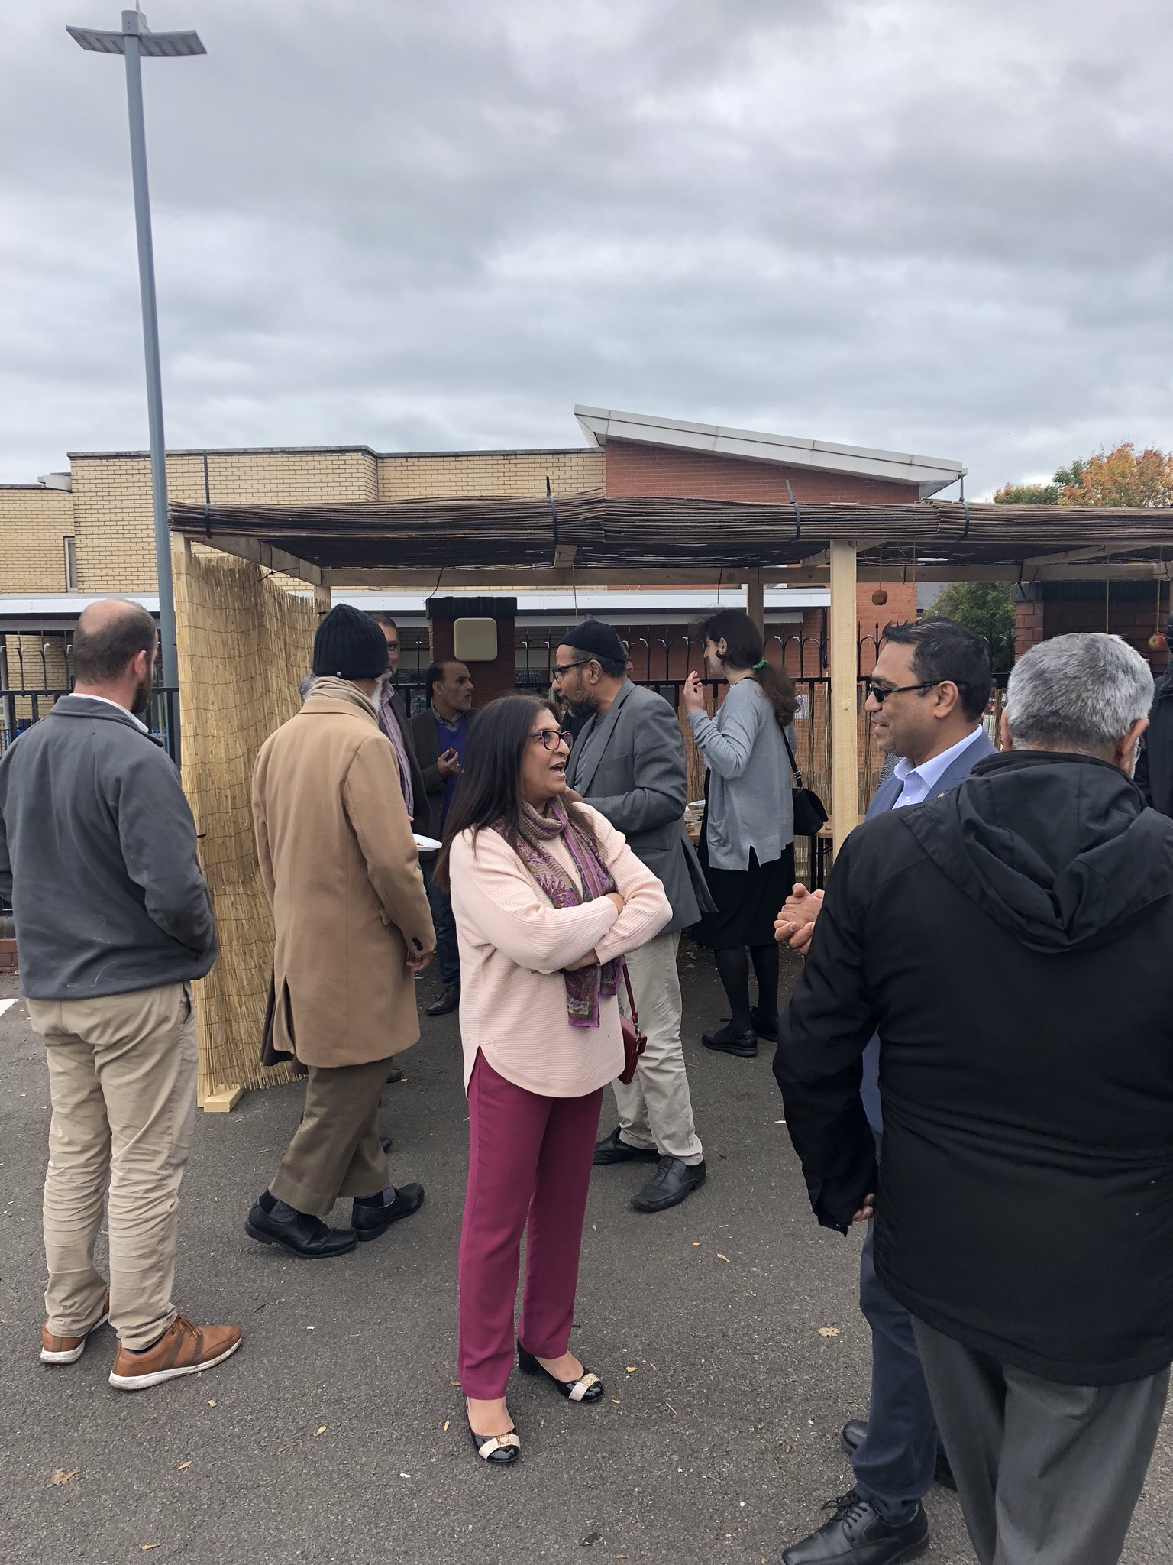
Muslims and Jewish people meeting for lunch under a sukkah in Birmingham in 2018
KS1_Y2_Unit_04_Aut_Wk_01_of_03_R123_Resource_1_v1
Muslims and Jewish people meeting for lunch under a sukkah in Birmingham in 2018

