Slide 1
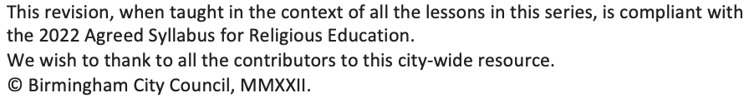
Torah
KS1_Y1_Unit_04_Aut_Wk_01_of_04_R123_Resource_v1

Slide 2
Slide 2
KS1_Y1_Unit_04_Aut_Wk_01_of_04_R123_Resource_v1
Download image of people holding decorated versions of the Torah. Jewishmuseum.org.uk/schools/in-the-classroom/inclusive-judaism/imagelibrary/simchat-torah-milton-keynes-and-district-reform-synagogue/
The site allows downloading of the image, but requires information from the teacher along with a promise to only use the image for educational purposes.

Slide 3
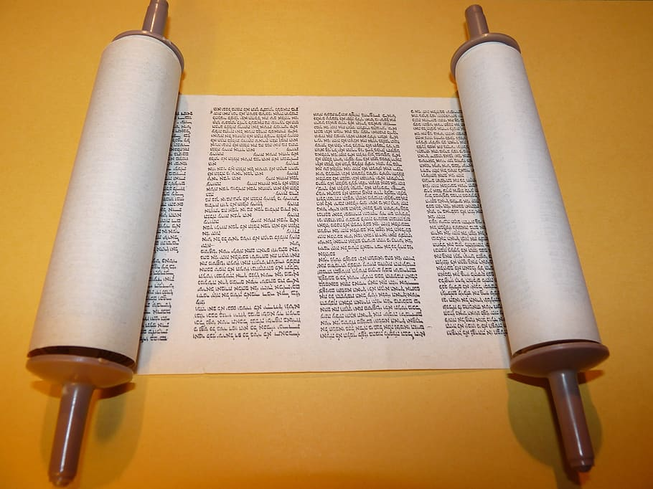
Slide 3
KS1_Y1_Unit_04_Aut_Wk_01_of_04_R123_Resource_v1

Slide 4
Slide 4
KS1_Y1_Unit_04_Aut_Wk_01_of_04_R123_Resource_v1
Download image of the Torah https://www.myjewishlearning.com/article/the-formation-of-the-oral-torah/

