Slide 1
Being thankful
KS2_Y5_Unit_11_Su_Wk_01_of_03_R123_Presentation_v2

Slide 2
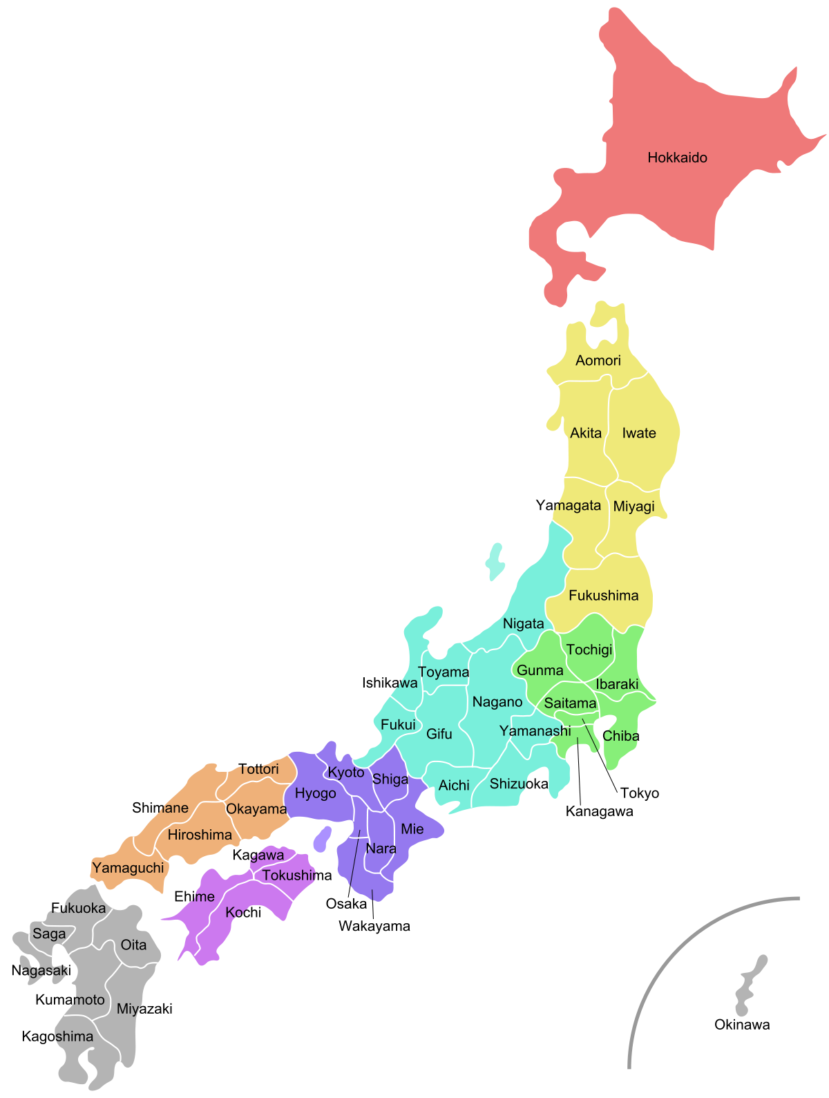
Slide 2
KS2_Y5_Unit_11_Su_Wk_01_of_03_R123_Presentation_v2
In Japan, meals traditionally begin with a single word:
itadakimasu
It can be translated to “I humbly receive this meal.”
This Photo by Unknown Author is licensed under CC BY-SA

Slide 3

Slide 3
KS2_Y5_Unit_11_Su_Wk_01_of_03_R123_Presentation_v2
In Ghana, people may say
Earth, when I am about to die I lean on you.
Earth, while I am alive I depend on you.

Slide 4

Slide 4
KS2_Y5_Unit_11_Su_Wk_01_of_03_R123_Presentation_v2
A traditional Christian prayer for children that is still said in some primary schools today.
Thank you, God, for the world so sweet,
thank you for the food we eat.
Thank you for the birds that sing;
thank you, God, for everything

Slide 5
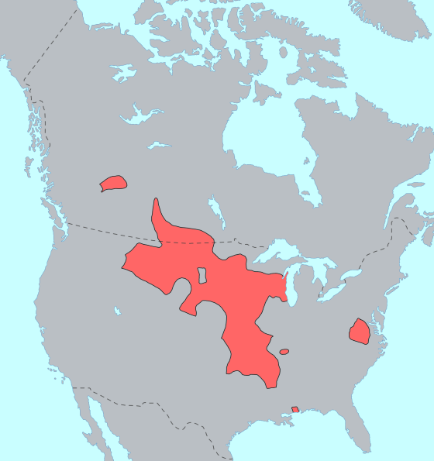
Slide 5
KS2_Y5_Unit_11_Su_Wk_01_of_03_R123_Presentation_v2
The Sioux repeat the following
I think about the common things like this pot. The bubbling water comes from the sky. The fire comes from the sun. The meat stands for our animal brothers who gave themselves so we should live. These things are sacred. Looking at that pot of good soup, I am thinking how, in this simple manner, the Great Spirit takes care of me.
This Photo by Unknown Author is licensed under CC BY-SA

Slide 6
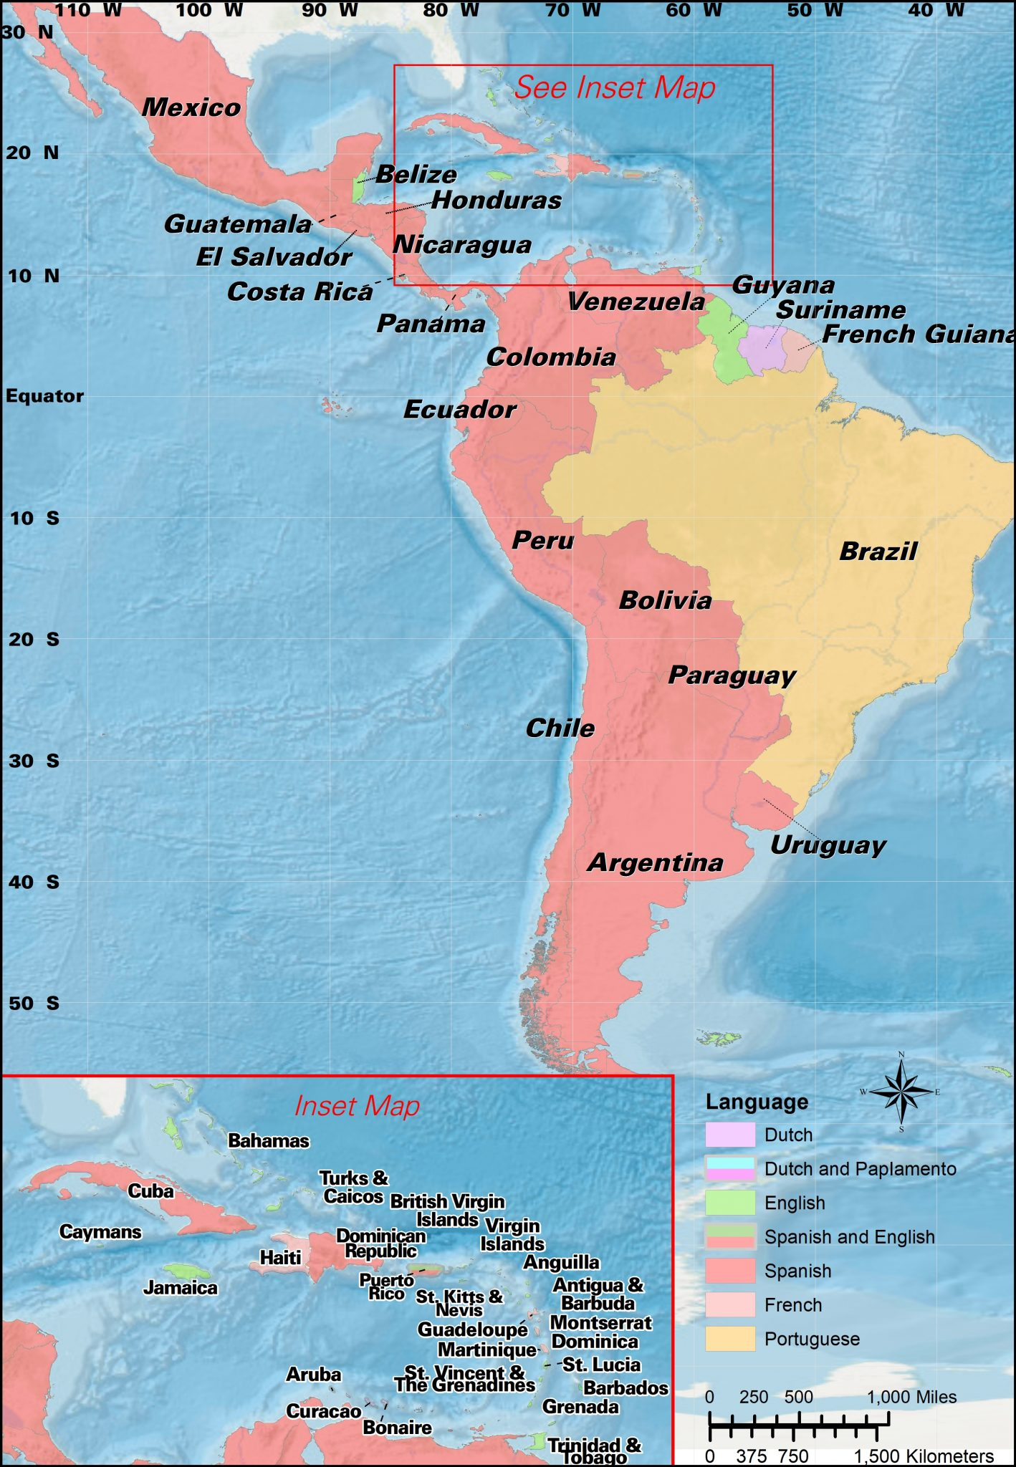
Slide 6
KS2_Y5_Unit_11_Su_Wk_01_of_03_R123_Presentation_v2
Latin Americans might offer up this prayer:
To those who have hunger,
give bread.
And to those who have bread,
give the hunger for justice.
This Photo by Unknown Author is licensed under CC BY-SA-NC

