Slide 1
Icons
KS2_Y4_Unit_12_Sum_Wk_02_of_03_R123_Presentation_v2

Slide 2
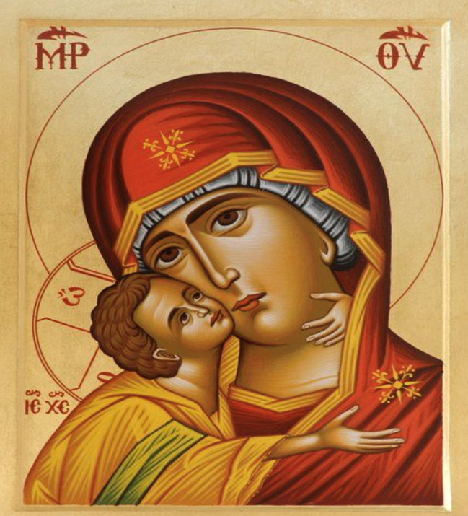
https://www.pinterest.co.uk/pin/theotokos-panagia-made-to-order-handpainted-eastern-orthodox-byzantine-icon-22k--561964859744883235/
KS2_Y4_Unit_12_Sum_Wk_02_of_03_R123_Presentation_v2

Slide 3
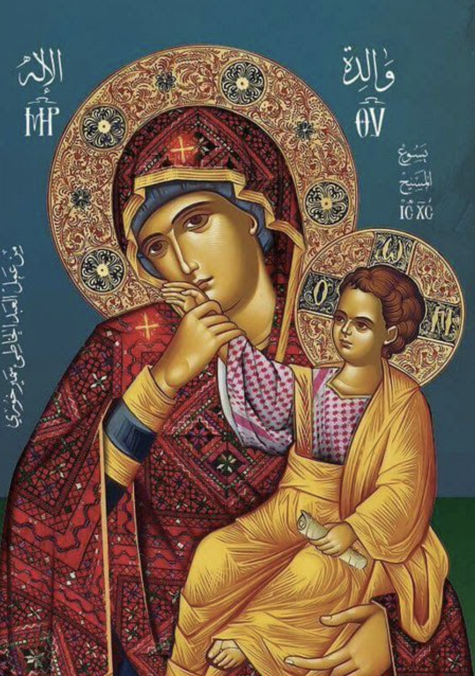
https://www.pinterest.co.uk/pin/19351473391954022/
KS2_Y4_Unit_12_Sum_Wk_02_of_03_R123_Presentation_v2

Slide 4
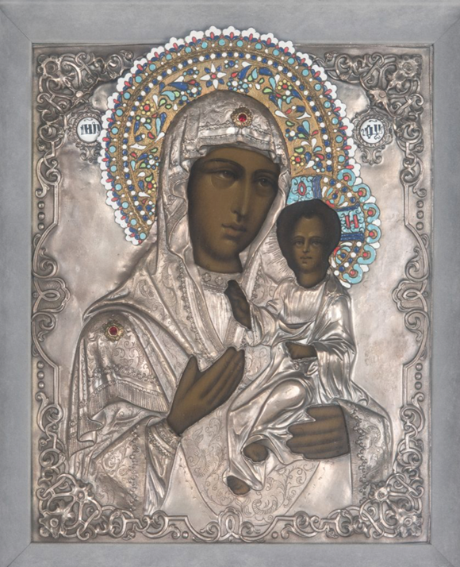
https://caseantiques.com/item/lot-89-russian-eastern-orthodox-icon-virgin-child/
KS2_Y4_Unit_12_Sum_Wk_02_of_03_R123_Presentation_v2

Slide 5
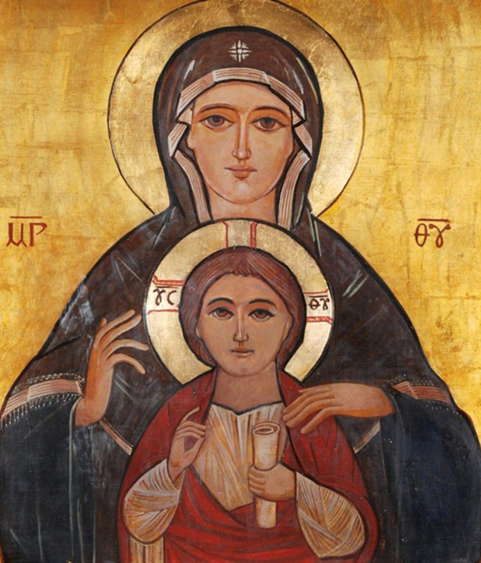
https://www.pinterest.co.uk/pin/367465650850041583/
KS2_Y4_Unit_12_Sum_Wk_02_of_03_R123_Presentation_v2

Slide 6
Stained glass
KS2_Y4_Unit_12_Sum_Wk_02_of_03_R123_Presentation_v2

Slide 7
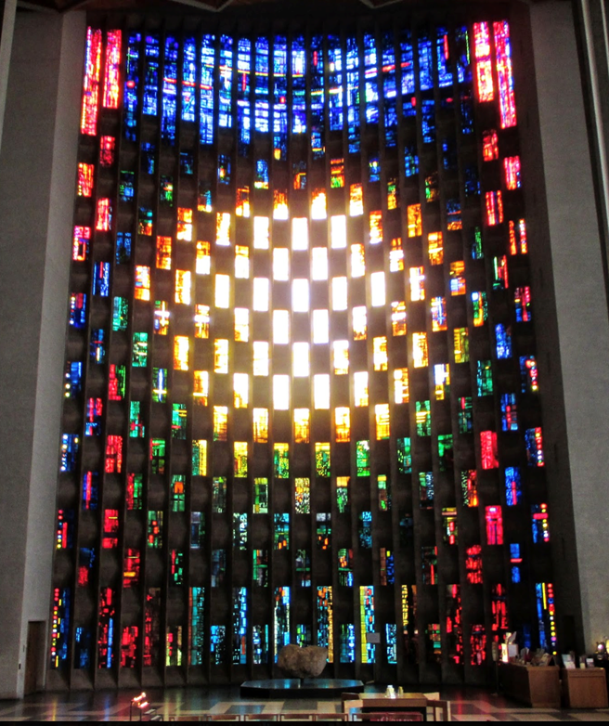
Coventry Cathedral Baptistery window
The Baptistery Window is made of 198 brightly coloured glass panels and measures 26 metres high. The artist John Piper was asked to design the stained glass. His view was that with 198 small areas of window to fill, the glass needed dazzling colour and an abstract pattern to create unity. Working with glassmaker Patrick Reyntiens, he created the window from thousands of differently-sized pieces of glass to visually vary the space and rest the eye. http://lolfrompasa.blogspot.com/2014/04/the-baptistry-window.html
KS2_Y4_Unit_12_Sum_Wk_02_of_03_R123_Presentation_v2

Slide 8
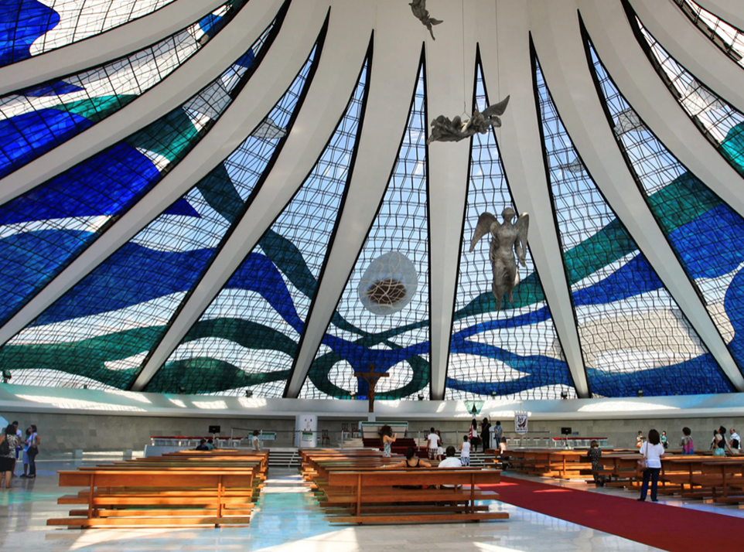
Cathedral of Brasília, Brazil
The Oscar Niemeyer–designed cathedral's distinctive stained glass was created by artist Marianne Peretti in 1990. The 22,000- square-foot work features waves of blue, green, white, and brown glass https://www.architecturaldigest.com/gallery/stained-glass-windows
KS2_Y4_Unit_12_Sum_Wk_02_of_03_R123_Presentation_v2

Slide 9
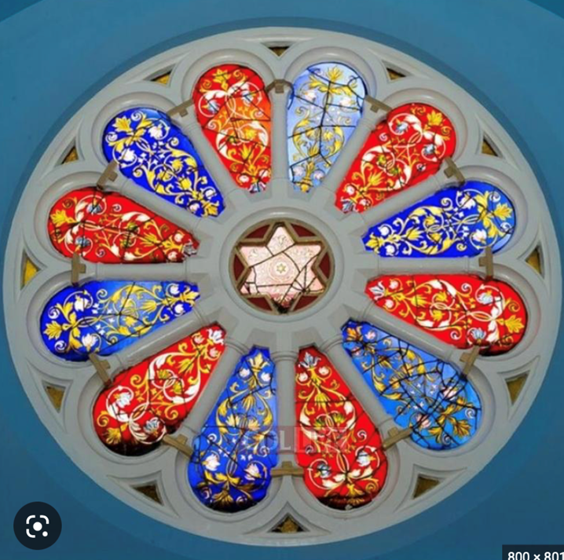
The Rose window – Singer’s Hill Synagogue, Birmingham https://www.google.com/imgres?imgurl=https%3A%2F%2Freligionresourcesblog.files.wordpress.com%2F2016%2F06%2Fstained-glass-rose-window.jpg%3Fw%3D840&tbnid=CUTee-0bHlklfM&vet=12ahUKEwjrnI7zjsz-AhURtUwKHbW5Ac8QMygBegUIARCyAQ..i&imgrefurl=https%3A%2F%2Freligionresources.org.uk%2Fphotographs%2Fjudaism%2Fsingers-hill-synagogue-birmingham%2Fstained-glass-rose-window%2F&docid=UOqQMlOhBMSWvM&w=840&h=762&q=singers%20hill%20synagogue%20window&ved=2ahUKEwjrnI7zjsz-AhURtUwKHbW5Ac8QMygBegUIARCyAQ
KS2_Y4_Unit_12_Sum_Wk_02_of_03_R123_Presentation_v2

Slide 10
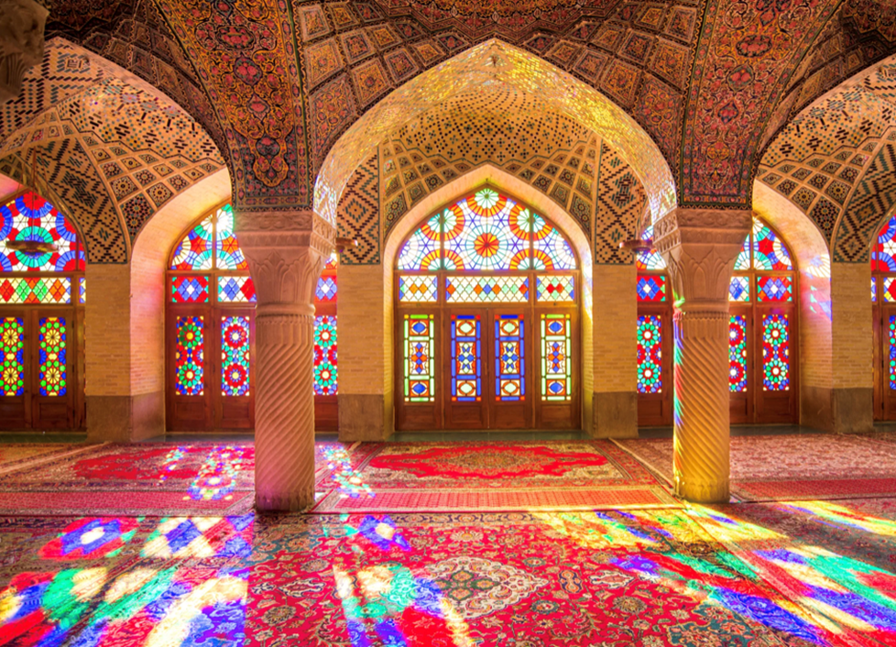
Nasir al-Mulk Mosque, Shiraz, Iran
Finished at the end of the 19th century, this Technicolor mosque in southern Iran dazzles with intricate stained-glass windows, richly coloured tiles, carved pillars, and woven rugs. Due to its strategic positioning, early-morning light produces a kaleidoscopic effect within the structure, which has survived numerous earthquakes thanks to the flexible wood struts within its walls. https://www.architecturaldigest.com/gallery/stained-glass-windows
KS2_Y4_Unit_12_Sum_Wk_02_of_03_R123_Presentation_v2

Slide 11
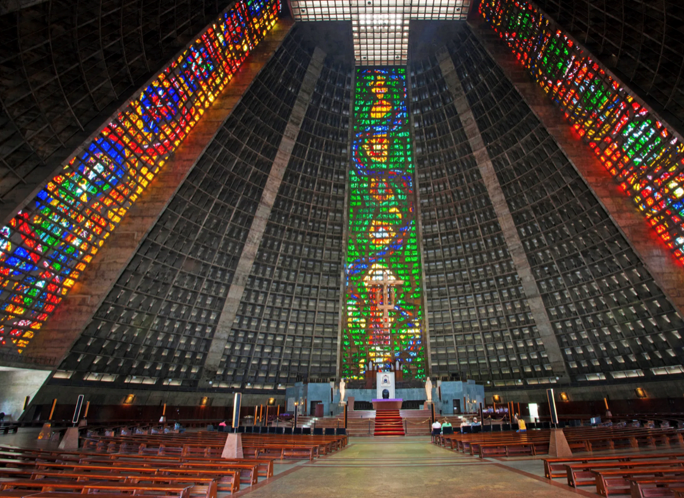
Metropolitan Cathedral of St. Sebastian, Rio de Janeiro
Adding warmth to an otherwise austere religious site, four rectilinear stained-glass windows stretch some 200 feet to the ceiling of this beehive-shaped cathedral, which was completed in 1976. As many as 20,000 people can fill the Edgar Fonseca–designed church, which holds the Museu de Arte Sacra in its subterranean space. https://www.architecturaldigest.com/gallery/stained-glass-windows
KS2_Y4_Unit_12_Sum_Wk_02_of_03_R123_Presentation_v2

Slide 12

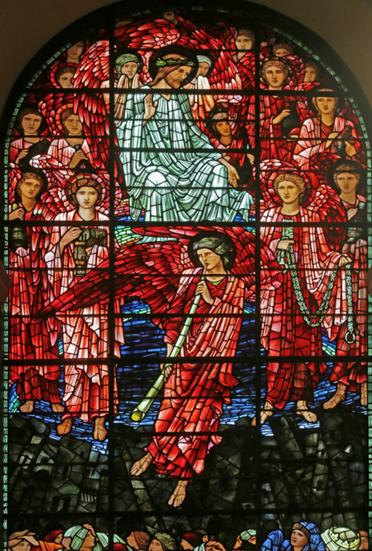
The Last Judgment, St. Phillip’s Cathedral, Birmingham
The Last Judgement (1897), is widely recognised as the finest example of Burne-Jones’ work, depicting the return of Christ and his judgement on humanity. The window was a memorial to the Bishop Bowlby of Coventry who was Rector of St Philip’s from 1875 to 1894. https://www.meisterdrucke.uk/fine-art-prints/Edward-Burne-Jones/378966/The-Last-Judgement,-1885-1897-(stained-glass).html
KS2_Y4_Unit_12_Sum_Wk_02_of_03_R123_Presentation_v2

