Slide 1
Being curious and valuing knowledge
KS1_Y1_Unit_11_Su_Wk_02_of_03_R123_slides

Slide 2
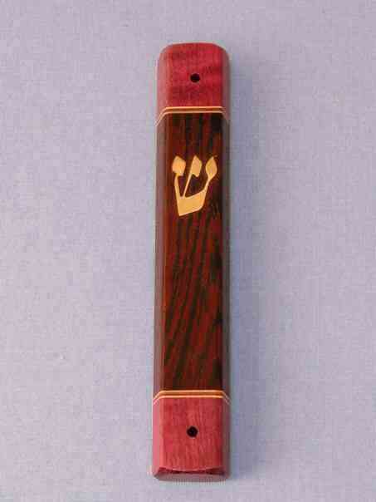
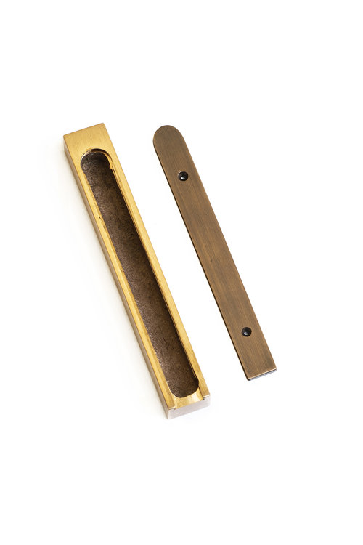
Slide 2
KS1_Y1_Unit_11_Su_Wk_02_of_03_R123_slides

Slide 3
Slide 3
KS1_Y1_Unit_11_Su_Wk_02_of_03_R123_slides
שְׁמַע יִשְׂרָאֵל יְיָ אֱלֹהֵֽינוּ יְיָ אֶחָד
Sh'ma Yisra'eil Adonai Eloheinu Adonai echad.
Hear, Israel, the Lord is our God, the Lord is One.

Slide 4
Slide 4
KS1_Y1_Unit_11_Su_Wk_02_of_03_R123_slides
And you shall love the Lord your God
with all your heart and with all your soul
and with all your might
And it shall be that these words
that I command you today
shall be in your heart
And you shall teach them diligently to your children
and you shall speak of them
when you sit at home
and when you walk along the way
and when you lie down and when you rise up.
………
And you shall write them
on the doorposts of your house and on your gates

