Slide 1
PREVENT CPD for
Special Schools
19th June 2017
Ayisha Ali
Colvin White

Slide 2
Welcome and Introductions
Ayisha Ali
Education Resilience Team- Curriculum lead

Slide 3
Workshop Order
Workshop 1: WRAP updates (AA)
Workshop 2: Prevent risk assessment (AA)
Workshop 3: Making a referral- Screening toolkit (CW)
Workshop 4: Curriculum resources- How do I teach about the dangers of extremism and radicalisation in school? (AA)

Slide 4
WRAP updates
Recent attacks
Social media- propaganda
Lone actors

Slide 5
Prevent in Birmingham
Largest Local Authority in UK serving over 1 Million Citizens
  Youthful City – almost 50% of population under the age of 30
  Birmingham is the most culturally mixed city in the UK, with 42% per cent non-white according to 2011 figures
  Outside London, Birmingham has the UK’s largest Muslim (22%), Sikh (3%) and Buddhist (0.45%) communities, the second largest Hindu community (2.08%) and the seventh largest Jewish community (0.21%).
Challenges
  Deprived – 40% of Birmingham’s population live in areas in the 10% most deprived in England
  Around a third of children are classified as living in poverty Skills Mismatch – low proportion of highly skilled residents
  Unemployment rate significantly above national average
  High youth unemployment
  Significant health inequalities

Slide 6
What do you think is the current threat level?
CRITICAL means an attack is expected imminently
SEVERE means a terrorist attack is highly likely
SUBSTANTIAL means it is strong possibility
MODERATE means an attack is possible, but unlikely
LOW means an attack is unlikely
Current threat level for international terrorism for UK is assessed at SEVERE (as of 15th June 2017)
To report an imminent threat call 999 or ring the Anti-Terrorist Hotline on 0800 789 321
Where Does the Threat Come From?
International Terrorism - DAESH
Domestic Extremism – Far Right Groups such as English Defence League
Northern Ireland related Terrorism - IRA

Slide 7
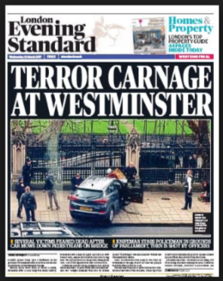
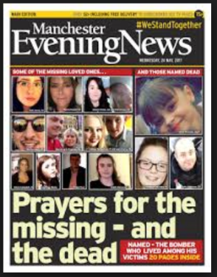
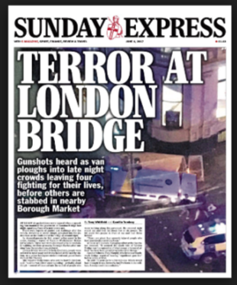
Lone actors
Notes:
Salman Abedi- Manchester
Khalid Masood- Adrian Elms- Westminister

Slide 9
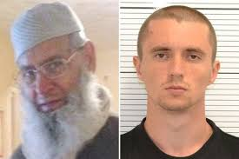
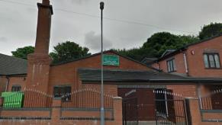
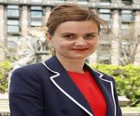
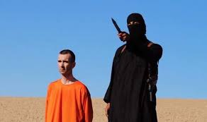
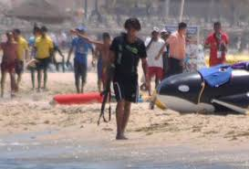
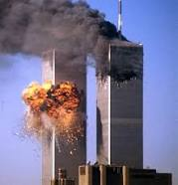
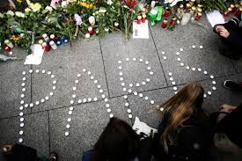
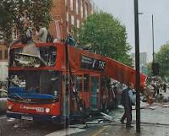
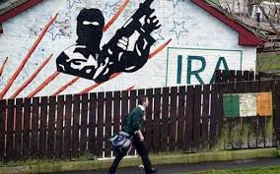
Mohammed Saleem murdered by
Pavlo Lapshyn (Ukrainian Neo Nazi Terrorist April 2013)
Pavlo Lapshyn planted nail bombs in several West Midlands Mosques 2013
MP Jo Cox, murdered by
Thomas Mair, Far Right supporter June 2016
ISIS (Jihadi John)
Tunisia Beach massarce - by ISIS Seifeddine Rezgui – June 2015
Al Qaeda attack 11/9/2001 on Twin Towers New York
LOCAL
NATIONAL
GLOBAL
Paris Bombings by ISIS - Nov 2016
London Bombing 7/7/2005
Islamic Extremists
Irish Republic Army IRA

Slide 10
Paragraph 64
Schools should be a safe space in which children and young people can understand and discuss sensitive topics, including terrorism and the extremist ideas that are part of terrorist ideology, and learn how to challenge these ideas. The Prevent duty is not intended to limit discussion of these issues. Schools should, however, be mindful of their existing duties to forbid political indoctrination and secure a balanced presentation of political issues.
These duties are imposed on maintained schools by sections 406 and 407 of the Education Act 1996.
Similar duties are placed on the proprietors of independent schools, including academies (but not 16-19 academies) by the Independent School Standards.
Notes:
School context and responsibility:
T &L
PSHE and SMSC provision
Enrichment
Debate and discussion opportunities
e.g. Hot topic for debate

Slide 11
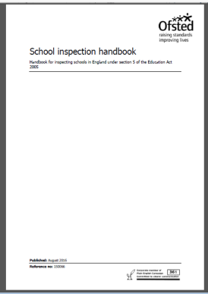
School inspection handbook
From:
  Ofsted
First published:
  15 June 2015
Last updated:
  September 2016
■ how well leaders and governors promote all forms of equality and foster greater understanding of and respect for people of all faiths (and those of no faith), races, genders, ages, disability and sexual orientations (and other groups with protected characteristics52), through their words, actions and influence within the school and more widely in the community
■ the effectiveness of safeguarding
■ the effectiveness of leaders’ and governors’ work to raise awareness and keep pupils safe from the dangers of abuse, sexual exploitation, radicalisation and extremism and what the staff do when they suspect that pupils are vulnerable to these issues.
142. Where the school has received external support, for example from the local authority, academy proprietor or trust, inspectors will evaluate and report on the quality and the impact of the external support and challenge on improvement in the school.
Notes:
Birmingham is a hot spot-possibly due to the Trojan Horse?

Slide 12
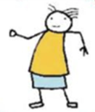

Slide 13
‘Safeguarding vulnerable people from radicalisation is no different from safeguarding them from other forms of harm’
Home Office; The Prevent Strategy

Slide 14
  PREVENT RISK ASSESSMENT
  Ayisha Ali

Slide 15
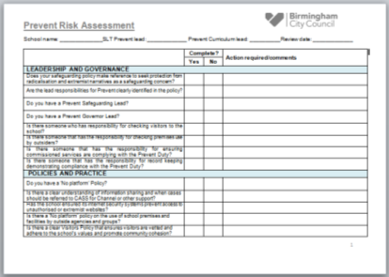
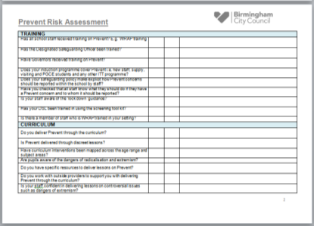
1-LEADERSHIP AND GOVERNANCE
2-POLICIES AND PRACTICE
3-TRAINING
4-CURRICULUM

Slide 16
  Screening tool kit
  Colvin White

Slide 17
Curriculum Resources

Slide 18

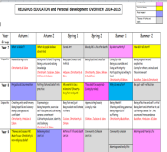
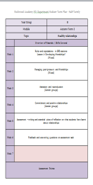
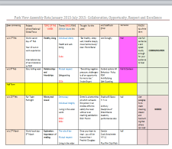
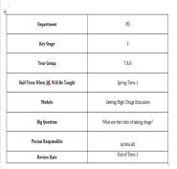
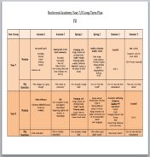
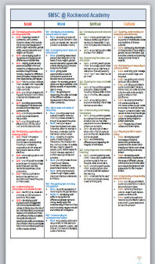
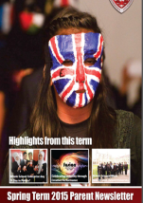
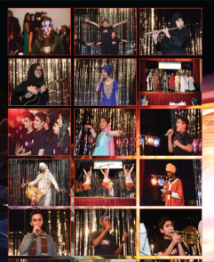
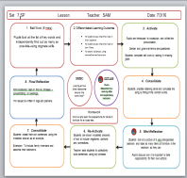
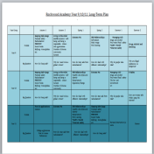
Mapping a dynamic curriculum that addresses safeguarding issues.
Notes:
UNICEF-Rights respecting schools award-impact underpins
School ethos and values
No outsiders-primary-equalities

Slide 19
curriculum group meetings
Once every term
Hosted in Birmingham schools
Share resources
Share best practice
Address controversial issues
Speed networking and setting up collaborative work opportunities
Rate providers
bespoke universal support-planning and mapping curriculum

Slide 20
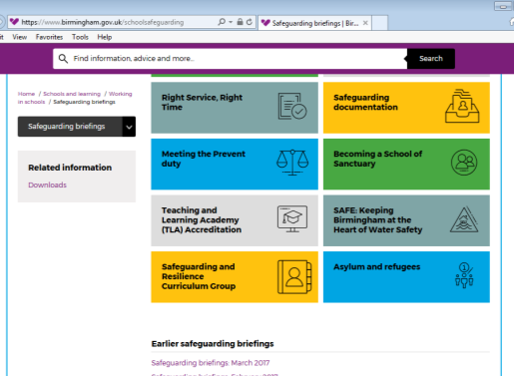
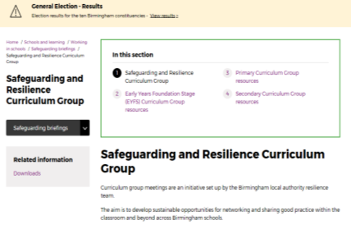
Where do I find resources?
2-Click here
1-Click here
https://www.birmingham.gov.uk/schoolsafeguarding

Slide 21
Discussing a terrorist attack with children in the primary phases
Ayisha Ali

Slide 22
What happens when a child hears about an attack?
Teaching and learning of PSHE education should be built into a planned progressive programme
Practical suggestions for ways that you can structure questioning and discussion on further information about such events.
When attack occurs , children will hear about it in many ways, some could be inaccurate, untrue or based on speculation.
Feelings- young people can sometimes feel a sense of personal anxiety, fear and may find it hard to articulate their feelings

Slide 23
Practical tips
1-Offer reassurance
2-Encourage questions and answer them honestly
3- Clarify the facts- What exactly happened? What is happening now? How do we know?
4- Allow children to talk about their feelings
5- Encourage community cohesion

Slide 24

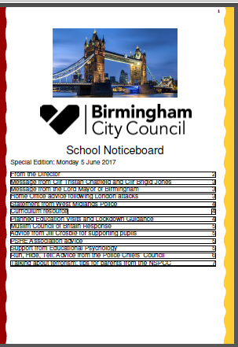
RED notice board
Notes:
Parents, websites, policies, procedures

Slide 25
  Parkfield Primary School
  Andy Moffat

Slide 26
  Selly Oak Trust School
  Simon Pearson

Slide 27
  Jason Hakin
  Assistant Team Manager (Theme Lead - Children and Young People with Complex Needs)

Slide 28
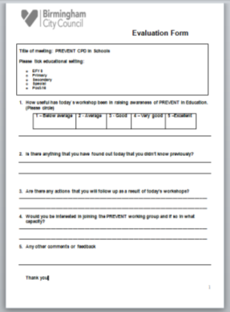
Questions and Evaluations

Slide 29
‘Safeguarding vulnerable people from radicalisation is no different from safeguarding them from other forms of harm’
The Prevent Strategy
Prevent Birmingham

