Slide 1
EYFS PREVENT CPD
18 ^{TH} July 2017
Ayisha Ali
Colvin White

Slide 2
Welcome and Introductions
Ayisha Ali
Education Resilience Team- Curriculum Lead
Colvin White
Early Help

Slide 3
Workshop Order
Workshop 1: WRAP updates-current threat (AA)
Workshop 2: Prevent Risk Assessment (AA)
Workshop 3: Making a referral- Screening toolkit (CW)
Workshop 4: Curriculum resources- How do I teach about the dangers of extremism and radicalisation in school? (AA)

Slide 4
WRAP updates
Recent attacks-current threat
Lone actors
Social media- propaganda

Slide 5
What do you think is the current threat level?
CRITICAL means an attack is expected imminently
SEVERE means a terrorist attack is highly likely
SUBSTANTIAL means it is strong possibility
MODERATE means an attack is possible, but unlikely
LOW means an attack is unlikely
Current threat level for international terrorism for UK is assessed at SEVERE
To report an imminent threat call 999 or ring the Anti-Terrorist Hotline on 0800 789 321
Where Does the Threat Come From?
International Terrorism – DAESH/ISIS
Domestic Extremism – Far Right Groups such as English Defence League
Northern Ireland related Terrorism - IRA

Slide 6
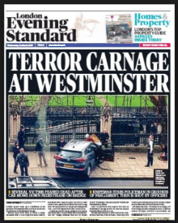

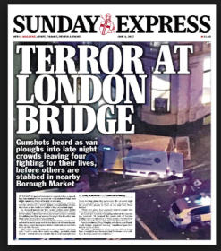
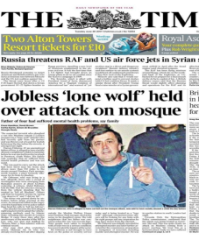
Recent attacks
Notes:
Salman Abedi- Manchester Arena- Ariana Grande Concert
Khalid Masood- Adrian Elms- West Minister
Khurum Butt, Yusuf, ?- London bridge attack- June 2017
Darren Osborne – Finsbury Park attack June 19th 2017

Slide 7
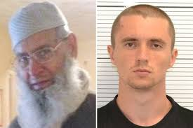
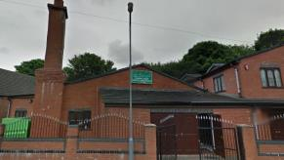
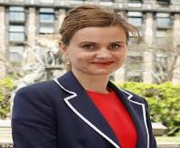
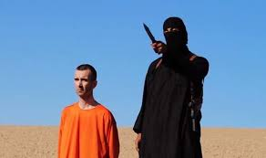
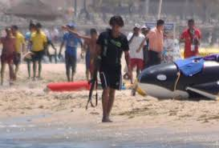
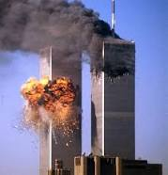
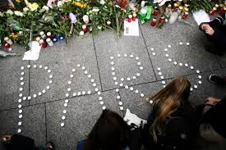
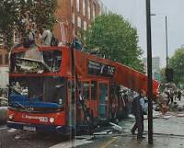
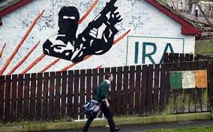
Mohammed Saleem murdered by
Pavlo Lapshyn (Ukrainian Neo Nazi Terrorist April 2013)
Pavlo Lapshyn planted nail bombs in several West Midlands Mosques 2013
MP Jo Cox, murdered by
Thomas Mair, Far Right supporter June 2016
ISIS/DAESH (Jihadi John)
NATIONAL
LOCAL
Tunisia Beach massarce - by DAESH Seifeddine Rezgui – June 2015
Al Qaeda attack 11/9/2001 on Twin Towers New York
GLOBAL
Paris Bombings by DAESH - Nov 2016
London Bombing 7/7/2005
Religious Extremists
Irish Republic Army IRA

Slide 9
Creating opportunities
Paragraph 64
Schools should be a safe space in which children and young people can understand and discuss sensitive topics, including terrorism and the extremist ideas that are part of terrorist ideology, and learn how to challenge these ideas. The Prevent duty is not intended to limit discussion of these issues. Schools should, however, be mindful of their existing duties to forbid political indoctrination and secure a balanced presentation of political issues.
These duties are imposed on maintained schools by sections 406 and 407 of the Education Act 1996.
Similar duties are placed on the proprietors of independent schools, including academies (but not 16-19 academies) by the Independent School Standards.
Notes:
School context and responsibility:
T &L
PSHE and SMSC provision
Enrichment
Debate and discussion opportunities
e.g. Hot topic for debate

Slide 10
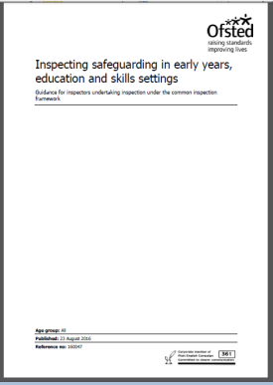
Inspecting safeguarding in early years, education and skills
From:
  Ofsted
First published:
  15 June 2015
Last updated:
  September 2016
action is taken to ensure that children are taught about safeguarding risks, including online risks
there is a clear approach to implementing the Prevent duty and keeping children and learners safe from the dangers of radicalisation and extremism.
the setting takes effective action to prevent and tackle discriminatory and derogatory language – this includes language that is derogatory about disabled people and homophobic and racist language
children and learners are able to understand, respond to and calculate risk effectively, for example risks associated with child sexual exploitation, domestic violence, female genital mutilation, forced marriage, substance misuse, gang activity, radicalisation and extremism, and are aware of the support available to them

Slide 11
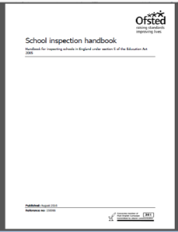
School inspection handbook
From:
  Ofsted
First published:
  15 June 2015
Last updated:
  September 2016
■ how well leaders and governors promote all forms of equality and foster greater understanding of and respect for people of all faiths (and those of no faith), races, genders, ages, disability and sexual orientations (and other groups with protected characteristics52), through their words, actions and influence within the school and more widely in the community
■ the effectiveness of safeguarding
■ the effectiveness of leaders’ and governors’ work to raise awareness and keep pupils safe from the dangers of abuse, sexual exploitation, radicalisation and extremism and what the staff do when they suspect that pupils are vulnerable to these issues.
142. Where the school has received external support, for example from the local authority, academy proprietor or trust, inspectors will evaluate and report on the quality and the impact of the external support and challenge on improvement in the school.
Notes:
Birmingham is a hot spot-possibly due to the Trojan Horse?

Slide 12
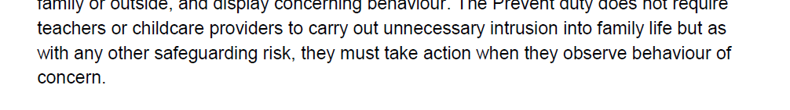
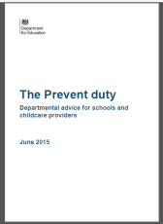

Slide 13
British values and the Prevent duty
From 1 July 2015 the Prevent duty became law. This is a duty on all schools and registered early years providers to have due regard to preventing people being drawn into terrorism. In order to protect children in your care, you must be alert to any reason for concern in the child’s life at home or elsewhere. This includes awareness of the expression of extremist views.
British values are a set of four values introduced to help keep children safe and promote their welfare – as is the duty of all providers following the EYFS; specifically to counter extremism.
The promotion of British values is firmly embedded in the work that you on a daily basis. In an EY setting.
How does your setting promote British Values?
Democracy
The rule of law
Individual liberty
Mutual respect and tolerance of different faiths and beliefs

Slide 14
Will we get away with sticking up a few posters and dotting a few multicultural books about?
No we won't I'm afraid, but then again that's never been enough to show that we actively promote respect for and tolerance of other faiths, cultures and races; challenge gender stereotypes; involve children in their wider community; challenge behaviours (whether of staff, children or parents) when they are not in line with our Fundamental British Values. It's more about what we do and what we say every single day - and that's completely free
How is Equality and Diversity promoted in your setting?
Notes:
https://www.pacey.org.uk/news-and-views/pacey-blog/september-2015/fundamental-british-values-in-the-early-years/

Slide 15
Think about…
Environment
Curriculum
Policies
Training

Slide 16
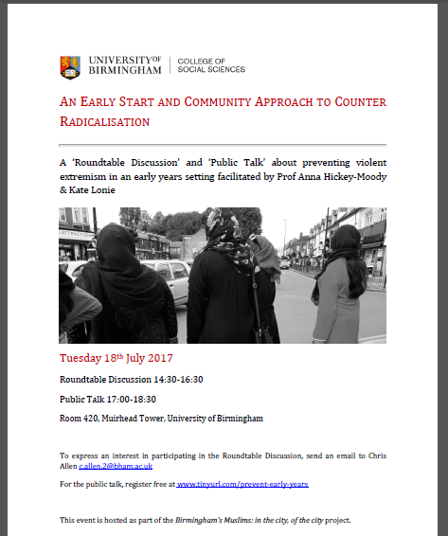
Notes:
About the Talk
Outreach and intervention work associated with PREVENT has traditionally focused on adolescents and adults. Although work examining the role of the family in processes of radicalisation is increasing, very little work has been undertaken in relation to creating interfaith understanding in early childhood. Early childhood education is directly linked to good health, while poor education, and associated lack of development, is now commonly considered a risk factor for child ill-health. The biosocial implications of learning in the early years are significant. In today’s presentation, we will examine empirical qualitative data that shows behavioural change and possibilities for neuroplastic development through art practice. We will also offer an overview of the project design and methods for the “Early Start Arts to Counter Radicalisation” research project, and explain some of the ways in which we hope the project will lead to stronger interfaith relationships from an early age. Desired outcomes include an increase in the sense of wellbeing and social cohesion experienced by Muslim and non-Muslim youth in the UK and Australia. As Heckman has shown, this is likely to have flow-on effects for education and health in children’s later years, as well as for developing a capacity to engage with others and to understand cultural differences.

Slide 17
‘Safeguarding vulnerable people from radicalisation is no different from safeguarding them from other forms of harm’
Home Office; The Prevent Strategy

Slide 18
  PREVENT RISK ASSESSMENT
  Ayisha Ali

Slide 19
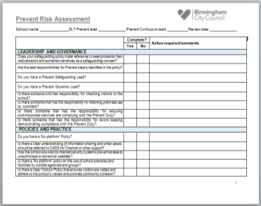
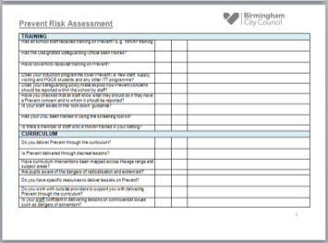
Prevent Risk Assessment
1-LEADERSHIP AND GOVERNANCE
2-POLICIES AND PRACTICE
3-TRAINING
4-CURRICULUM
https://www.birmingham.gov.uk/downloads/download/773/the_prevent_duty

Slide 20
  Screening tool kit
  Colvin White see separate hand out

Slide 21
Early Help & Safeguarding in Birmingham
Prevent Duty
Early Help and Children Social Care
Extremism Guidance and Assessment Support

Slide 22
Learning Outcome
To update awareness of the current legislation and responsibilities for professionals in relation to extremism/ radicalisation.
Cascade the aim of this guidance
Prevent duty
Channel Panel
Provide children’s practitioners with an explorative set of questions and screening tool to assess the nature of extremism concerns being presented by a child or young person (CYP) and their family.

Slide 23
Prevent Duty July 2015
Came into effect from 1 July 2015, which makes specific reference to the need to have safeguarding arrangements to promote pupil`s welfare and prevent radicalisation and extremism. The statutory guidance on the Prevent duty summarises the requirements for specified authorities. I.e. Local Authorities, Schools and Childcare providers in terms of five general themes:
Risk assessment
Working in partnership
Staff training
IT
No Platform

Slide 24
Prevent Guidance
In Birmingham we are strongly committed to meeting
the Prevent duty
This guidance document contains a screening tool and assessment questions to assist with exploring extremism concerns
The Extremism guidance is to provide children’s practitioners with an explorative set of questions to assess the nature of extremism concerns being presented by a child or young person (CYP) and their family.

Slide 25
Currently in Birmingham
When a child and their family have needs that may require support, where an Adult or Young person experience trauma, abuse, that’s emotional, physical, sexual. harbour grievances that are born from being subject to persistent influences radicalised and extremist by parent sibling or other individuals.
Request for support to CASS – The risk will be explored and assessed to determine whether threshold met for Universal/ additional or complex and significant. Where there is an imminent concerns a crime is being or will be committed the WMCTU police should be informed, Prevent inbox referral to access Channel information sharing or request for a specialist mentor if needed
Anyone can make a Request for support and accompanying extremism screening through CASS.
Professional's can make a referral to the Prevent Inbox.
Staff/Professionals can access information and guidance at an Early Help Panel
Staff can make referral to request support from community safeguarding Panel.

Slide 26
High Risk Indicators | Tick
Plans to travel to a conflict zone; or unexplained and/or sudden plans to travel to a country from which you can travel to a conflict zone
Demonstrates support for and/or is articulating extreme views that are of significant harm to themselves or others, and may refuse to acknowledge other viewpoints
Is living with someone who has a conviction against the Counter Terrorism and Security Act 2015 – known as TACT Offences
Is in contact with, is being influenced by, and/or shows support for individuals, groups, or organisations that are known to hold harmful extreme views and/or undertake harmful acts based on those views; this includes family members
Participation in an activity that might cause immediate harm to themselves or others based on them holding extreme views, e.g. a violent attack against others
Has disengaged from wider activities and interests and become fixated with a particular issue, viewpoint or way of living that is unhealthy and harmful to the CYP, and/or others
Is accessing and/or sharing material of an extremist nature that is of significant harm to themselves and/or others e.g. that contains violent or disturbing images; that encourages people to undertake violent acts, etc.
Is spending time with unknown individuals that raises concern, including potential religious or sexual grooming
Medium Risk Indicators | Tick
Demonstrates support for and/or is articulating extreme views that are/may be of harm to themselves or others, and finds it difficult to acknowledge other viewpoints
Is showing interest in, and may have contact with individuals, groups, or organisations that are known to hold harmful extreme views and/or undertake harmful acts based on those views; this includes family members
Is starting to disengage with wider activities and interests and spending more time focusing on a particular issue, viewpoint or way of living that may be unhealthy and harmful to the CYP or others
Is isolated from family, friends, peer and peer groups and/or is not forthcoming about how and who they spend their spare time with
Is accessing and/or sharing material of an extremist nature that is harmful to themselves and/or others e.g. that encourages people to develop harmful views about others that encourages people to isolate themselves and narrow their viewpoints, etc.
Has mental health concerns or developmental disorders (e.g. ASD) that make the CYP vulnerable to developing extreme views that are harmful to themselves or others
Has alcohol and/or substance abuse issues that makes the CYP vulnerable to developing extreme views that are harmful to themselves or others
Is at risk from harmful cultural practices. Please state the type of risk e.g. FGM, Forced Marriage, removal from education, honour based violence, abuse linked to faith or belief, etc. | …………………………...
Low Risk Indicators | Tick
Is struggling with their own identity, sense of belonging and/or may feel out of place in wider society
A change in CYP’s views, appearance, behaviour and wellbeing that starts to raise concern
Is easily lead by others making them susceptible to influence
Is becoming isolated from family, friends, peer and peer groups

Slide 27
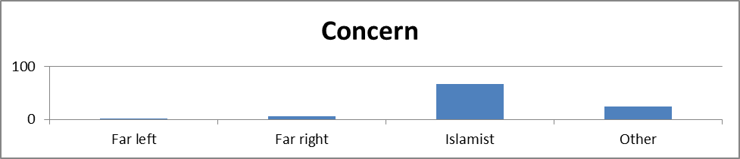
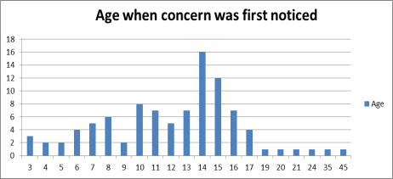
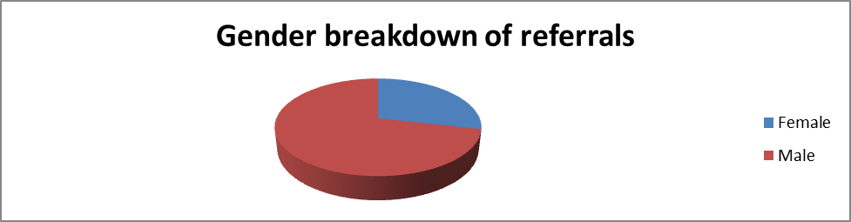
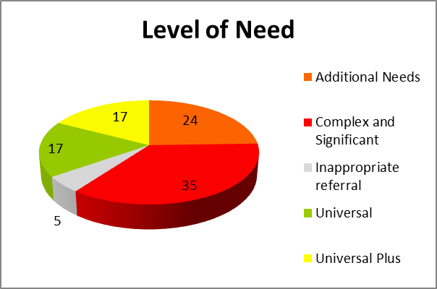
Snapshot of data

Slide 29
Summary of CASS
CASS will determine the level of risk from the Request for Support form (and Extremism Screening tool ?).
2. The Social Worker i.e. TM at CASS will advise what level of
concern is met on the Right Service Right Time framework.
3. Universal – Universal Plus – Additional needs does not meet FST/ TF criteria Referrer contacted and informed of outcome of referral triage .If Universal or Universal Plus referrer advised to address action seeking support through resilience adviser or Early Help Prevent Lead at Early Help Panels
4. Additional needs – meets FST / TF criteria Conversation with FST manager in MASH and PREVENT school and Early Help leads – Police for de-confliction - allocation to FST / TF as appropriate
5.Complex and Significant – Safeguarding discussion: Outcome of Amber discussion: Early Help Support or ASTI Family assessment. Outcome of Strategy discussion: to determine whether s47 CP assessment is carried out.

Slide 30
Prevent support
Prevent Leads invited to the discussion to offer information to inform the discussion about risk protective factors history etc.
Prevent leads will provide advice and guidance when requested will liaise with referrer and allocated worker to offer advice and guidance in relation to accessible support and updates from Channel process.
CTU de-confliction: is to determine whether should be brought to Channel for discussion. No Action three “M” tested as an aspect of Prevent /Channel case management: where the three “M” are tested for Malicious, Misguided or Maligned intent.
Early Help partnership desk includes Health, School, WM police involved in the gathering of information for discussion.

Slide 31
Intervention’s for frontline workers
CSC EH Extremism Guidance
Prevent in Birmingham EY,EH,SGVA
Request for support
Referral pathways: Channel and CS
Extremism Screening tool
Explorative questions to aid assessment
Prevent Vulnerbility assessment
Signs of safety (SOS)
Three Houses
EARS

Slide 32
Extremist profile
Family resemblance model: features commonly but individuals may not display all traits.
Authoritarianism: rigid thinking, harsh punishments, blind obedience
Prejudice: stereo typing, simplistic categorisations
Political, historical and religious ideologies: perceived or real grievances, strict interpretation of text, economic factors, trauma
Issues of identity and belonging: Hybrid identities, sense of purpose, sense of isolation

Slide 33
Protecting young people – practitioner to consider
All about me
Self assessment
PHSE
Early Help Assessment / EH Plan
Channel Panel
Community Safety Panel

Slide 34
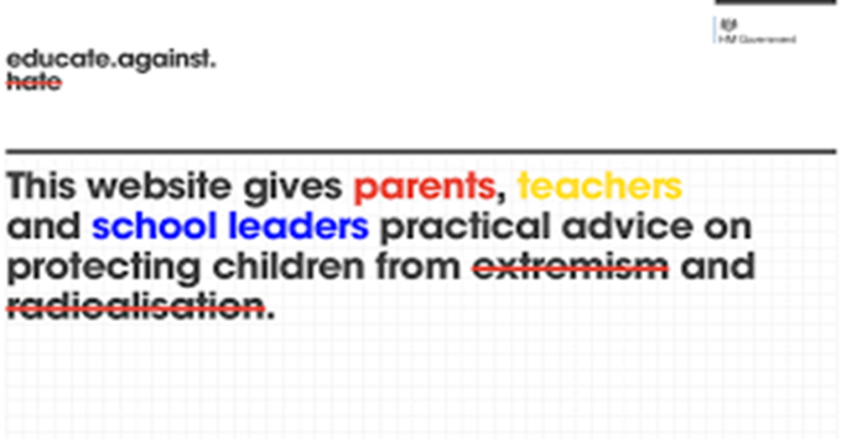

Slide 35
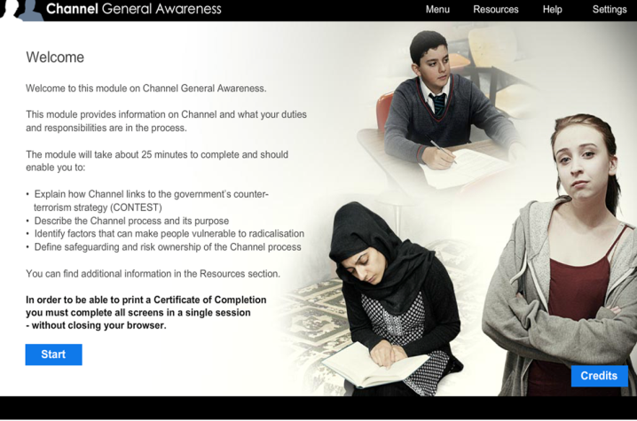
http://course.ncalt.com/Channel_General_Awareness

Slide 36
Prevent online resources
Educate Against Hate(January 2016) - toolkit for
schools and parents http://www.educateagainsthate.com/
Home office (March 2015; revised September 2015) Prevent Duty Guidance https://www.gov.uk/government/publications/prevent-duty-guidance
Local Safeguarding Children’s Board http://www.lscbbirmingham.org.uk/
Channel Panel awareness online resources; http://course.ncalt.com/Channel_General_Awareness
INTRODUCTION TO PREVENT E-LEARNING PACKAGE https://www.elearning.prevent.homeoffice.gov.uk/screen2

Slide 37
WHAT NEEDS TO HAPPEN
Training for all frontline workers
Channel awareness
Completion/ Dissemination of Prevent Guidance
Screening and Vulnerbility assessment tools dissemination

Slide 38
Case study
15 year old – presenting with extremist views associated with EDL – online posting inciting racial hatred
CSC involvement resulting in a CP Plan – boundaries and routine in home lacking. Parental extremist influences impacting on young person
Concerns raised with Prevent coordinator and Prevent Leads
Refer to Prevent inbox to enable a VAF to carry out de-confliction 22 point assessment that determine engagement, intent or capability
Channel panel threshold met partners agree to support
Channel Plan: mental health support explored through PIP & Forward Thinking
Channel specialist mentor provided – explore ideology and political narratives

Slide 39
Case study continued
Joint work with CTU officer and CSC Officer
Diversionary activities introduced to support peer relationship development.
School carried out work through direction of Prevent support to enable curriculum centred activities. To foster positive narrative about other faiths and culture
Anger management to enable the YP to better respond to difficult and challenging situations.
Six month support regarding Prevent concerns. further monitoring by school as an exit strategy along with professional to continually monitor reduced vulnerability maintained

Slide 40
Curriculum Resources

Slide 41
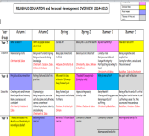
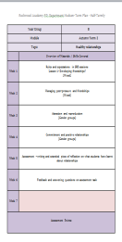
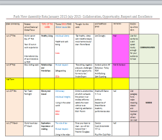
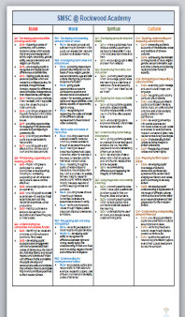
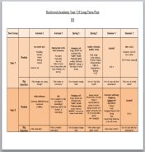
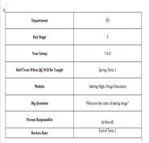
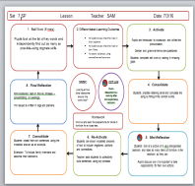
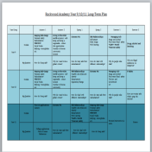
Mapping PREVENT through the curriculum- A whole school approach (Primary –Post-16)
Teaching and learning of PSHE education should be built into a planned progressive programme
Notes:
UNICEF-Rights respecting schools award-impact underpins
School ethos and values
No outsiders

Slide 42
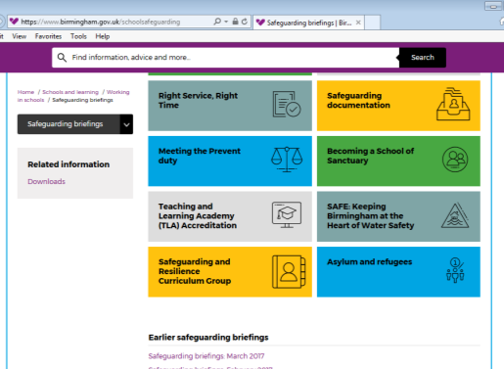
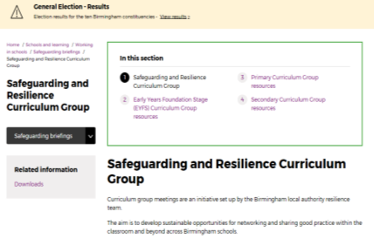
Where do I find resources?
2-Click here
1-Click here
https://www.birmingham.gov.uk/schoolsafeguarding

Slide 43


RED notice board
Notes:
Parents, websites, policies, procedures

Slide 44
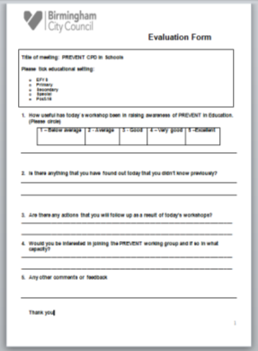
Questions and Evaluations

