Slide 1

Supporting Refugees, Asylum Seekers & Migrants.
Dr. Halit Hulusi
Acting Principal Educational Psychologist

Slide 2





Slide 3

British Psychological Society
BPS Presidential Task Force :
Responding to Refugees, Asylum Seekers and other Migrants

Slide 4
The Context
1.3 million asylum applications within the EU
  32,000 people sought asylum in the UK (60% refused)
  32,400 people were held in immigration detention
  88,245 unaccompanied minors applied for asylum in the EU
  3,045 unaccompanied minors applied for asylum in the UK
  Within the EU, 10,000 children had gone missing
  50% of child asylum seekers had STDs
  (Eurostat, 2016) (Refugee Council, 2016) (Migration Observatory 2016) House of Lords Report (2016)

Slide 5
Five Interesting Points
Differences in ‘help seeking’ behaviours and rituals*
50% of children from countries of conflict did not meet the criteria for PTSD**
Leave to remain can be revoked at 18 years old
Gaining refugee status can take days or years
‘Exile related stress’ as significant as ‘pre flight’ events***
(Yule et al- unpublished)**; (Pernice and Brook, 1996)**; (Tribe, 2007)*

Slide 6
Best Practice in Supporting Schools
  Systems Level
  Preparing the ground for new arrivals
  Removing barriers to inclusion and learning
  Working at a joint systems level (family & school)
Direct work with C&YP
  Sticking to the graduated response
  A focus on ecological validity in assessment
  Seek opportunities for creative work……………..

Slide 7
“To survive, you must tell stories.”
Umberto Eco (1995)
The Island of the Day Before

Slide 8
I wish I was home
(Year 6 Refugee in a Birmingham School)
I remember a taste when I was small’, ice cream, sweets, cakes, plate of food, so yummy.
I remember a place when I was small, parks, seaside and ice-skating, movies and restaurants.
I don’t know if its true.
I remember a sound when I was small,
Song, rhythm, talking, laughing, birds singing, how wonderful.
I wish it would happen again.
Polices took my mum and dad away, I ran away with my bag with pictures and clothes a little bit of food.
Flames, bombs, shouting screaming and shooting of bullets,
I wish I was home.

Slide 9
Talking Stones
Wearmouth (2004)
There is a voice that doesn’t use words. Listen. Rumi

Slide 10
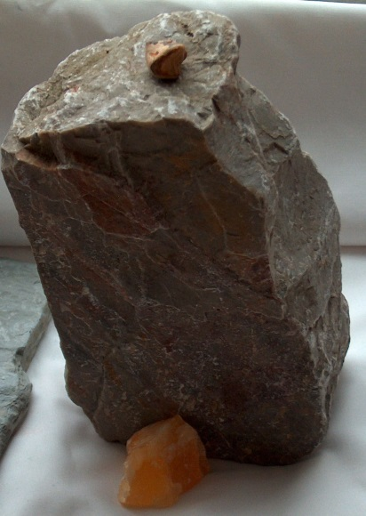
Part of the school Kamil knew
Amount of English Kamil knew
Taken from Oland (2010)

Slide 11

Zofia: “Yeah ‘cos I thought about it; it’s difficult to choose one of all these, so I think that this rough one can represent all these difficulties that we meet on the way to our career and …actually, …finally I be rich…that’s the one course, then next one, next one then finally my job, yeah, that’s OK.”
Taken from Oland (2010)

Slide 12
Hulusi, H. and Oland, L. (2010) Using narrative to make sense of transitions: supporting newly arrived children and young people. Journal of Emotional and Behavioural Difficulties 15: pp.341-351
House of Lords. European Union Committee (2016) Children in crisis. Unaccompanied migrant children in the EU. HL Paper 2
Hulusi. H. (2010) The Right Skills- Helping asylum seekers and refugees thrive. Children’s Workforce Development Council (2010) http://webarchive.nationalarchives.gov.uk/20120119192332/http://cwdcouncil.org.uk/assets/0000/8321
Oland, L. (2009) The educational experiences of Polish newly arrived young people aged 12-16 in a large urban local authority in the UK. Unpublished Doctoral Thesis. University of Bristol.
Ricoeur, P. (1991)‘Life: A Story in Search of a Narrator’ in M. Valdes (ed.) A Ricoeur Reader. London: Harvester Wheatsheaf
Schauer, M. Neuner, F and Elbert, T. (2005) Narrative Exposure Therapy: A short-term treatment for traumatic stress (2nd Ed. Hogrefe. Abingdon
Sunderland, M. (2001) Using Story Telling as a Therapeutic Tool with Children. Milton Keynes: Speechmark
Todd , L. (2007). Partnerships for inclusive education: A critical approach to collaborative working, London: Routledge
Eco, U. (1998) The island of the day before. Translated by William Weaver. Vintage Books. London.
Vetere, A. & Dowling, E. (2005) Narrative Therapies with Children and their Families. Abingdon: Routledge
Waters, T. (2002) ‘The Therapeutic Use of Story Writing.’ Psychodynamic Practice Vol. 8, No 3 pp 343- 358
Wearmouth, J. (2004). ‘Talking Stones’: an interview technique for disaffected students. Pastoral Care in Education, 22(2) pp. 7–13.

