Slide 1
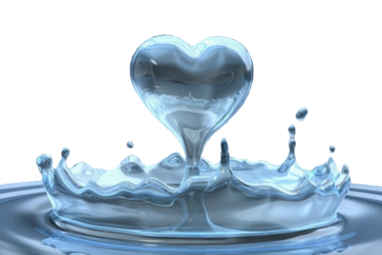
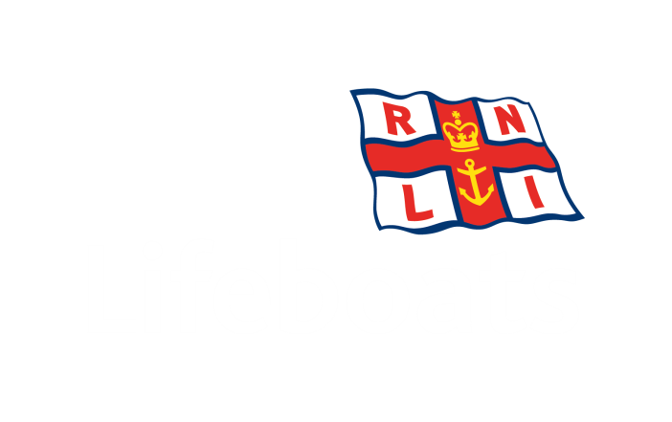
Notes:
400 people drown in the UK every year. It is serious issue that effects many young people and it is important that you understand the dangers and effects of the water.

Slide 2
Objectives
By the end of this workshop you will be able to:
Identify why people get into trouble around water.
Identify where people are most likely to drown and why.
Understand the effect of taking risks around water.
Understand the effect Cold Water Shock can have on the body.
Identify a rip current and understand how to escape from these.
Notes:
Workshop Objectives
By the end of the workshop you will be able to:
Identify why get into trouble around water.
Identify where people are most likely to drown and why.
Understand the effect of taking risks around water.
Understand the effect Cold Water Shock can have on the body.
Identify Rip Currents and understand how to escape from these.

Slide 3
Drowning Information
400
People die
from drowning
EVERY YEAR
in the UK
A QUARTER
of people who Drown have ALCOHOL
in their
SYSTEM
Approximately
one person
DROWNS
EVERY
20 Hours
80% of people
That Drown
Are MALE
Notes:
On average 400 people drown across the UK every year, this works out to one person every 20 hours.
Statistics from WAID (Water Incident Database) shows:
80% of people who drown are Male.
25% of people who drown have alcohol in their system
44% of people who drown never intended to be in the water
Around 60% of people drown at inland water sites
Who is most likely to drown?
16 to 44 year old males are the largest group of casualties. Being a strong swimmer does not mean you can’t drown.
Why do people drown?
Inability to cope because of insufficient survival and swimming skills and experience, lack of supervision, falling in unexpectedly or accessing water without safety advice. Lack of knowledge by misjudging the hazards or having a raised perception of own ability in their environment. Causes could include being under the influence of alcohol and the affects of cold water
Where are people most likely to drown?
60% of fatal drowning incidents occur at inland water sites, mainly rivers and streams although many drowning incidents happen at other popular areas

Slide 4
?
?
?
?
?
?
?
?
?
Play Your Cards Right
Where do people drown?
Flip through the cards and decide whether you think the statistics get higher or lower
Notes:
Interactive Game – Play Your Cards Right
This goes through different locations people can drown.
Most drownings happen at inland water sites, like rivers, canals, quarries and reservoirs but people can drown anywhere where there is water

Slide 5
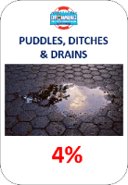
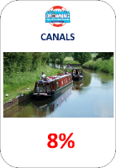
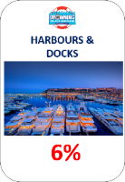
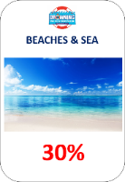
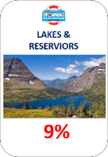
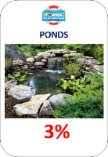
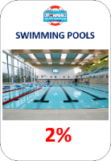
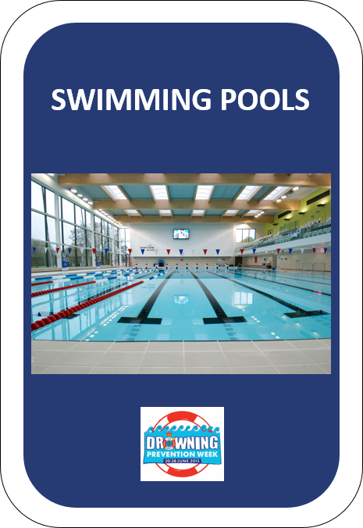
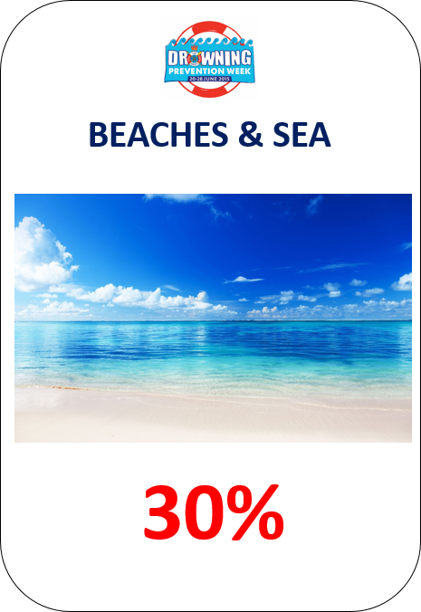
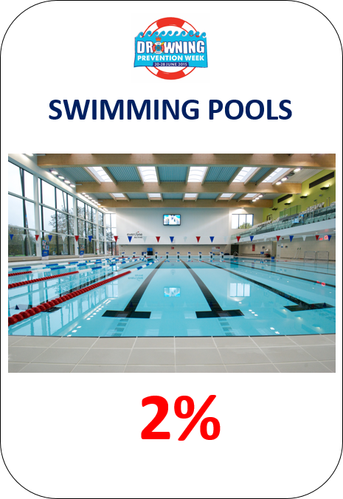
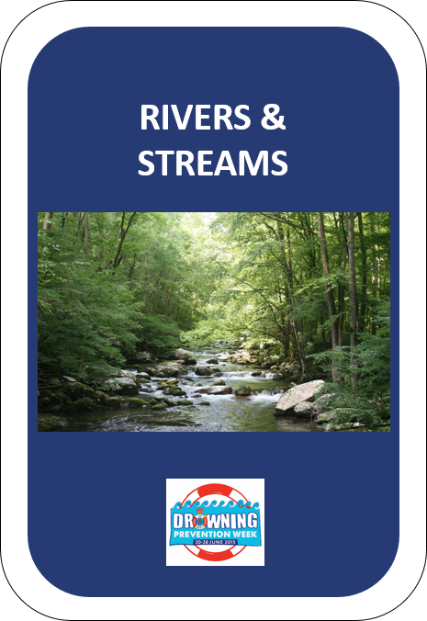
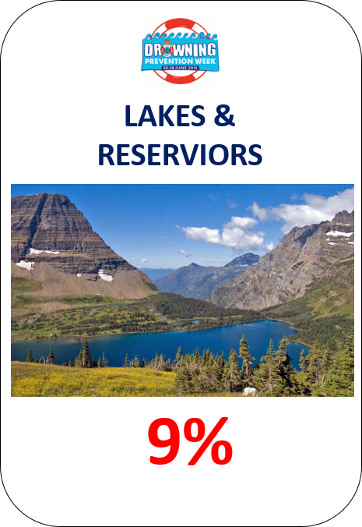
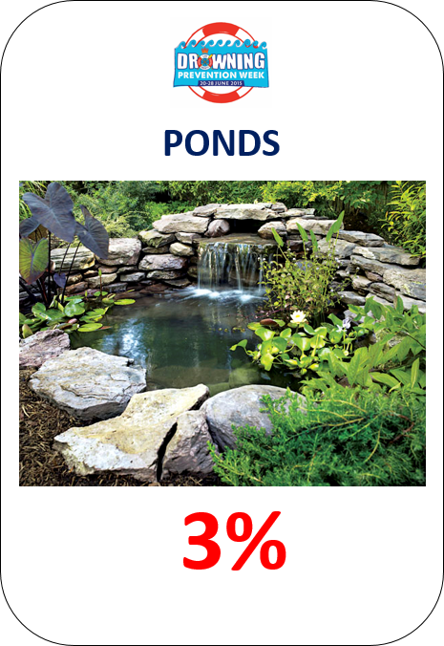
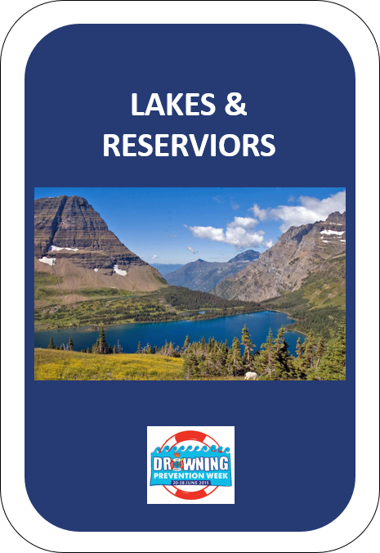
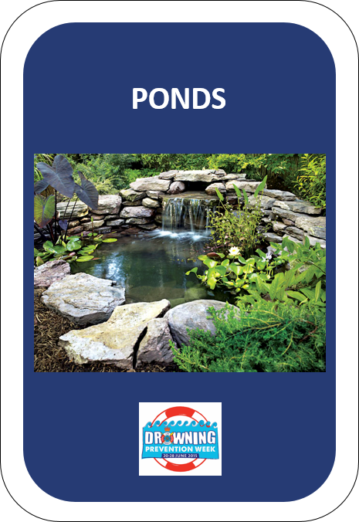
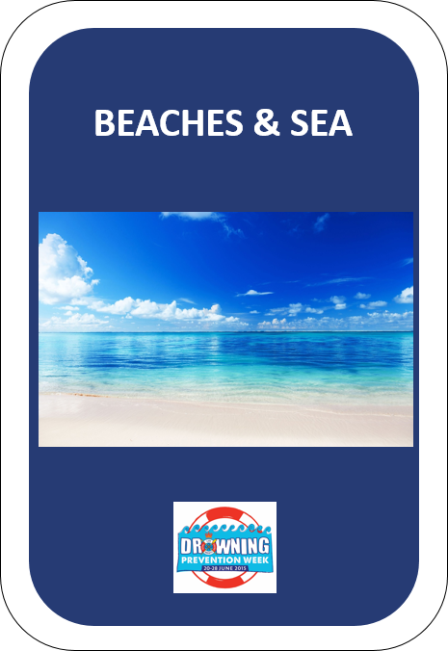
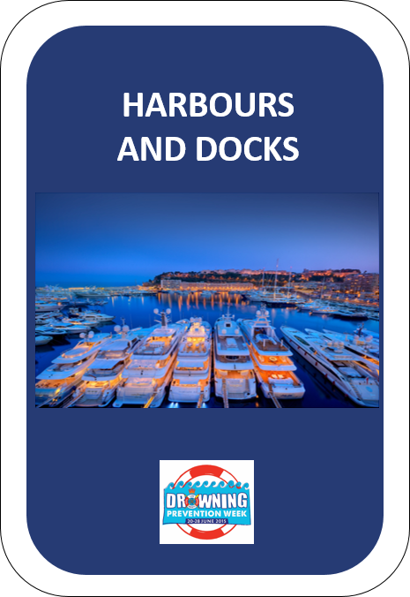
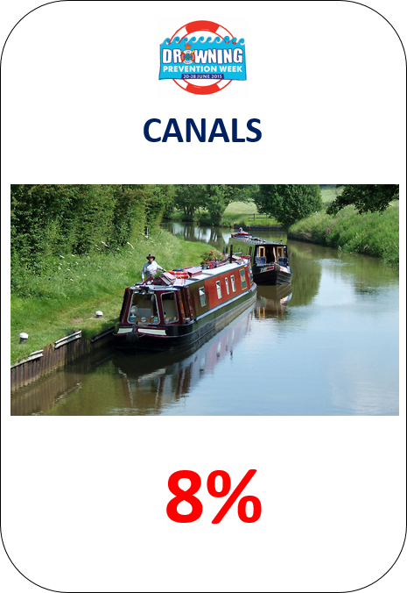
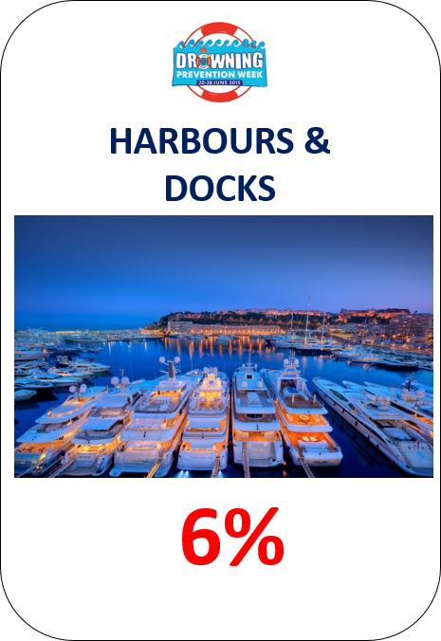
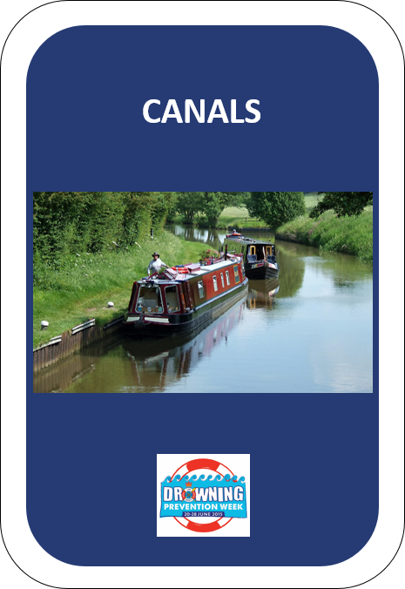
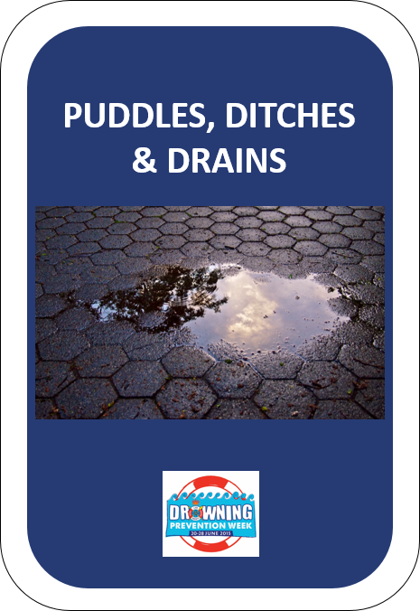
?
?
?
?
?
?
?
?
?
NEXT
Notes:
Click the Next button to play

Slide 6
Notes:
The water in and around the British Isles is officially cold, around 12-degrees centigrade on average.
Most of us learnt to swim in a swimming pool where the water temperature is typically around 30-degrees centigrade. Open water temperatures range from between 6 and 10-degrees centigrade in the winter to between 15 and 20-degrees centigrade in the summer.
Our normal body temperature is 37-degrees centigrade, so imagine the shock to the system when you fall into water. As we said earlier, that happens to half of the people who drown accidentally.
A sudden and dramatic drop in temperature is one of the biggest shocks the body will experience.

Slide 7
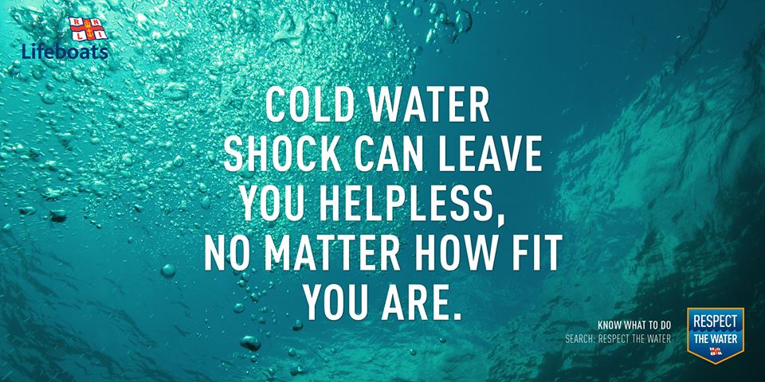
Notes:
Cold Water Shock is the body's short term involuntary response to being suddenly immersed in cold water. When the body enters this cold environment there are a number of physiological responses. The sudden lowering of skin temperature is one of the most profound stimuli that the body can encounter. The responses tend to be short lived, but threaten survival.
First of all, closure of the blood vessels in the skin which results in increased resistance to blood flow. The heart then has to work harder and blood pressure increases. At the same time there is a gasp response which can result in water being breathed rather than air. Concurrently the breathing rate changes dramatically, increasing by as much as tenfold. All these responses contribute to a feeling of panic which makes a bad situation a lot worse.

Slide 8
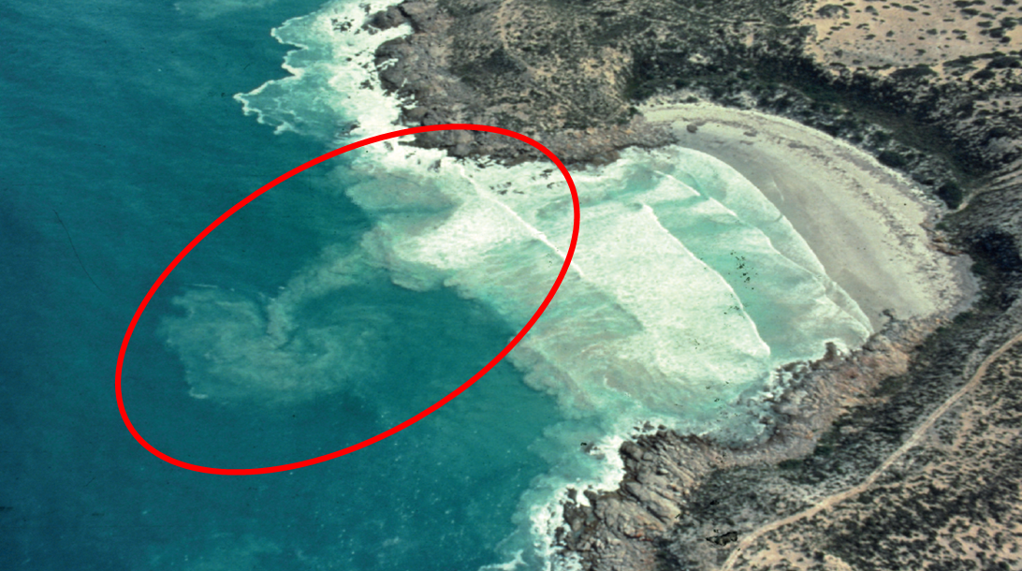
At the beach…
Rip currents
Notes:
Rip currents are essentially fast flowing bodies of water that can drag people and debris away from the shoreline and out to deeper water. They are a major cause of accidental drowning on beaches all across the world, and in the UK more than 60 percent of RNLI lifeguard incidents involve rip currents.
The speed of rip currents varies between 3 and 7 kilometres an hour. That’s faster than an Olympic swimmer.
Generally speaking, the bigger the waves the stronger the currents, though don't underestimate the power of the water on any occasion.
Rips can be very difficult to spot, but sometimes can be identified by a channel of churning, choppy water or debris on the sea’s surface. They're most common on sandy surf beaches, and can also form around permanent structures in the sea, like piers or sea walls.

Slide 9
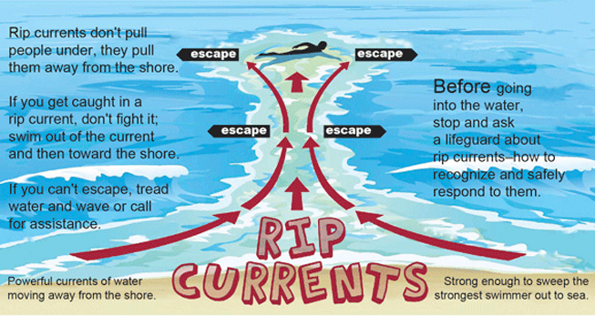
Rip currents
Notes:
If you find yourself in a rip, stay calm don’t panic. If you can stand, wade. Don’t try to swim. If you have an inflatable or board keep hold of it to help you float. Raise your hand and shout for help loudly. Don’t swim directly against the rip or you’ll get exhausted. Swim parallel to the beach until free of the rip and then head for shore
If possible swim from a lifeguarded beach. They will know what to look out for.

Slide 10
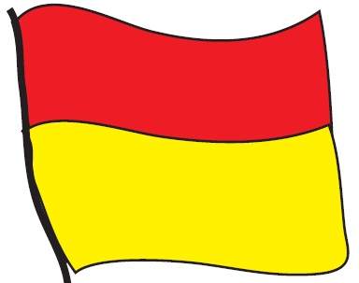
At the beach…
Flags - Do you know them?
Red and Yellow Flags - Lifeguards patrol here, safest place to swim.
Black and White Chequered Flags – These flags are for non-swimming water sports such as surfing and wind surfing.
Red Flags - Danger, stay out of the water.
Notes:
Go through the beach flags, see if any of the class know what they are before revealing their identity.

Slide 11
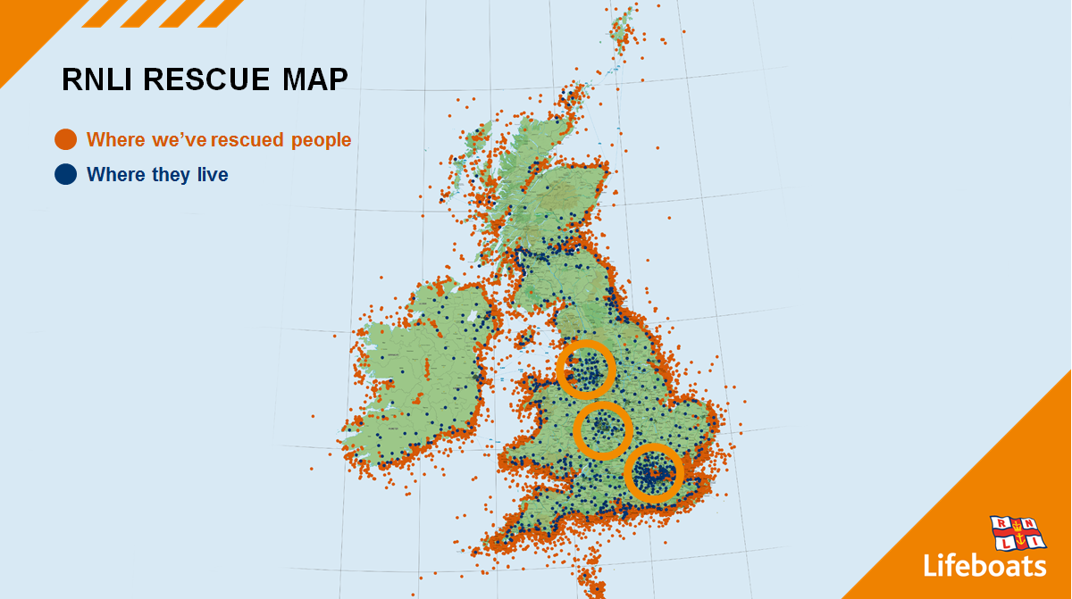
RNLI rescue map
Notes:
Why is it important to learn about beach safety when we live so far from the beach?
As the graphic shows from our lifeboat and lifeguard rescues, there are big hot spots from inland areas. This is because more people are visiting the coast than ever, and for some people they have never been before so don’t understand how tides work, how rip currents form, what the different coloured flags mean and unfortunately get themselves into difficulty.
What you are learning today is to be water aware, whether at the beach or walking along the local canal.

Slide 12
Inland waters can be just as dangerous
Notes:
Open water, whether it’s a river or on lake or reservoir is probably one of the few places you can use to do stuff without training or passing a test. You’re free to make up your own mind about what to do and what risks you are prepared to take.
Look closely at these pictures, though, and you will see that the people on the water are managing their risk by wearing something to help keep them afloat. The angler on the bank is sitting near a lifebuoy that will do the same thing if he fell in.
Inland waters are often very inviting, especially on a hot summers day. But even though the water looks nice and calm, it can still have dangerous currents running downstream. Do you know what is just underneath the surface or how deep it is? Are you dressed appropriately to be able to get out of the water easily? Unfortunately people die every year in our inland waters because of the dangers within.

Slide 13
Notes:
Given everything we’ve talked about, here’s the truth we’d like you to walk away with. Water is powerful and it demands your respect
So how come these people have ignored the sign and decided to go swimming in a gravel pit where a teenage boy had drowned days earlier?
We know warning signs are only part of the answer. We are surrounded by them everywhere we go, telling us what we can and what we can’t do. Often, we’re not really sure what picture-only signs mean anyway. So we either ignore them or fail to notice them.

