Slide 1






Keeping
Birmingham
At the Heart
Of Water Safety
Notes:
Tell the children that water is fun, but it is important to stay safe near the water and that’s what you are going to talk to them about today.

Slide 2

Aim
To understand the basics of being safe around water
To be able to identify hazards, risks and how to protect others
Objective
By the end of this session you will be able to:
Spot the dangers around water
Know where to find advice
Stay safe near the edges of rivers and canals
Know what to do/who to call in an emergency
Notes:
The aim of this Presentation is to understand the basics of Water Safety and to know how to keep yourself and others safe around water.
By the end of this session you will be able to:
Spot the Dangers around water
Know where to find advice about water
Stay Safe around water
Know what to do in an Emergency

Slide 3
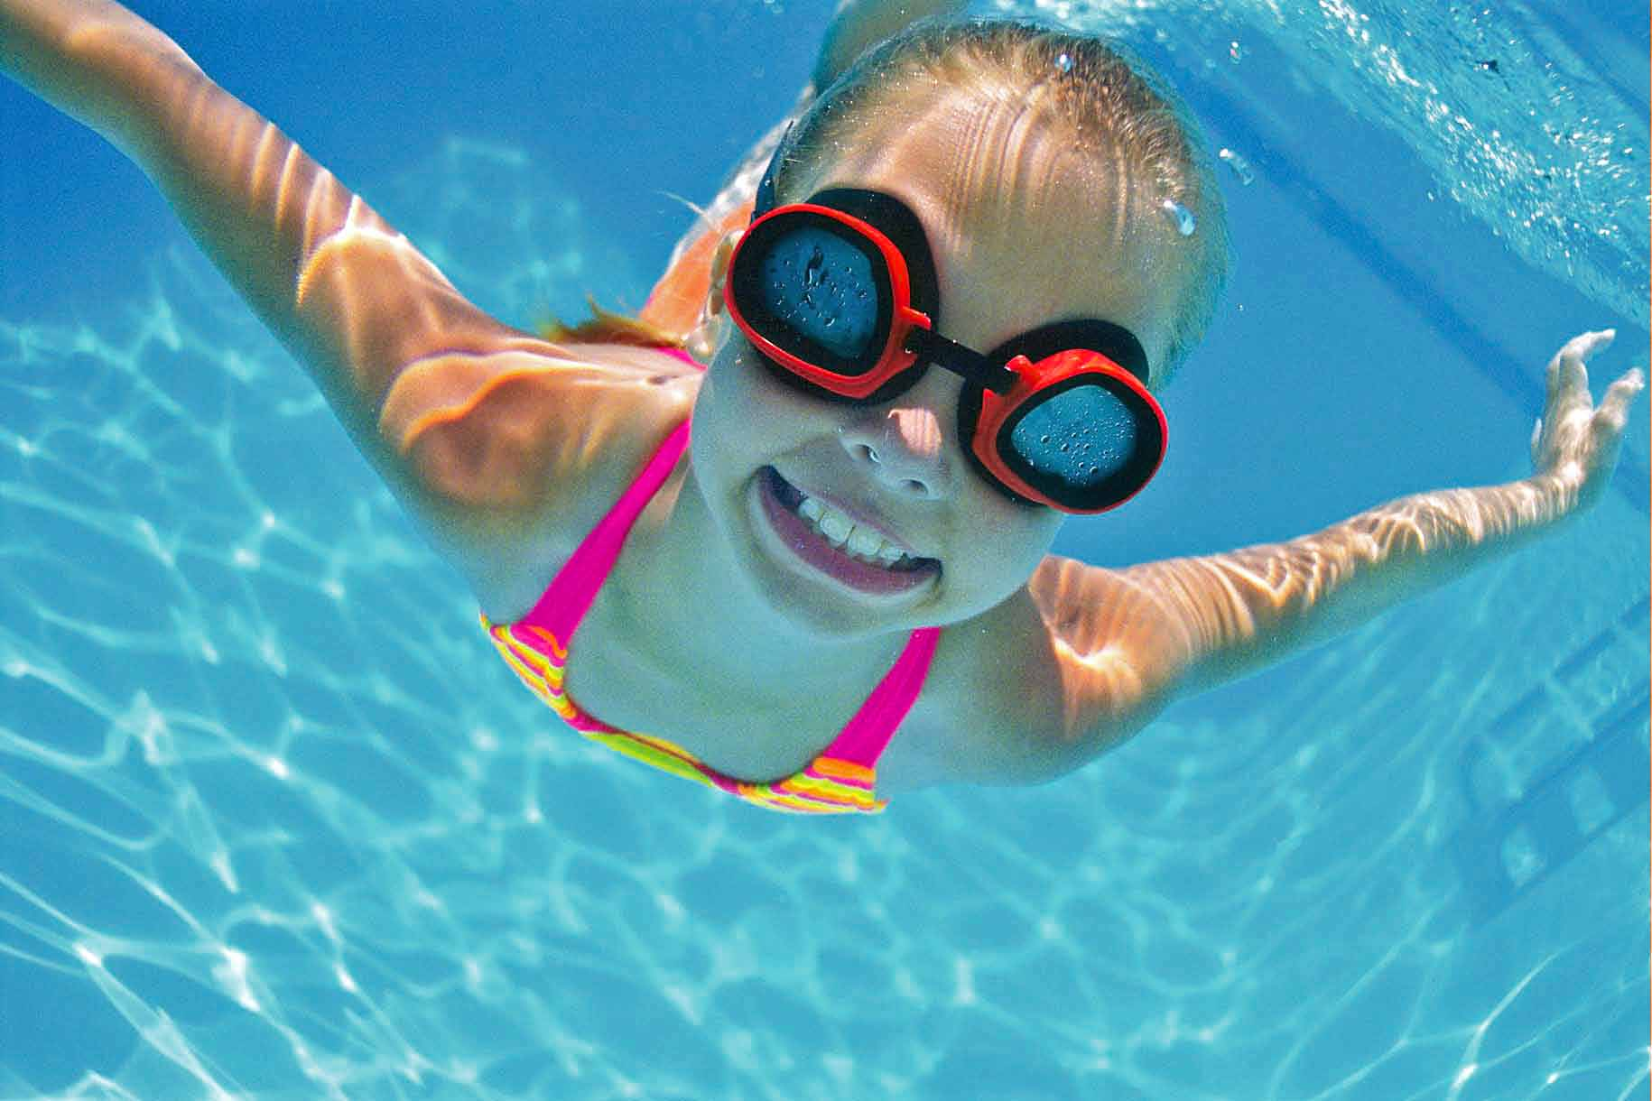
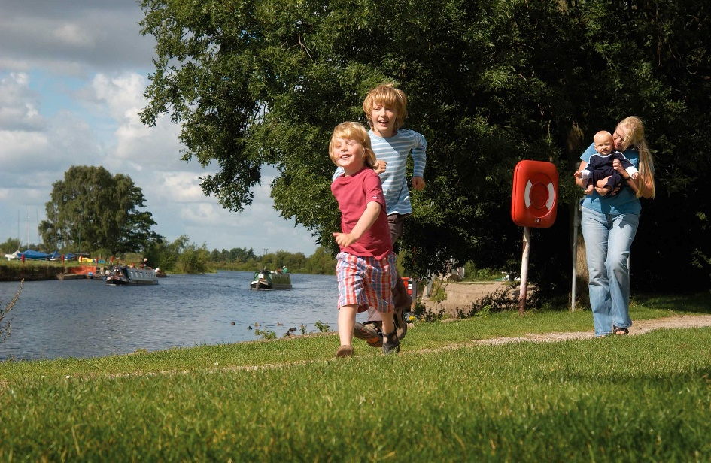
Water is FUN!
Notes:
Ask the children if they think that water is fun and ask what fun activities they can do in, on and around the water?
E.g. canoeing, boating, fishing?
Say that it is dangerous if you can’t swim and ask the pupils if they go to the pool and have they had swimming lessons.
Ask if they go to the deep end or stay in the shallow end and why?
Note: emphasise that we are not trying to put the children off water, just to make sure they keep themselves safe when near it.

Slide 4
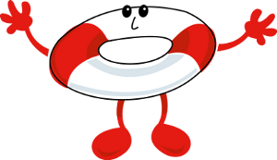
We’re going to watch a video of how to stay SAFE
Notes:
Tell the children that we’re going to watch a video of how to Stay SAFE and learn the SAFE code.

Slide 5


Keeping
Birmingham
At the Heart
Of Water Safety
<iframe width="560" height="315" src="https://www.youtube.com/embed/UDTmv4Sddvk?rel=0&amp;controls=0&amp;showinfo=0" frameborder="0" allowfullscreen></iframe>

Slide 6
Keeping
Birmingham
At the Heart
Of Water Safety
S A F E
pot
dvice
riend
mergency
S - is for spot the dangers
A - is for take advice
F - is for go with a friend
E - is for in an emergency call 999
Notes:
Tell children that the best way to stay safe near water is to remember the SAFE code.
Recite with the children, you call out the letter and let them tell you what it means.
Say you are now going to look at each of these letters.

Slide 7
S - is for spot the dangers
Can you spot the dangers?
Notes:
Tell children S is for SPOT – it means Spot the Dangers
Ask children what dangers there might be.
Answers could be:
deep water, currents, rocks, cold water, slippery banks, water sports nearby, hidden objects under the water

Slide 8
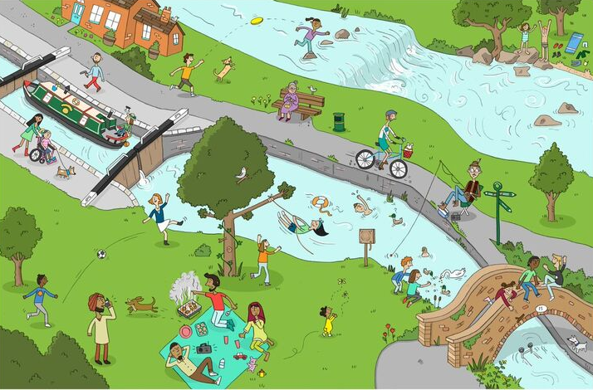
Can you find all 10?
Notes:
On this slide, talk to the children about what they can see, there are 10 dangers, can you find them all?
These are the dangers you should find:
• Child running off because the parents have become distracted.
• Children playing too near the water’s edge.
• Child swimming in canal.
• Children sitting on the edge of a bridge.
• Children swinging from tree over the canal.
• Child about to dive into a lock with strong currents and very deep water.
• A weir with fast running water.
• Fisherman with long pole which can trip people up.
• Objects in the water which may be sharp or trap your feet.
• Cyclist very close to the edge.
Note. Remind children that visiting canals and rivers with an adult can be a great day out provided they follow the SAFE code and Keep away from the edge.

Slide 9
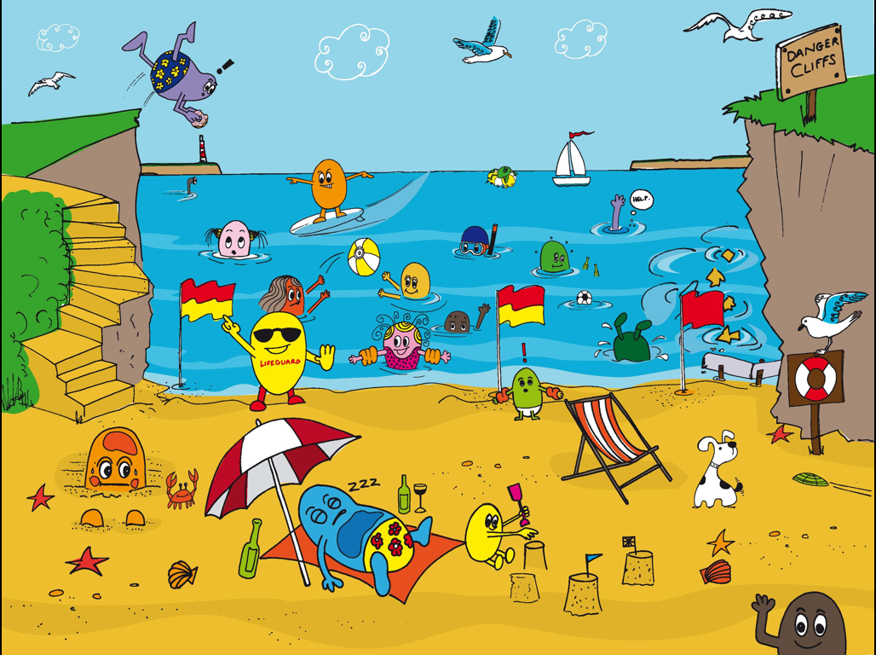
CAN YOU FIND ALL 11?
DON’T SWIM SOON AFTER EATING
BEWARE OF CURRENTS OUT TO SEA
1
5
TETHER INFLATABLES TO THE SHORE
BEWARE OF DEEP WATER – KNOW WHAT TO DO IN AN EMERGENCY
3
DON’T SWIM IN A WATER SPORTS AREA
BEWARE SLIPPERY AND CRUMBLING CLIFFS – READ THE SIGNS
2
4
DON’T JUMP FROM CLIFFS, THE WATER MIGHT BE SHALLOW
8
AVOID DIRTY AND POLLUTED WATER
10
6
BE SUN SAFE – WEAR SUN CREAM
9
7
WEAR YOUR BUOYANCY AIDS
11
ALWAYS KEEP AN EYE ON CHILDREN
AVOID PIPES AND ROCKS
RED FLAG MEANS DANGER - NO SWIMMING
Notes:
The teacher or pupils can click (or touch) where they think there is a danger, then the information notice will appear.
Pupils can discuss each of the dangers and how they would keep themselves safe.

Slide 10
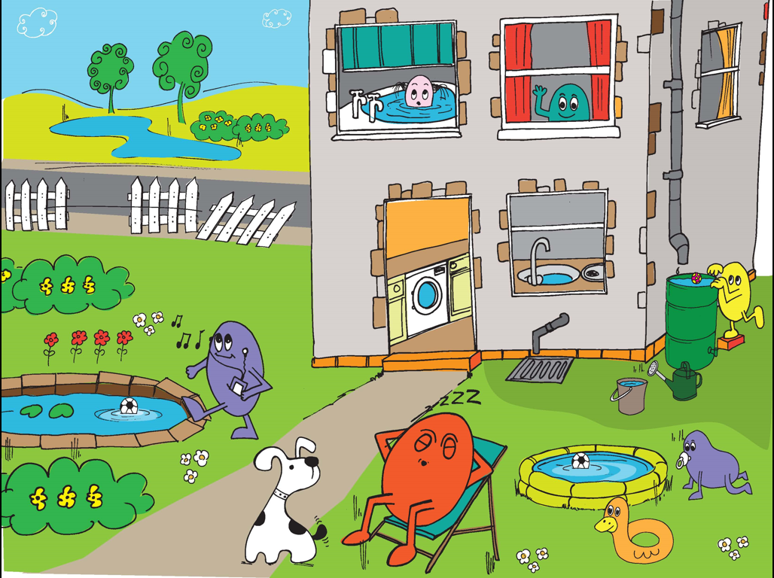
CAN YOU FIND ALL 7?
NO LIFEGUARDS ON DUTY AT THE LAKE – NO SWIMMING
ALWAYS KEEP AN EYE ON CHILDREN IN AND AROUND WATER
2
1
WATER STORAGE CONTAINERS SHOULD BE COVERED
7
THIS FENCE ISN’T GOOD ENOUGH TO KEEP PEOPLE SAFE FROM THE POND OR THE LAKE
WATER SHOULD BE DRAINED AWAY AFTER USE
3
4
6
A FENCE WOULD STOP HIM FALLING IN
ALWAYS KEEP AN EYE ON CHILDREN IN AND AROUND WATER
5
Notes:
The teacher or pupils can click (or touch) where they think there is a danger, then the information notice will appear.
Pupils can discuss each of the dangers and how they would keep themselves safe.

Slide 11
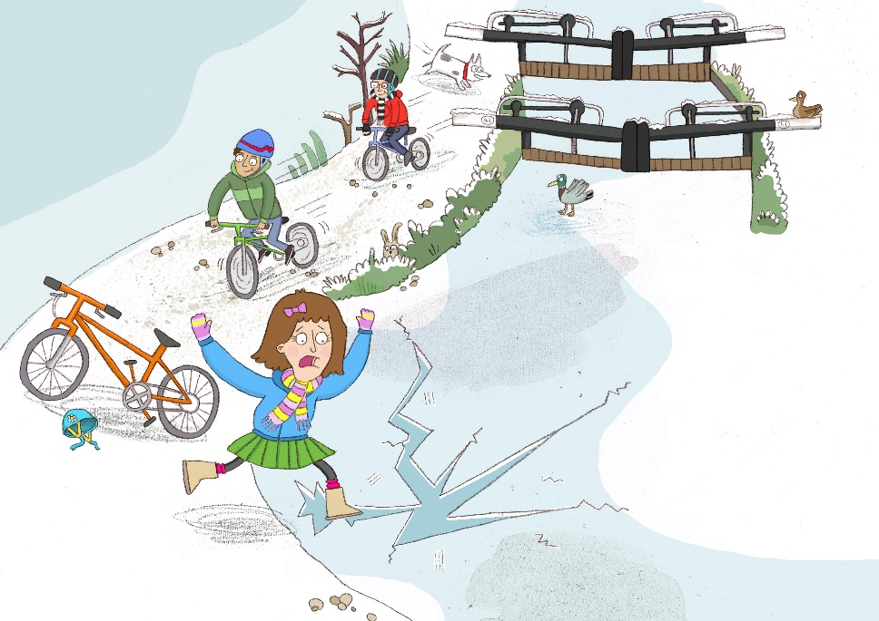
Jade steps on the ice.
It seems safe, but a giant crack appears. HEEEEELP!
What could happen
to Jade?
Notes:
Read Out: “Jade steps on the ice. It seems safe, but a giant crack appears on the ice. HEEEEELP!”
Say the water could be too cold, swimming pools are nice and warm and safe, rivers and lakes are really cold
Cold water can kill you in minutes.
You could get trapped under the ice.
NEVER, EVER STEP ON TO ICE!

Slide 12
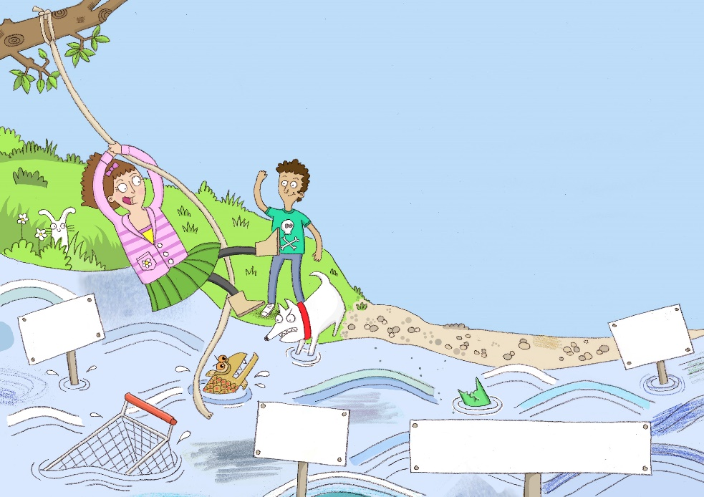
Jade is having a great time on the swing. But if she falls in she’ll be in BIG TROUBLE!
Can you spot the hidden Dangers?
Very cold water
Deep Water
Strong Currents
Rubbish, rocks and weeds can lurk under the water
Notes:
Read Out: “Jade is having a great time on the swing. But if she falls in she’ll be in BIG TROUBLE!”
Say there may be hidden dangers under the water that they can’t see!
Question: ‘Can you spot the hidden dangers and fill in the signs?’
Strong current
Deep water
Slimy fish and rats live here
Rubbish, rocks and weeds can lurk under the water
Note. Remind Children that Swimming pools are the safest place to swim!

Slide 13
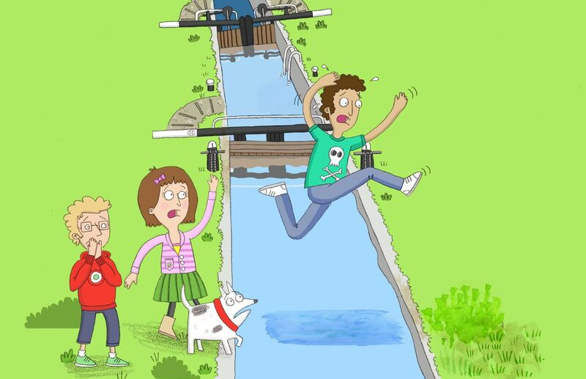
The friends are off to play by the canal. Oh no! Raj is going to jump the lock
Is this a good idea?
What could happen?
Notes:
Read Out “The friends are off to play by the canal. Oh no! Raj is going to jump the lock”
These are some of the ‘Canal do’s and don’ts’:
Do have fun exploring canals with friends.
Do stick to the path.
Don’t cross lock gates without a grown up.
Don’t play with lock paddle gears.
NEVER EVER JUMP ACROSS!
Note. Remind children to Always keep away from the edge

Slide 14
A - is for take advice
Where can you get advice?
Notes:
Tell children A is for ADVICE – There are lots of things that help to keep you safe near the water.

Slide 15
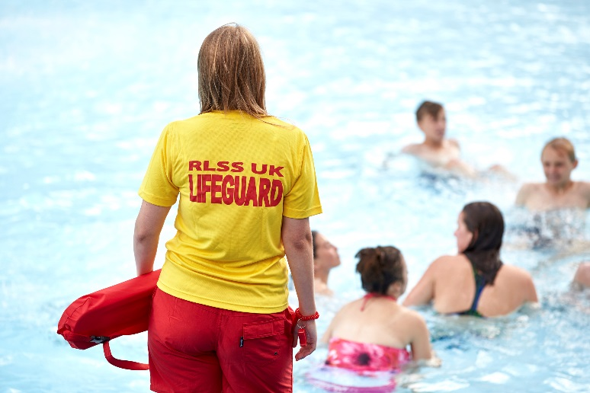
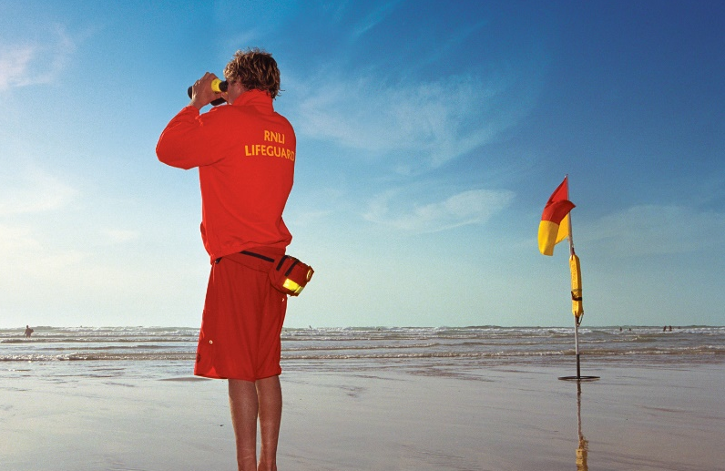
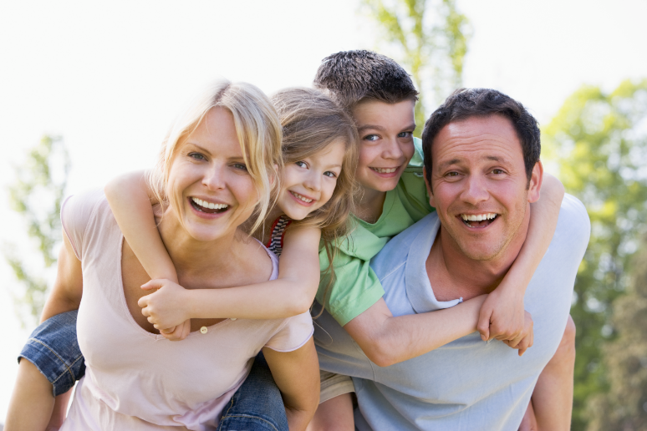
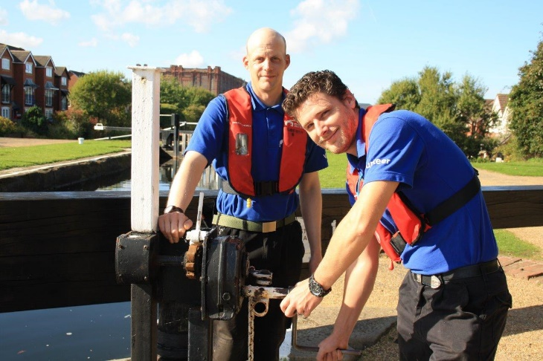
Notes:
Ask the children what people look after them when they are near water – lifeguards, parents, teachers, lock-keepers etc
Tell children to ask these people for advice about going near the water. Never swim without permission.

Slide 16
Do you know what these signs mean?
Notes:
Tell the children that we’re going to look at some Signs and ask them if they know what they mean?

Slide 17
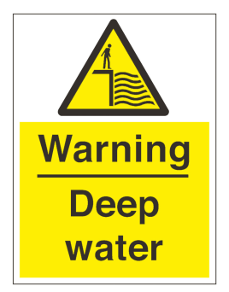





Keeping
Birmingham
At the Heart
Of Water Safety
Warning Signs
Notes:
No Swimming – canals were built for boats not people
Deep Water – you can’t tell how deep the water is unless you measure it. Canals and rivers can be very deep in places, especially in locks
Danger Thin Ice – you might fall through
No Diving – you might hurt your head
Life Jackets Must be Worn – so you are safe if you fall in
No Fishing – this is often used near boat moorings, locks and where there are Overhead Power Cables.
Cyclists Dismount – often used near low bridges, heavy pedestrian areas and steep slopes
Flood – don’t go in, go around
No Inflatables – they might be blown away
Overhead Power Cables – don’t get zapped!
Note. Please tell the children that boats are an additional hazard to be aware of, especially when fishing or canoeing!

Slide 18
Do you know what the beach flags mean?
Notes:
Tell the children that we’re going to look at some Beach Flags and ask them if they know what they are for?

Slide 19




Red and Yellow Flags - Lifeguards patrol here, safest place to swim
Black and White Chequered Flags - Between these flags is for non-swimming water sports such as surfing and wind surfing
Red Flags - Danger, stay out of the water
Windsock or Orange Flag - This shows the direction and force of the wind, special care should be taken during an offshore wind
Notes:
Tell children that signs will be around the pool and water and flags give you advice whilst at the Beach.
Show the flags and ask the kids what they mean, if they don’t know then explain what they mean:
Red and Yellow Flags –Lifeguards patrol here, safest place to swim
Black and White Chequered Flags - Between these flags is for non-swimming water sports such as surfing and wind surfing
Red Flags - Danger, stay out of the water
Windsock or Orange Flag - This shows the direction and force of the wind, special care should be taken during an offshore wind

Slide 20
F - is for go with a friend
Notes:
Tell children F is for FRIENDS – There are lots of things that help to keep you safe near the water

Slide 21
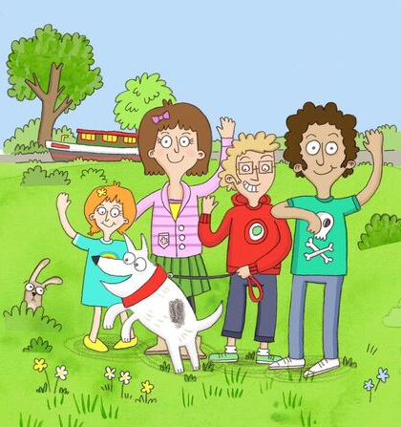
Notes:
Ask them whether they go to the pool/beach etc alone
Ask them “why they think it is better to go with friends and family?”
Answers are:
It’s more fun
A friend or family member could go for help if you get into trouble
A friend or family member could help you spot the dangers
Note. Tell children they should always go swimming with a friend or family member and Swimming Pools are the safest places to go swimming.

Slide 22
E - is for in an emergency call 999
Notes:
Tell children E is for Emergency – what to do if someone is in trouble

Slide 23
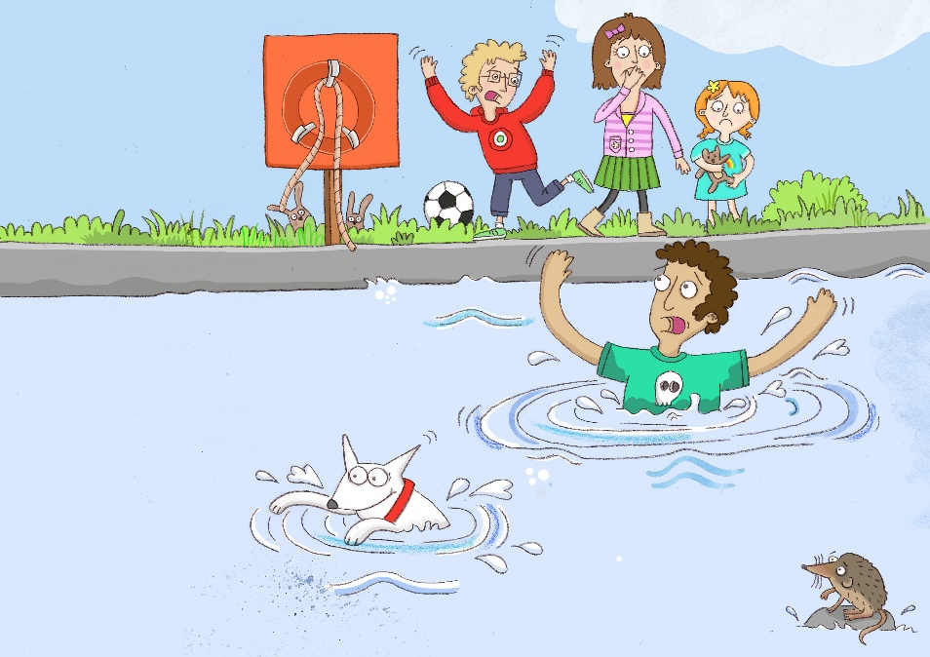
Raj’s dog has jumped into the canal chasing ducks! Raj has jumped in after to get him back out.
The sides are very steep and Raj can’t get back out. The dog has safely jumped back onto the path.
What should his friends
do to help?
Notes:
Read Out “Emergency!!! OH NO!!! Raj’s dog has jumped into the canal and Raj has jumped in after to try and save it! Someone has stolen the Life Ring. What can the friends do to help?”
What can you do to help someone in trouble?
Shout for help! Call 999
Encourage Raj to move to the bank
Throw him something that floats (a football)
Don’t jump in after dogs, they can look after themselves. 99% of the time a dog will be able to get themselves out of water. They are good swimmers and can jump out easier than we can!

Slide 24
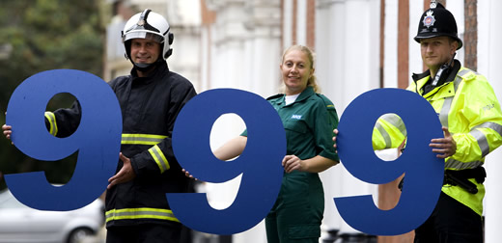
Notes:
In an emergency, keep yourself SAFE, don’t jump in after anyone or anything.
Shout for HELP and call 999
Make sure you give them as much information as possible:
Where you are
Who is in trouble
What has happened
When did it happen

Slide 25
Keeping
Birmingham
At the Heart
Of Water Safety
S A F E
pot
dvice
riend
mergency
S - is for spot the dangers
A - is for take advice
F - is for go with a friend
E - is for in an emergency call 999
Notes:
Tell children that the best way to stay safe near water is to remember the SAFE code
Recite with the children, you call out the letter and let them tell you what it means.
Repeat for a while, altering the pattern in which you ask the letters, keep repeating until you are sure that the pupils understand what each letter stands for
Say you are now going to look at each of these letters

Slide 26
You can visit the following websites if you’d like any further information or to download more of our free water safety resources
www.rlss.org.uk/water-safety
www.rnli.org/education
www.canalriverexplorers.org.uk
Notes:
For more information and resources please visit the following websites.

