Slide 1




Keeping
Birmingham
At the Heart
Of Water Safety
Notes:
Today we’re going to learn about Water Safety and how to keep SAFE whenever you’re in, on or around water.
Ask the children if they think that water is fun
Ask them: ? Ask what fun activities they can do in, on and around the water? E.g. canoeing, boating, fishing? What they do in the water?
Tell the children that water is fun, but it is important to stay safe near the water and that’s what you are going to talk to them about today

Slide 2

Introduction
We’re going to watch a video of how to Stay SAFE
Notes:
Tell the children that we’re going to watch a video of how to Stay SAFE and Perry is going to teach us the SAFE Code

Slide 3

<iframe width="560" height="315" src="https://www.youtube.com/embed/UDTmv4Sddvk?rel=0&amp;controls=0&amp;showinfo=0" frameborder="0" allowfullscreen></iframe>

Slide 4
Remember the CODE
S A F E
pot
dvice
riend
mergency
Notes:
Tell children that the best way to stay safe near water is to remember the SAFE code
Recite with the children, you call out the letter and let them tell you what it means.
Repeat for a while, altering the pattern in which you ask the letters, keep repeating until you are sure that the pupils understand what each letter stands for
Say you are now going to look at each of these letters

Slide 5

Questions
What can you See?
Can you Spot the Dangers?
Notes:
Ask the children if they can Spot the Dangers on the next slide – there are 8 to find at the River

Slide 6
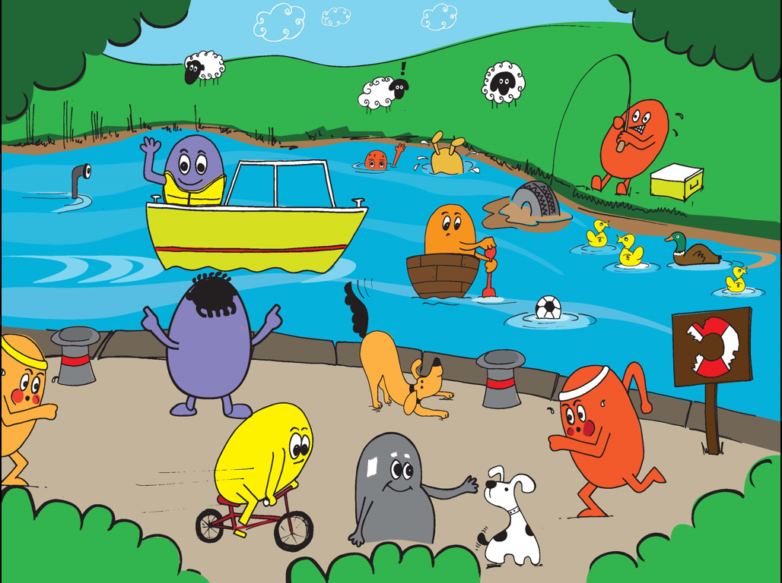
CAN YOU FIND ALL 8?
WATER DEPTH CAN CHANGE QUICKLY
YOU DON’T KNOW WHAT’S BENEATH THE SURFACE
BANKS CAN HAVE CRUMBLING OR SLIPPERY EDGES
1
3
ALWAYS WEAR A BUOYANCY AID
4
2
BROKEN AND MISSING RESCUE AIDS
5
8
6
7
DON’T RUN BY THE EDGE – YOU MIGHT SLIP OR TRIP
DON’T RUN BY THE EDGE – YOU MIGHT SLIP OR TRIP
DON’T CYCLE NEAR THE EDGE – YOU MIGHT FALL IN
Notes:
The teacher or pupils can click (or touch) where they think there is a danger, then the information notice will appear.
Pupils can discuss each of the dangers and how they would keep themselves safe.

Slide 7
Questions
Do you know what these Signs mean?
Notes:
Tell the children that we’re going to look at some Signs and ask them if they know what they mean?

Slide 8








Keeping
Birmingham
At the Heart
Of Water Safety
Warning Signs
Notes:
No Swimming – canals were built for boats not people
Deep Water – you can’t tell how deep the water is unless you measure it. Canals and rivers can be very deep in places, especially in locks
Danger Thin Ice – you might fall through
No Diving – you might hurt your head
Life Jackets Must be Worn – so you are safe if you fall in
No Fishing – this is often used near boat moorings, locks and where there are Overhead Power Cables.
Cyclists Dismount – often used near low bridges, heavy pedestrian areas and steep slopes
Flood – don’t go in, go around
No Inflatables – they might be blown away
Overhead Power Cables – don’t get zapped!
Note. Please tell the children that boats are an additional hazard to be aware of, especially when fishing or canoeing!

Slide 9
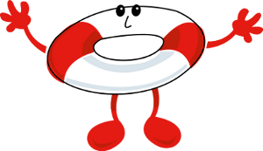
Questions
What can you See?
Can you Spot the Dangers?
Notes:
Ask the children if they can Spot the Dangers on the next slide – there are 11 to find at the Beach

Slide 10
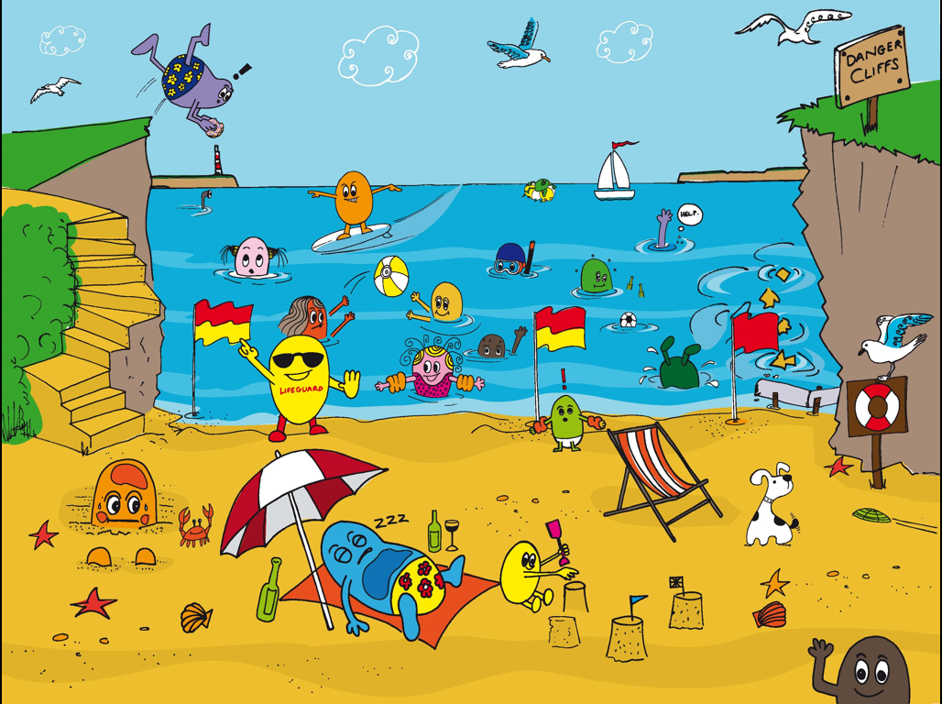
CAN YOU FIND ALL 11?
DON’T SWIM SOON AFTER EATING
BEWARE OF CURRENTS OUT TO SEA
1
5
TETHER INFLATABLES TO THE SHORE
BEWARE OF DEEP WATER – KNOW WHAT TO DO IN AN EMERGENCY
3
DON’T SWIM IN A WATER SPORTS AREA
BEWARE SLIPPERY AND CRUMBLING CLIFFS – READ THE SIGNS
2
4
DON’T JUMP FROM CLIFFS, THE WATER MIGHT BE SHALLOW
8
AVOID DIRTY AND POLLUTED WATER
10
6
BE SUN SAFE – WEAR SUN CREAM
9
7
WEAR YOUR BUOYANCY AIDS
11
ALWAYS KEEP AN EYE ON CHILDREN
AVOID PIPES AND ROCKS
RED FLAG MEANS DANGER - NO SWIMMING
Notes:
The teacher or pupils can click (or touch) where they think there is a danger, then the information notice will appear.
Pupils can discuss each of the dangers and how they would keep themselves safe.

Slide 11
Questions
Do you know what the Beach Flags mean?
Notes:
Tell the children that we’re going to look at some Beach Flags and ask them if they know what they are for?

Slide 12


Keeping
Birmingham
At the Heart
Of Water Safety
Notes:
Tell children that signs will be around the pool and water and flags give you advice whilst at the Beach.
Show the flags and ask the kids what they mean, if they don’t know then explain what they mean:
Red and Yellow Flags –Lifeguards patrol here, safest place to swim
Red Flags - Danger, stay out of the water

Slide 13
Questions
What can you See?
Can you Spot the Dangers?
Notes:
Ask the children if they can Spot the Dangers on the next slide – there are 7 to find at the Home

Slide 14
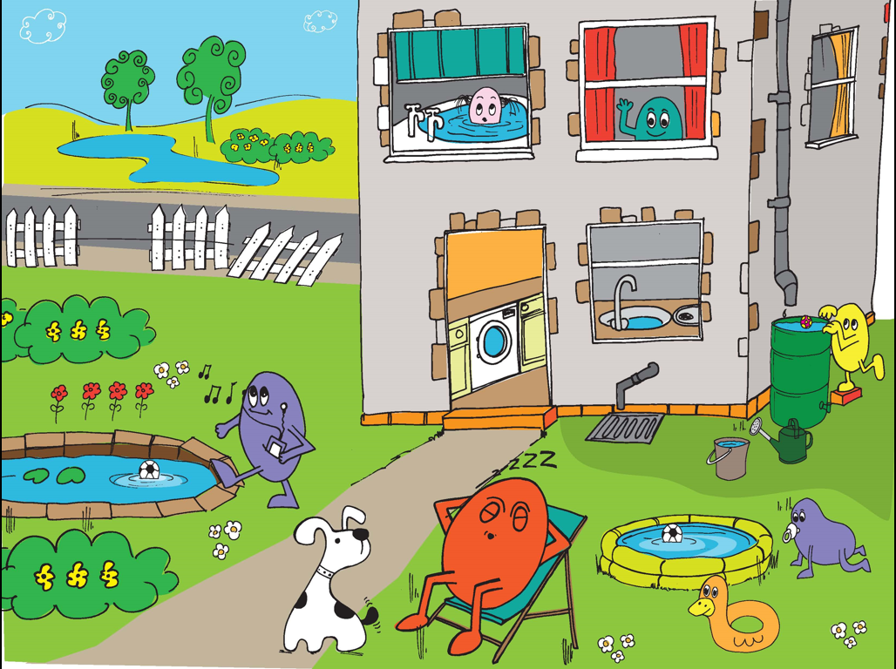
CAN YOU FIND ALL 7?
NO LIFEGUARDS ON DUTY AT THE LAKE – NO SWIMMING
ALWAYS KEEP AN EYE ON CHILDREN IN AND AROUND WATER
2
1
WATER STORAGE CONTAINERS SHOULD BE COVERED
7
THIS FENCE ISN’T GOOD ENOUGH TO KEEP PEOPLE SAFE FROM THE POND OR THE LAKE
WATER SHOULD BE DRAINED AWAY AFTER USE
3
4
6
A FENCE WOULD STOP HIM FALLING IN
ALWAYS KEEP AN EYE ON CHILDREN IN AND AROUND WATER
5
Notes:
The teacher or pupils can click (or touch) where they think there is a danger, then the information notice will appear.
Pupils can discuss each of the dangers and how they would keep themselves safe.

Slide 15
Remember the CODE
Keeping
Birmingham
At the Heart
Of Water Safety
S A F E
pot
dvice
riend
mergency
S - is for Spot the Dangers
A - is for Take Advice
F - is for Go with a Friend
E - is for Emergency! call 999
Notes:
Tell children that the best way to stay safe near water is to remember the SAFE code
Recite with the children, you call out the letter and let them tell you what it means.
Repeat for a while, altering the pattern in which you ask the letters, keep repeating until you are sure that the pupils understand what each letter stands for
Say you are now going to look at each of these letters

Slide 16
Websites
You can visit the following websites if you’d like any further information or to download more of our free water safety resources
www.rlss.org.uk/water-safety
www.rnli.org/education
www.canalriverexplorers.org.uk
Notes:
For more information and resources please visit the following websites.

Slide 17
Evaluation
Click the link below and tell us how many children you have delivered this presentation to:
https://goo.gl/forms/gDa5zUEcvpMGK3cx2
Notes:
Click the link below and tell us how many children you have delivered this presentation to:
https://goo.gl/forms/gDa5zUEcvpMGK3cx2

