Slide 2
Enabling children and families to make positive changes

Slide 3
Services for Education
Providing services in support of excellence in the teaching, learning and well-being of young people

Slide 4
Introductory offer
6 half day sessions – mentoring or family support
Commitment is to all six sessions
Reduce cost £690 (6 half day sessions)
Full cost £810 (6 half day sessions)
Schools will refer pupils or families

Slide 5
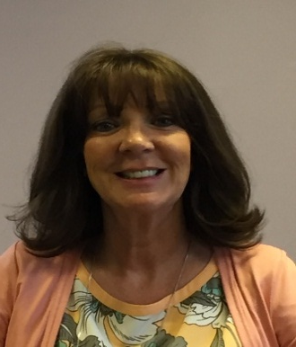
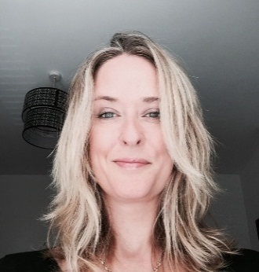
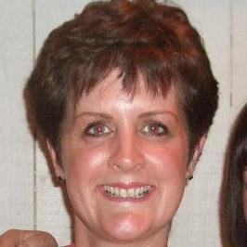
Debbie May
Worked in education for over 18 years,
worked for Homestart,
mentor, family support
Charlie Laffan-Butler
Artist, trained councillor,
Over 15 years experience
Petrena Keane
Background in special needs,
20 years experience,
experienced in holistic therapy

Slide 6
Support offered
A higher level of 1:1 support including:
Low self-esteem
Behaviour
Anger management
Emotional trauma
Positive praise
Rules/routines
Each school will have a bespoke offer depending on the needs of pupils and families.
Initial sessions will focus on building the trust and relationship between mentor and child.

Slide 7
Practicalities
All the team undergo full DBS checks, are provided with safeguarding training and receive weekly supervision.
A family support worker will work with 3 parents per half day
Pupil mentor will work with 4/5 pupils in a half day in approx 20-30 minute sessions.
Mentors work with pupils in Year 1 and above. Possible sessions for reception but depends on cognitive ability of individual child.
Schools refer pupils and parents – the Family Support Worker contacts parents

Slide 8
How do you take part?
Confirmation via email to andrew.cooper@servicesforeducation.co.uk

Slide 9
PSHE
RSE
Emotional Health and Well-Being
Safeguarding
Including DSL training , DSL update training, Safer Recruitment and Governor training

Slide 10
PSHE Subject Leader Network Meetings
Primary
Secondary

Slide 11
What we can offer:
Support and discount for Jigsaw PSHE
PSHE (RSE) Modelling Programme
Be Healthy Schools’ Award
The Full Primary School Relationships Education Development Programme
The Lite Primary School Relationships Education Development Programme
Building Confidence in talking to children about Puberty and the changes that happen as they grow up

Slide 12
Healthy Eating
Growing Food
Physical Activity
Cooking
National Quality Mark
Increases pupils’ understanding of how their school works and democracy in action
Teamwork
Focuses on children’s rights
Links to UNCRC
Finance Education
Evidenced through real life impact in schools
Run a Mile Study
Getting children to run or walk a mile (about 15 minutes) a day
Assess the impact on their overall health and well-being
University of Birmingham

Slide 13
S R E =
Sex and Relationships Education
R S E ?
Healthy Relationships?

Slide 14
Resistance
By parents? By governors? By teachers?
Real or imagined?

Slide 15
Supporting Staff
Sessions give teachers and pupils the confidence to tackle tricky/uncomfortable issues.
Not embarrassing - fun!
A relaxed and out in the open atmosphere enabling children to contribute, have fun and learn more!

Slide 16
Consultation Programme – effective in engaging the whole school community in developing a bespoke policy and programme of Relationships and Growing Up Education
Introduction meeting
Staff and Governor Introduction
Pupil consultation
Parent engagement and awareness raising session
Staff consultation
RSE Policy and Scheme development day
Finalising the policy and SoW

Slide 17
Supporting Parents
“Building confidence in talking to children about Puberty and the changes that happen as they grow up”
The session aims to:
Remind parents of the physical and emotional changes that happen to both boys and girls as they go through puberty
Clarify correct terms for male and female body parts
Explore the different things that support children to manage these changes including sanitary wear/ friendships/ family/ thinking about privacy
Explore parental fears and concerns when supporting children as they grow up
Highlight the importance of answering children’s questions
Explore how parents might respond to tricky questions providing real practical responses

Slide 18
Resources

Slide 19
Emotional Health and Well-Being
Bespoke staff training and centre based courses
Attachment
The emotionally safe classroom – an emotionally literate school
The right to feel safe – an approach to anti-bullying without mentioning the ‘b’ word
Protective Behaviours – a whole school approach
Surviving not thriving – Adverse Childhood Experiences
Loss and Bereavement
Divorce and Separation
Self Harm and Eating Disorders

Slide 20
Resources

Slide 21
Mental Health and the Workforce
A whole day training to equip Senior Leaders with the knowledge, understanding and skills to have conversations about mental health, reduce stigma by increasing awareness, understand and comply with the Equality Act 2010
Mental health is a key determinant of the workplace environment as it affects employee retention and team relationships, and every year mental health issues will affect around one in four of us.

Slide 22
Bespoke Training and Support
Domestic Abuse
FGM
Emotional Health and Well-being
CSE
Online Safety
Honour Based Violence
VAWG / gender-based violence
Forced marriage
Anti-Bullying
Radicalisation and Extremism
Drugs

Slide 23
www.servicesforeducation.co.uk
Jo Perrin
jo.perrin@servicesforeducation.co.uk
Liz Bates
Liz.bates@servicesforeducation.co.uk

