Slide 1
Schools White Paper & SEND Reform Consultation Briefing

Slide 2
Headline messages and the case for change
Build a genuinely inclusive education system
Redesign SEND pathways around early intervention and outcomes
Rebalance investment towards prevention and family support
Respond to rapid technological change, including AI
Position schools as public services and community anchors
Strengthen evidence-based teaching and the importance of continued learning at home
Tackle attendance, behaviour, disadvantage and narrow the attainment gap
Stabilise and support the workforce and rebuild parental confidence

Slide 3
Chapter 1: Our children’s future
Wraparound services to be accessible, joined up, and evidence-driven
New models of local partnership and shared accountability around outcomes
Investment in Best Start Family Hubs, including £200m over three years for SEND practitioners
Hubs as a single access points for health, family support, and early learning

Slide 4
Chapter 2: Narrow to broad
Early Years | Primary/Secondary
Rebuild family services and strengthen quality of early years, prioritising core knowledge and skills | Strengthen Progress 8 and introduce Year 8 reading test
Invest in providers through a new Inclusive Early Years Fund. | Expand English and Math's Hubs and launch a RISE KS3 Alliance
Childcare and Early Education Review | Introduce new enrichment benchmarks and accountability
Expand the Reading Ambition CPD Programme | Review the admissions code for greater transparency
Establish RISE Reception Networks to share best practice | Improve transitions into post-16 pathways
Strengthen early years to schools' transitions | Create a Level 1 prep for GCSE qualification for learner below grade 3
LAs to ensure sufficient, high quality local provision | Update 16-18 English and Math's progress measures

Slide 5
Chapter 3: Sidelined to included
High standards and inclusion seen as equally important
Sidelined: white working class, SEND, CiC, and those not reaching their full potential
Summer 2026 consultation to improve funding fairness
Two place-based missions (NE and Coastal) to trial new collaborative models
Building an evidence base around use of pupil premium
£3.7bn by 2030 for accessible buildings and to create 50,000 special school places by establishing inclusion bases in mainstream settings

Slide 6
Chapter 4: Withdrawn to engaging
New pupil engagement framework; by 2029 all schools will monitor pupils' sense of belonging and engagement
Expansion of Families First, attendance mentoring, new Attendance and Behaviour hubs and specialist advisors for LAs with high absence rates
New duty on LAs to notify schools, health visitors and GPs of children in temporary accommodation
Proposals to better use school spaces for health services in partnership with DHSC and NHSE
Reintegration Support Partnerships after suspensions and new guidance on completing suspensions in schools
Race Equality Unit to research rise in racist abuse in schools

Slide 7
Chapter 5: Support and investment in
high-quality staff
Recruitment and training of 6,500 new expert teachers
Improving maternity pay for teachers, with plans to extend to support and college staff
Strengthening teacher development through a £200 million SEND focused CPD programme
Introducing a new mentoring and coaching offer for headteachers
Launching a pilot programme to improve headteacher retention

Slide 8
Chapter 6: Collaboration between schools and with other partners
Requirement for all schools to be part of a trust; enable LAs to establish new trusts
Strengthen partnerships between trusts, schools, LAs, and health
New Trust Standards
Local governance: annual parental forums, local representations, co-operative trust models to be updated
LAs to maintain a central role
New statutory duties via the Children’s Wellbeing and Schools Bill: EHE registers, kinship care, family-decision making, CiC and the extended Virtual School Head role

Slide 9
Chapter 7: Enabling innovation and ambition
Self-improving schools system where collaboration and sharing best practice are core
Expand RISE programmes and create a digital one stop shop for evidence-led school improvement
Introduce AI tools, assistive technology and a digitised National Curriculum framework

Slide 10
SEND Reform
Universal offer of high quality teaching and support from early years to 25 – commonly occurring need to be met in mainstream
Three new layers of support – Targeted, Targeted Plus, and Specialist
Individual support plans (ISPs) will outline day to day educational provision
Nationally designed Specialist Provision Packages (SPPs) will guide eligibility for EHCPs and provision available to meet needs
Where required, EHCPs will set out statutory entitlement as per SPPs, supported by ISP describing day to day provision

Slide 11
SEND Reform
Tribunals will remain a route to redress regarding specialist provision, hearing appeals regarding thresholds for specialist provision and settings. The Tribunal will not be able to name a placement for a child.
Reform AP – outreach into mainstream, time limited placements and longer-term placements where needed
New funding arrangements – schools and settings to have direct responsibility for an inclusive mainstream fund
Via local groupings, schools to pool a minimum level of funding to support less common needs fairly across the grouping
Transitional arrangements post legislation
Oversight and scrutiny of implementation of reforms via Children’s Commissioner

Slide 12
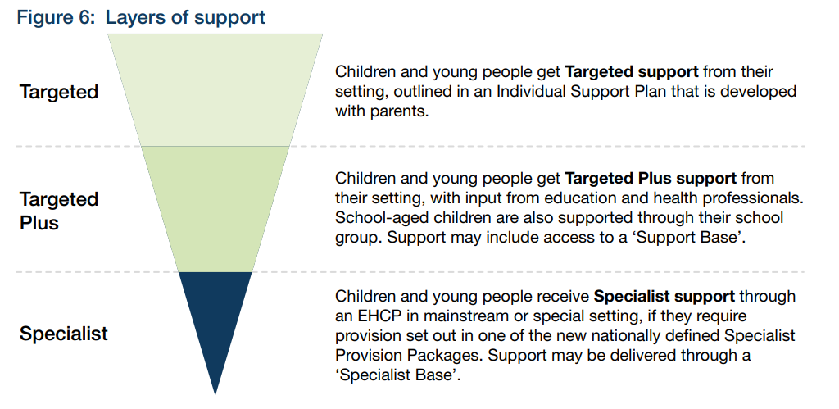
SEND Reform: Putting Children and Young People First

