Slide 1
Webinar for Schools Children and Families Updates
Sue Harrison – Executive Director, Children and Families
Helen Ellis – Director, Early Years, SEND and Inclusion
Razia Butt – Director, Thriving Children and Families
Martin Fitzwilliam – Interim Director, Schools and Employability
4 December 2025

Slide 2
Welcome and Introduction
Thank you for joining us today. We know your time is valuable, and we really appreciate it.
This session will cover key updates from the Children and Families Directorate to keep you informed and prepared.
I’m joined by fellow directors: Helen Ellis, Razia Butt, and Martin Fitzwilliam.
Together, we’ll provide headlines from each service area, and I’ll focus on progress with our Birmingham Families First programme.
The session will be recorded. Slides will be shared afterwards.
Cameras on is fine, but please mute your mics to avoid background noise – thank you!

Slide 3
Birmingham Families First
Sue Harrison
Notes:
Needs a more exciting first slide please

Slide 4
Birmingham Families First – Who we are
Birmingham Families First Transformation Group
Co-production with children, young people and families
Wider partnership, including schools, the ICB, wider council, police and voluntary sector

Slide 5
Birmingham Families First – The vision
Our vision is to deliver improved outcomes for children, young people and families through integrated services, delivered in partnership, at a district level.
A core principle is a passionate belief in providing earlier, more proactive and effective support to children, young people and families (in line with the current national reform direction).

Slide 6
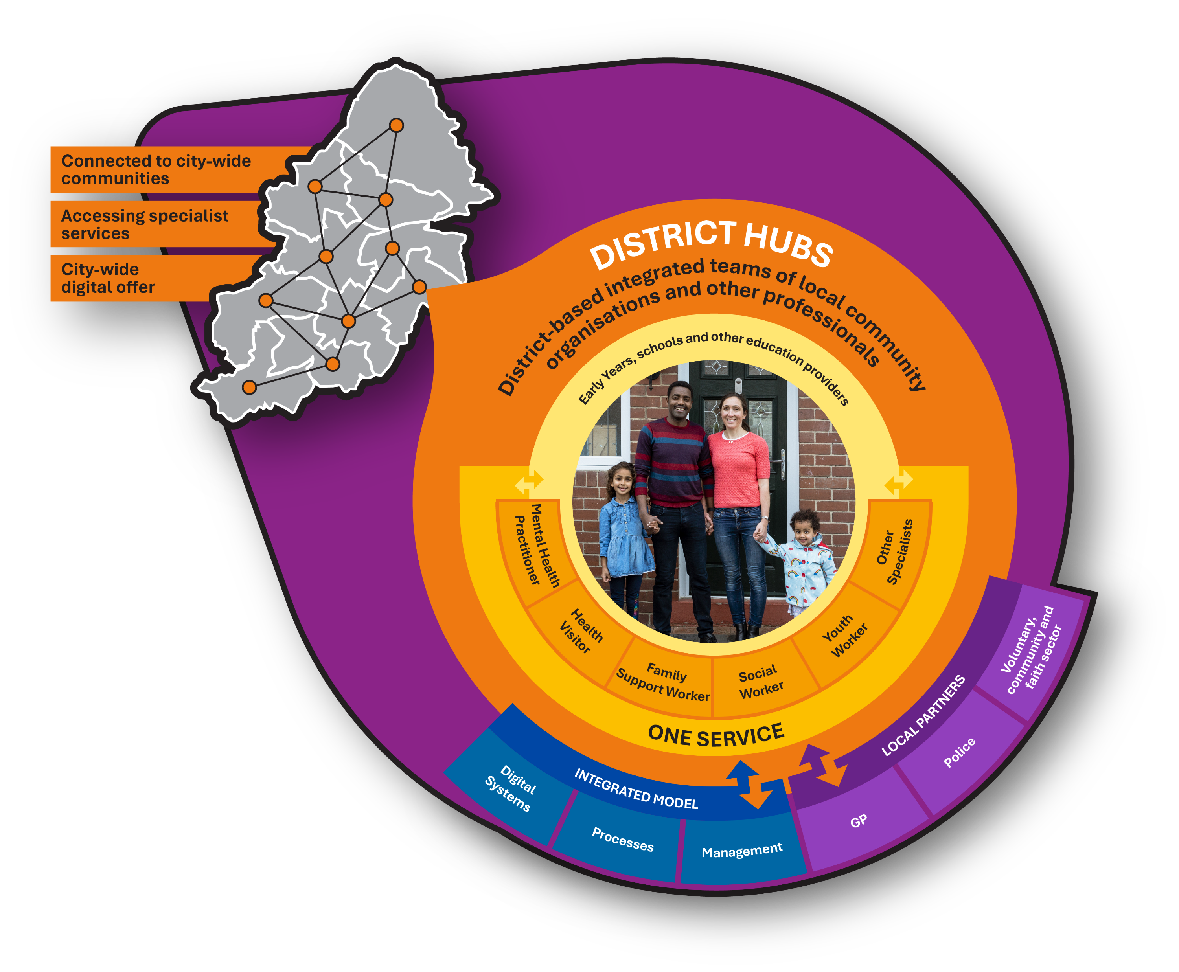
District Hubs

Slide 7
Our strategic outcomes. We want a system that…
Identifies children, young people and families early when extra support is needed.
Provides help as soon as needs emerge, before they
escalate.
Ensures support is effective, reducing ongoing need.
Makes support proportionate and targeted, using multi-agency expertise.
Delivers outcomes quickly, avoiding delays
Notes:
Can you include the speaker notes for me that Laura shared they were really helpful thanks

Slide 8
Design principles We’ll create a system that is…
Shaped by families – Built on what children, young people, and families say matters.
Inclusive – Promotes equity, equality, and inclusion in both change and service delivery.
Community-based, district-led – Uses the full local support network and aligns with locality leadership to deliver consistent outcomes while adapting to local needs.
Joined-up – One multi-agency plan so families experience seamless support. Act quickly to achieve outcomes and minimise delays.
Clear about roles and efficient – Partners work together with defined responsibilities based on expertise. Time with families is maximized, avoiding duplication.
Digitally enabled and data-driven – Uses technology to support frontline practice and proactively identify families who need extra help.

Slide 9

District Operating Model – Pilot in Hodge Hill
Priority Shared Outcomes:
Keeping more
families together
Improving
school attendance
Improving child development in early years
A multi-disciplinary training offer for parents and professionals in universal services
A digital offer of resources for parents and professionals in universal services, as well as a directory of agencies for single agency responses
Family Hubs as an estate based and peripatetic multi-disciplinary team
Team Around the School or Early Years Setting for initial consultation for professionals
Team Around the Family Network for initial multi-agency response
Family Help for multi-agency response to lower-level risk
Multi-agency child protection for response to higher level risk
Enablers:
The Model:
Engagement and
co-production with children, young people and families
District based leadership and governance
Aligned ways of working

Slide 10
Five Pillars
Shared Priority Outcomes
Keeping Families Together
Improving School Attendance
Improving Child Development in Early Years
Engagement &
Co-production
Ensure active involvement of children, young people, and parents in shaping and improving services.
Incorporates the voices of children, young people and families to ensure meaningful participation.
Leadership & Governance
Provide structural oversight through steering groups and Transformation Board for effective service delivery.
Ensures accountability and alignment through formal groups and decision-making boards.
Tiers of Need & Service
Framework for identifying and addressing support levels required by families.
Outline support
levels from
universal to
targeted interventions
Ways of Working
Operational practices and
cultural norms enabling effective collaboration and service delivery
Shared principles and cultural shifts

Slide 11



Children and Young People’s Intelligence Workstream
Across the Partnership we need a shared evidence base across these three levels
Strategic overview of demographics, needs, performance and outcomes across the partnership for effective planning, policy and prioritisation.
Ability to break down information by characteristics and geography
Strategic Level
Summary information about children and families, services and outcomes within a district for planning, management, operational purposes and transparency
District level analysis tools based on shared and trusted data
District Level
Single View of the Child and Family
Comprehensive information on individual children and families to keep them safe and understand and effectively meet their needs through front line services
Analysis of data to inform proactive identification and early help

Slide 12
What this means for you: Hodge Hill is Leading the Way!
Hodge Hill has been chosen as the pilot district for Birmingham Families First.
As part of the pilot, we’re creating a District Leadership Team. This group will meet regularly to review data, share insights, and set up working groups to test new ideas.
District Operating Model — we want you to be part of shaping the future!
Over the next few weeks, the Families First Programme Team will be connecting with colleagues across Hodge Hill. We’ll work alongside you to understand how you support families and explore opportunities to make things even better—whether that’s smoother processes, stronger collaboration, or more joined-up working.
You may be asked to join one of the working groups to help test, review and measure pilot ideas.
We’ll keep you updated with regular communications, so you know what’s happening and how you can get involved.
Your experience and input are key to making this a success—together, we can make a real difference for families in Birmingham!

Slide 13
SEND and Inclusion Post SEND Inspection Update
Helen Ellis
Notes:
Assume Helen has approved these slides?

Slide 14
Background & Context
An area SEND inspection took place between 9th – 27th June 2025 conducted jointly by Ofsted / CQC.
Inspectors looked at the support provided to children and young people with SEND and their families by the Local Area Partnership which consists of BCC, the Children’s Trust and the NHS Integrated Care Board (ICB).
There are three outcomes from a Local Area SEND Inspection:
The local area partnership’s SEND arrangements typically lead to positive experiences and outcomes for children and young people with SEND. The local area partnership is taking action where improvements are needed.
The local area partnership’s arrangements lead to inconsistent experiences and outcomes for children and young people with SEND. The local area partnership must work jointly to make improvements. In 2025 we have received this outcome
There are widespread and/or systemic failings leading to significant concerns about the experiences and outcomes of children and young people with SEND, which the local area partnership must address urgently.
In 2021 we received this outcome
While the inspection recognised our improvement and that the foundations for sustainable improvement are now in place and beginning to make a difference, we still have work to do to reach our goal of consistent experiences and outcomes for our SEND children and young people.

Slide 15
The Six Areas We Need To Improve
The local area partnership should continue to improve the quality and consistency of EHC plans to ensure that they reflect up-to-date views along with information from education, social care and health services.
The local area partnership should further support improved partnership working at a strategic level This includes, but is not limited to:
The accurate use of data collected across the partnership
Commissioning arrangements
SEND governance being consistently embedded across the ICB, as well as health providers, social care and education
Partnership leaders should reduce waiting times for neurodevelopmental assessment and diagnosis across all ages and also ensure that suitable support is available for those waiting.
Partnership leaders should take action to reduce the amount of time that children, young people and families wait to access specialist equipment and for home adaptations to be made.
The local area partnership should ensure better oversight and use of the DSR to help prevent children and young people’s needs escalating.
Partnership leaders should ensure that children, young people, their families and professionals are clear about the services available through local offer. This should include community activities, short breaks and social groups so that children and young people with SEND are valued and visible across Birmingham.

Slide 16


Post Inspection Next Steps
Following on from the inspection there are certain requirements for the Local Area to follow:
The formulation and submission of a detailed action plan covering the six areas requiring improvement which was approved by the DfE & NHSE on 26th October 2025.
The publication of the action plan on the Local Offer on 29th October 2025 which can be viewed via this link.
https://www.localofferbirmingham.co.uk/send-improvement/
The participation in monitoring meetings where our progress will be assessed by DfE & NHSE.

Slide 17
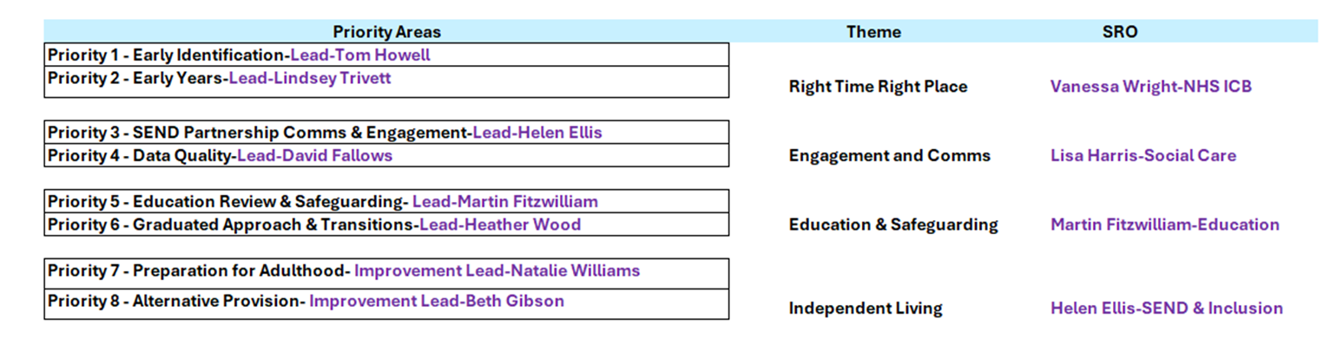
SEND & AP Improvement Programme Structure & Governance
Fig 1.
Fig 1. shows the structure of the SEND & AP Improvement Programme.
This consists of the eight priority areas and the four themes.
Each areas has an improvement lead, and themes have Senior Responsible Officers representing all the partner organisations.
The six improvement areas from the inspection have been incorporated into the overall plan but are visible for reporting purposes.

Slide 18
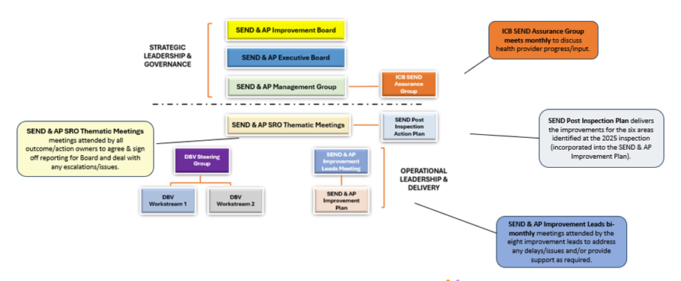
SEND & AP Improvement Programme Structure & Governance
Fig 2.
Fig 2. illustrates the governance structure that provides the oversight of the programme.
This shows the link from the working groups and plans through to the Improvement Board.

Slide 19
Thriving Children and Families Education Safeguarding and Children Out of Sight
Razia Butt
Notes:
I think you should share your team structure Razia so the heads know what capacity you will have

Slide 20
Education Safeguarding
Strategic Objectives: Strengthen safeguarding leadership, improve practice consistency, enhance multi-agency collaboration, and promote the child’s voice.
Key Priorities:
Compliance with Keeping Children Safe in Education (KCSIE) and Working Together to Safeguard Children.
Updated Model Safeguarding Policy 2025, S175, annual training, and guidance for schools.
New initiatives: Designated Safeguarding Lead Supervision Policy and Professional Curiosity Guide.
Addressing disproportionality and discrimination in safeguarding responses.
Notes:
Can we include links to the strategy and guidance and policies please?

Slide 21
Children Out of Sight
Focus Areas:
Children in home education, missing education, and complex circumstances requiring multi-agency triage.
Established pathway for safeguarding oversight of home-educated children with social workers.
Key Developments:
Collaboration between BCC, BCT, and Virtual School for lateral checks and safeguarding oversight.
Joint assessments for children with complex social, educational, or health needs, ensuring coordinated support across agencies.
Foundations laid for the forthcoming Children’s Wellbeing and Schools Bill.

Slide 22
Schools and Employability School Improvement and Attendance Strategy
Martin Fitzwilliam

Slide 23
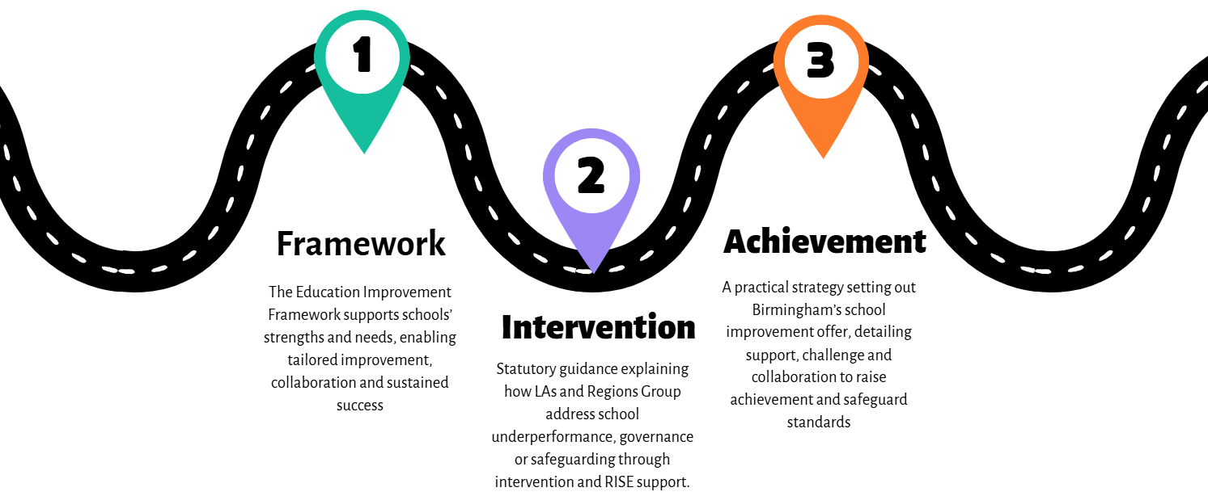
Where are we going to next?

Slide 24

School Improvement
LA responsibilities:
“Promote high standards in maintained schools”
“Identifying risk early, challenging underperformance and taking action that supports strong educational outcomes.”
Education Act 1996

Slide 25
Where are we going to next?

Slide 26
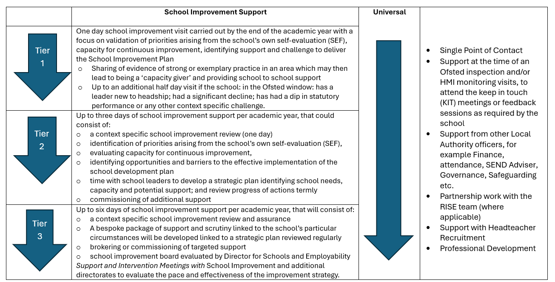
School Improvement Support
Notes:
Is this too detailed? Do we really need this slide?

Slide 27

Support for schools when they need it most
A small named team works alongside you when and where you need it most and focuses on the priorities that matter for your pupils.
Brings together the right people so support is coordinated, consistent and clearly directed at improving outcomes for children.
Draws on established Birmingham City Council services, experienced school system leaders and trusted external specialists so you receive practical and tailored help without managing multiple routes.
Reviews progress with you, keeps attention on what is making the difference and adjusts the support so it stays proportionate and responsive as your school’s needs change.

Slide 28
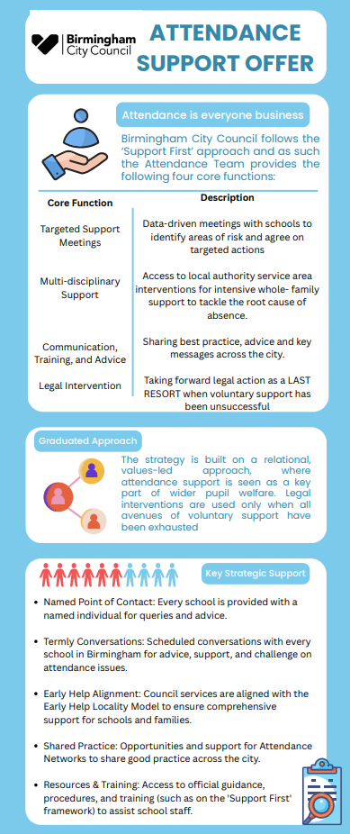
Overview of the Attendance Strategy
City-wide Collaborative Effort
The strategy is a co-produced initiative involving Local Authority, Health, and Social Care sectors working together.
Unified Approach to Absenteeism
The strategy addresses school absenteeism with a unified, multi-agency approach to support every child.
Core Principle: Everyone’s Business
Attendance is framed as everyone’s responsibility, ensuring children have opportunities to succeed.
Focus on Educational Outcomes
Reducing absence rates aims to enhance educational achievements and well-being for all pupils.

Slide 29
School Attendance
1: Relational, Values-Led Approach
Child and Family Centric
Focus on placing the child and family at the core of all support initiatives for holistic wellbeing.
Policy Review and Fairness
Review policies on penalty notices and court actions to ensure fairness and adherence to regulations.
Support During Transitions
Developing a Transition Support Toolkit to assist pupils, especially those with SEND, during challenging changes.
2: Multi-Agency Support Offer
Attendance Toolkit
Schools will receive a comprehensive toolkit to support effective attendance interventions and data-driven decision-making.
Support First Packages
Specialised support will address severe absence issues and part-time timetable challenges among students.
Targeting Support meetings
1-3 meetings a year will be held with schools to review attendance practices and plan coordinated interventions.
3: Communication and Data Transparency
Annual Attendance Campaign
Launching an annual campaign to keep attendance a high priority and address emerging trends effectively.
Localised Attendance Forums
Facilitating forums for schools and professionals to share best practices and improve attendance locally.
Annual Attendance Conference
Hosting a city-wide conference to promote collaboration and professional development focused on attendance

Slide 30
Stages So Far
Staffing 85% in place, 100% by January
NPOC (named point of contact for every school)
TSM paperwork created
TSM pilot underway before full roll out in the spring
Each school in Birmingham categorised by LA in terms of processes and PA and SA
Webinars every two weeks since September
Mini Toolkit provided to all schools
Notes:
Too many acronyms in this slide!is there a link to the strategy and toolkit we can include please?
I think we need to explain more about the staffing – which roles? How many? How will they benefit schools?

Slide 31
Practical Actions for Schools to Consider
Ensure you are using VYED data, Similar schools report, ABIE and SAIL to plan actions.
Ensure your SLT and attendance team know who the NPOC is and how to use the district contact email address for the attendance team.
Look at the webinars for the spring term and allocate staff to attend.
Check School Noticeboard weekly for updates and next steps from the attendance team.

Slide 32
Resources Available
Mini toolkit (while the BCC website is redeveloped)
Self Audit tool
TSM paperwork
VYED resources
Webinars (previous ones on youtube)

Slide 33
Final Thoughts and Closing Messages
Sue Harrison

Slide 34
Key Surveys
We know we ask a lot of our schools, but surveys are important and shape future decisions that benefit everyone. Your input really makes a difference. Please share the SEND surveys with children, young people, and families, and complete the AI survey within your school:
SEND Lived Experience Surveys – closing date 12 December 2025
Lived Experience Survey for Young People
Lived Experience Survey for Parent Carers
AI in Education – closing date 19 December 2025
Birmingham Schools – AI in Education Survey
Notes:
Conscious of time we could remove this its in Noticeboard

Slide 35
Keeping in Touch
If you have any questions or comments, please email them directly to education@birmingham.gov.uk and we’ll be happy to respond.
Valuable resources:
School Noticeboard published each Thursday afternoon during term time: www.birmingham.gov.uk/blog/school-nb
To help schools connect with the right support, the Children and Families - Meet the team directory provides contact details for lead team members across each service area, with a separate document outlining the School Improvement Team
For Birmingham Families First updates visit: www.birmingham.gov.uk/birminghamfamiliesfirst. Any questions can be emailed directly to: BirminghamFamiliesFirst@birminghamchildrenstrust.co.uk.
There’s lots of amazing things happening in our schools so please continue to share your good news stories with us.

Slide 36
Thank You!
Thank you for everything you do to make a difference every day.
Your commitment and passion inspire us all.
Together, we’re shaping something special for Birmingham’s children and families.
Your support and engagement mean so much.
Wishing you a successful end to the Autumn term and a joyful festive break!

