Slide 1
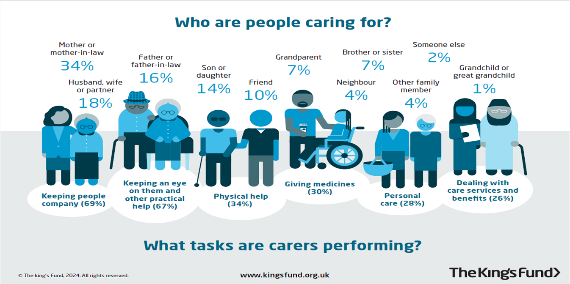
Kings Fund infographic
2021 Census highlights

