Slide 1
Children and Families Directorate All - Staff Webinar
2025/26 Budget Headlines
Wednesday 12th February 2025

Slide 2
Introduction to Webinar
Welcome
Outline key budget headlines
Provide an opportunity for questions and answers
Further opportunities to discuss the budget in more details - across team, division and Directorate activity
Council wide all staff webinar, Thursday 13th February 10:30am

Slide 3
Overall Context
Birmingham City Council’s challenging financial position continues:
Section 114 notice (issued in September 2023)
Government appointed Commissioners
Spend Control Restrictions - Council and the Trust
Savings were identified and set to be achieved for 24/25
To date the Directorate has delivered agreed 24/25 savings
To date the Trust has delivered its savings to support the Council with its 24/25 budget
Last week the Council published details of its budget for 25/26, including savings of £149m.

Slide 4
2025/26 Budget: Birmingham City Council
BCC has set a balanced budget for 2025/26 and is on track to deliver all 24/25 savings.
£149m of savings are proposed for 2025/26, the details of which are now in the public domain – link here.
The draft budget was considered at the Council’s Cabinet on Tuesday 11th
February 2025.
Cabinet’s role was to consider the draft which will then be presented to the full
Council for approval.
Full Council will meet 25th February to consider and approve the budget, this
includes the setting of 2025/26 Council Tax rates for Birmingham residents.
The draft budget proposes to increase Council Tax by 7.49% for 25/26.

Slide 5
25/26 Budget: Wider Context
The Council draft budget for 2025/26 allocates £383m to the Directorate
This represents an overall increase in the Directorates budget of £9m
compared to 2024/25
The draft 2025/26 budget includes total planned C&F Directorate savings for 2025/26 of £41m, which must be delivered by the Directorate.
£24m of the total Directorate planned savings will be delivery by BCT.
£15.4m savings will be delivered to the Council’s general fund by grant substitutions – £4m of this will be dealt with directly by the Trust, the rest within the Council.

Slide 6
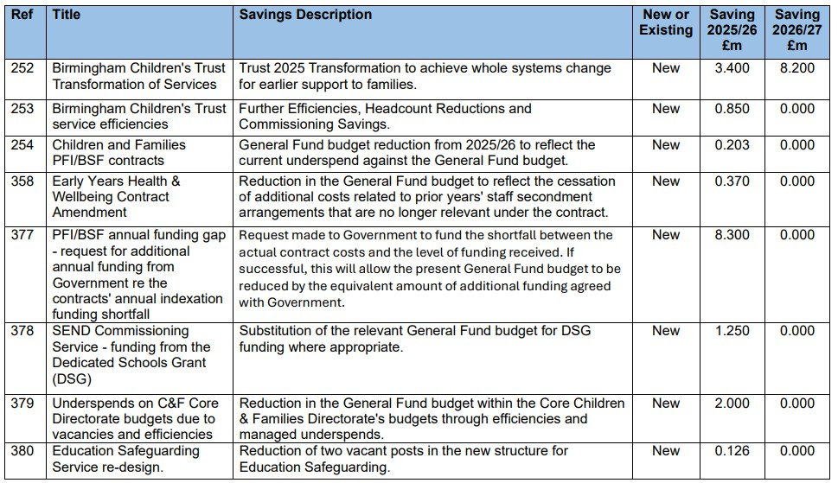
25/26 Budget: Proposed Saving Lines

Slide 7
25/26 Budget: Proposed Savings Lines

Slide 8
To Conclude…
The savings assigned to the Directorate and the Trust for 25/26 are challenging.
We are confident that they can be delivered, while protecting our services to children, young people and families, as demonstrated across 24/25.
It is essential for us all to maintain our focus on efficiency, including following the spend control guidance.
It is equally important that we continue to invest in our strength based transparent culture of support to ensure we work together to provide services for children, young people and families

Slide 9
To Conclude…
We appreciate that the draft budget documents significant detail, we will build in further opportunities to discuss the budget/proposed savings in more details across team and division activity to better understand what the changes mean for individual services and our Directorate approach to service provision.
The Directorate has and will continue to put Birmingham’s children, young people and families first, ensuring that we have quality fit for purpose and safe service provision.
Council wide all staff webinar, Thursday 13th February 10:30am

Slide 10
Q and A
We will provide a written response to all questions posed during this webinar. Thank you for your continued hard work, contribution and commitment to ensuring that we secure better outcomes for children, young people and families

