Slide 1
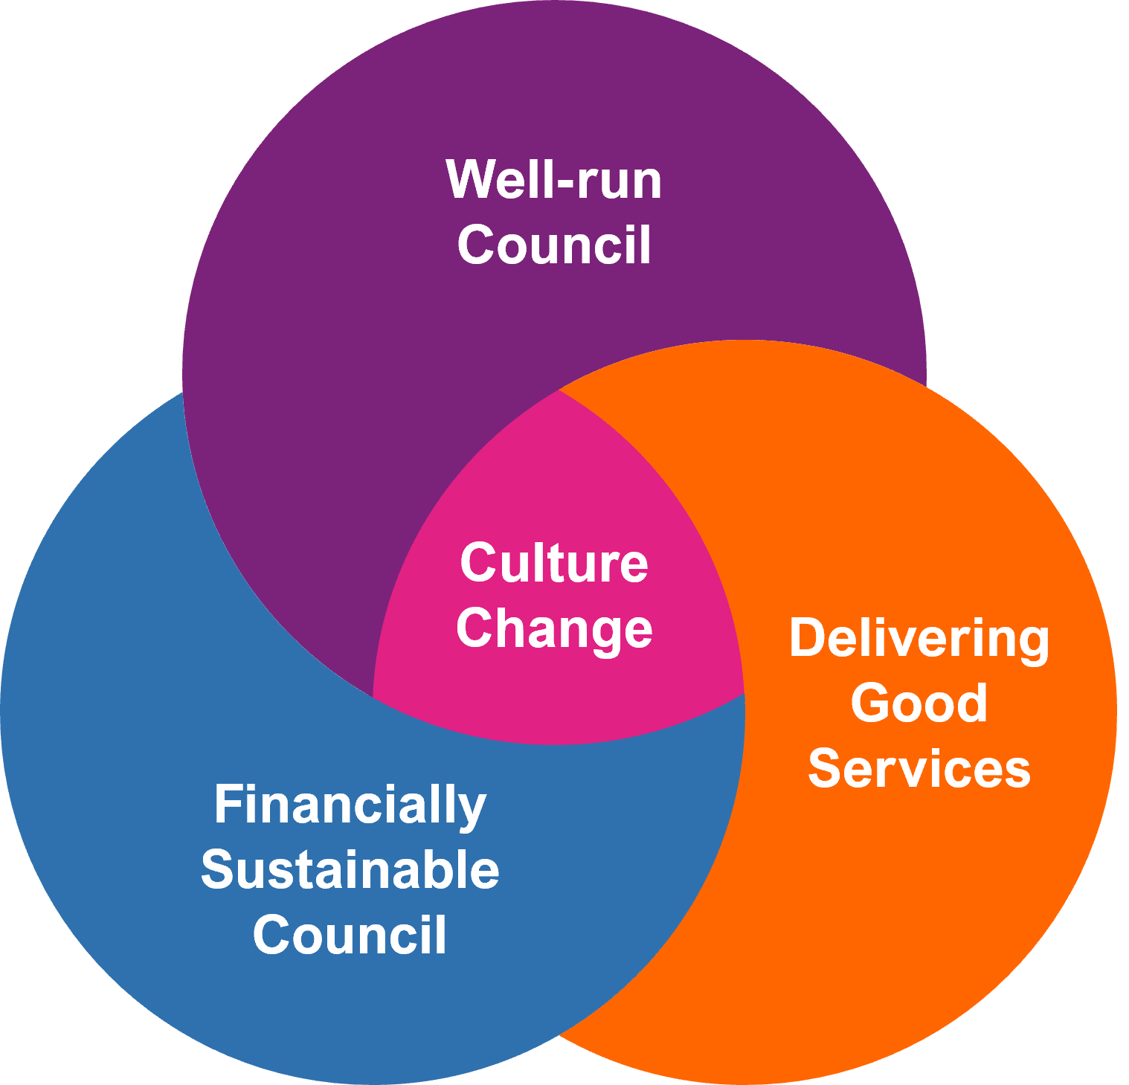
Equal Pay Update
Alan Downton (Equal Pay Programme Lead)
13/02/2025

Slide 2
What our Equal Pay Programme is looking to achieve
We’re working towards a more positive workplace for all colleagues
Dealing with our Equal Pay settlement will be an important milestone
Equal Pay Programme:
- Job Evaluations
- Reshaping our Pay and Grading structure

Slide 3
Job evaluation for Phase 1 (benchmark roles)
Employee & Manager Briefing Sessions
Job Description Review
Job Description Questionnaire Workshop
Job Information Approved
Evaluation
Moderation
Phase 1 – Benchmark Roles
Completed 164 benchmark job evaluations, these roles cover 50% of BCC employees Benchmark roles are in place to ensure consistency of all future evaluations We’ve had valuable feedback from colleagues, managers and our Trade Union colleagues Continuously improving the process to make it more engaging for colleagues

Slide 4
Job evaluation in 2025
Phase 2 to 5 – All other roles within BCC, BCT and Acivico
Phased approach to completing all other roles over the next 12 months (c1600 roles) Based upon large number of job holders (e.g. 10+; 5+ ; > 5) Or that haven’t been evaluated for several years (over 10; 5; 3+ years) Managers and colleagues play an important role in making sure we do this right Positively working with our Trade Unions Job evaluation outcomes will be communicated once moderated and majority of phases completed All roles in the organisation have a current NJC job evaluation, we have not changed the methodology Job evaluation will continue once the programme has finished
Employee & Manager Briefing Sessions
Job Description Review
Job Description Questionnaire Workshop
Job Information Approved
Evaluation
Moderation

Slide 5
Pay and Grading – Reshaping for a Fairer Future
Pay & Grading Model
We are reshaping our Pay & Grading structure
  Model our pay structure and allocation of the existing spine points (within existing NJC salary scales)
  Review the number of grades
  Retain the existing NJC job evaluations
Consultation
Positive and collaborative discussions with our Trade Unions
  Pay & grading model options
  Maintaining existing Terms and conditions
  Simplified structure
  Create opportunities for earnings growth; invest in lowest paid employees and offer salary structure to attract external talent
Watch this space…….working towards April implementation

Slide 6
Pay and Grading – Reshaping for a Fairer Future
Keeping you updated:
Updates through DMTs and monthly news updates
Face to face meetings with frontline workers
New:
New BCC webpages dedicated to reshaped Pay & Grading – accessible to all
Short Videos – cutting through the jargon – quick messaging re Job Evaluation
Helpdesk to email any queries
For non-digital colleagues – new telephone Helpline
Briefing information for line managers
Individual letter and information Booklets for all colleagues

