Slide 1
Perspective Lite / Record of Visits - Schools
Steve Kay - Director, Schools and Employability
Lisa Smith – School Improvement, Strategic Development
Gillian Heath – Angel Solutions

Slide 2
Key aims
We will demonstrate how schools can:
  download and respond to visit reports
  securely send and receive files and documents
  use interactive data reports and real-time data dashboards, before the DFE statistical first release
  turn census data into instant shareable infographics, with just one click
  access all the latest information on Ofsted and its Inspectors
  how to pick up key announcements, manage users and access the Help Centre
  reminder of all the key information already available on Perspective.
Notes:
Bham

Slide 3
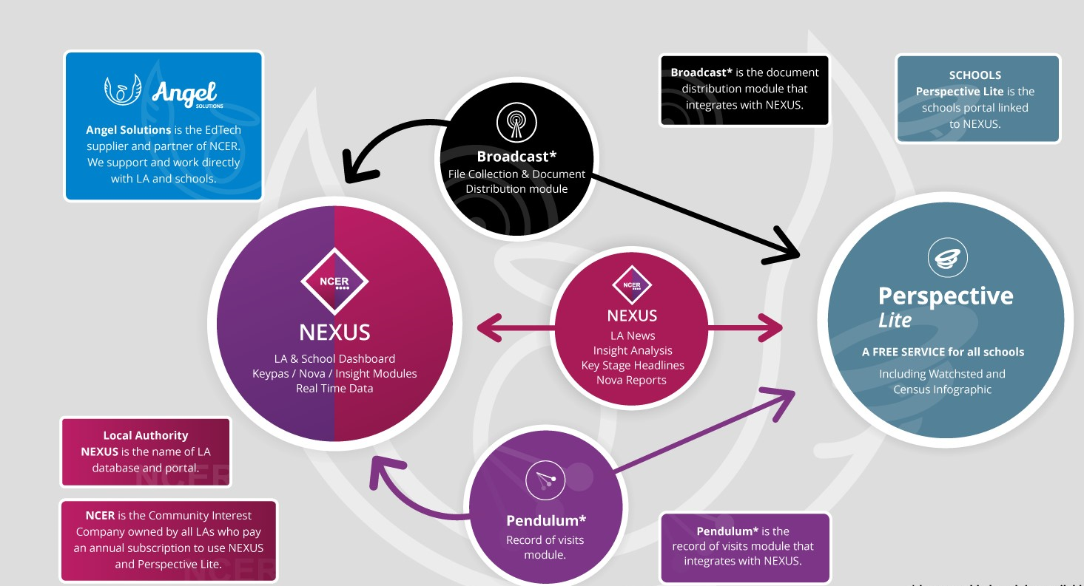
Perspective Lite
Notes:
Gillian

Slide 4
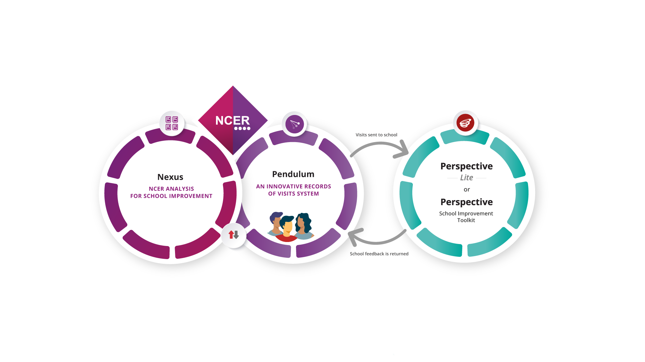



Pendulum
Transform the way you work
Notes:
Gillian

Slide 5




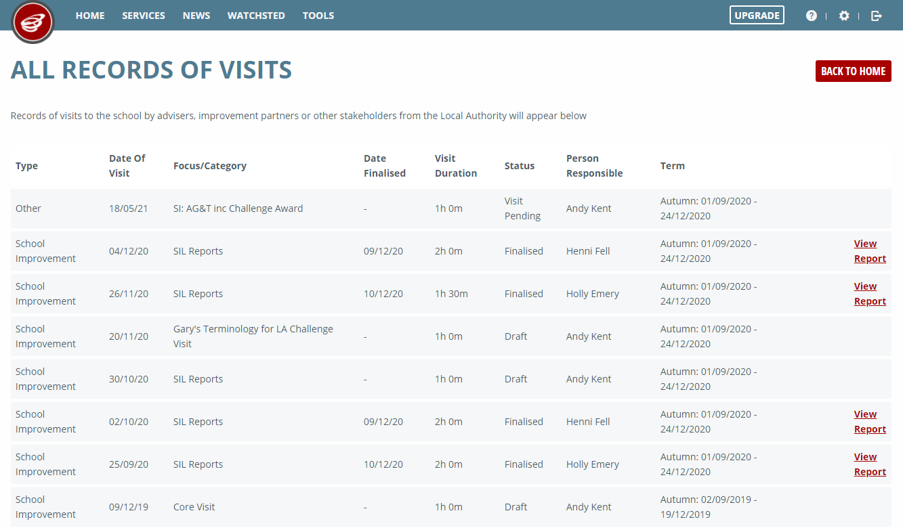



Schools: Stay Connected
Perspective Lite
Integration
See same visit history and reports as LA
Schools can provide feedback as part of
Q&A process
Secure access from any location
Weekly email digest
Email alerts when reports are completed
Schools can choose who can access the visit reports
Transform the way you work
Notes:
Gillian and demo to follow

Slide 6
Perspective - School Census and Data Quality
Within LA documents section, folders ‘Census’ and ‘Data Validation’ will be where your school's reports/data will be posted, this includes:
        School Census Letter which includes DfE guidance
        School Census Errors reports
        Data quality Error reports (i.e. Addresses, dates of birth or UPNs)
Currently, School Census team working on Autumn School Census and will be uploading reports, please review and respond to the team.
Any queries regarding School Census data or Data Validations reports e-mail SchoolCensus@birmingham.gov.uk
Notes:
SA

Slide 7
Perspective - Attainment
Within LA documents section, folders for each key stage is where your school will be sent reports/data to be checked, this will include:
        EYFS, Phonics and optional KS1 summaries and pupil lists (important to be checked for statutory collections)
        Summary Attainment reports
        Absence and Exclusion summaries
        Pupil Premium Listings
Current updates for Primary schools include a summary dashboard and detailed performance report. Note, reports can change and read Perspective news bulletins.
Any queries regarding access, attainment data or reports e-mail educationdata@birmingham.gov.uk
Notes:
SA

Slide 8
School User Protocol
A guidance and instruction document for schools, college and maintained nursery schools.
It set out key protocols around system access and security, quality assurance, data sharing and reporting, compliance monitoring and incident management.
It sets out how services within the directorate will be using the system with schools, colleges and our maintained nursery schools. How the children and families directorate will record in pendulum.
It has support information for school users including account and user set up, actions and workflow, as well as training, support and key contact information

Slide 9
Children and Families Directorate - Planned Service Onboarding
 | Go live Phase Cohorts
 | Phase 1 Sept – Dec ‘24 | Phase 2: Jan – April ‘25 | Phase 3: April – Aug ‘25
 | Schools and settings | Strategic Governance | HR
 | BEP | Transport | Occupational Therapy
 | Finance | SENAR | SEND Commissioning
 | Virtual School | Admissions | Youth Service
 | School Improvement Team | Ed Psychology | Employment & Skills
 | Governor Services | Pupil & School Support
 | Early Years and Childcare | Communication & Autism
 | Education Safeguarding | Early Years Inclusion
 | Business Support | Careers
 | Elective Home Education
 | Children and Families Directors
 | Data and Performance Team
 | Education Infrastructure & Capital Projects

Slide 10
Records of Visit - Planned Use Phase 1 - Autumn Term
Phase 1 Sept – Dec ‘24 | Summary of planned use
BEP | For key to Success reports to be uploaded for Autumn term 2024 via Jaswinder Didially and the School Improvement Team For all DLP consortia and network DLP meetings as record of actions and summary of discussion.
Children and Families Directors | Notes from school visits
Data and Performance Team | Attainment data for the school Attendance data trends Suspension data trends
Early Years and Childcare | The team will continue to use Impulse for all records of contact and visit with all Early Year settings. They will log an ‘other visit’ for maintained nursery schools for LA staff only citing the impulse nexus record. Visits will be

Slide 11
Cont..
Phase 1 Sept – Dec ‘24 | Summary of planned use
Education Infrastructure & Capital Projects | Will be recording the following: Phone calls regarding pupil places and admission numbers Capital team phone calls and site visit issues discussion, including agreed next steps or progress updates Property Management phone calls relating to 3rd party usage on-site/appropriate arrangements Property Management phone calls and site visits on Academy conversion matters Property Management phone calls on school organisation proposals
Finance | Correspondence and letters with schools with a deficit budget Submitted and agreed action plans for schools in deficit budgets will be saved in the shared document area
School Admissions and Fair Access Service | Recording advice, guidance or direction emails related to school admissions Recording advice, guidance or correspondence related to fair access and sharing panels.

Slide 12
Cont..
Phase 1 Sept – Dec ‘24 | Summary of planned use
School and Governor Services | Will be recording the following: Advice, guidance and actions regarding parental complaints Emails from school regarding unform policy revision External reviews of governance and desk top analysis Full Governing Body training attendance and share resources via the documents area Notes from any Parental meeting Notes from new Headteacher visits Notes/minutes/actions from all Interim Education and Project Boards Emails for key updates direct to Headteachers and Chair of Governors
School Improvement Team | Will be recording the following: Records of school visits for Key to Success Schools Notes/minutes/actions from all Interim Education and Project Boards Notes from new Headteacher visits Attendance at training commissioned from BEP and share resources via the documents area Records of school visits general Advice, guidance and actions regarding phone call and emails to school improvement team
Virtual School | To record advice and guidance emails to DTs and DSLs on suspensions, admissions, transitions, attendance, additional funding and PEP quality To record all visits to schools with DT and /or DSL. To record training attendance for DTs and share resources via the documents area Emails for key updates direct to DSLs and DTs

