Slide 1
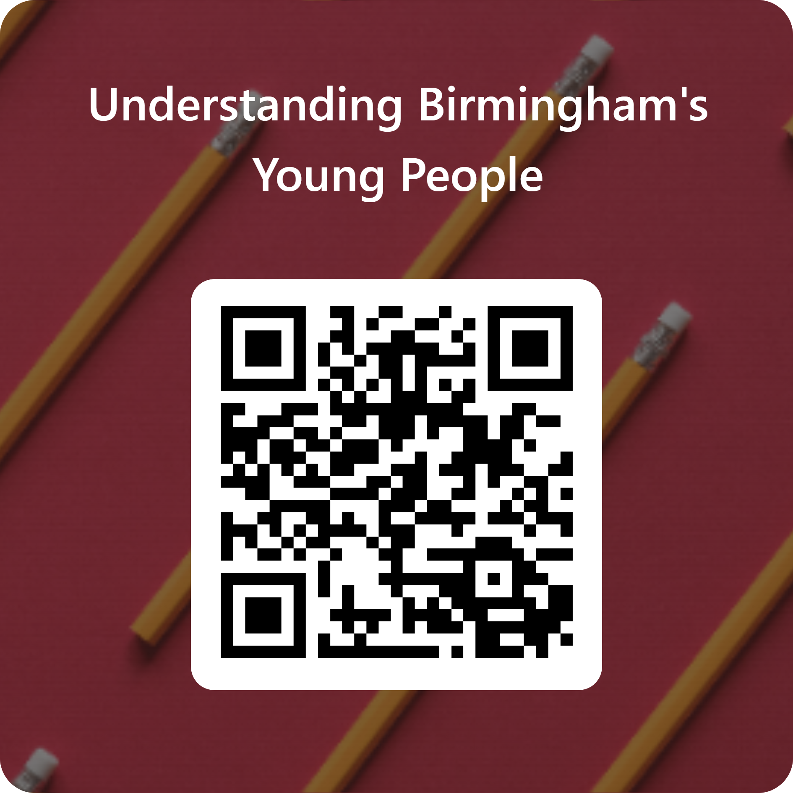
Understanding Your Priorities | Overview
WHAT ARE WE DOING?
WHAT DOES IT INVOLVE?
We have an opportunity for young people in Birmingham to help shape the future of support they receive in the city.
SUPPORTING YOUNG PEOPLE TO THRIVE
One of our top priorities is to support young people to thrive in our city and achieve their full potential. This is something we are very passionate about and we want to do this in the best and most informed way possible.
FOCUSING ON WHAT IS IMPORTANT TO YOU
To do this, we need your feedback and opinions on what you value most and what is most important to you as you grow up in Birmingham.
To help us shape the future of support for young people in Birmingham, we would appreciate it if you could take 5 minutes to fill in this survey. The survey covers three key questions:
As a young person, what do you care about most?
How do you feel about the support you are currently getting?
Do you know where to go for help and support?
If you do not feel comfortable answering a question, there is the option to skip it and move on to the next.
All survey responses will be anonymous. This means we cannot see your individual responses.
You can scan the QR code below or use the link to access the survey.
https://forms.office.com/e/2KtqKChwia
WHY DO WE NEED YOUR HELP?
Tailored Services Your feedback will help us focus on what is most impactful and relevant to your needs.
Community Impact You understand what affects well-being and the future of young people in your community.
Inclusive Approach We believe that the best approaches are shaped by those who use them.

Slide 2
Understanding Your Priorities | What does the survey involve?
Within this survey you will be asked three questions:
If you do not feel comfortable filling in a question, please feel free to leave it blank.
The questions focus on the following priorities which have been identified as things young people care about in previous research:
Education – “I can get educational support which meets my needs, including lesson support, or help with my schoolwork, homework, or college/university applications.”
Employment and job security – “I have the chance to learn key skills, gain work experience, get career advice and mentoring, and to apply for a job.”
Access to physical health services – “I can see a doctor or nurse when I need one.”
Access to mental health services – “I can access mental health support if I need it.”
Access to sexual health services – “I can access sexual health services and contraception if I need them.”
Safety – “I have a safe space to go to when I need it. I can get support away from home if things are difficult there.”
Social inclusion and non-discrimination – “I feel included as part of a community, without prejudice or discrimination. I can meet people like me. I can speak to an adult, or a role model, or someone I can trust.”
Social interaction – “I can spend time with others and build friendships and connections by getting involved in sports, music, learning skills, or other activities.”
As part of this exercise, you will get three sets of 10 coloured counters. You will use these to mark out your responses to the prompts below. You can split your counters in any way you like – you can use all ten on the same thing, or share them between a few things.
“As a young person, what are the things you care about most?”
“How do you feel about the support you are currently getting?”
“Do you know where you would go for help and support?”

