Slide 1
KEEPING CHILDREN SAFE IN EDUCATION Annual Safeguarding Training September 2025
Birmingham City Council Education Safeguarding Service

Slide 2
KCSIE Refresher & Updates 2025 Please note, at the time of issuing this presentation (2 July) the 2025 edition of Keeping Children Safe in Education has not yet been published

Slide 3
What changes to KSCIE might be coming?
1. Mandatory reporting of child sexual abuse
The Crime and Policing Bill includes a statutory duty for people working in regulated activity to report known or suspected sexual abuse. This would be a significant change in safeguarding culture and procedure, and we would expect KCSIE to reflect it across Parts 1, 2 and 4.
If this becomes law, schools will need to review:
how staff are trained to recognise and report concerns
how leaders record, triage and act on those concerns
how this new duty interacts with existing LADO and allegations procedures.

Slide 4
What changes to KSCIE might be coming? (2)
2. Increased references to AI and digital safeguarding
The same Bill also tackles emerging risks from AI-generated child abuse imagery and online exploitation. If included in KCSIE, it is likely to appear in safeguarding risks, staff training content and the wider online safety curriculum.
3. Stronger multi-agency requirements and local oversight
The Children’s Wellbeing and Schools Bill could bring in clearer expectations around:
schools' roles in multi-agency safeguarding arrangements
child protection teams and local decision-making
registers of children not in school
It also links to wider changes around data sharing, elective home education and early help — any of which may need reflecting in school policies or procedures.

Slide 5
What changes to KSCIE might be coming? (3)
Potential shift in the DSL role
The 2024 Call for Evidence flagged concerns about the scale and complexity of the DSL role. While no concrete proposals have been shared, it is possible that:
the scope or structure of the role could change
greater emphasis might be placed on shared safeguarding leadership
workload, governance or training requirements may shift
Nothing is certain, but it is a space to watch.

Slide 6
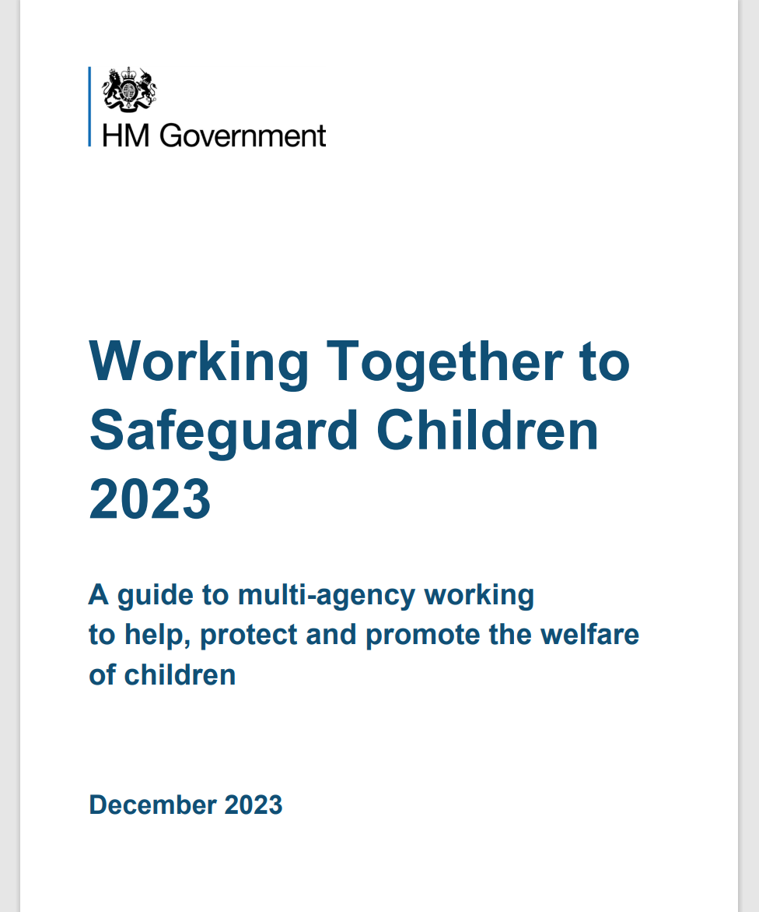
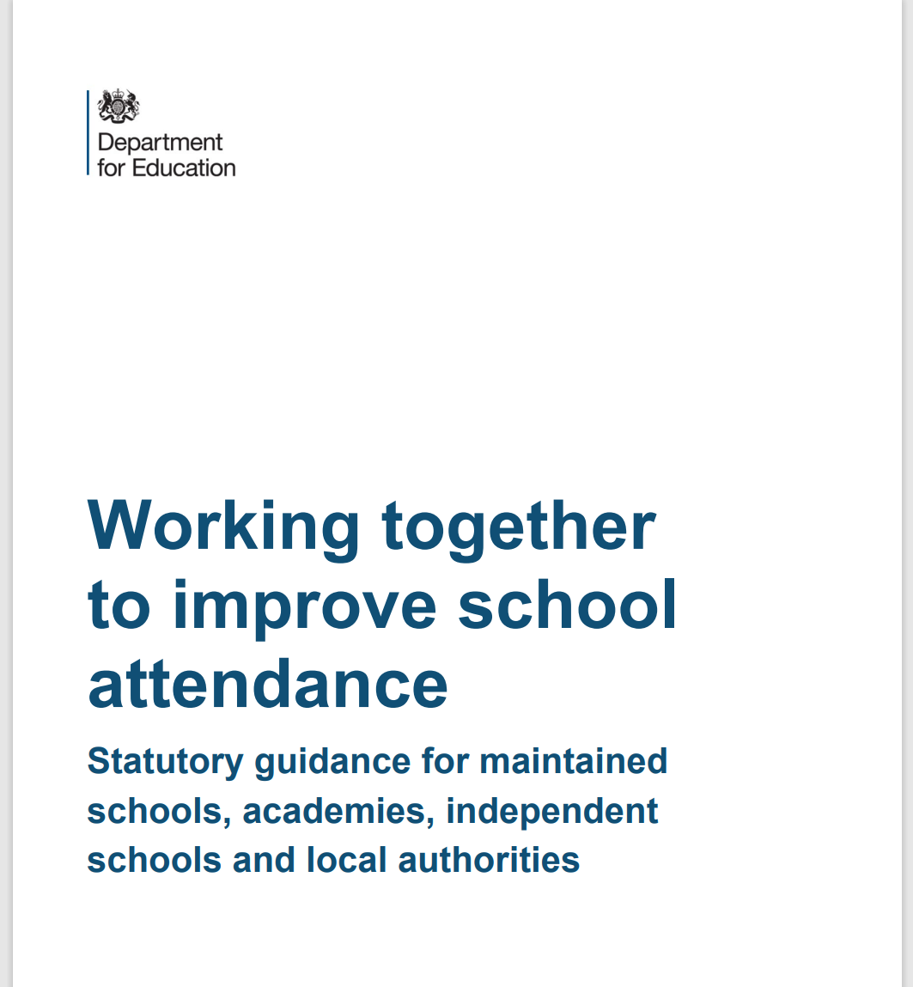
Essential Reading

Slide 7
KCSI 2024 - Part 1 Children includes everyone under 18
Reminder to all staff that “Children includes everyone under 18” (para 2) – it is important that older children are given the same level of consideration and assessment when considering their vulnerability and risk of suffering harm.
Professionals must be mindful that older children are not ‘adultified’ and assumed to be capable of caring for themselves or responsible when they do not appear to be coping or presenting in the expected ways. All children under 18, although developing independence remain the responsibility of their parents/carers.

Slide 8
KCSI 2024 - Part 1 Definition of safeguarding
“Providing help and support to meet the needs of children as soon as problems emerge…whether that is within or outside the home including online” (para 3).
The definition was expanded in recognition of the potential risks external to a child’s home environment and reinforcing the message that support should be provided as soon as problems are identified, promoting a strong culture of early help.

Slide 9
KCSI 2024 - Part 1 Prompts for Early Help
“Missing from education, home or care….experienced multiple suspensions, risk of permanent exclusion from school, college, Alternative Provision or Pupil Referral Unit.” (para 18).
The increased emphasis on this area reflects growing concern nationally around the increases in the use of suspension and the emphasis in Behaviour in Schools to ensure settings view these issues through a safeguarding lens at all times.

Slide 10
KCSI 2024 - Part 1 Exploitation as a type of harm
Inclusion of exploitation as a type of harm of which indicators staff need to be aware of (para 19)
Exploitation is recognised as a standalone and serious risk of harm to children and young people and therefore staff are required to understand what it is and the indicators that may be presented in children and young people’s behaviour, disclosures and relationships with peers, adults and the environment around them.
This links with the importance of not treating older children to be more mature and capable than they are and recognising that some of their presenting behaviours may be a result of exploitation rather than not engaging or misusing their independence.

Slide 11
KCSI 2024 - Part 1 Indicators of abuse and neglect
Indicators of abuse and neglect includes mention of the impact on children seeing, hearing or experiencing the effects of domestic abuse - In response to Section 2 of The Domestic Abuse Act 2021 (para 24).
It is important that staff recognise and understand that children are victims in their own right. Children within the same sibling groups may experience this abuse differently, impacting them in different ways and as such resulting in them having different needs.
Professionals should not automatically consider older children to be more resilient because they are not presenting with concerning behaviour or that a younger child is resilient because they have been exposed to less domestic abuse incidences.

Slide 12
KCSI 2024 - Part 1 Terminology
The term “deliberately missing education” is worded “unexplainable and/or persistent absences from education” (para 29).
This language ensures that such concerns are considered with a safeguarding lens, and children are not blamed for missing education.
This links further with the introduction of exploitation as one of the possible reasons for these absences and the need to consider any and all risk/influencing factors around a child that may be contributing to the absence

Slide 13
KCSI 2024 - Part 2 Oversight of APs
Emphasis on the need for schools to ensure they have oversight of APs – “Where a school places a pupil with an alternative provision provider, it continues to be responsible for the safeguarding of that pupil and should be satisfied that the placement meets the pupil’s needs” (para 171).
There has been an increased focus on the use of alternative provisions during inspections and as such it is important that where schools use this pathways for children, they ensure that such provision is suitable both for their education but also a child’s wellbeing. The child remains the responsibility of the school whilst they attend an AP.

Slide 14
KCSI 2024 - Part 2 Elective Home Education (EHE)
Reframed tone when describing Elective Home Education (EHE) – removal of “overwhelmingly” positive with introduction of the need to recognise that as well as being less visible some children are “not in receipt of suitable education” (page 179).
There has been an increase nationally in the number of children whom parents have decided to EHE. Whilst such provision of education is suitable for many children enabling them to thrive and learn, this change in language highlights the fact that professionals need to be aware and recognise that when a child is EHE they are less visible which can increase vulnerability and impact on the suitability of the education they receive.
The National Safeguarding Practice Panel published a report, Safeguarding Children in Elective Home Education (2024) on the area of EHE and identified areas of learning from cases which featured this style of educational provision.

Slide 15
KCSI 2024 - Part 2 Gender Questioning
Three paragraphs (206-208) were added to the retitled section on children who are lesbian, gay, bisexual or gender questioning. The term ‘bi’ is replaced with ‘bisexual’ and the term ‘trans’ has been removed from KCSIE which flags this section “remains under review, pending the outcome of the gender questioning children guidance consultation” which closed in December 2023. The results of the consultation and the DfE's response will be published on GOV.UK in 2025.
When supporting a gender questioning child, schools should take a cautious approach and consider the broad range of their individual needs, in partnership with the child’s parents (other than in the exceptionally rare circumstances where involving parents would constitute a significant risk of harm to the child), including any clinical advice that is available and how to address wider vulnerabilities such as the risk of bullying.

Slide 16
KCSI 2024 - Part 2 Terminology
“Provide a safe space” described as “create a culture” where children are able to speak and share their concerns with staff.
This seeks to raise awareness of the importance that there should be a whole school culture which promotes safety and welcomes children to be comfortable to share and disclose any information which may be worrying them.
It is important that when staff have any concerns about child-on-child abuse they should speak to their DSL.

Slide 17
KCSIE 2024
The definition of child criminal exploitation (CCE) and child sexual exploitation states (CSE) 'may involve an exchange for something the victim wants, and/or for the financial advantage or increased status of the perpetrator or facilitator’ (para 34).

Slide 18
Online Safety
The DSL should take lead responsibility for updates on Online Safety
Staff Safeguarding and Child Protection training should include an understanding of online safety
Reiteration that schools should follow the recently published DfE publication of filtering and monitoring standards and guidance
Governing bodies/proprietors strategic training should include an understanding of online safety and should review the standards with IT staff and service providers
Schools should consider meeting the Cyber security standards
The Safeguarding and Child Protection Policy should reflect the individual schools’ approach to online safety on school devices and networks

Slide 19
Online Safety
All staff should be aware of the dangers young people face online
Risks include:
Criminal and sexual exploitation
Online child on child abuse
Exposure to inappropriate adult content
Online grooming
Radicalisation
Sexting, up-skirting and sharing of indecent images

Slide 20
Consensual and non-consensual sharing of indecent images as part of child-on-child abuse
Your policy should include the school’s approach to dealing with consensual and non-consensual sharing of nude and semi-nude images and/or videos, known as sexting or youth produced sexual imagery.
DfE provides Searching Screening and Confiscation Advice for schools
UKCIS Education Group has published Sharing nudes and semi-nudes: advice for education settings working with children and young people which outlines how to respond to an incident of nude and/or semi nude being shared.

Slide 21
Responsibility of schools to support parents with online safety
Schools and colleges should use communications with parents and carers to reinforce the importance of children being safe online and should share information with parents/carers about:
What systems they have in place to filter and monitor online use
What they are asking children to do online, including any sites they will be asked to access
Who from the school or college their child is going to be interacting with online

Slide 22
Attendance
Improving attendance is crucial for pupils’ attainment, wellbeing, and life chances. Regular attendance is linked to higher academic achievement and reduced risk of extra-familial harms.
Schools should develop a culture promoting high attendance, have clear policies, accurately complete registers and build strong relationships with families to address barriers.
Schools should regularly analyse attendance data to identify trends and areas for improvement.
The DfE published new guidance on improving school attendance which came into force from August 2024.

Slide 23
Equality Act
Confirmation that provisions within the Equality Act allow schools to take positive action, where it can be shown that it is proportionate, to deal with particular disadvantages affecting pupils or students with certain protected characteristics in order to meet their specific need.
A school could, for example, consider taking positive action to support girls if there was evidence they were being disproportionately subjected to sexual violence or sexual harassment.
There is also a duty to make reasonable adjustments for disabled children and young people.

Slide 24
Equality Act Protected Characteristics
Age
Gender reassignment
Being married or in a civil partnership
Being pregnant or on maternity leave
Disability
Race including colour, nationality, ethnic or national origin
Religion or belief
Sex
Sexual orientation

Slide 25
Safer Recruitment
Schools should inform shortlisted candidates that online searches may be done as part of due diligence checks.
Copies of documents used to verify the successful candidate’s identity, right to work and required qualifications should be kept on their personnel file.
Applicants will undergo strict vetting procedures.
Necessary pre-employment checks must be carried out.
Staff members should receive appropriate training to undertake their duties.

Slide 26
Use of School Premises for Non-School Activities
Clarity around safeguarding arrangements that schools should expect providers [hirers] to have in place, see Keeping children safe in out of school settings.
Schools should follow the Birmingham No Platform policy.
Schools may receive an allegation relating to an incident that happened when an individual or organisation was using their school premises for the purposes of running activities for children, e.g., community groups, sports associations or service providers that run extra-curricular activities.
As with any safeguarding allegation, schools should follow their safeguarding policies and procedures, including informing the LADO.

Slide 27
Safeguarding and Promoting the Welfare of all Children
All staff have responsibility to provide a safe environment in which children can learn.
All staff should be prepared to identify children who may benefit from early help.
Any staff member who has any concerns about a child’s welfare should follow the safeguarding procedures within their setting.
Staff should expect to support social workers and other agencies following any referral.
Every school and college should have a Designated Safeguarding Lead who will provide support to staff to carry out their safeguarding duties and who will liaise closely with other services such as the local authority children’s social care.

Slide 28
Staff Safeguarding Responsibilities
All staff should be aware of the systems within their school which support safeguarding, including:
Insert name of filtering and monitoring system used
Child Protection Policy
Behaviour Policy
Staff Behaviour Policy or Code of Conduct

Slide 29
Staff Safeguarding Responsibilities
Always maintain an attitude of “it could happen here”
Always act within the best interests of the child.
Always act immediately on any concerns about a child’s welfare.

Slide 30
Allegations and Whisteblowing
If staff have a concern or an allegation about another member of staff, this should be reported to the headteacher, head of school or principal.
If there is a concern or allegation about the headteacher, head of school or principal, this should be reported to the chair of governors or chair of committee.

Slide 31
Designated Safeguarding Leads
Please insert names of staff members with DSL and safeguarding responsibilities as well as other key staff – i.e. Safeguarding Governor, SENCO etc.

Slide 32
Safeguarding Context
You may wish to provide a contextual picture of what safeguarding looks like in your school.
Issues covered may include mental health, neglect, youth violence/gang culture, criminal/sexual exploitation etc.

Slide 33
School Safeguarding Data
You may wish to include some school data in relation to your setting’s safeguarding/recording etc.

Slide 34
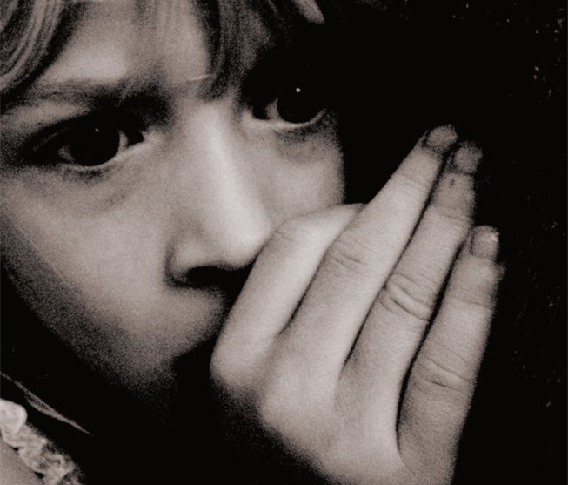
Disclosures
Children may not feel ready, or know how to tell someone what they are experiencing:
They may feel it’s their fault
They will get into trouble
Nobody will believe them
Nobody can stop it
Things will get worse
People they love will be hurt if they tell
They told before and nobody listened
They will be taken into care
They believe that this is what happens in families
They feel ashamed

Slide 35
Safeguarding Concerns
All staff should have an awareness of safeguarding issues that can put children at risk of harm, including:
Child on child abuse
Domestic abuse
Serious Youth Violence
Child Sexual Exploitation (CSE)
Child Criminal Exploitation (CCE)
Online Safety
Mental Health
FGM
Neglect
Prevent
Physical, Sexual and Emotional abuse
All staff should know how to report and record concerns.

Slide 36
Child on Child Abuse
It is essential that all staff understand the importance of challenging inappropriate behaviours between children, that are abusive in nature.
Downplaying certain behaviours, for example dismissing sexual harassment as “just banter”, “just having a laugh”, “part of growing up” or “boys being boys” can lead to a culture of unacceptable behaviours, an unsafe environment for children and in worst case scenarios a culture that normalises abuse leading to children accepting it as normal and not coming forward to report it.

Slide 37
Children who identify as LGBTQ+ or Gender Questioning
The fact that a child or a young person may be LGBTQ+ is not in itself an inherent risk factor for harm. However, children can be targeted by other children. In some cases, a child who is perceived by other children to be LGBTQ+ (whether they are or not) can be just as vulnerable as children who identify as LGBTQ+.
‘Schools and colleges should be respectful and tolerant places where bullying is never tolerated. Staff and children should treat each other with compassion and consideration, in accordance with the ethos of the school or college’. (Gender Questioning Children draft guidance 2023).

Slide 38
Domestic Abuse
Important to recognise that domestic abuse:
can be psychological, physical, sexual, financial, or emotional
can impact on children through seeing, hearing or experiencing the effects of domestic abuse and/or experiencing it through their own intimate relationships (teenage relationship abuse)
can encompass a wide range of behaviours and may be a single incident or a pattern of incidents
All of these can have a detrimental and long-term impact on children’s health, well-being, development, and ability to learn.
Nationally, the police receive a domestic abuse call on average every 30 seconds. 2 women a week are killed by a current or former partner. In Birmingham there were 56 Domestic Homicide Reviews from April 2011 to March 2024.

Slide 39
Birmingham Domestic Abuse Prevention Strategy 2024 - 2029
As part of the new citywide Domestic Abuse and Prevention Strategy schools must:
Respond swiftly to concerns in line with safeguarding procedures.
Seek advice and guidance from CASS where needed.
Identify a key adult to complete Operation Encompass training.
Work in conjunction with Operation Encompass Education Lead.
Follow up with discreet monitoring of child and family by DSLs and key staff.
Do not discuss directly.
Birmingham Domestic Abuse Strategy BCSP
Operation Encompass

Slide 40
Serious Youth Violence
All staff should be aware of indicators, which may signal that children are at risk from, or are involved with serious violent crime. These may include:
increased absence from school
a change in friendships or relationships with older individuals or groups
a significant decline in performance
signs of self-harm or a significant change in well-being
signs of assault or unexplained injuries
unexplained gifts or new possessions
All staff should be aware of the associated risks and understand the measures in place to manage these.
For further advice:
Criminal exploitation of children and vulnerable adults: county lines - GOV.UK (www.gov.uk)

Slide 41
Child Criminal and Sexual Exploitation
Both CCE and CSE are forms of abuse that occur where an individual or group takes advantage of an… imbalance in power to coerce, manipulate or deceive a child into taking part in sexual or criminal activity, in exchange for something the victim needs or wants, and/or for the financial advantage or increased status of the perpetrator or… facilitator and/or through violence or the threat of violence.
CCE and CSE can affect children, both male and female and can include children who have been moved (commonly referred to as trafficking) for the purpose of exploitation.
Stages of Exploitation video

Slide 42
County Lines
County Lines refers to a form of criminal exploitation where gangs and organised criminal networks transport illegal drugs across the country.
Exploitation
Vulnerable children are at a higher risk of being exploited. They may be coerced into distributing drugs or moving money to avoid detection.

Slide 43
Child Criminal Exploitation and County Lines
It is important to note that the experience of girls who are criminally exploited can be very different to that of boys. The indicators may not be the same, and professionals should be aware that girls are at risk of criminal exploitation too.
It is also important to note that both boys and girls being criminally exploited may be at higher risk of sexual exploitation.

Slide 44
Neglect
Neglect is the ongoing failure of a parent or carer to meet the basic physical, emotional, educational and medical needs of their children. This means that children who are experiencing neglect don’t regularly get all of the essential things they need to keep them happy, healthy and safe and well.
Neglect is the most common form of child abuse and the most common reason for a child to be subject to a Child Protection plan.
Neglect can have a significant and long-lasting impact on children. It is better to respond to neglect at an early stage.

Slide 45
Neglect Strategy and Graded Profile
What is Graded Care Profile 2 (GCP2)?
GCP2 is a licensed assessment tool from NSPCC
GCP2 can support professionals working with children and families to measure the quality of care provided to a child
The tool evaluates the quality of physical and emotional care provided to children by using a scale of 1 (best) to 5 (worst) in different areas of physical and emotional care such as nutrition, hygiene, safety, and supervision
This can be used by one or more agencies working with the family and will help focus and inform intervention plans
Tackling Neglect in Birmingham: A Strategy for Children and Young People 2022-2026
How to Spot Neglect (NSPCC video)

Slide 46
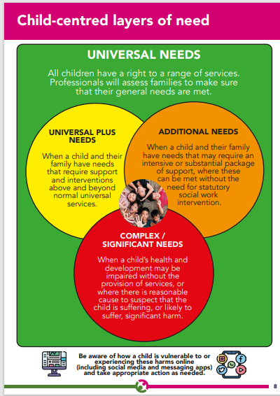
Right Help Right Time 2025
Requests for support are deemed by thresholds. These thresholds determine who is the most appropriate agency to respond to the needs of a family. Schools and other organisations can seek support for children and families through Locality Hubs in every district. These provide access to much needed services and funds for vulnerable families within our community.

Slide 47
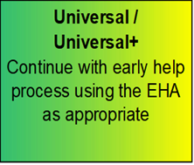
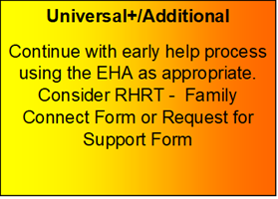
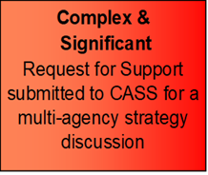
Right Help Right Time RHRT
Right Help Right Time Guidance 2025
Locality Leads
CONCERNED ABOUT A CHILD Speak to Safeguarding Leads (DSL) if urgent. Record on electronic recording system. Use RHRT Thresholds to determine next actions.
At any point schools can seek advice and guidance from Children’s Advice Support Service 01213031888. In the event of an emergency call police on 999.

Slide 48
Children’s Advice and Support Service (CASS) Telephone: 0121 303 1888
This is the central referral point for the Birmingham Multi-Agency Safeguarding Hub. Professionals that sit within the hub include Health, Birmingham Children’s Trust and Police.
Early Help requests are accessed via an online form known as the Family Connect Form
Family Support and Children’s Services support is accessed via a Request for Support Form
Support for Criminal Exploitation and Sexual Exploitation is accessed via a Screening Tool submitted the EMPOWERU Exploitation Hub
Support for FGM is accessed via a screening tool to CASS
Support for concerns around radicalisation are accessed via a screening tool to the PREVENT Team via CASS

Slide 49
Useful Resources
Barnardos Exploitation
Children's Safeguarding Partnership child-exploitation
Defining Child Criminal Exploitation
St Giles vulnerabilities-to-child-criminal-exploitation
NSPCC
Birmingham Early Help Locality Leads
EMPOWERU Referral Process
Domestic Abuse Act 2021 factsheet
Birmingham neglect Strategy 2022-2026
Forced marriage - GOV.UK (www.gov.uk)

Slide 50
Contact Us
Educationsafeguarding@birmingham.gov.uk
CASSEducation@birmingham.gov.uk
OpEncompassBham@birmingham.gov.uk

Slide 51
Social media final slide

