Slide 1
KEEPING CHILDREN SAFE IN EDUCATION UPDATES & Annual Safeguarding Training September 2024
Birmingham City Council Education Safeguarding Team

Slide 2
Updates to KCSIE 2024

Slide 3
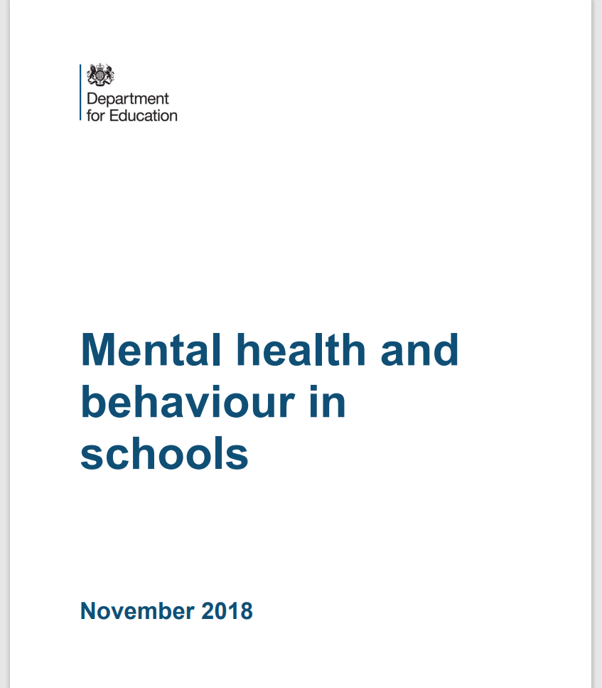
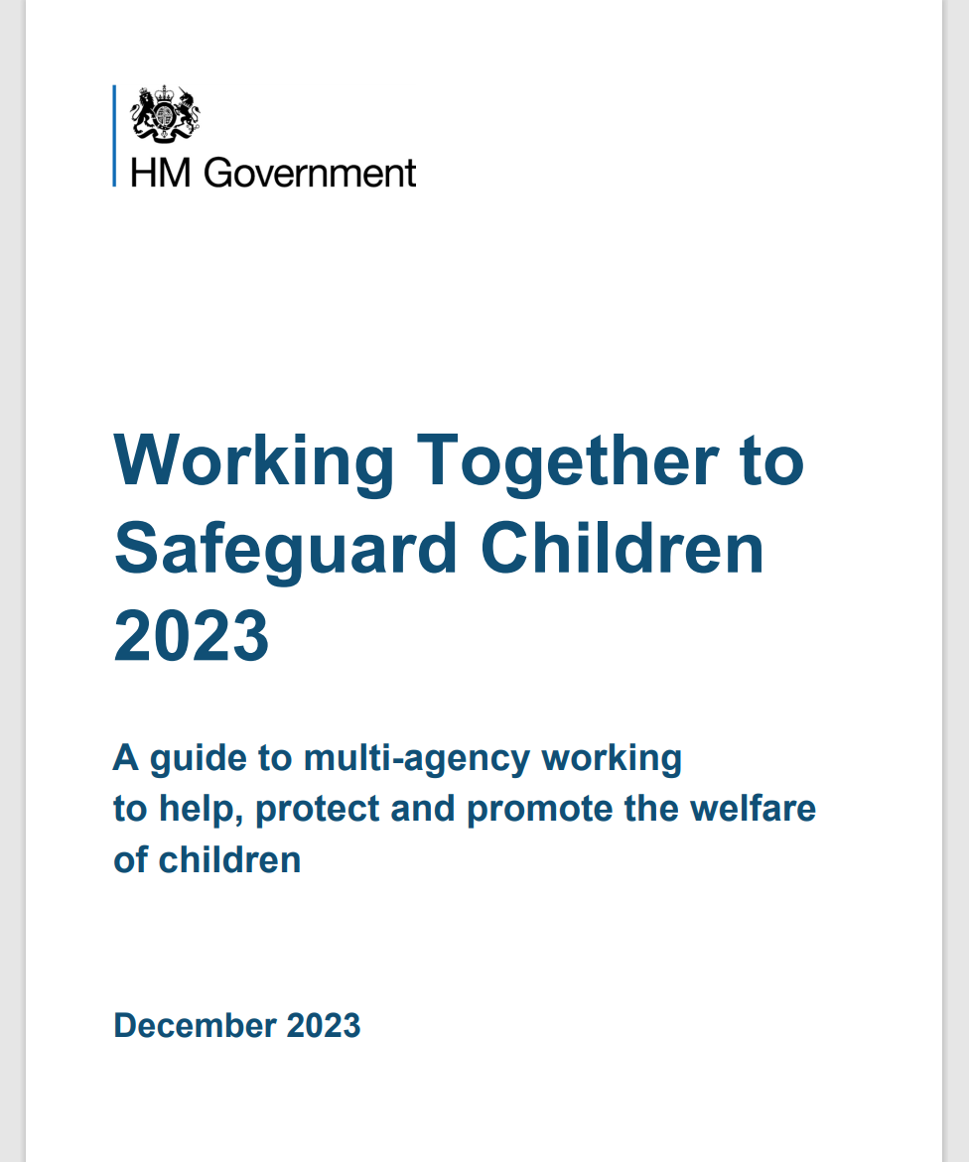
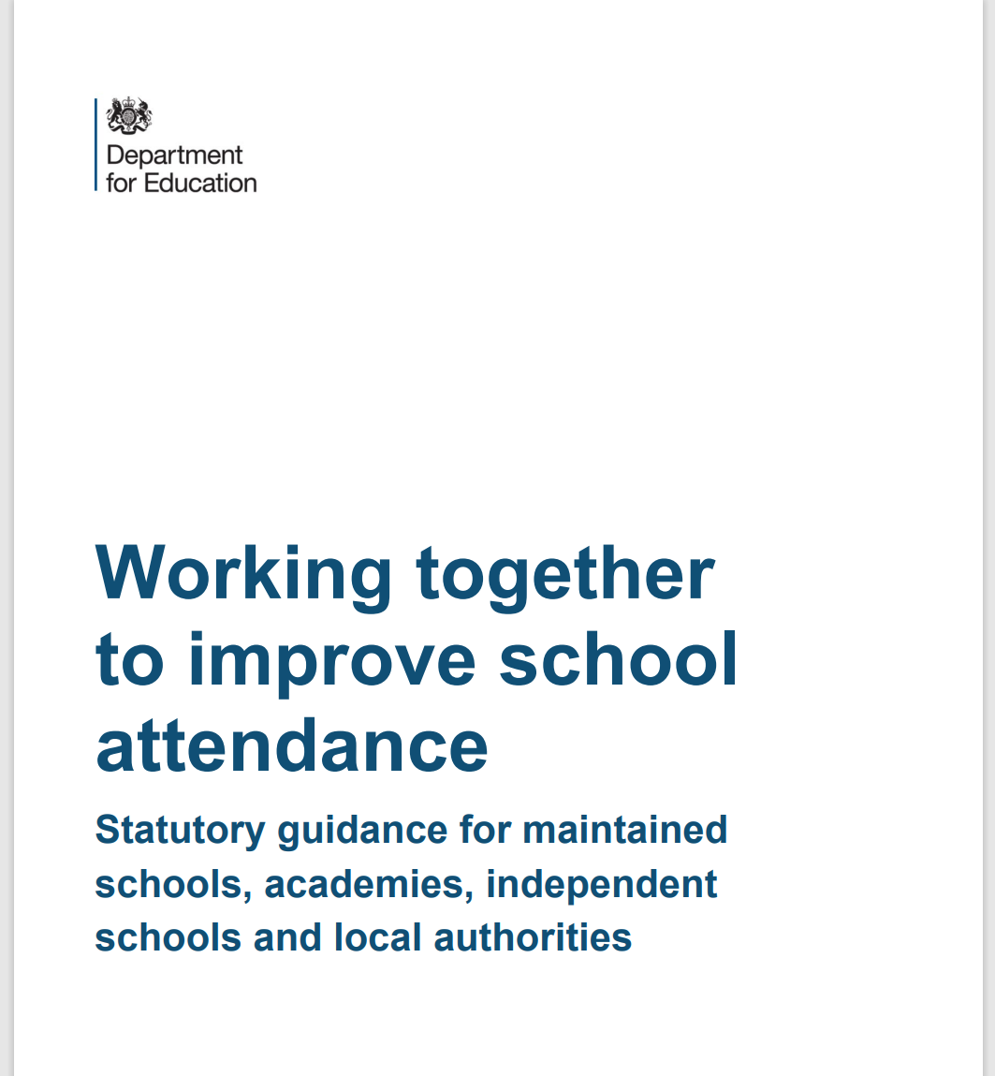
Essential Reading

Slide 4
Guidance Terms
“Must”
Indicates a legal requirement that staff are obligated to follow.
“Should”
Suggests that the advice should be followed unless there is a good reason not to.

Slide 5
KCSIE 2024 Part 1 updates
KCSIE 2024:
now in line with ‘Working Together to Safeguard Children 2023’
Updated safeguarding definition
Providing help and support to meet the needs of children as soon as problems emerge
Protecting children from maltreatment, whether that is within or outside the home, including online (known as extra-familial harm)
Preventing the impairment of children’s mental and physical health or development
Making sure that children grow up in circumstances consistent with the provision of safe and effective care
Taking action to enable all children to have the best outcomes

Slide 6
KCSIE 2024 New wording and changes to terminology.
When referring to ‘abuse and neglect’, the guidance now also includes ‘exploitation’ throughout.
The definition of abuse now also has 'including where they see, hear or experience its effects' in relation to domestic abuse (paragraph 24).
‘Unexplainable and/or persistent absences from education’ has replaced the phrase 'deliberately missing education’ when referring to safeguarding issues (paragraph 29).
'It is important that when staff have any concerns about child-on-child abuse they should speak to their DSL' – this has replaced '... if they have concerns ...' (paragraph 31).

Slide 7
KCSIE 2024 New wording and changes to terminology.
The definition of child criminal exploitation and child sexual exploitation now says CCE and CSE 'may involve an exchange for something the victim wants, and/or for the financial advantage or increased status of the perpetrator or facilitator'. Previously the definition didn't include the word 'may' (paragraph 34)
Additional paragraph on alternative provision that clarifies school’s responsibilities (paragraph 171)
Removed: information on plans for further guidance on sexual harassment and sexual violence.
KCSIE 2023 stated that further guidance on teaching relationships education specifically to prevent sexual harassment and sexual violence would be published. This has been removed (paragraph 132 of KCSIE 2023)

Slide 8
KCSIE 2024 New wording and changes to terminology.
Updated wording in section on elective home education (EHE)
It now says that:
Elective home education can mean that some children are not in receipt of suitable education
Many home educated children have a 'positive learning experience' (previously it said 'overwhelmingly positive learning experience')
paragraph 179.

Slide 9
KCSIE 2024
Updated Early Help Indicators
Pupils experiencing multiple suspensions or at risk of permanent exclusion. Including those in Alternative Provision and Pupil referral Units.
Pupils with a parent or carer in custody.
Pupils frequently missing from education, home or care.
Paragraph 18

Slide 10
KCSIE 2024 Part 2 updates
Gender Questioning
The phrase ‘gender questioning’ has replaced the word ‘trans’.
Children questioning their gender may have wider vulnerabilities i.e. complex mental health and/or psychological needs, ASD and/or ADHD.
Schools should take a cautious approach to support a child questioning their gender.
Schools should ‘provide a safe space’ has been changed to ‘create a culture’ where pupils can speak out or share any concerns with staff.

Slide 11
KCSIE 2024 Part 2 updates.
Alternative Provision
If a school places a child in alternative provision, the school continues to be responsible for safeguarding the pupil. Schools should ensure the placement meets the pupils needs.

Slide 12
KCSIE 2024 Part 5 updates
Updated Early Help Definition
Support for children of all ages that improves a family’s resilience or reduces the chance of a problem getting worse.

Slide 13
Online Safety
The DSL should take lead responsibility for updates on Online Safety
Staff Safeguarding and Child Protection training should include an understanding of online safety
Reiteration that schools should follow the recently published DfE publication of filtering and monitoring standards and guidance
Governing bodies/proprietors strategic training should include an understanding of online safety and should review the standards with IT staff and service providers
Schools should consider meeting the Cyber security standards
The Safeguarding and Child Protection Policy should reflect the individual schools’ approach to online safety on school devices and networks

Slide 14
Online Safety.
All staff should be aware of the dangers young people face online
Risks include:
Criminal and sexual exploitation
Online child on child abuse
Exposure to inappropriate adult content
Online grooming
Radicalisation
Sexting, up-skirting and sharing of indecent images

Slide 15
Consensual and non-consensual sharing of indecent images as part of child on child abuse
Your policy should include the school’s approach to dealing with consensual and non-consensual sharing of nude and semi-nude images and/or videos, known as sexting or youth produced sexual imagery.
DfE provides Searching Screening and Confiscation Advice for schools.
UKCIS Education Group has published Sharing nudes and semi-nudes: advice for education settings working with children and young people which outlines how to respond to an incident of nude and/or semi nude being shared.

Slide 16
Responsibility of schools to support parents with online safety
Schools and colleges should use communications with parents and carers to reinforce the importance of children being safe online and should share information with parents/carers about:
What systems they have in place to filter and monitor online use
What they are asking children to do online, including any sites they will be asked to access
Who from the school or college their child is going to be interacting with online

Slide 17
Attendance
Improving attendance is crucial for pupils’ attainment, wellbeing, and life chances. Regular attendance is linked to higher academic achievement and reduced risk of extra-familial harms.
Schools should develop a culture promoting high attendance, have clear policies, accurately complete registers and build strong relationships with families to address barriers.
Schools should regularly analyse attendance data to identify trends and areas for improvement.
The DfE published new guidance on improving school attendance which came into force from August 2024.

Slide 18
Equality Act
Confirmation that provisions within the Equality Act allow schools to take positive action, where it can be shown that it is proportionate, to deal with particular disadvantages affecting pupils or students with certain protected characteristics in order to meet their specific need.
A school could, for example, consider taking positive action to support girls if there was evidence they were being disproportionately subjected to sexual violence or sexual harassment.
There is also a duty to make reasonable adjustments for disabled children and young people.

Slide 19
Equality Act Protected Characteristics
age
gender reassignment
being married or in a civil partnership
being pregnant or on maternity leave
disability
race including colour, nationality, ethnic or national origin
religion or belief
sex
sexual orientation

Slide 20
Safer Recruitment
Schools should inform shortlisted candidates that online searches may be done as part of due diligence checks.
Copies of documents used to verify the successful candidate’s identity, right to work and required qualifications should be kept on their personnel file.
Applicants will undergo strict vetting procedures.
Necessary pre-employment checks must be carried out.
Staff members should receive appropriate training to undertake their duties.

Slide 21
Use of School Premises for Non-School Activities
Clarity around safeguarding arrangements that schools should expect providers [hirers] to have in place, see Keeping children safe in out of school settings.
Schools should follow the Birmingham No Platform policy.
Schools may receive an allegation relating to an incident that happened when an individual or organisation was using their school premises for the purposes of running activities for children, e.g., community groups, sports associations or service providers that run extra-curricular activities.
As with any safeguarding allegation, schools should follow their safeguarding policies and procedures, including informing the LADO.

Slide 22
Safeguarding and Promoting the Welfare of all Children
All staff have responsibility to provide a safe environment in which children can learn.
All staff should be prepared to identify children who may benefit from early help.
Any staff member who has any concerns about a child’s welfare should follow the safeguarding procedures within their setting.
Staff should expect to support social workers and other agencies following any referral.
Every school and college should have a designated safeguarding lead who will provide support to staff to carry out their safeguarding duties and who will liaise closely with other services such as local authority children’s social care.

Slide 23
Staff Safeguarding Responsibilities
All staff should be aware of the systems within their school which support safeguarding, including
Insert name of filtering and monitoring system used
Child Protection Policy
Behaviour Policy
Staff Behaviour Policy or Code of Conduct

Slide 24
Staff Safeguarding Responsibilities.
Always maintain an attitude of “it could happen here”
Always act within the best interests of the child.
Always act immediately on any concerns about a child’s welfare.

Slide 25
Allegations and Whisteblowing
If staff have a concern or an allegation about another member of staff, this should be reported to the headteacher, head of school or principal.
If there is a concern or allegation about the headteacher, head of school or principal, this should be reported to the chair of governors or chair of committee.

Slide 26
Designated Safeguarding Leads
Please insert names of staff members with DSL and safeguarding responsibilities as well as other key staff – i.e. Safeguarding Governor, SENCO etc.

Slide 27
Safeguarding Context
You may wish to provide a contextual picture of what safeguarding looks like in your school.
Issues covered may include mental health, neglect, youth violence/gang culture, criminal/sexual exploitation etc.

Slide 28
School Safeguarding Data
You may wish to include some school data in relation to your setting’s safeguarding/recording etc.

Slide 29
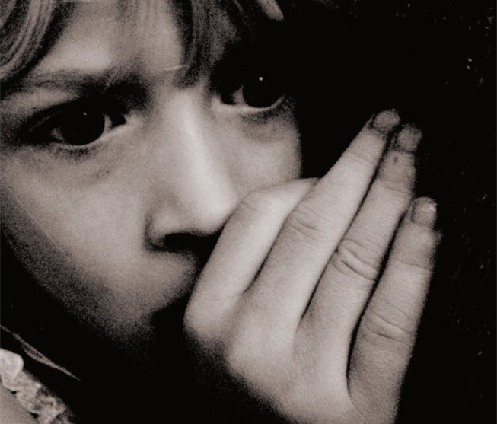
Disclosures
Children may not feel ready, or know how to tell someone what they are experiencing:
They may feel it’s their fault
They will get into trouble
Nobody will believe them
Nobody can stop it
Things will get worse
People they love will be hurt if they tell
They told before and nobody listened
They will be taken into care
They believe that this is what happens in families
They feel ashamed

Slide 30
Safeguarding Concerns
All staff should have an awareness of safeguarding issues that can put children at risk of harm, including:
Child on child abuse
Domestic abuse
Serious Youth Violence
Child Sexual Exploitation (CSE)
Child Criminal Exploitation (CCE)
Online Safety
Mental Health
FGM
Neglect
Prevent
Physical, Sexual and Emotional abuse
All staff should know how to report and record concerns.

Slide 31
Child on Child Abuse
It is essential that all staff understand the importance of challenging inappropriate behaviours between children, that are abusive in nature. Downplaying certain behaviours, for example dismissing sexual harassment as “just banter”, “just having a laugh”, “part of growing up” or “boys being boys” can lead to a culture of unacceptable behaviours, an unsafe environment for children and in worst case scenarios a culture that normalises abuse leading to children accepting it as normal and not coming forward to report it.

Slide 32
Children who identify as LGBTQ+ or Gender Questioning
The fact that a child or a young person may be LGBTQ+ is not in itself an inherent risk factor for harm. However, children can be targeted by other children. In some cases, a child who is perceived by other children to be LGBTQ+ (whether they are or not) can be just as vulnerable as children who identify as LGBTQ+.
Schools and colleges should be respectful and tolerant places where bullying is never tolerated. Staff and children should treat each other with compassion and consideration, in accordance with the ethos of the school or college.
DFE Gender Questioning Children draft guidance 2023

Slide 33
Domestic Abuse
Domestic abuse has been added to the list of safeguarding issues that staff should be aware of.
It’s important to recognise that domestic abuse:
can be psychological, physical, sexual, financial, or emotional
can impact on children through seeing, hearing or experiencing the effects of domestic abuse and/or experiencing it through their own intimate relationships (teenage relationship abuse)
can encompass a wide range of behaviours and may be a single incident or a pattern of incidents
All of these can have a detrimental and long-term impact on children’s health, well-being, development, and ability to learn.

Slide 34
Operation Encompass
As part of the citywide response to the Domestic Abuse and Prevention Strategy schools must:
Complete the Operation Encompass online training from Virtual College Online Key Adult Training
Key Adults to monitor a notifications portal where information is shared in respect of incidents of domestic violence and abuse
Complete the actions listed in the school’s Operation Encompass Action Plan (available on the Education Safeguarding website).
Follow up with discreet monitoring with child and family by DSLs and key staff.
Subsequent referrals to be made where appropriate.

Slide 35
Serious Youth Violence
All staff should be aware of indicators, which may signal that children are at risk from, or are involved with serious violent crime. These may include:
increased absence from school
a change in friendships or relationships with older individuals or groups
a significant decline in performance
signs of self-harm or a significant change in well-being
signs of assault or unexplained injuries
unexplained gifts or new possessions
All staff should be aware of the associated risks and understand the measures in place to manage these.
For further advice:
Criminal exploitation of children and vulnerable adults: county lines - GOV.UK (www.gov.uk)

Slide 36
Child Criminal and Sexual Exploitation
Both CCE and CSE are forms of abuse that occur where an individual or group takes advantage of an… imbalance in power to coerce, manipulate or deceive a child into taking part in sexual or criminal activity, in exchange for something the victim needs or wants, and/or for the financial advantage or increased status of the perpetrator or… facilitator and/or through violence or the threat of violence.
CCE and CSE can affect children, both male and female and can include children who have been moved (commonly referred to as trafficking) for the purpose of exploitation.
3 stages of Exploitation

Slide 37
County Lines
County Lines refers to a form of criminal exploitation where gangs and organised criminal networks transport illegal drugs across the country.
Exploitation
Vulnerable children are at a higher risk of being exploited. They may be coerced into distributing drugs or moving money to avoid detection.

Slide 38
Child Criminal Exploitation and County Lines – Know the signs!

Slide 39
Child Criminal Exploitation and County Lines
It is important to note that the experience of girls who are criminally exploited can be very different to that of boys. The indicators may not be the same, and professionals should be aware that girls are at risk of criminal exploitation too.
It is also important to note that both boys and girls being criminally exploited may be at higher risk of sexual exploitation.

Slide 40
Neglect
Neglect is the ongoing failure of a parent or carer to meet the basic physical, emotional, educational and medical needs of their children. This means that children who are experiencing neglect don’t regularly get all of the essential things they need to keep them happy, healthy and safe and well.
Neglect is the most common form of child abuse and the most common reason for a child to be subject to a Child Protection plan.
Neglect can have a significant and long lasting impact on children. It is better to respond to neglect at an early stage.

Slide 41
Neglect Strategy and Graded Profile
What is Graded Care Profile 2 (GCP2)?
GCP2 is a licensed assessment tool from NSPCC
GCP2 can support professionals working with children and families to measure the quality of care provided to a child
The tool evaluates the quality of physical and emotional care provided to children by using a scale of 1 (best) to 5 (worst) in different areas of physical and emotional care such as nutrition, hygiene, safety, and supervision
This can be used by one or more agencies working with the family and will help focus and inform intervention plans
Birmingham Neglect Strategy
How to Spot Neglect

Slide 42
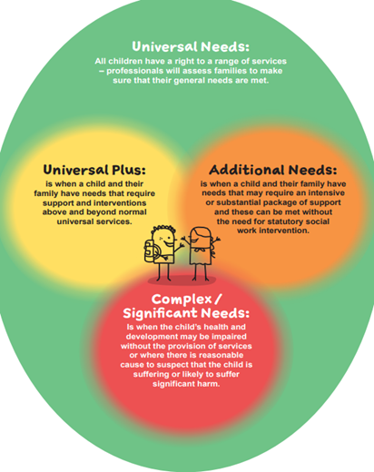
Right Help Right Time
Referrals for support are deemed by thresholds. These thresholds determine who is the most appropriate agency to respond to the needs of a family. Schools and other organisations now seek support for children and families through Locality Hubs in every district. These provide access to much needed services and funds for vulnerable families within our community.

Slide 43
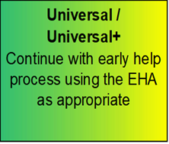
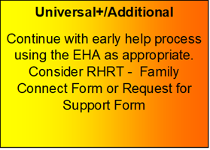
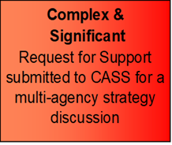
Right Help Right Time RHRT
eLearning Courses (lscpbirmingham.org.uk)
Family Connect Form

Slide 44
Children’s Advice and Support Service (CASS) Telephone: 0121 303 1888
This is the central referral point for the Birmingham Multi-Agency Safeguarding Hub. Professionals that sit within the hub include Health, Birmingham Children’s Trust and Police.
Early Help requests are accessed via an online form known as the Family Connect Form
Family Support and Children’s Services support is accessed via a Request for Support Form
Support for Criminal Exploitation and Sexual Exploitation is accessed via a Screening Tool submitted the EMPOWERU Exploitation Hub
Support for FGM is accessed via a screening tool to CASS
Support for concerns around radicalisation are accessed via a screening tool to the PREVENT Team via CASS

Slide 45
Useful Resources
Barnardos Exploitation
Children's Safeguarding Partnership child-exploitation
Defining Child Criminal Exploitation
Child Exploitation Prevention Toolkit
CSE police and prevention toolkits
St Giles vulnerabilities-to-child-criminal-exploitation
NSPCC
DSL resources contextual safeguarding
Birmingham Early Help Locality Leads
Violence Reduction Unit
WMP Violence Reduction Birmingham offer
EMPOWERU Referral Process
Domestic Abuse Act 2021 factsheet
Birmingham neglect Strategy 2022-2026
Forced marriage - GOV.UK (www.gov.uk)

Slide 46
Contact Us
Educationsafeguarding@birmingham.gov.uk
CASSEducation@birmingham.gov.uk
OpEncompassBham@birmingham.gov.uk
Education Safeguarding Team Web Page
Birmingham Safeguarding Children Partnership

Slide 47
Social media final slide

