Slide 1

Oracle Finance, Payroll and HR
Session with Academies
Dr Sue Harrison: Strategic Director of Children & Families (DCS)
Friday 21st June 2024

Slide 2
Welcome and thank you for coming
Today we will:
Address some myths
Provide an update on the current position
Share information about the options
Respond to questions received to date
Ask for feedback regarding ideas for support
Provide a reminder of how you can be involved.

Slide 3
Mythbusting
The decision has already been made
No decision has yet been made. There will be a detailed business case considering all the options available.
There must be formal consultation
We will work with schools to explore the options. The decision is a Cabinet decision that has been delegated to Sue Harrison and the Lead Member for Children, Young People and Families.

Slide 4
Latest update
We are considering a full spectrum of options, from 'do nothing' all the way through to the option mentioned in the Cabinet report of ‘considering sale or transfer of the business activity’ and everything in between.
We are assessing all the options against a set of agreed criteria which include –
  Ensuring schools have a workable solution by Sept '25
  Supporting the council’s Improvement and Recovery Plan
  Providing value for money for schools and BCC
  Ensuring schools have access to appropriate advice and guidance
  Ensuring schools and BCC can meet their statutory obligations.

Slide 5
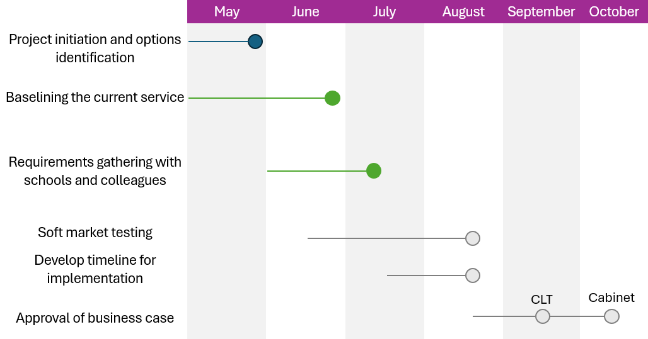
Decision-making timelines
Key dates
11th July drop-in session will be a listening session to hear your requirements for a future solution
Sue Harrison has delegated authority to make the decision, but if we feel the decision needs to go to Cabinet, we will be going to the October Cabinet (15th)

Slide 6
Emerging themes from questions received to date
We need more clarity on what is happening and the decision-making process.
We need a detailed timeline for this process. What are the key decision and information sharing dates?
If there is a new system, how will they ensure there is no repeat of the issues with Oracle?
What is the future of schools traded services and how will BCC support with any transition to new providers if that is needed?
Effective communication from BCC to schools, and vice versa, is essential in this process.
There is a wealth of expertise and experience in schools. We must ensure that School Business Managers are involved in this process.
Specific financial and technical questions.

Slide 7
How you can be involved
Fortnightly drop-in sessions:
  Thursday 27th June on Teams
    Sharing of detailed timeline and the decision-making / information sharing process
  Thursday 11th July on Teams
  Detailed school requirements gathering session
11 July listening session to hear your requirements for a future solution
Send questions by contacting OracleSchoolsRelationship@Birmingham.gov.uk
Working group for the remainder of the project when we know which option we will be progressing

Slide 8
Thank you and questions
Thank you and questions

