Slide 1
Birmingham Women's Health Needs

Slide 2
CONTENT WARNING
The following presentation contains topics that some participants might find sensitive including topics around premature mortality, infant mortality, domestic abuse and suicide.

Slide 3
HELP & SUPPORT
Samaritans 116 123, jo@samaritans.org. Support is available 24 hours a day, 365 days a year.
Shout. Text SHOUT to 85258: If you would prefer not to talk but want some mental health support, you could text SHOUT to 85258. Shout offers a confidential 24/7 text service providing support
CRUSE Bereavement 0121 687 8010, support@brusebirmingham.co.uk - Cruse Bereavement is a local helpline that provides initial and ongoing support to grieving residents.
Birmingham & Solihull Women’s Aid: If you, or someone you know is affected by domestic abuse, needs help or support; Call 0808 800 0028 or visit Birmingham & Solihull Women's Aid

Slide 4
INTRODUCTION: GENDER HEALTH INEQUALITIES PROJECT
The Inclusion Health Team (Public Health, Birmingham City Council) developed a gender related health inequalities project to influence and support the delivery of local action to reduce health inequalities affecting women, men, transgender and non-binary populations in the city.
Phase 1 focused on Women’s Health Needs:
Based on the National Strategy for Women’s Health in England (2022)
Women’s health needs data and evidence review and report with recommendations
Building local evidence
Developing tools to support community organisations & service providers

Slide 5
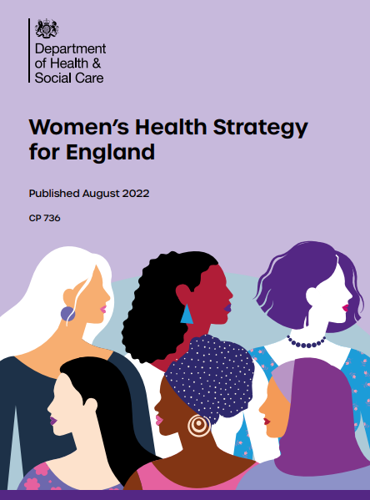
PHASE 1: PRIORITY AREAS & THEMES
National Women’s Health Strategy for England 2020-2030
Ambitions:
Ensuring women’s voices are heard
Improving access to services
Addressing disparities in outcomes among women
Better information and education
Greater understanding of how women’s health affects their experience
in the workplace
Supporting more research, improving the evidence base and
spearheading the drive for better data.
Priorities:
Menstrual health and gynaecological conditions
Fertility, pregnancy, pregnancy loss, and postnatal support
Menopause
Mental health and wellbeing
Cancers
The health impacts of violence against women and girls
Healthy ageing and long-term conditions

Slide 6
BIRMINGHAM WOMEN’S HEALTH NEEDS: METHODOLOGY
Stakeholder engagement
Cross-sector Women’s Health Working Group
Review of Published Evidence
Commissioned literature review on gender disparities in health
Supplementary evidence review focused on women’s health, incl. grey literature using thematic areas for searches based on national priorities
Qualitative research used, e.g. ‘Seldom Heard Conversations About Pregnancy’ Report, ‘Labyrinth Project – Supporting GBV Victims’.
Data consolidation and synthesis
Local datasets - Joint Strategic Needs Assessment, Deep Dives, Birmingham Community Health Profiles, Birmingham City Observatory
National datasets – Office for National Statistics (Census 2021), Office for Health Improvement & Disparities (Public Health Data, Fingertips), NHS Health Check Data
Notes:
Our research approach was to collect and review local data including JSNA, Deep Dives, Community Health Profies, Fingertips Mortality Profiles and NHS Health Check Data. Where there were significant gaps or limitations in the data, we supplemented this with a literature review, using the grey literature address data gaps from the key priorities and to develop the understanding and analysis from the local perspective. We also reviewed qualitative evidence and engaged with key stakeholders such as practitioners, people with lived experience to further understand the picture for womens health needs in Birmingham.

Slide 7
BIRMINGHAM WOMEN’S HEALTH NEEDS: PUBLICATION
Women’s Health Needs in Birmingham. Report provides a synthesis of local evidence and identifies local opportunities for action.
Full reports and additional resources will be available on Birmingham City Council | Health & Well-being and Birmingham City Observatory

Slide 8
BIRMINGHAM Women’s Health Needs
FINDINGS

Slide 9
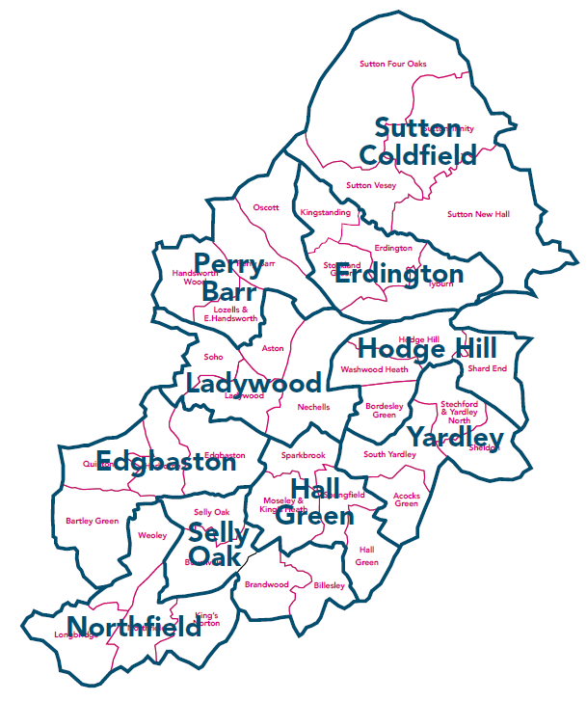
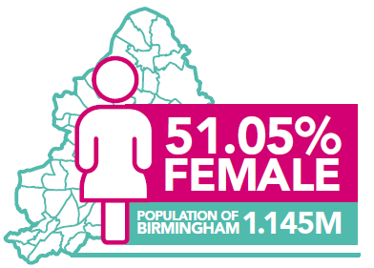
OVERVIEW OF BIRMINGHAM’S FEMALE POPULATION
Gender equal at city and ward-level
‘Europe’s Youngest City’
Birmingham has the highest percentage of residents from ethnic communities outside of London

Slide 10
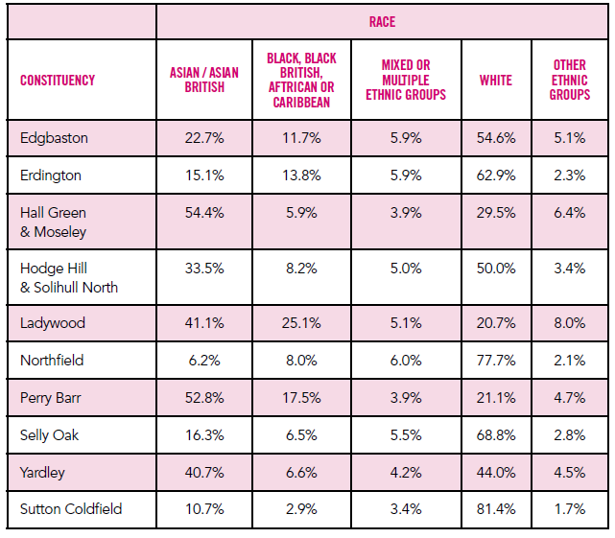
BIRMINGHAM’S FEMALE POPULATION: DEMOGRAPHICS
Birmingham’s female population by race and constituency
E.g. More than half of Perry Barr’s female population is Asian / Asian British
Notes:
[1] Birmingham City Council (2022), Ward Profiles, Birmingham Total Population, All Topics by city – Census 2021, Birmingham City Observatory. Even gender distribution across the city: ONS data shows that gender distribution between males and females is relatively equal city-wide and at the ward level. Birmingham’s total gender split is 51.1% female and 48.9% male. [1]
Racial distribution of female population: The ONS data tells us that… constituencies have the largest proportions of global minority ethnic groups. And the data also highlights the differences in geographic distribution between women of different racial groups. E.g. 54.5% of Hall Green & Moseley female population: Asian / Asian British.
Detailed breakdown of ethnic groups available in report.

Slide 11
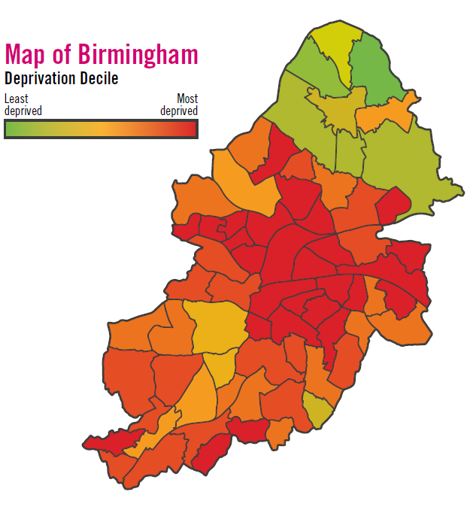
KEY FINDINGS: GENDER & DEPRIVATION
Health inequalities linked to gender
There are strong links between life expectancy, poverty and social exclusion.
Evidence suggests women who live in more deprived parts of the city have worse health outcomes than those living in more affluent areas.
Birmingham is ranked as the 7th most deprived local authority in England.
Hodge Hill is the most deprived constituency in Birmingham followed by Ladywood and Erdington. The largest female populations in these constituencies are of Pakistani, White English, African and Caribbean ethnic origin.
Notes:
[1] ONS (2020), Deaths of homeless people in England and Wales: 2019 registrations, gov.uk.
There are strong links between life expectancy and poverty and social exclusion. The mean age at death for homeless females in 2019 was 43.4 years compared to the general female population of England and Wales at 80.9 years. This stark inequality indicates the need for support of highly vulnerable female populations. [1]
The role of place when measuring gender health inequality is important to consider in the context of levels of deprivation present in the area, as the evidence suggests women who live in more deprived parts of the city have worse health outcomes than those living in more affluent areas.
Hodge Hill is the most deprived constituency in Birmingham followed by Ladywood and Erdington. The largest female populations in these constituencies are of Pakistani, White English, African and Caribbean ethnic origin.

Slide 12
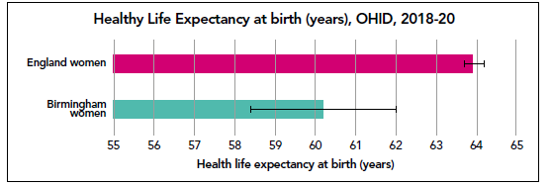
KEY FINDINGS: PREMATURE MORTALITY
Poorer health outcomes for women in Birmingham are evidenced across the life course, and this is shown both by lower life expectancy at birth and higher under 75 mortality rates.
Notes:
We looked at what local data is available and cross-referenced it with the grey literature to develop a stronger understanding of the female-specific health needs of target population in the city. In 2017-2019, the mortality rate of women under 75 in Birmingham was 18% higher than the rest of England. This mortality rate focuses on all deaths for all causes which were considered preventable. Overview of lifestyle & preventable risk factors, assessing potential areas for targeted interventions through the NHS Health check Data. Obesity prevalence across ethnicity and IMD for female HC attendees, it becomes clear that the obesity prevalence for Asian women in the most deprived area has increased from 32.6% to 49.7%.
Black women in the most deprived quintile still have the highest prevalence of obesity at 67.4% under the NICE definition.
Women of all ethnicities and deprivation levels are more likely to be inactive than men.
Rates of inactivity are highest for Asian patients and those living in the most deprived quintiles.
[NHS Health Checks, Birmingham Public Health, Service Data (2023) ].

Slide 13
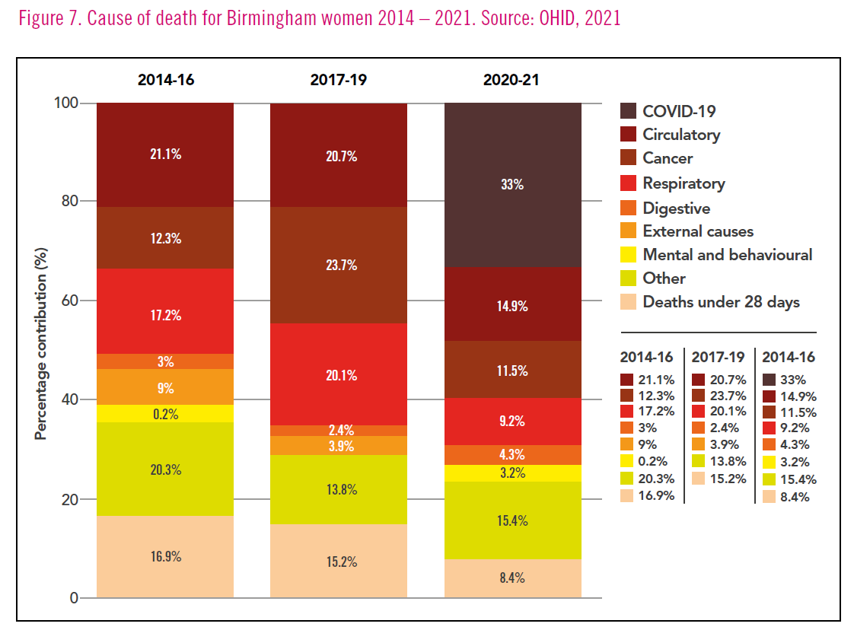
KEY FINDINGS: DRIVERS OF PREMATURE MORTALITY FOR WOMEN IN BIRMINGHAM
Main causes between 2020-21: COVID-19, Circulatory, Cancer, Respiratory, Digestive, Mental and Behavioural, Other.
Cause of death for Birmingham women 2014 – 2021. Source: OHID, 2021

Slide 14
KEY FINDINGS: LIFESTYLE AND PREVENTABLE RISK FACTORS
NHS Health Check data highlight obesity and physical inactivity high in specific groups in the city
49.7% of Asian women and 67.4% of black women from the most deprived areas of Birmingham.
Positive case study for change – ‘Kickstart’ in 2022 supported women from the Bangladeshi community in Birmingham to improve their health behaviours.

Slide 15
KEY FINDINGS: MENTAL HEALTH
Birmingham has a significantly higher estimated prevalence of common mental health disorders.
Rate of premature mortality in female adults in Birmingham with severe mental illness (SMI) was higher than the national average.
38% higher chance of poor mental health (anxiety or depression) in lesbians.
Prevalence of mental health problems is higher in lesbian and bisexual women in the West Midlands compared to the general population.

Slide 16
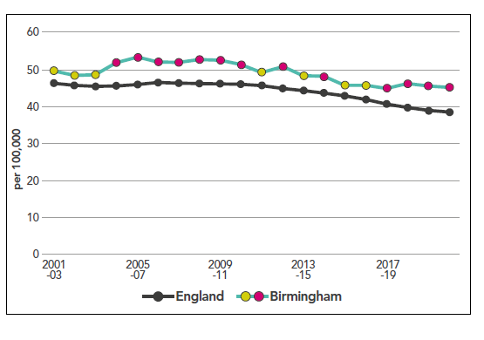
KEY FINDINGS: CANCER
Between 2020-22, 17.7% more women under 75 died from all types of cancer in Birmingham (45.1 per 100,000 population) compared to the national figures (38.3 per 100,000 population).
These deaths were considered preventable; and compared to males, whose outcomes in Birmingham are also significantly worse than in England, the gap is bigger for females by 2.1%.
Notes:
OHID (2022), Fingertips Mortality Profile: Under 75 mortality rate from cancer (female).

Slide 17
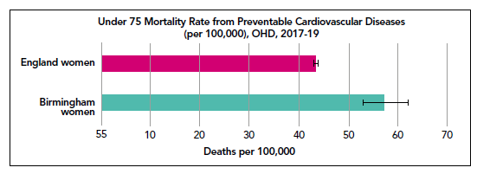
KEY FINDINGS: CARDIOVASCULAR DISEASE
Between 2017-2019, 32% more women under 75 died from all cardiovascular diseases in Birmingham compared to the national average, of these 38.4% were considered preventable (OHID, 2019).
Across Birmingham, Coronary Heart Disease is the main cause of early death with almost 3,200 excess years of life lost between 2014-2016.

Slide 18
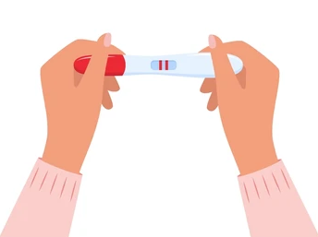
KEY FINDINGS: SEXUAL HEALTH
Higher proportion of repeat abortions in women under 25 in Birmingham compared to women in England.
Lower rate of total prescribed Long-Acting Reversible Contraception (LARC), excluding injections in Birmingham compared to women in England.
Public Health Fingertips data also suggests a significantly lower coverage of one and two doses of HPV vaccination for girls in Birmingham compared to girls in England.
Ethnicity and sexual orientation as a key driver in sexual health disparities
Notes:
There is also a lower rate of total prescribed Long-Acting Reversible Contraception (LARC), excluding injections, for women in Birmingham (35.6 per 1,000) compared to women in England (44.1 per 1,000).​
There is a significantly higher proportion of repeat abortions in women aged under 25 in Birmingham compared to women of the same age in England.
There is also a lower rate of total prescribed Long-Acting Reversible Contraception (LARC), excluding injections, for women in Birmingham compared to women in England.
PHOF data also suggests a significantly lower coverage of one and two doses of HPV vaccination for girls in Birmingham compared to girls in England. This may be linked to poorer outcomes.

Slide 19
KEY FINDINGS: MENSTRUAL HEALTH
Limited data available
Public Health carried out a focused, small-scale study to understand the impact menstrual health issues have on young women in Birmingham.

Slide 20
KEY FINDINGS: MENSTRUAL HEALTH
Young People: 40% of girls had at one point stayed off from school due to their period (2022).
Only 53% of secondary school teachers reported that menstrual cycle education lessons were taught in their school.
Double stigma: Awareness around period poverty and menstruation low in Birmingham’s homeless and rough sleeping community.
Notes:
Brown, N, et al. (2022), Teachers' perceptions and experiences of menstrual cycle education and support in UK schools, Frontiers in Global Women's Health, 3, 827365.

Slide 21
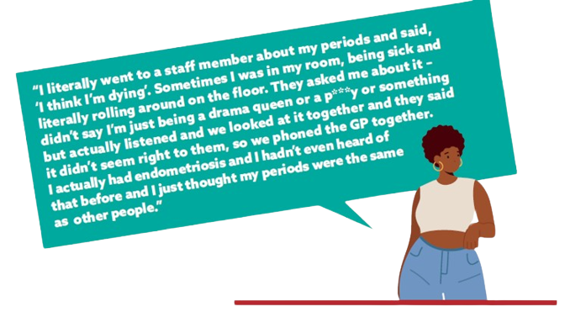
Women experiencing ‘double stigma’ of periods and homelessness
Women experiencing ‘double stigma’ of periods and homelessnessg Birmingham, 2023
Notes:
Spring Housing toolkit is due to be published in November, direct quote will be available to read in November 2023

Slide 22
KEY FINDINGS: REPRODUCTIVE HEALTH
Birmingham - 3rd highest rate of infant mortality in England (2019-2021).
Disproportionate percentage of child deaths amongst those who identify as Pakistani between 2018 - 2020.
12% of women who died during or up to a year after pregnancy had multiple severe disadvantages.
‘Seldom Heard Conversations about Pregnancy in Birmingham’ - Low satisfaction levels
Notes:
[1]Department of Health and Social Care (2022), ‘New taskforce to level-up maternity care and tackle disparities’, gov.uk/government/news/new-taskforce-to-level-up-maternity-care-and-tackle-disparities.
[2] OHID (2022), Fingertips Child and Maternal Health: Infant Mortality Rate 2019-21.
[3] Birmingham City Council (2021), Infant Mortality Scrutiny Report, Health and Social Care Overview and Scrutiny Committee, birmingham.gov.uk.
[4] Birmingham City Council (2022), Birmingham and Lewisham African Caribbean Health Inequalities Review.
[5] MBRRACE-UK (2023), Saving Lives, Improving Mothers’ Care: Lessons learned to inform maternity care from
the UK and Ireland Confidential Enquiries into Maternal Deaths and Morbidity 2019-21.
2019-21 data found that Birmingham had the 3rd highest rate of infant mortality in England. For every 1,000 births in Birmingham, 7 die before reaching their first birthday. The most recent national report on perinatal mortality reported that 42% of births at University Hospitals Birmingham (UHB) and 38% of births at Birmingham Women’s Hospital (BWH) were in the most deprived decile.
12% of women who died during or up to a year after pregnancy had multiple severe disadvantages, such as histories of substance abuse or domestic violence, and women living in the most deprived areas continue to have the highest maternal mortality rate compared to those living in the least deprived areas.

Slide 23
Experiences heard at a West Birmingham listening session of recent women’s births
“With the pregnancy where I had a still born, I did not have any consultant appointments to assure me that I was okay, and baby was okay. All the appointments were virtual [...] When they finally agreed to admit me, she put me on a monitor for the baby, she looked at me and said there is no heartbeat…. I had to give birth, I gave birth, had high temperature, kidney infection. Then I was put in a room where next door people were giving birth. I couldn’t stay there, and I discharged myself after three days. Someone came down from the bereavement team. The consultant apologized but it’s not enough”
Full quote available: (Healthwatch, 2023)

Slide 24
KEY FINDINGS: MENOPAUSE
Impacts on Birmingham’s population: Approximately 209,832 women above the age of 45 in Birmingham are likely to be affected by menopause.
Lack of support: 44% of menopausal women in employment say their ability to work has been affected by their symptoms.
Risk of suicide: ONS data shows that those aged 50 to 54 years had the highest suicide rate in 2022 (15.2 deaths per 100,000)
Notes:
Despite this, 8 in 10 menopausal women say their workplace has no basic support in place for them – no support networks (79%), no absence policies (81%) and no information sharing with staff (79%).

Slide 25
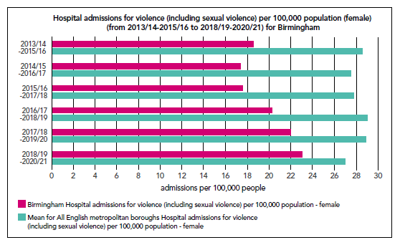
KEY FINDINGS: HEALTH IMPACTS OF VIOLENCE AGAINST WOMEN & GIRLS
Between 2022 to 2023, there were 4317 high-risk cases of domestic abuse in the city.
Of these 4317 cases, 66% involved female victims indicating that there is a higher prevalence of female victims with greater support needs in Birmingham

Slide 26
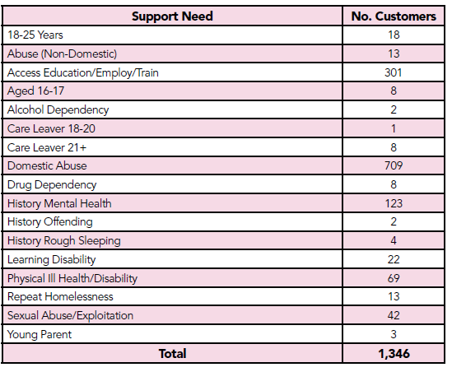
KEY FINDINGS: INCLUSION HEALTH & VIOLENCE AGAINST WOMEN & GIRLS
Between 2022 to 2023, there were 992 instances of homelessness presentation in Birmingham where domestic abuse was cited as the main reason for homelessness.
847 households had additional support needs: poor mental health, learning disability and physical ill health or disability.
Domestic abuse was the third highest reason for 17.3% of households being placed in temporary accommodation.
Notes:
Birmingham City Council (2023), Domestic Abuse Information 2022-23, Housing Service Data. The 2022-2023 homelessness data for Birmingham also demonstrated the additional support needs of women in Birmingham facing homelessness due to domestic abuse. Of the 847 households who had a full Housing Needs Assessment, 123 had a history of poor mental health, 22 reported a learning disability, and 69 were experiencing physical ill health or disability. 301 households reported barriers to education, employment, and training.

Slide 27
SUMMARY: KEY FINDINGS & CROSS-CUTTING THEMES
Cultural and intersectionality considerations in service delivery that may prevent access and / or impact on quality of experience.
Low levels of health literacy particularly amongst specific female groups i.e. inclusion health groups and ethnic communities.
Need to evaluate and improve cancer screening programs - approaches to be more inclusive and intersectional
CVD/CHD is one of the main causes of early death in Birmingham and is linked to under-diagnosis in women. This increases for ethnic minority women.
Key areas of improvement for preventable risks are obesity and weight management, especially Black and Asian women living in the most deprived quintiles
High-quality health education and awareness on menstrual cycle for women, with sensitive and culturally appropriate guidance for support workers.
Support and care for women from inclusion health groups and women experiencing multiple barriers to accessing healthcare need to improve to reduce the health inequalities they currently experience.
Many women suffer without their symptoms being recognised and barriers to menopause support especially women from ethnic minority backgrounds and LGBT+ community, impacting their mental as well as physical health.
Further support needed for victims of domestic abuse, particularly lesbian and bisexual women.

Slide 28
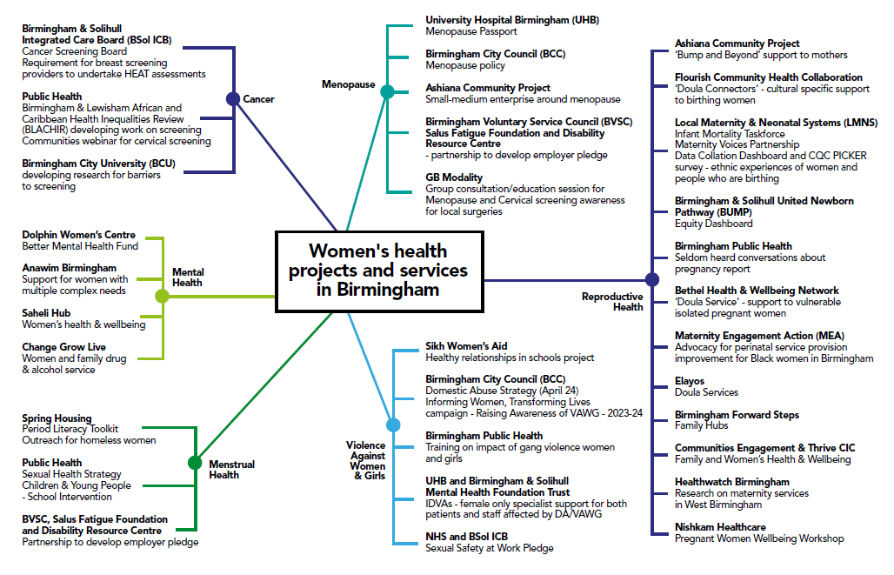
SERVICES AND PROJECTS
Notes:
Mapping targeted interventions and provisions (current and planned) to address women’s health needs across the city. More is taking place across city, not an exhaustive list

Slide 29
RECOMMENDATIONS
RECOMMENDATIONS THEME 1: CANCER
Ref # | Recommendation | Lead Organisation(s)
1 | Routinely collect, monitor, and publish data on female cancer patient satisfaction with health care and use it to improve quality of care. | BSol ICS
2 | Develop a whole system approach to improving recording of attendance in cancer screenings to ensure that sex, gender, disability, ethnicity, and locality are captured. This will help inform targeted approaches to improve cancer screening coverage. | BSol ICS
3 | Develop culturally sensitive tailored campaigns to promote breast, cervical and other cancer screenings within the target populations/ communities to improve early diagnosis and reduce mortality. | NHSE supported by BSol ICS and Birmingham Public Health
4 | Produce a series of accessible and culturally appropriate resources and literature to increase awareness of the importance of cancer screening and the improved service offer within ethnic communities. | NHSE

Slide 30
RECOMMENDATIONS: CARDIOVASCULAR DISEASE & CORONARY HEART DISEASE THEME and LIFESTYLE AND PREVENTABLE RISK FACTORS
RECOMMENDATIONS THEME 2: CARDIOVASCULAR DISEASE & CORONARY HEART DISEASE
Ref # | Recommendation | Lead Organisation(s)
5 | Develop awareness campaigns for women and primary care providers/ practitioners to raise awareness of CHD/CVD risks in women and improve early detection and diagnosis. | BSol ICS, Birmingham Public Health
RECOMMENDATIONS THEME 3: LIFESTYLE AND PREVENTABLE RISK FACTORS
Ref # | Recommendation | Lead Organisation(s)
6 | Develop and deliver culturally sensitive targeted community-based campaigns to promote healthy behaviours with a specific focus on women’s health needs. | Birmingham Public Health with relevant service providers and community partners
7 | Raise awareness of available support and continue to encourage the take up of health checks with a specific focus on women’s health needs. | Birmingham Public Health

Slide 31
Recommendations: Mental Health theme
RECOMMENDATIONS THEME 4: MENTAL HEALTH
Ref # | Details | Lead Organisation(s)
8 | Develop a greater insight into Birmingham women’s mental health and promote a gender-based and culturally competent approach to service delivery and mental health practice, focused on prevention and early intervention. | Bsol ICS Mental Health Provider Collaborative
9 | Work with the local LGBT+ organisations and the lesbian communities themselves to develop accessible wellbeing resources to address low level mental health needs and promote pathways to addressing more complex needs around self-harm, suicide and eating disorders within these communities. This work needs to be incorporated into the local suicide prevention programme. | Bsol ICS Mental Health Provider Collaborative
10 | Strengthen direct referral routes to specialist mental health services for women from inclusion health groups, women with disabilities and lesbian/ bi-sexual women and girls. | BSol ICS

Slide 32
Recommendations: Sexual Health Theme and Menstrual Health Theme
RECOMMENDATIONS THEME 5: SEXUAL HEALTH
Ref # | Recommendation | Lead Organisation(s)
11 | Collaborate with the education sector to develop culturally competent messages, resources and services to improve sexual health outcomes amongst young women. | Sexual and reproductive health service providers
12 | Conduct a deep dive research to explore reasons behind repeat abortions, particularly in lesbian and bisexual, and vulnerable women, and explore tailored targeted interventions that can prevent them. | NHSE
RECOMMENDATIONS THEME 6: MENSTRUAL HEALTH
Ref # | Recommendation | Lead Organisation(s)
13 | Support the education settings in raising awareness of menstrual health and support amongst children and young people to reduce stigma associated with periods, period poverty, absenteeism related to menstrual health and improve young females’ wellbeing. | Children and Families Directorate and Education

Slide 33
Recommendations: Reproductive Health theme
THEME 7: REPRODUCTIVE HEALTH
Ref # | Recommendation | Lead Organisation(s)
14 | Co-produce robust training and performance framework for community midwives, nurses, and local hospitals to address poor quality of ante- and post-natal care for women, particularly disadvantaged women and those from ethnic communities. The framework should include cultural awareness and humility, learning from lived experience, awareness of inclusion practices and policies, awareness of trauma caused by racism and discrimination and how to deliver sensitive care. Healthcare professionals who serve the most socially deprived areas of Birmingham with a larger ethnic population should be prioritised (e.g., Heartlands Hospital). | BSol ICS with communities of experience
15 | Improve data collection by specific ethnicity in maternity and early years services, so that the unique needs of specific ethnic and inclusion health groups can be further explored and considered to improve quality of care. | LMNS (BSol ICS)
16 | Implement a robust monitoring and patient feedback system across ante-/ post-natal clinics and maternity services to evaluate and improve care experiences of all women, with a particular focus on care quality and outcomes for women from ethnic communities, inclusion health groups as well as Lesbian women accessing IVF services and referrals. | BSol ICS, Healthwatch Birmingham
17 | Support all women who are migrants, refugees and asylum seekers, particularly those with no access to public funds, to access appropriate care during and post pregnancy. | GP and midwifery services

Slide 34
Recommendations: Menopause theme
RECOMMENDATIONS THEME 8: MENOPAUSE
Ref # | Recommendation | Lead Organisation(s)
18 | Champion across the city the adoption of the Menopause Workplace Pledge, an accreditation scheme for employers providing flexible working arrangements for employees experiencing menopause. | Birmingham City Council
19 | Evaluate the impact of the Birmingham City Council’s workplace menopause policy as a model of good practice and promote its positive impacts. | Birmingham City Council
20 | Support the evaluation of the menopause passport initiative and continue to promote menopause friendly policies across its workplaces. | BSol ICS
21 | Continue to increase awareness of menopause symptoms, and improve diagnosis and access to appropriate treatment, if needed. | BSol ICS

Slide 35
RECOMMENDATIONS THEME 9: IMPACTS OF VIOLENCE AGAINST WOMEN AND GIRLS
Ref # | Recommendation | Lead Organisation(s)
22 | Work to improve services (particularly mental health support) and promote a trauma informed approach to supporting victims of domestic violence and abuse. | BSol with the Birmingham Community Safety Partnership
23 | Domestic Abuse and VAWG Strategies and associated action plans for the city to incorporate public health evidence and preventative approaches to tackling domestic abuse and reducing the impacts that violence against women and girls has on their health and mental wellbeing. This includes, but is not limited to, working with: a) the education sector on developing healthy attitudes towards relationships early on b) BCC and local employers to implement or strengthen policies that promote attitude and behaviour change towards violence and abuse towards females, protect them from it in the workplace and support them to seek help. | Birmingham City Council (Adult Social Care), Birmingham Community Safety Partnership

Slide 36
Questions? CONTACT:
phinequalities@birmingham.gov.uk

