Slide 1
Guidance and Instructions for Non-Cheque Book & EPA Schools – Accrual Submission and Evidence
Schools Funding Team

Slide 2
DEADLINE
The deadline for Non-Cheque Book and EPA schools to submit their returns is 19th April 2024.

Slide 3
Accrual Guidance

Slide 4
Accrual Definitions
For there to be an accrual, the requirement is that goods and services must have been received or provided by 31st March to be included in the year’s accounts.
If someone owes the Council money at 31st March, there is a DEBTOR.
If non one owes the Council money at 31st March, there is NO debtor.
If the Council owes money to someone at 31st March, there is a CREDITOR.
If the Council does not owe money to someone at 31st March, there is no CREDITOR.

Slide 5
Internal Debtors & Creditors
There should be no internal indebtedness on the Balance Sheet.
Cheque Book Schools are INTERNAL to BCC.
Academy Schools are EXTERNAL to BCC.
ACIVICO is EXTERNAL to BCC.
Birmingham Children’s Trust is EXTERNAL to BCC.

Slide 6
Accrual Overview
Achievement of deadlines must not be compromised by spending inappropriate amounts of time on minor items.
A de minimis of £1,000 has been set for school accruals.
Accruals at year-end 31st March 2024 must be evidence based. This is critical following the findings of external audit looking at accruals and cut-over testing over the last few years.
The fact that some accruals will be based on estimates does not remove the need for clear evidence; if anything, estimates require more detailed evidence.

Slide 7
Accrual Evidence
Evidence can be in several guises/formats but in all cases must be accurate, reasonable, and documented. Examples of evidence as to how an accrual was calculated are as follows:
Actual invoices received in advance of accruals input deadline but unable to be authorised in General Ledger by 31st March.
Purchase Orders where the Goods Received Note ought to have been entered by midday 31st March but wasn’t and has not been posted to 2023/24 General Ledger. These will be
Expected to be few and far between and
Clearly referenced by correspondence that they are a legitimate manual accrual
An ultra-simplistic approach of accruing to Approved Budget is, in most cases, unlikely to meet requirements of a satisfactorily evidence-based accrual.
There should be a robust challenge to requests for accruals to ensure integrity of closedown figures.
All accruals must be approved. Each school will have its own process; however, the anticipation is completion of the accrual journal by School Business Manager / School’s Administrative Staff and approval by the Headteacher.
All accruals must have supported evidence attached in Oracle.

Slide 8
Estimating Accruals
The auditors will test any estimates (and specific values) that are entered with the corresponding activity that falls into the following year to ensure that they are comparable.
They will be looking for evidence to support any accrual.
There is no prescribed format for working papers, but the following must be considered and delivered:
Reasonableness
Clarity
Understandable by someone with no previous knowledge
Suitable for review by external audit
Visibility of the evidenced figure

Slide 9
Information from the Council’s External Auditor

Slide 10
Instructions for Completing Journal Compiler

Slide 11
Overview
Accruals will be processed using the standard Journal Compiler Form.
Debtors and Creditors MUST BE submitted in separate compilers.
Debtors and Creditors MUST NOT be netted off.
Each accrual journal compiler should be supported by a file with relevant evidence. It is an Oracle process requirement that supporting evidence is attached when the accrual journal compiler is loaded. We recommend an Excel Spreadsheet use separate worksheets for each accrual line.
Evidence must be cross referenced to the accrual line.
If several items of evidence make up one accrual line, then please ensure that a summary is included so that it can easily be tracked back to the line total.

Slide 12
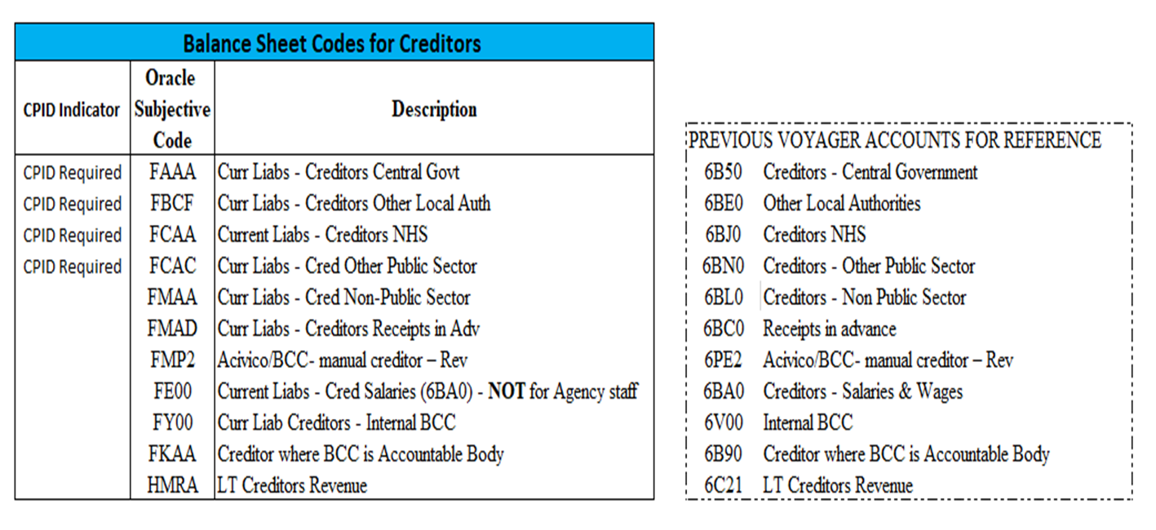
Table of Available Creditor Balance Sheet Codes

Slide 13
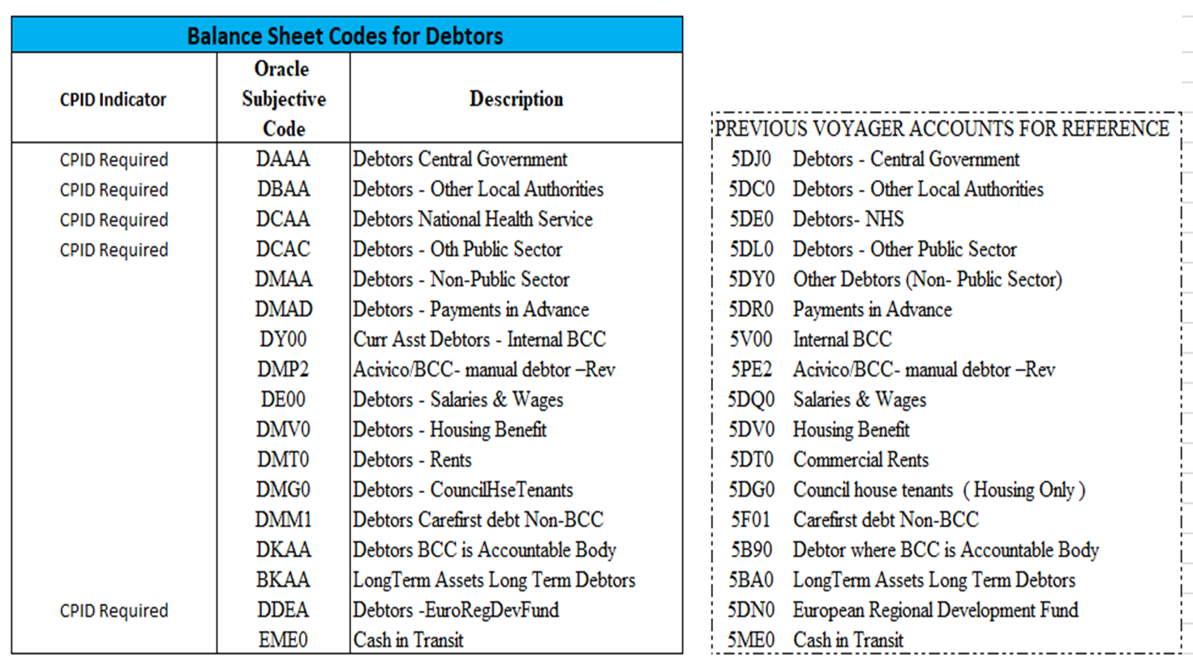
Table of Available Debtor Balance Sheet Codes

Slide 14
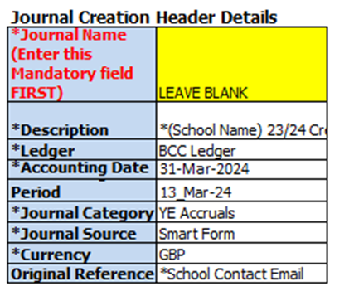
Instructions for Completion (Step 1)
Enter information into the face of the journal first.
You will only need to complete the “Description” and “Original Reference” cells.
“Description” should be “(School Name) 23/24 Creditors/Debtors
“Original Reference” should be the email address of the individual completing the journal.

Slide 15
Instructions for Completion (Step 2)
Entity: B1
Cost Centre: School Cost Centre (Use Oracle Mapping File to convert SAP code to Oracle)
Subjective: (Use Oracle Mapping File to Convert SAP code to Oracle)
Fund: ED1
Project: JZZZZZ
Sub Analysis: TV1L0
Spare 1: JZZZ
Spare 2: JXXX

Slide 16
Instructions for Completion (Step 3)
Split out accruals one per line, though each accrual should have two lines; one line for the relevant subjective code and another for the relevant balance sheet code.
Enter positive figures in both debit and credit columns. Figures must be to two decimal places. Total of debits on the journal compiler should balance to the total of credits.
Example of a Creditor Entry:
*Note the Credit is on the line that correlates to the creditor balance sheet code.
Example of a Debtor Entry:
*Note the Debit is on the line that correlates to the debtor balance sheet code.

Slide 17
Instructions for Completion (Step 4)
The “Line Description” should be relevant to the accrual. Do not include any punctuality in this description e.g., “23-24” should be noted as “23 24” or “2023 24”.
Ensure you have checked the BCC CPID and RELPTY lists and included the relevant CPID and RELPTY references where appropriate. These should be entered as “CPIDXXXXX” or “RELPTYXXX”.
The line description for both lines of these Related Party accruals must start with the RELPTY reference followed by the organisation’s name e.g., “RELPTYXXX”.
Example of a RELPTY Line Description:

Slide 18
Instructions for Completion (Step 4) Continued
For accruals which require a CPID reference, you must select the CPID in the drop down of the “DFF-WGA CounterPartyID (CPID)” column. The line description must also begin with this CPID reference.
An example of a CPID accrual’s line description:
It is possible that some accruals require both CPID and RELPTY references.
An example of such instance:
*Note: the CPID number MUST be before the RELPTY number

Slide 19
Instructions for Completion (Step 4) Continued
Debtors and Creditors for Whole of Government Accounts (WGA) Bodies / CPID
Any WGA elements within accruals should use the relevant balance sheet codes below
ACIVICO and Birmingham Children’s Trust and Related Parties (RELPTY)
N.B. WMCA/Centro is both WGA (CPID) and RELPTY – please use CPID and RELPTY on the entry in that order with balance sheet code DBAA (Debtor) or FBCF (Creditor).
Several Academies are both WGA and RELPTY – please use CPID and RELPTY on the entry in that order with balance sheet code DAAA (Debtor) or FAAA (Creditor).
You must accrue for:
Receipts in Advance – Creditor (FMAD)
Payments in Advance – Debtor (DMAD)

Slide 20
Instructions for Completion (Step 5)
As previously stated, we expect a separate evidence file to submitted for both debtor and creditor accruals. We recommend using an Excel Spreadsheet, and to set out the evidence on separate tabs cross referenced to the line number of each accrual.
An example of how this would look:
Ensure the evidence file is named appropriated e.g., “(School Name) 23-24 Debtor Evidence” or “(School Name) 23-24 Creditor Evidence”.

Slide 21
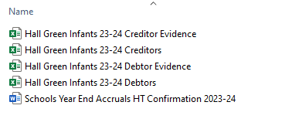
Instructions for Completion (Step 6)
You must ensure a signed Headteacher Confirmation Letter is submitted with the school’s accrual submission and evidence files.
You MUST state if either of your creditors or debtors are Nil Returns.
An example of a full submission:
Send the completed accrual template along with separate evidence files and Headteacher Confirmation letter to schoolsaccruals@birmingham.gov.uk. State the school’s name in the subject box.

