Slide 1
Current measles situation in Birmingham – January 2024
Dr Mary Orhewere – Assistant Director, Health Protection
Funmi Worrell – Service Lead, Health Protection
Helen Bissett – Senior Officer, Health Protection
hpteam@birmingham.gov.uk

Slide 2
Key messages for all
MMR vaccination provides best protection against measles
MMR vaccines that do not contain pork are available at all GP surgeries
Contact your GP surgery to catch up with MMR vaccinations at any age
Anyone with suspected measles should not attend a healthcare setting without calling ahead first
If in doubt, ensure that you report a potential case to the UKHSA West Midlands Health Protection Team
Unvaccinated close contacts of a measles case may be advised not to come to school for a number of days

Slide 3
Measles virus and MMR
One of the most contagious viruses (more so than COVID, hepatitis, HIV)
Mainly airborne transmission
9/10 unvaccinated close contacts will get infected
WHO MMR target is 95%. Lower uptake means a population is at risk of a measles outbreak

Slide 4
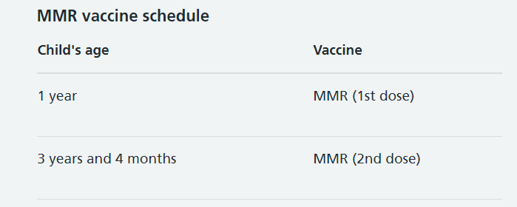
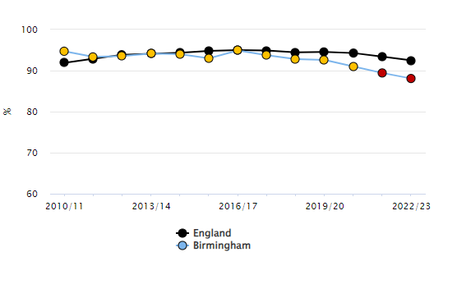
MMR uptake
2 doses of MMR give an individual protection against measles
MMR 1 at 12 months, MMR2 at 40 months
Birmingham uptake is 88% MMR1 at 5 years
England uptake (2021/2022) is below 90% for MMR1 and at 86% for MMR2 UKHSA
Notes:
Only 88.1% of 5-year-olds in 2022-23 had MMR dose 1. 1 dose of MMR gives 99% protection against measles

Slide 5
Current situation
Measles is circulating in Birmingham and across the West Midlands (also nationally and internationally)
There have been over 260 cases (w/c 15th Jan) of measles in Birmingham since October 2023
Around half of the cases have required hospitalisation, majority of cases are unvaccinated
Median age of all WM cases is 6 years

Slide 6
What are the symptoms of measles?
Cold-like symptoms such as runny or blocked nose, sneezing and cough
Red, sore watery eyes
High temperature (fever) which may reach around 40C / 104F
A non-itchy, red-brown rash usually appears 3-5 days later (sometimes starts around the ears before spreading to rest of the body), spots may be raised and join to form blotchy patches – which may be harder to see on darker skin tones

Slide 7
What do I do if a child has suspected measles?
If children have symptoms of measles, please tell them to stay at home or return home. Please advise parents they should not bring their children with measles symptoms to the setting.
Suspected measles may cause concern. Advice is available on the NHS website, UKHSA webpages, NHS 111 and from the person’s GP. Please advise parents NOT to go to their GP practice or any other healthcare provider – instead, they should phone for advice and say it could be measles.

Slide 8
What do I do if a child has suspected measles?
UKHSA will support in the risk assessment and advise on actions that need to be taken
If your setting needs any further support, UKHSA will work in partnership with the Birmingham City Council’s Public Health team and with the local NHS.
UKHSA West Midlands Health Protection Team
Call: 0344 225 3560 (option 2)
Email: wmmeaslescell@ukhsa.gov.uk

Slide 9
Key messages for all
MMR vaccination provides best protection against measles
MMR vaccines that do not contain pork are available at all GP surgeries
Contact your GP surgery to catch up with MMR vaccinations at any age
Anyone with suspected measles should not attend a healthcare setting without calling ahead first
If in doubt, ensure that you report a potential case to the UKHSA West Midlands Health Protection Team
Unvaccinated close contacts of a measles case may be advised not to come to school for a number of days

Slide 10
Key Links and Contact Details
National measles guidelines January 2024 (publishing.service.gov.uk)
MMR (measles, mumps and rubella) vaccine - NHS (www.nhs.uk)
UKHSA West Midlands Health Protection Team
Call: 0344 225 3560 (option 2)
Email: wmmeaslescell@ukhsa.gov.uk

Slide 11
End of presentation

