Slide 1
Adult Social Care Home Support and Quick Discharge Services Market Briefing
December 2023

Slide 2
Purpose of this Market Briefing
To feed back on previous engagement events
To share the approved Commissioning Strategy for home support and QDS services
To answer questions about the approved Commissioning Strategy
To update providers on proposed re-commissioning timescales and next steps

Slide 3
Feedback from Market Engagement (Oct 23)
Some providers were concerned about the proposal for a single QDS provider as this, combined with the length of stay for QDS does impact demand for long term services
Providers told us we needed to be clear about the expectations of the QDS+ service but most providers felt the timescales for accepting and starting QDS+ packages were achievable
The majority of providers were supportive of an ongoing geographic approach to service delivery and commissioning support
Most providers agreed the fixed price works well – but some providers felt the rate needed to be higher
Most providers supported the move away from small/medium/large categorisation and for all providers to be able to apply for up to two Areas to support potential growth
Concerns were raised by most providers about the changes in demand for home support services and the impact this has on the ability of providers to retain their workforce
There was overall support for reopening the contract for new applications, but some providers were concerned that there would be too many providers overall, particularly as demand is decreasing
Concerns were raised from some RI providers in particular as they would be unable to apply for the new contracts
Some providers found it difficult to get a CQC inspection and thought the Council should also use our own quality ratings as part of the tender process
There was overall support for limiting the entry of providers via a quality rating.
There were mixed views about the proposed ‘B’ postcode – some providers were supportive, others felt it would limit their ability to apply, however the rationale that was shared was considered to be clear
The transition period was reasonable, but some providers were concerned about the impact on citizens

Slide 4
Quality
Aim to secure best possible quality of care for citizens
Will only commission CQC rated Good or Outstanding provider locations (within geographic boundary)
BCC quality ratings will NOT be considered
The Council will accept CQC ‘inherited’ ratings
No CQC dormant or unrated locations will be accepted
Continue with highest rated offer, with citizen feedback to distinguish between offers

Slide 5
Contracts
Extension to current contracts until no later than 7 October 2024
Contract Extension notice issued 20 December 2023 and will take effect from 18 January 2024
New contract will be a 5+2 year Flexible Contracting Arrangement
May re-open to new applications (that meet entry criteria) where:
The number of providers falls below the minimum number for any/all categories
Where the Council considers there is insufficient supply to meet demand

Slide 6
Home Support – Service Delivery Areas
Same 5 geographic areas as currently for service delivery
Providers will be able to state Area preferences in order 1 – 5 in their application
All providers will be able to state the number of Area lots they wish to apply for, up to a maximum of 2
Area | Current Provider Location Lots | Proposed Min. Provider Location Lots
Area One | 22 | 25 incl 5 Childrens
Area Two | 20 | 22 incl 5 Childrens
Area Three | 15 | 22 incl 5 Childrens
Area Four | 18 | 22 incl 5 Childrens
Area Five | 10 | 22 incl 5 Childrens

Slide 7
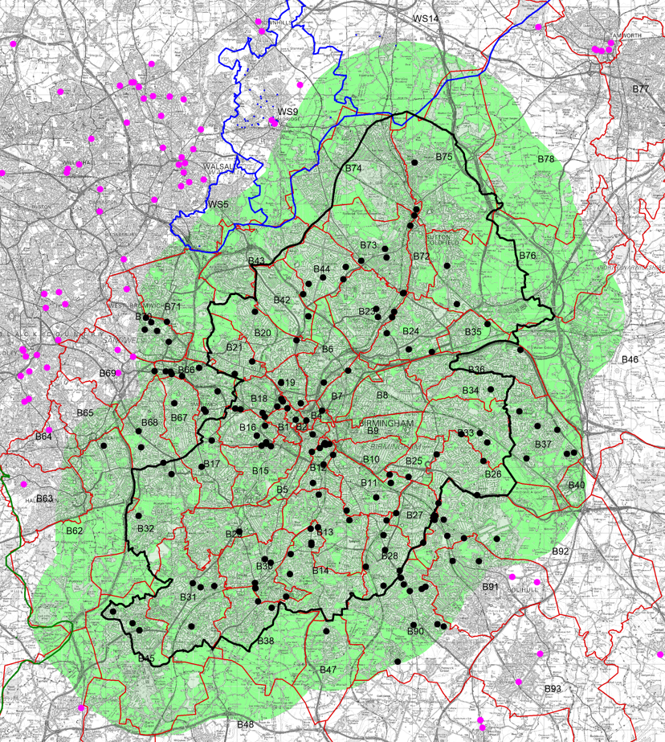
Geographic Entry Criteria
Changed from ‘B’ postcode to locations which are within 2 miles of the Birmingham Council Tax boundary
Proposal designed to:
ensure local people are employed
allow efficient care to be delivered
ensure providers are local (previously open to EU)
reduce travel time for staff
support Net Zero compliance and reduce environmental impact
ensure care staff have access to local management/oversight
allow Commissioners to have oversight of the quality of services and undertake in-person quality visits
allows the majority of current contracted providers to apply
minimise the impact on citizens of needing to change providers
opens up to more providers to cover winter pressures
opens up to more providers registered to provide Children’s home support, where there have been capacity challenges
Produce with the permission of the Controller of His Majesty’s Stationery Office and Crown Copyright. Unauthorised reproduction infringes Crown Copyright and may lead to prosecution or civil proceedings.

Slide 8
Fees
MS&IF and ASCDF Grants for 23/24 currently being processed but will mean:
One off payments in lieu of fee increase for 23/24 currently being processed
Application of Grants into 24/25 fee rate = at least £20.59/hr for home support
National Living Wage confirmed as £11.44/hr from 1 April 2024
Council’s S114 Notice means revised budget setting process
Council budget to be finalised by 27 February 2024
Any inflation provision to be confirmed as soon after 27 Feb as possible

Slide 9
Transition Arrangements
Transition arrangements for:
Any unsuccessful providers who are currently contracted
Currently contracted providers who are rated RI at the time of the tender
Currently contracted providers who don’t have registered location within 2 miles of the Birmingham Council Tax Boundary
Two year transition period:
Maintain existing commissioned packages of care during transition period
No new commissioned packages of care
Fee increase in 2024/2025 only – no fee increases after this for commissioned packages of care
Routine social work reviews to consider if citizens wish to remain under a DP or whether they want the Council to recommission their care with a new contracted provider
If citizens remain with the existing provider but under a DP any new DP rate will apply

Slide 10
Quick Discharge Service
Single city-wide provider, but to operate and manage the service on a locality basis
Quick Discharge Service+ for any additional demand that cannot be met – see next slide
Out of hours Quick Intervention Service to continue
Working as an integrated partner within our Early Intervention Community Team alongside BCC and NHS colleagues
No change to fee structure, although rates will be revised in line with ‘Fees’ slide
Entry criteria:
Must have a CQC registered location within 2 miles of the Birmingham Council Tax Boundary
Good or Outstanding CQC rating only
Provider location must employ 200+ staff
Detailed specification still being finalised with NHS partners, but any significant new elements will have an implementation period

Slide 11
Quick Discharge Service+
To provide additional capacity when needed
Home Support 2024 providers able to request access to these referrals as part of application process
QDS Premium (currently £1/hr) will be paid
Providers accepting QDS+ referrals will need to accept packages within 4hrs and start within 2 hours of requested start time
No other additional requirements of QDS specification apply to QDS+

Slide 12
Proposed Timescales/Next Steps
Activity | Earliest Possible Dates
Cabinet Approval (Strategy) | 12 December 2023
Council Budget to Full Council | 27 February 2024
Fee Increases confirmed | 13 March 2024
Market Briefings – Application Process | Late Feb – early March
ITT Issued | 13 March 2024
Clarification Period (3 weeks) | 14 March 2024 – 4 April 2024
ITQ Return (allowing 30 days) | 12 April 2024
Evaluation Period (5 weeks) | 15 April 2024 – 19 May 2024
Award Approval (3 weeks) | 20 May 2024 – 9 June 2024
FCA Contract Award | 13 June 2024
FCA Standstill Period (10 working days) | 13 June 2024 – 27 June 2024
FCA Award Letters Issued | 28 June 2023
FCA Starts – Individual Contracts | 1 July 2024

Slide 13
Q&A Session

Slide 14
Contact information

