Slide 1
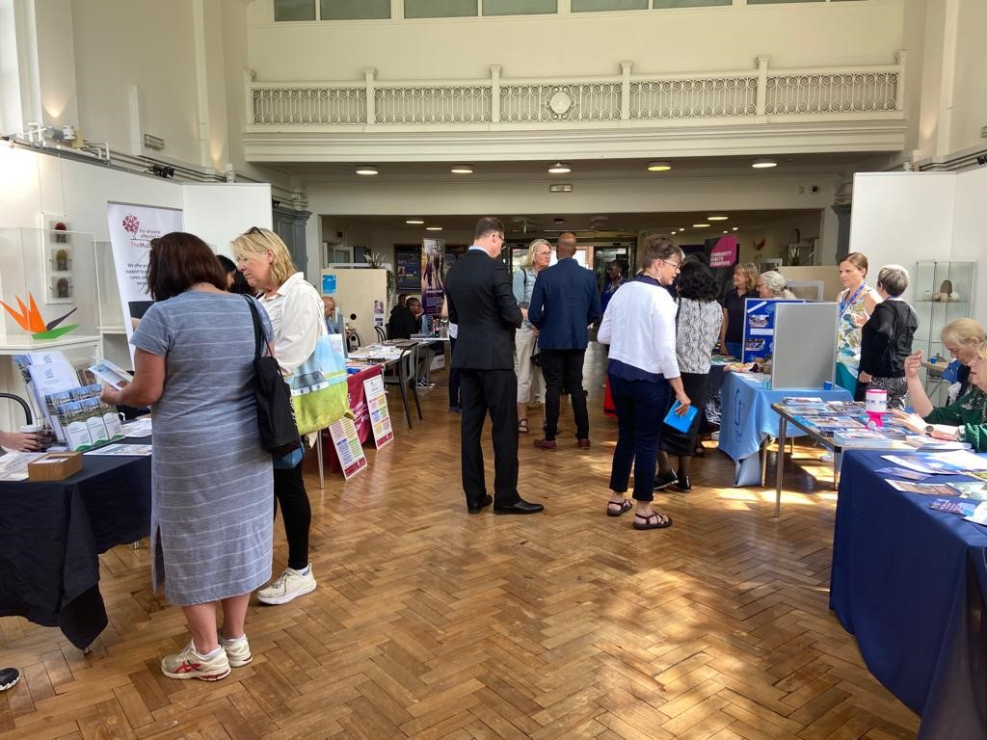
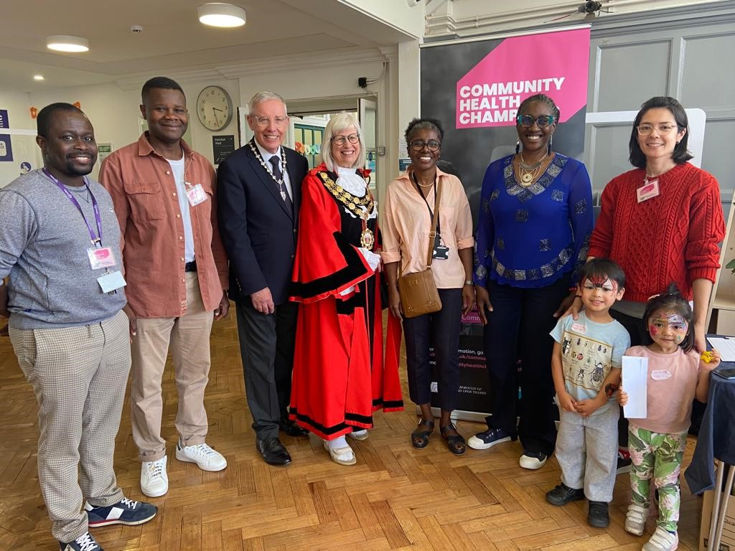
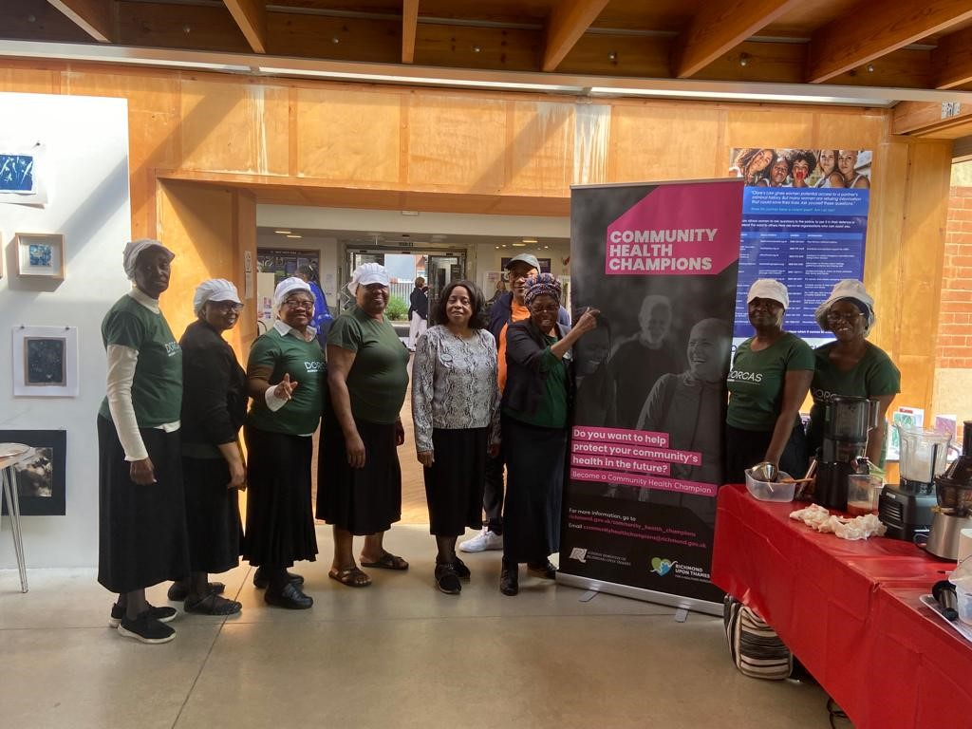
Addressing Health Inequalities in Richmond upon Thames Borough Council.
Addressing Health Inequalities in Richmond upon Thames Borough Council By Patricia Kanneh-Fitzgerald Lead, Community Health Champions Programme Dr Nike Arowobusoye, Public Health Consultant
INTRODUCTION
This report is about addressing health inequalities in Richmond Borough Council by working with our Community Health Champions (CHCs). We have CHCs in every ward of the borough and they have helped make previously “invisible” communities more visible and engaged in the borough and public health initiatives. We work with our champions using our Public Health Community Action - 5-Step collaborative model.
Engagement and Insight gathering
Capacity building (individuals, organisations)
Co-production
Communication
Celebration
One of the key parts of whole systems thinking is collaborative work and this has been very important to the champions. They have been involved in the engagement and co-production of some of our services.
Our focus for this report is the collaborative Summer Health Fair by Richmond Public Health and Richmond Community Health Champions held in July 2023.
KEY LEARNINGS
The Council cannot deliver in isolation
We should focus on systems thinking and design – co-designing our approach
Listening to our communities
Flexibility - think longer term
Community led – their terms and choice
Make it interesting and exiting
Don’t judge people
Offer incentives – (food, vouchers, training)
Feeding back to our communities
The messenger is more important than the message
Some of our Community Champions and local residents had the opportunity to meet and engage with senior members of the council
OBJECTIVE
The objective of the Summer Health Fair was to bring together local Health and Wellbeing services and our communities to raise awareness about general health and wellbeing. The theme was,
“Thinking about your health and wellbeing”
Dorcas is a group run by Caribbean men and women whose confidence has grown in promoting healthy eating and lifestyle in the London Boroughs of Richmond and Wandsworth. They provide informal and socially inclusive training for local people. They are very well organised and enjoy supporting their fellow ethnic minorities to embrace healthy eating and improve their lifestyle which influences their behaviour.
STRATEGY
Public Health Richmond provided data on Health Inequalities
The Champions met and identified the most disadvantaged and disengaging wards in the borough
A decision was made on a date and time that will work for most of our residents
A suitable venue with easy access, space and required facilities was secured
A list of service providers and support services in the borough was created and invited to showcase their work
Free Eventbrite was created, the event was publicised via social media, press release, flyer distribution targeting those communities who don’t always engage with us or our NHS partners
The Mayor of Richmond upon Thames borough council was invited to deliver the vote of thanks
SUCCESSES
14 information stalls were present at the event showcasing their work
170 local residents attended
People said the food was fantastic and healthy
People said they were happy with the venue and information and support available however, they would like more events like this in public areas, for example; outside Twichenham Train Station
People loved the stall with information and advice on sugar contents in drinks and what alternative we could go for.
People were pleased with the stall that provided information, advice and tastings of the different fruit and vegetable puree
Local organisations said they are keen to work with the Community Health Champions

