Slide 1
Annual Safeguarding Training
September 2023
Prepared by the Education Safeguarding Team

Slide 2
Updates to KCSIE 2023

Slide 3
Updates Include
Online Monitoring and Filtering
Children Absent from Education
Elective Home Education
Changes to terminology
Safer recruitment – online searches
Use of school premises for non-school activities

Slide 4
Online Safety
The DSL should take lead responsibility for updates on Online Safety
Staff Safeguarding and Child Protection training should include an understanding of online safety
Reiteration that schools should follow the recently published DfE publication of filtering and monitoring standards and guidance
Governing bodies/proprietors strategic training should include an understanding of online safety and should review the standards with IT staff and service providers
Schools should consider meeting the Cyber security standards
The Safeguarding and Child Protection Policy should reflect the individual schools’ approach to online safety on school devices and networks

Slide 5
Online Safety
All staff should be aware of the dangers young people face online
Risks include:
  Criminal and sexual exploitation
  Online child on child abuse
  Exposure to inappropriate adult content
  Online grooming
  Radicalisation
  Sexting, up-skirting and sharing of indecent images

Slide 6
Consensual and non-consensual sharing of indecent images as part of child on child abuse
Your policy should include the school’s approach to dealing with consensual and non-consensual sharing of nude and semi-nude images and/or videos, known as sexting or youth produced sexual imagery.
DfE provides Searching Screening and Confiscation Advice for schools.
UKCIS Education Group has published Sharing nudes and semi-nudes: advice for education settings working with children and young people which outlines how to respond to an incident of nude and/or semi nude being shared (KCSiE 156:6e).

Slide 7


Responsibility of schools to support parents with online safety
Schools and colleges should use communications with parents and carers to reinforce the importance of children being safe online and should share information with parents/carers about:
  What systems they have in place to filter and monitor online use
  What they are asking children to do online, including any sites they will be asked to access
  Who from the school or college their child is going to be interacting with online

Slide 8
Children Absent from Education
Where a child has an EHCP the local authority will need to review the plan whilst working closely with parents:
  Elective Home Education (EHE) – and the need for greater vigilance and consideration of vulnerabilities
  ‘Children missing from education’ replaced with ‘Children who are absent from education’
  Updated guidance on school attendance, and children being absent from education for prolonged periods and/or on repeat occasions see Working together to improve school attendance
  Updated information on how schools should work with local authority children’s services where school absence indicates safeguarding concerns

Slide 9
Children Absent from Education and Attendance
The DfE published new guidance on improving school attendance which came into force from September 2022.
Working together to improve school attendance (publishing.service.gov.uk)

Slide 10
Changes in Terminology
Updated throughout to include reference ‘pupils or students’
Reference to teachers can ‘discipline’ have been replaced with teachers can ‘sanction’
Replaced children may be ‘vulnerable’ with children may be ‘susceptible’
Forced marriage to child marriage, highlighting the changes in law February 2023

Slide 11
Equality Act
Confirmation that provisions within the Equality Act allow schools to take positive action, where it can be shown that it is proportionate, to deal with particular disadvantages affecting pupils or students with certain protected characteristics in order to meet their specific need.
A school could, for example, consider taking positive action to support girls if there was evidence they were being disproportionately subjected to sexual violence or sexual harassment.
There is also a duty to make reasonable adjustments for disabled children and young people.

Slide 12
Safer Recruitment
Schools should inform shortlisted candidates that online searches may be done as part of due diligence checks.
Copies of documents used to verify the successful candidate’s identity, right to work and required qualifications should be kept on their personnel file.

Slide 13
Use of School Premises for Non-School Activities
Clarity around safeguarding arrangements that schools should expect providers [hirers] to have in place, see Keeping children safe in out of school settings.
Schools should follow the Birmingham No Platform policy.
Schools may receive an allegation relating to an incident that happened when an individual or organisation was using their school premises for the purposes of running activities for children, e.g., community groups, sports associations or service providers that run extra-curricular activities.
As with any safeguarding allegation, schools should follow their safeguarding policies and procedures, including informing the LADO.

Slide 14
UPDATES TO KEEPING CHILDREN SAFE IN EDUCATION
Part 1: Safeguarding Information for ALL Staff

Slide 15
Safeguarding and Promoting the Welfare of all Children
Safeguarding and promoting the welfare of all children is defined as:
  protecting children from maltreatment
  preventing the impairment of children’s mental and physical health or development
  ensuring that children grow up in circumstances consistent with the provision of safe and effective care
  taking action to enable all children to have the best outcomes
Children includes all young people under the age of 18 and 25 in the case of young people with disabilities.

Slide 16
Safeguarding and Promoting the Welfare of all Children
All staff have a responsibility to provide a safe environment in which children can learn
All staff should be prepared to identify children who may benefit from early help as well as understanding their local early help process
All staff should report any concerns to a DSL and record accordingly
All staff should be aware of the systems and staff within their school or college which support safeguarding, including
  Insert name of monitoring system used
  Child Protection Policy
  Behaviour Policy
  Staff Behaviour Policy or Code of Conduct

Slide 17
Designated Safeguarding Leads
Please insert names of staff members with DSL and safeguarding responsibilities as well as other key staff – i.e. Safeguarding Governor, SENCO etc.

Slide 18
Safeguarding Context
You may wish to provide a contextual picture of what safeguarding looks like in your school.
Issues covered may include mental health, neglect, youth violence/gang culture, criminal/sexual exploitation etc.

Slide 19
School Safeguarding Data
You may wish to include some school data in relation to your setting’s safeguarding/recording etc.

Slide 20
Safeguarding Concerns
All staff should have an awareness of safeguarding issues that can put children at risk of harm, including:
  Child on child abuse
  Domestic abuse
  Serious Youth Violence
  Child Sexual Exploitation (CSE)
  Child Criminal Exploitation (CCE)
  Online Safety
  Mental Health
  FGM
  Neglect
  Prevent
  Physical, Sexual and Emotional abuse
All staff should know how to report and record concerns.

Slide 21
Child on Child Abuse
It is essential that all staff understand the importance of challenging inappropriate behaviours between children, that are abusive in nature. Downplaying certain behaviours, for example dismissing sexual harassment as “just banter”, “just having a laugh”, “part of growing up” or “boys being boys” can lead to a culture of unacceptable behaviours, an unsafe environment for children and in worst case scenarios a culture that normalises abuse leading to children accepting it as normal and not coming forward to report it.
Children who identify as LGBTQ+: The fact that a child or a young person may be LGBTQ+ is not in itself an inherent risk factor for harm. However, children can be targeted by other children. In some cases, a child who is perceived by other children to be LGBTQ+ (whether they are or not) can be just as vulnerable as children who identify as LGBTQ+.

Slide 22
Domestic Abuse
Domestic abuse has been added to the list of safeguarding issues that staff should be aware of.
It’s important to recognise that domestic abuse:
  can be psychological, physical, sexual, financial, or emotional
  can impact on children through seeing, hearing or experiencing the effects of domestic abuse and/or experiencing it through their own intimate relationships (teenage relationship abuse)
  can encompass a wide range of behaviours and may be a single incident or a pattern of incidents
All of these can have a detrimental and long-term impact on children’s health, well-being, development, and ability to learn.

Slide 23
Disclosures
Children may not feel ready, or know how to tell someone what they are experiencing:
  They may feel it’s their fault
  They will get into trouble
  Nobody will believe them
  Nobody can stop it
  Things will get worse
  People they love will be hurt if they tell
  They told before and nobody listened
  They will be taken into care
  They believe that this is what happens in families
  They feel ashamed

Slide 24

Operation Encompass
As part of the citywide response to the Domestic Abuse and Prevention Strategy schools must:
  Complete the Operation Encompass online training from Virtual College Online Key Adult Training
  Key Adults to monitor a notifications portal where information is shared in respect of incidents of domestic violence and abuse
  Complete the actions listed in the school’s Operation Encompass Action Plan (available on the Education Safeguarding website).
  Follow up with discreet monitoring with child and family by DSLs and key staff.
  Subsequent referrals to be made where appropriate.

Slide 25

Serious Youth Violence
All staff should be aware of indicators, which may signal that children are at risk from, or are involved with serious violent crime. These may include:
  increased absence from school
  a change in friendships or relationships with older individuals or groups
  a significant decline in performance
  signs of self-harm or a significant change in well-being
  signs of assault or unexplained injuries
  unexplained gifts or new possessions
All staff should be aware of the associated risks and understand the measures in place to manage these.
For further advice:
Criminal exploitation of children and vulnerable adults: county lines - GOV.UK (www.gov.uk)

Slide 26
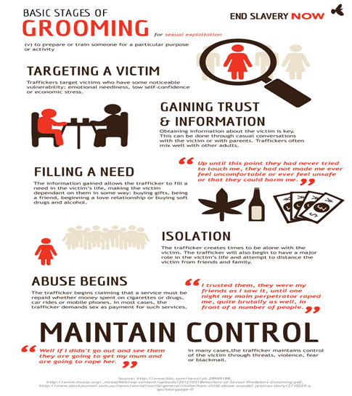
Child Criminal and Sexual Exploitation
Both CCE and CSE are forms of abuse that occur where an individual or group takes advantage of an… imbalance in power to coerce, manipulate or deceive a child into taking part in sexual or criminal activity, in exchange for something the victim needs or wants, and/or for the financial advantage or increased status of the perpetrator or… facilitator and/or through violence or the threat of violence.
CCE and CSE can affect children, both male and female and can include children who have been moved (commonly referred to as trafficking) for the purpose of exploitation.
3 stages of Exploitation

Slide 27
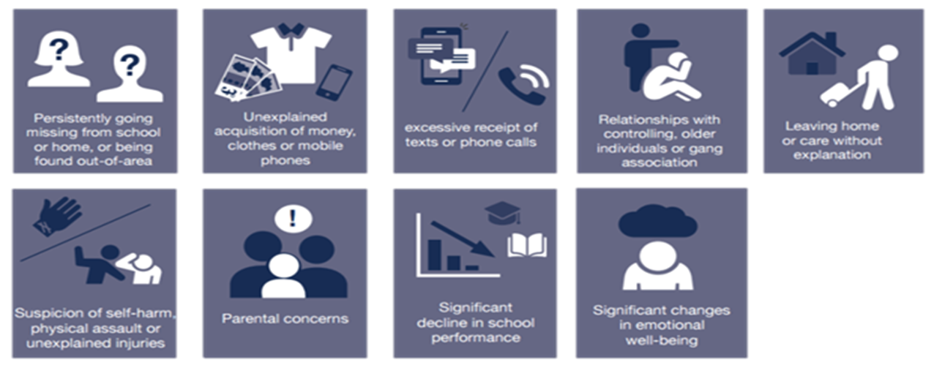
Child Criminal Exploitation and County Lines – Know the signs!

Slide 28




Child Criminal Exploitation and County Lines
It is important to note that the experience of girls who are criminally exploited can be very different to that of boys. The indicators may not be the same, and professionals should be aware that girls are at risk of criminal exploitation too.
It is also important to note that both boys and girls being criminally exploited may be at higher risk of sexual exploitation.

Slide 29
Neglect
Neglect is when a parent or carer doesn’t meet the basic physical and/or emotional needs of their children. This means that children who are experiencing neglect don’t regularly get all of the essential things they need to keep them happy, healthy and safe and well – things like nutritious food, good hygiene, a safe place to live, adequate clothing, medical care, education and love and affection.
Neglect is the most common form of child abuse and the most common reason for a child to be subject to a Child Protection plan.
Neglect can have a significant and long lasting impact on children. It is better to respond to neglect at an early stage, but it can be difficult to identify and to assess.
This means that neglect is often missed or noticed at a much later stage where it is harder to intervene.

Slide 30
Neglect Strategy and Graded Profile
What is Graded Care Profile 2 (GCP2)?
  GCP2 is a licensed assessment tool from NSPCC
  GCP2 can support professionals working with children and families to measure the quality of care provided to a child
  The tool evaluates the quality of physical and emotional care provided to children by using a scale of 1 (best) to 5 (worst) in different areas of physical and emotional care such as nutrition, hygiene, safety, and supervision
  This can be used by one or more agencies working with the family and will help focus and inform intervention plans
Birmingham Neglect Strategy
How to Spot Neglect

Slide 31

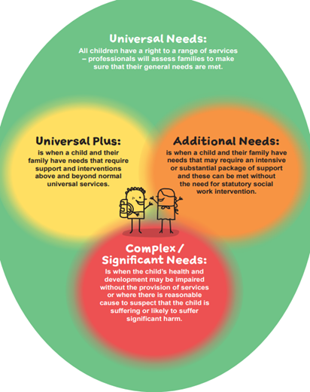
Right Help Right Time
Referrals for support are deemed by thresholds. These thresholds determine who is the most appropriate agency to respond to the needs of a family. Schools and other organisations now seek support for children and families through Locality Hubs in every district. These provide access to much needed services and funds for vulnerable families within our community.

Slide 32
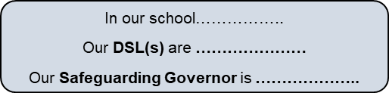
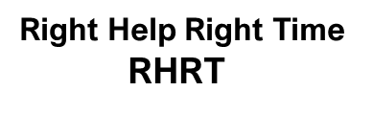
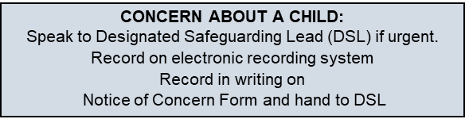
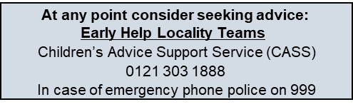
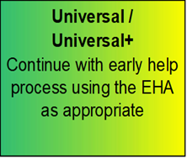
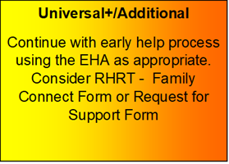
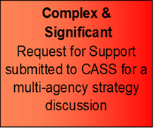
Right Help Right Time RHRT
eLearning Courses (lscpbirmingham.org.uk)
Family Connect Form

Slide 33
Children’s Advice and Support Service (CASS)
Telephone: 0121 303 1888
This is the central referral point for the Birmingham Multi-Agency Safeguarding Hub. Professionals that sit within the hub include Health, Birmingham Children’s Trust and Police.
  Early Help requests are accessed via an online form known as the Family Connect Form
  Family Support and Children’s Services support is accessed via a Request for Support Form
  Support for Criminal Exploitation and Sexual Exploitation is accessed via a Screening Tool submitted the EMPOWERU Exploitation Hub
  Support for FGM is accessed via a screening tool to CASS
  Support for concerns around radicalisation are accessed via a screening tool to the PREVENT Team via CASS

Slide 34
Useful Resources
Barnardos Exploitation
Children's Safeguarding Partnership child-exploitation
Defining Child Criminal Exploitation
Child Exploitation Prevention Toolkit
CSE police and prevention toolkits
St Giles vulnerabilities-to-child-criminal-exploitation
NSPCC
DSL resources contextual safeguarding
Birmingham Early Help Locality Leads
Violence Reduction Unit
WMP Violence Reduction Birmingham offer
EMPOWERU Referral Process
Domestic Abuse Act 2021 factsheet
Birmingham neglect Strategy 2022-2026
Forced marriage - GOV.UK (www.gov.uk)

Slide 35
Contact Us
Educationsafeguarding@birmingham.gov.uk
CASSEducation@birmingham.gov.uk
OpEncompassBham@birmingham.gov.uk
Education Safeguarding Team Web Page
Birmingham Safeguarding Children Partnership

Slide 36
Social media final slide

