Slide 1
Annual Safeguarding Training and Updates to . Keeping Children Safe in Education 2022
Prepared by
Education Safeguarding Team.

Slide 2
Part 1 Safeguarding Information for ALL Staff

Slide 3
Safeguarding and Promoting the Welfare of all children
Safeguarding and promoting the welfare of all children is defined as:
protecting children from maltreatment
preventing the impairment of children’s mental and physical health or development
ensuring that children grow up in circumstances consistent with the provision of safe and effective care, and
taking action to enable all children to have the best outcomes.
Children includes all young people under the age of 18 and 25 in the case of young people with disabilities.

Slide 4
All staff have a responsibility to provide a safe environment in which children can learn.
All staff should be prepared to identify children who may benefit from early help as well as understanding their local early help process.
All staff should report any concerns to a DSL and record accordingly.
All staff should be aware of the systems and staff within their school or college which support safeguarding, including:
[Insert name of monitoring system used]
Child Protection Policy
Behaviour Policy
Staff Behaviour Policy or Code of Conduct

Slide 5
Designated Safeguarding Leads
[Please insert names of staff members with DSL and safeguarding responsibilities as well as other key staff – i.e. Safeguarding Governor, SENCO etc]

Slide 6
Safeguarding Context
[You may wish to provide a contextual picture of what safeguarding looks in your school. Issues covered may include mental health, neglect, youth violence/gang culture, criminal/sexual exploitation etc]

Slide 7
School Safeguarding Data
[You may wish to include some school data in relation to your setting’s safeguarding/recording etc.]

Slide 8
Safeguarding Concerns
All staff should have an awareness of safeguarding issues that can put
children at risk of harm, including:
Child on Child Abuse
Domestic Abuse
Serious Youth Violence
Child Sexual Exploitation (CSE)
Child Criminal Exploitation (CCE)
Online Safety
Mental Health
FGM
Neglect
Physical, Sexual and Emotional abuse
All staff should know how to report and record concerns.

Slide 9
CHILD ON CHILD ABUSE – changes to KCSIE 2022
Child-on-child abuse – replaces the term ‘peer-on-peer abuse’, there is a clear requirement that the school/college’s child protection policy should include procedures for dealing with child on child abuse, and all staff should be aware of this. (p12-13)
Additional guidance relating to LGBT+ pupils and the need to further safeguard
within the context of child-on-child abuse. This should be reflected in school policies.
Sexual Violence and Sexual Harassment in Schools: The DfE’s advice on Sexual violence and sexual harassment between children in schools and colleges (DfE, 2021) has been merged into Keeping children safe in education 2022.
Supporting victims of abuse – there is an emphasis that all staff should be able to reassure victims of abuse that they are being taken seriously and will be supported; ensuring that children/ young people are never made to feel ashamed or that they are creating a problem by reporting abuse, sexual violence or sexual harassment.

Slide 10
Child on Child Sexual Violence and Sexual Harassment
This section has been expanded to incorporate guidance previously covered in the DfE’s Sexual Violence and Sexual Harassment between Children in Schools and Colleges advice. It also provides new information, emphasising:
• the importance of explaining to children that the law is in place to protect rather than criminalise them.
• the importance of understanding intra-familial harms, and any necessary support for siblings following incidents.
• the need for schools and colleges to be part of discussions with statutory safeguarding partners.

Slide 11
Child on Child Abuse
It is essential that all staff understand the importance of challenging inappropriate behaviours between children, many of which are listed below, that are abusive in nature. Downplaying certain behaviours, for example dismissing sexual harassment as “just banter”, “just having a laugh”, “part of growing up” or “boys being boys” can lead to a culture of unacceptable behaviours, an unsafe environment for children and in worst case scenarios a culture that normalises abuse leading to children accepting it as normal and not coming forward to report it.
Children who identify as LGBT+
The fact that a child or a young person may be LGBT is not in itself an inherent risk factor for harm. However, children who are LGBT can be targeted by other children. In some cases, a child who is perceived by other children to be LGBT (whether they are or not) can be just as vulnerable as children who identify as LGBT. (KCSiE 2022, P49, Para 202)

Slide 12
Domestic Abuse – changes to KCSIE 2022
Domestic abuse has been added to the list of safeguarding issues that all staff should be aware of. It is important to recognise that this…
can be psychological, physical, sexual, financial, or emotional
can impact on children through seeing, hearing or experiencing the effects of
domestic abuse and/or experiencing it through their own intimate relationships (teenage relationship abuse).
Domestic abuse can encompass a wide range of behaviours and may be a single incident or a pattern of incidents.
All of which can have a detrimental and long-term impact on their health, well-being, development, and ability to learn.

Slide 13
Birmingham Domestic Abuse Prevention Strategy
Domestic violence is a crime. We are committed to preventing domestic abuse, improving the support and protection for victims and their children, and bringing domestic abusers to justice.
In doing so, we will ensure that women, their children and families are liberated from fear, insecurity and harm, and can lead the safe, happy, healthy and fulfilling lives that they deserve.
Councillor Paulette Hamilton Chair of Birmingham Health and Wellbeing Board Cabinet Member for Health and Social Care

Slide 14
Disclosures:
Children may not feel ready, or know how to tell someone what they are experiencing:
They may feel it is their fault
They will get into trouble
Nobody will believe them
Nobody can stop it
Things will get worse
People they love will be hurt if they tell
They told before and nobody listened
They will be taken into care
They believe that this is what happens in families
They feel ashamed

Slide 15
Operation Encompass
As part of the city wide response to domestic abuse and prevention strategy, Birmingham Schools must:
Complete the Operation Encompass online training from Virtual College Online Key Adult Training.
Key adults to monitor a notifications portal where information is shared in respect of incidents of domestic violence and abuse.
Complete the actions listed in the school’s Operation Encompass Action Plan. (available on the Education Safeguarding Website)
Follow up with discrete monitoring of child and family by DSLs and key staff.
Subsequent referrals to be made where appropriate.

Slide 16
Serious Violence
All staff should be aware of indicators, which may signal that children are at risk from, or are involved with serious violent crime. These may include:
increased absence from school
a change in friendships or relationships with older individuals or groups
a significant decline in performance
signs of self-harm or a significant change in well-being
signs of assault or unexplained injuries
unexplained gifts or new possessions
All staff should be aware of the associated risks and understand the measures in place to manage these.
For further advice see :–
Preventing youth violence and gang involvement and Criminal exploitation of children and vulnerable adults: county lines

Slide 17
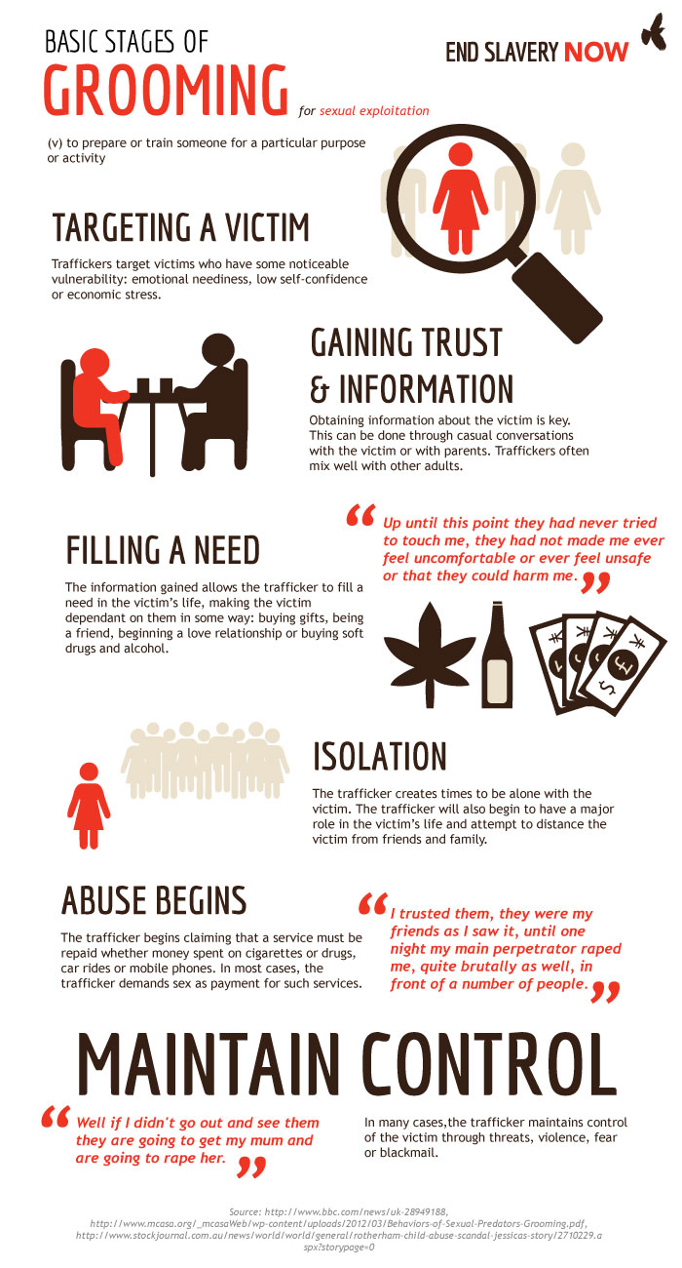
Child Criminal and Sexual Exploitation
Both CCE and CSE are forms of abuse that occur where an individual or group takes advantage of an
…imbalance in power to coerce, manipulate or deceive a child into taking part in sexual or criminal activity, in exchange for something the victim needs or wants, and/or for the financial advantage or increased status of the perpetrator or… facilitator and/or through violence or the threat of violence.
CCE and CSE can affect children, both male and female and can include children who have been moved (commonly referred to as trafficking) for the purpose of exploitation.

Slide 18
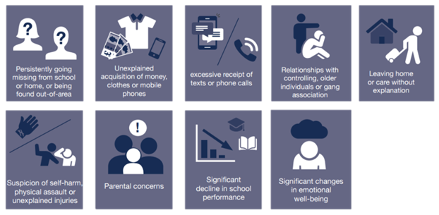
Child Criminal Exploitation and County Lines.
Know the signs!

Slide 19
It is important to note that the experience of girls who are criminally exploited can be very different to that of boys.
The indicators may not be the same, however professionals should be aware that girls are at risk of criminal exploitation too.
It is also important to note that both boys and girls being criminally exploited may be at higher risk of sexual exploitation

Slide 20
Online Safety
All staff should be aware of the dangers young people face online.
Risks include:
Criminal and Sexual Exploitation
Online child on child abuse
Exposure to inappropriate adult content.
Online grooming
Radicalisation
Sexting, up-skirting and sharing of indecent images.

Slide 21
Consensual and non-consensual sharing of indecent images as part of child on child abuse.
‘consensual and non-consensual sharing of nude and semi-nude images and/or videos41 (also known as sexting or youth produced sexual imagery): the policy should include the school or college’s approach to it. The Department provides Searching Screening and Confiscation Advice for schools. The UKCIS Education Group has published Sharing nudes and semi-nudes: advice for education settings working with children and young people which outlines how to respond to an incident of nude and/or semi[1]nude being shared’
(KCSiE para 156 (bullet point 6 e)
SearchingConfiscateScreenatSchool- GOV.UK (www.gov.uk)
Notes:
This should be reflected within school’s safeguarding and ICT acceptable usage policies.

Slide 22
Responsibility of schools to support parents with online safety.
Schools and colleges should use communications with parents and carers to reinforce the importance of children being safe online.
Schools should share information with parents/carers about:
• what systems they have in place to filter and monitor online use
• what they are asking children to do online, including the sites they will asked to access
• who from the school or college (if anyone) their child is going to be interacting with
online.

Slide 23
Neglect
Neglect is when a parent or carer doesn’t meet the basic physical and/or emotional needs of their children.
This means that children who are experiencing neglect don’t regularly get all of the essential things they need to keep them happy, healthy and safe and well – things like nutritious food, good hygiene, a safe place to live, adequate clothing, medical care, education and love and affection.
Neglect is the most common form of child abuse and the most common reason for a child to be subject to a Child Protection plan.
Neglect can have a significant and long-lasting impact on children. It is better to respond to neglect at an early stage, but it can be difficult to identify and assess.
This means that neglect is often missed or noticed at a much late stage where it is harder to intervene.
You can access this link about How to Spot Neglect

Slide 24
Neglect Strategy and Graded Profile.
What is Graded Care Profile version 2 (GCP2)
GCP2 is a licensed assessment tool from NSPCC
GCP2 can support professionals working with children and families to measure the quality of care provided to a child.
The tool evaluates the quality of physical and emotional care provided to children by using a scale of 1 (best) to 5 (worst) in different areas of physical and emotional care such as nutrition, hygiene, safety, and supervision.
This can be used by one or more agencies working with the family and will help focus and inform intervention plans.
Birmingham’s Neglect Strategy for 2022-26 will be launched at the planned Neglect Conference on 26th September 2022.

Slide 25
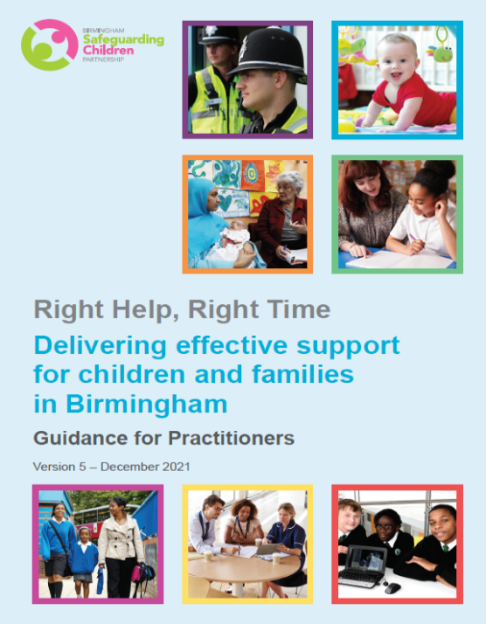
Right Help Right Time
Referrals for support are deemed by thresholds. These thresholds determine who is the most appropriate agency to respond to the needs of a family. Schools and other organisations now seek support for children and families through Locality Hubs in every district. These provide access to much needed services and funds for vulnerable families within our community.
RHRT document

Slide 26
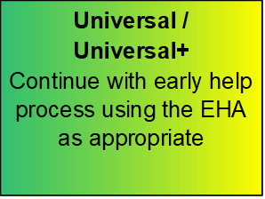
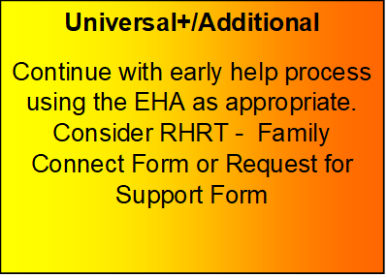
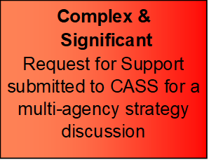
The schools model policy incorporates the Right Help Right Time (RHRT) process
In our school……………..
Our DSL(s) are …………………
Our Safeguarding Governor is ………………..
E-learning course available: http://www.lscpbirmingham.org.uk/training
CONCERN ABOUT A CHILD:
Speak to Designated Safeguarding Lead (DSL) if urgent.
Record on electronic recording system
Record in writing on
Notice of Concern Form and hand to DSL
At any point consider seeking advice:
Early Help Locality Teams
Children’s Advice Support Service (CASS)
0121 303 1888
In case of emergency phone police on 999

Slide 27
Children Missing Education and Attendance
The DfE have published new guidance on improving school attendance which will come into force from September 2022.
Working together to improve school attendance (publishing.service.gov.uk)

Slide 28
Children’s Advice Support Service (CASS)
You should contact CASS to raise concerns about a child and forms part of the ‘front door’ to Birmingham Children’s Trust
CASS: 0121-303-1888
Emergency Duty Team: (out of hours) 0121- 675 - 4806
The Birmingham Multi-Agency Safeguarding Hub (MASH) is also located within the front door space along with Missing and Exploitation Hub (EMPOWER-U).
Professionals that sit within these spaces include Health, Birmingham Children’s Trust (BCT), Police and Education Safeguarding.

Slide 29
Support from the Education Safeguarding Team
For queries, enquiries or questions around:
Referrals, Requests for Support or cases currently progressing through the front door, please email CASSEducation@birmingham.gov.uk and one of the officers will respond
Whole school safeguarding policy and procedure, training or Section 175 please email EducationSafeguarding@birmingham.gov.uk
Operation Encompass technical support or cases, please email OpEncompassBham@birmingham.gov.uk
Also…….
You should access the Resolution and Escalation protocol for any professional disputes that may arise when you are raising your concerns at the front door:
Escalation policy: Resolution of professional disagreements (procedures.org.uk)

Slide 30
Resource List:
NSPCC
Birmingham Children's Safeguarding Patrnership
St Giles vulnerabilities-to-child-criminal-exploitation
Defining Child Criminal Exploitation
Child Exploitation Prevention Toolkit
CSE police and prevention toolkits
Children's Safeguarding Partnership child-exploitation
Barnardos Exploitation

Slide 31
Resources continued
DSL resources contextual safeguarding
Violence Reduction Unit (now known as the Violence Reduction Partnership VRP
WMP Violence Reduction Birmingham offer
EMPOWERU Referral Process
Domestic Abuse Act 2021 factsheet
Birmingham Early Help Locality Leads

Slide 32
Useful Links.
Supporting practice in tackling child sexual abuse - CSA Centre
PACE Code C 2019 (accessible) - GOV.UK (www.gov.uk)
TeamOperationEncompassBirmingham
Searching, screening and confiscation at school - GOV.UK (www.gov.uk)
Working together to improve school attendance (publishing.service.gov.uk)
Human Rights Act 1998 (legislation.gov.uk)
EqualityAct2010:guidance(www.gov.uk)
RHRTElearningBirmingham(lscpbirmingham.org.uk)
BirminghamChildrensSafeguardingPartnershipTrainingOpportunities
Relationships Education and the Relationships and Sex Education

Slide 33
References
Department for Education (DfE) (2021) Keeping children safe in education 2021 [Accessed 13/07/2021]
CASPAR briefing Keeping children safe in education 2021 [Accessed 13/07/2021]
Relationships Education and the Relationships and Sex Education
Preventing youth violence and gang involvement
Criminal exploitation of children and vulnerable adults: county lines
Advice for Practitioners Providing Safeguarding Services to Children, Young People, Parents and Carers
Data protection: toolkit for schools
Sharing nudes and semi-nudes: advice for education settings working with children and young people
Mental health and behaviour in schools
Better Heath - every mind matters
Exclusions from maintained schools, academies and pupil referral units in England
Contextual Safeguarding
Alternative provision - DfE Statutory Guidance
Education for children with health needs who cannot attend school

Slide 34
Social media final slide

