Slide 1


Oracle Cloud
Guidance for BCC/BCT Suppliers
Last Updated: 10/03/2023

Slide 2
Guides included in this document
1. How to register as a supplier for BCC or BCT
2. How to create and submit invoices
3. How to track invoices & payments
4. How to respond to tender
5. How to manage contract deliverables
PAGE 2

Slide 3
For more help:
- First reach out to your contact within the Council or Children’s Trust
- If you still require assistance, please email
cps@birmingham.gov.uk

Slide 4

How to Register as a BCC or BCT Supplier

Slide 5

Register as a Supplier
1 |
Use one of the following links to register as a prospective supplier for either
Birmingham City Council (BCC) or Birmingham Children’s Trust (BCT).
Birmingham City Council:
https://enre.fa.em3.oraclecloud.com/fscmUI/faces/PrcPosRegisterSupplier?pr
cBuId=300000006062115
Birmingham Children’s Trust
https://enre.fa.em3.oraclecloud.com/fscmUI/faces/PrcPosRegisterSupplier?pr
cBuId=300000006062196

Slide 6

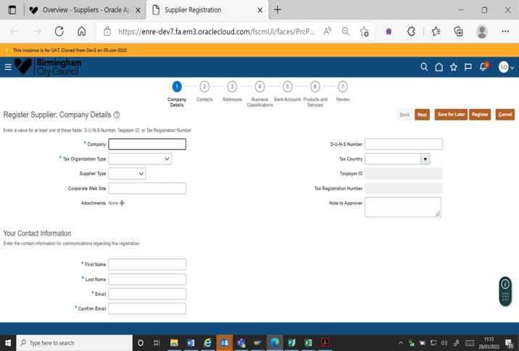
2 |Company Details
1. Company: Enter the company name in full as registered with
Companies House. For all other suppliers, HM Revenue &
Customs registered name should be used.
On the registration page, you will be able start registering your company details:
2. Tax Organisation Type: Choose the appropriate option from
the dropdown list.
3. Supplier Type: Choose the appropriate option from the
dropdown list
4. Company Web Site: Enter this if relevant
5. Attachments: Enter relevant attachments here
6. First Name – Enter this.
7. Last Name – Enter this.
8. Email: Enter the suppliers' general email address.
Preference should be given to shared email inbox address.
Please provide an email address suitable for receiving
purchase orders and remittance advice information.
9. DUNS Number: The Dun & Bradstreet DUNS number is a
unique nine digit identifier for business. The number is
assigned once you have completed the D&B resolution
process which identifies a company as being unique from any
other. DUNS numbers are often referenced by tenders and
potential business partners to help predict reliability and/or
financial stability of the company in question. It also enables
identification of relationships between corporate entities.
10. Tax Country: Choose the appropriate option from the
dropdown list
11. Taxpayer ID: Enter this
12. Tax Registration Number: Enter this

Slide 7
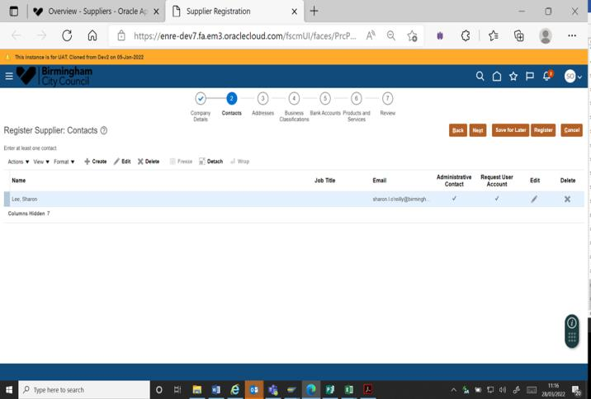
3 |Contacts
Different contacts can be set up for Tendering; Purchase Orders. Enter contact details as shown below:
The main contact details should be of the person who would
receive general communications etc.

Slide 8
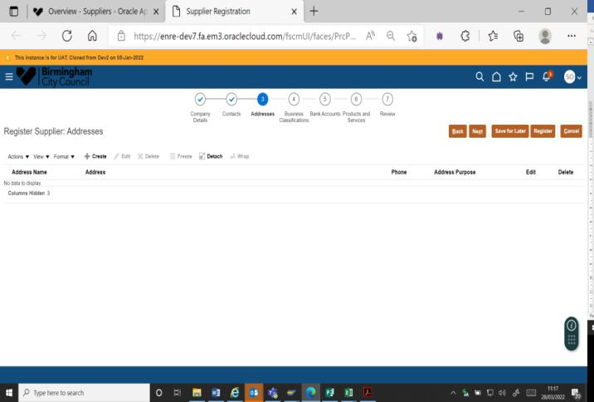
4 |Addresses
Enter address details as shown below:
The address should be the company address as set out in
Companies House.

Slide 9
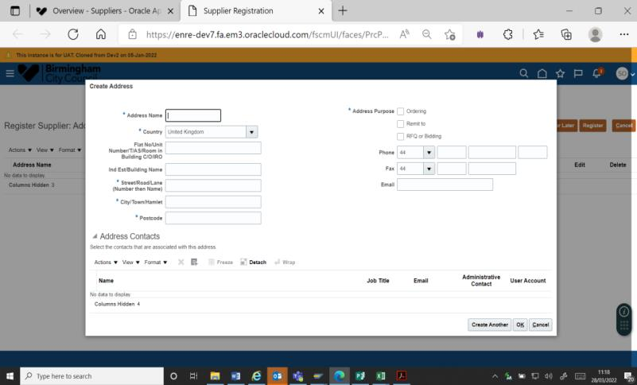
4 |Addresses
1. Address Name: Please ensure you enter the legal entity
registration address validated by Royal Mail including
post code.
2. Country: Pick the right country from the dropdown list
3. Flat no/Unit no etc: Enter this if relevant
4. Building Name: Enter this if relevant
5. Street/Road/Lane: Enter the number, then name
6. City/Town: Enter this
7. Postcode: re-enter the postcode
8. Address Purpose: this needs to be checked as RFQ or
Bidding if supplier is going to respond to tendering
activities
9. Phone: Enter this
10. Fax: Enter this
11. Email: Enter this

Slide 10

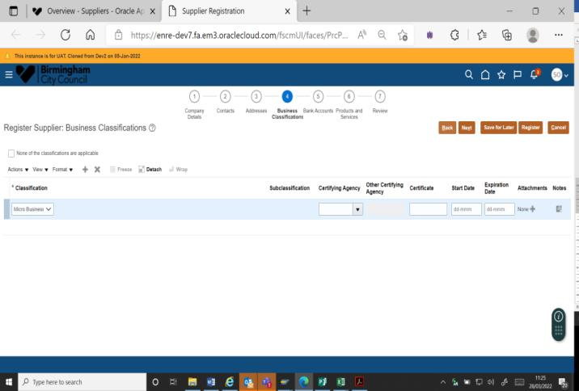
5 |Business Classification
Business Classification:
Is your business classified as one of the following?
Company Category
Medium-sized
Small
Staff Headcount
Turnover/Balance sheet total
≤ € 50 m ≤ € 43 m
≤ € 10 m
<250
<50
Micro
<50
≤ € 2 m
Third Sector Organisation - For this purpose, the third sector includes
any organisation where the profits are not distributable to an individual.
This is also known as asset locked which includes the following
organisation types:
- Community Interest Company (CIC).
- Charitable Incorporated Organisation (CIO).
- Registered Charity.
- A limited company (LTD) that is wholly owned by one of the above.
- A Housing Association on the RSL (Registered Social Landlord)
register.
- Industrial and Provident Societies (IPS).
- Companies Limited by Guarantee can be included in the third sector,
but their constitution needs to be examined regarding distribution of
surpluses.

Slide 11
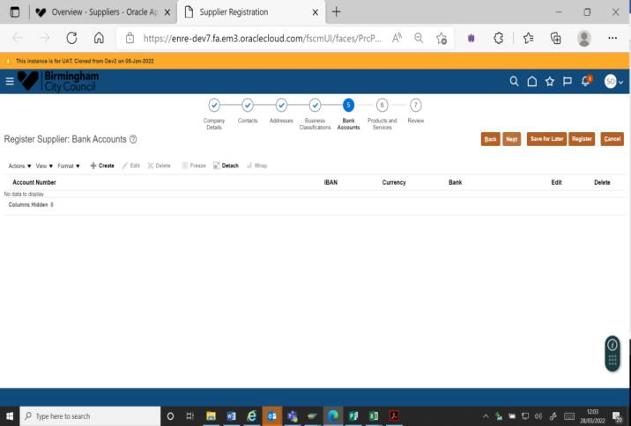
6 |Bank Accounts
1. Use the Create function to open the form to enter the bank
details.
2. If there are any attachments, please add them in the Company
Details form as demonstrated in that section.

Slide 12
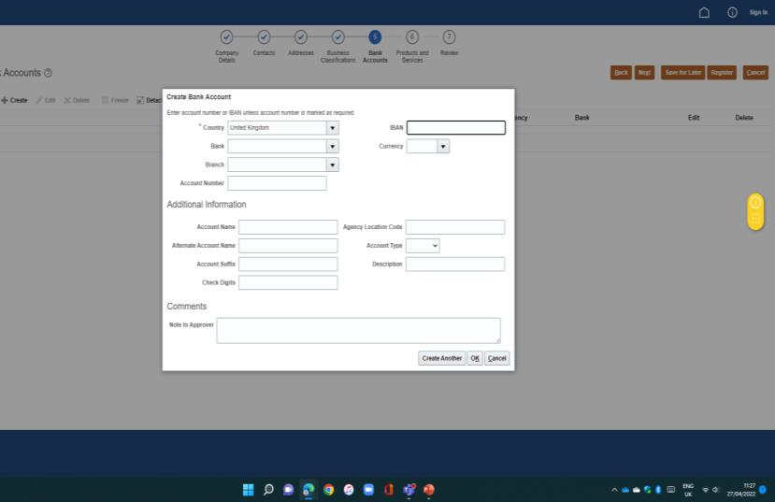
6 |Bank Accounts
Complete the details within the screen as evidence that the bank account belongs to you:
1. Country: select the correct country from the dropdown list
2. Bank: select the name of your bank from the dropdown list
3. Branch: select the bank branch from the dropdown list.
4. Account number: enter your account number
5. IBAN Number: International Bank Account No. is the
agreed system of identifying bank accounts across national
borders to facilitate the communication and processing of
cross border transactions. The IBAN consists of 34
alphanumeric characters comprising of a country code, two
check digits and a number that includes the domestic bank
account number, branch identifier, and potential routing
information.
6. Currency: select the currency from the dropdown list
7. Agency Location Code: enter this if relevant
8. Account Type: select the correct option if relevant
9. Comments: Add a note to the approver here if required
Note: If your bank or branch is not listed in the dropdown lists,
please email the vendor data team.

Slide 13
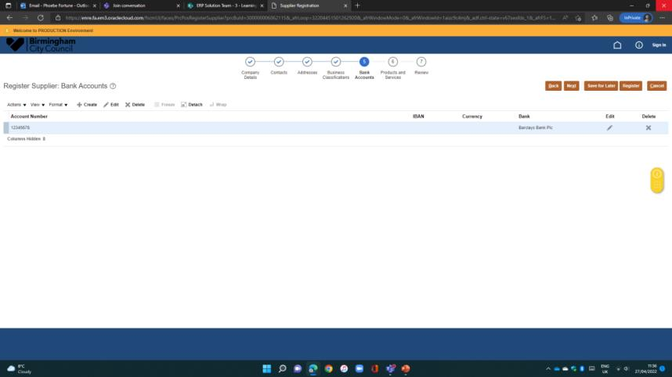
6 |Bank Accounts
1. The Account details will be show here. Click Next to move on.

Slide 14
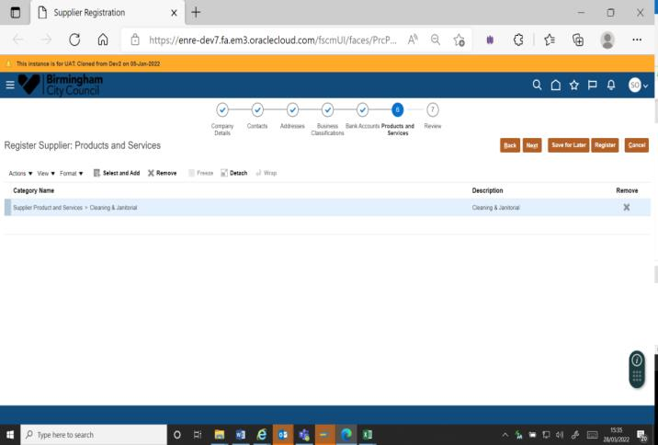
7 |Products and Services
1. Category Name: A comprehensive, easy to use
procurement classification is essential for any organisation
seeking to understand its third-party expenditure. ProClass
is tailored for use across the UK in local government to
categorise spend.
2. Choose the ‘Select and Add’ icon. This will bring up all the
choices available.
3. Choose the category that best describes the
products/services you provide.

Slide 15
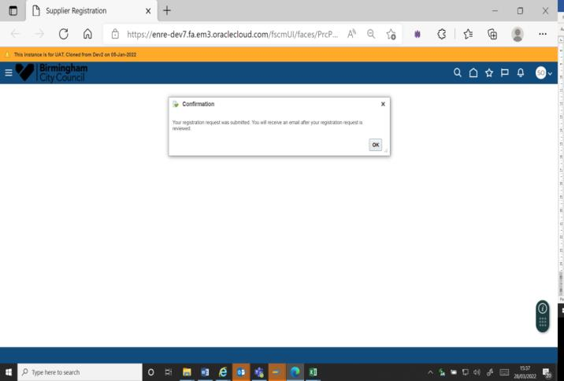
8 |Submit
You will be able to review all your details.
Then click OK on the Confirmation box.
Your details will be reviewed by the Council and you’ll receive an
email when your supplier portal account has been approved and
is ready for use.

Slide 16
How to view create and submit invoices

Slide 17



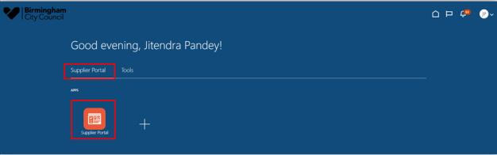
1 |Login to the Supplier Portal
1. Sign into Oracle Fusion by entering your username and password.
Screen print of Oracle on how to login to the supplier portal
2. Once signed in, you’ll be taken to the Home Page. You can sign out by clicking on your initials on the right-hand corner of the screen. There are several
key features to note:
Home Button: Returns
you to the main page
Favourites: You can save frequent
screens for quick access (for
example Submitting annual leave)
Navigator: You can
navigate to different areas
of the system
Bell notification: You will be notified
of any transactions including
approvals or actions required

Slide 18

Suppliers – Creating and Submitting Invoices
Overview
•
•
This guide provides steps to create and submit an invoice to respond to a purchase order from the City Council, Birmingham Children's Trust or others.
This is the preferred process for submitting invoices, as it allows us to automate matching purchase orders, therefore process payments quicker, providing goods
and services have been received.
Supplier processes
•
Please ensure any invoices submitted match the corresponding purchase order.

Slide 19
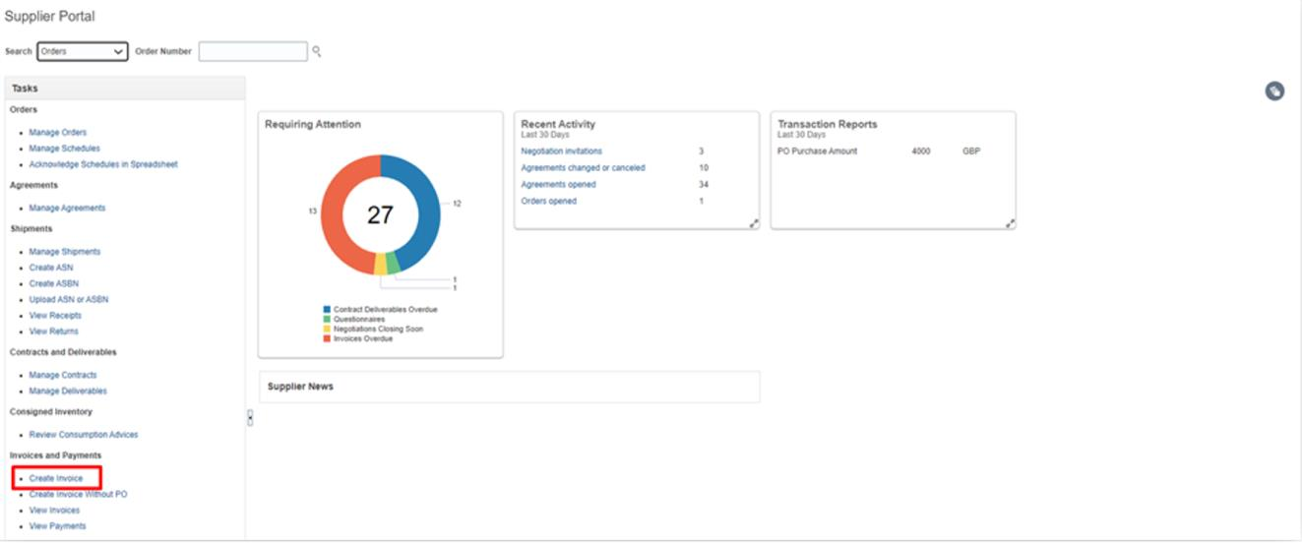

2| Create Invoice
Create Invoice: You can find the
option to create invoice under the
Invoices and Payments section
on the Task Bar

Slide 20

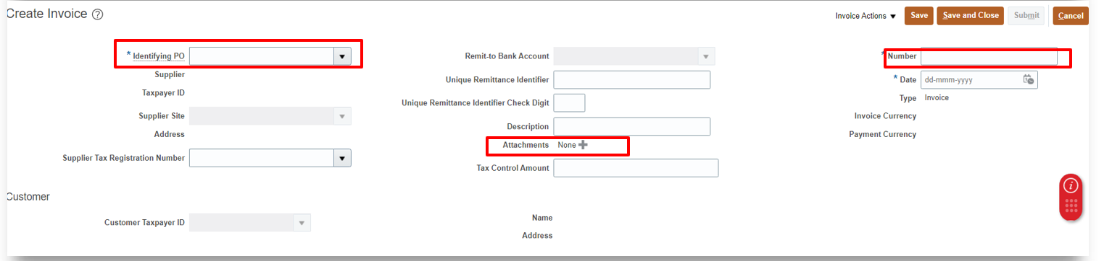
2| Create Invoice
Select the PurchaseOrder Number for which the invoice needs to be created. The user needs to enter the InvoiceNumber and the InvoiceDate.
•
•
•
Please note that Invoice can be submitted only for the purchase orders that are not closed or Final Closed or Cancelled.
Based on the PO number, Supplier and Supplier Site Information will be defaulted.
Also, attach the Invoice Copy in the Attachment section as highlighted in the screen below.

Slide 21

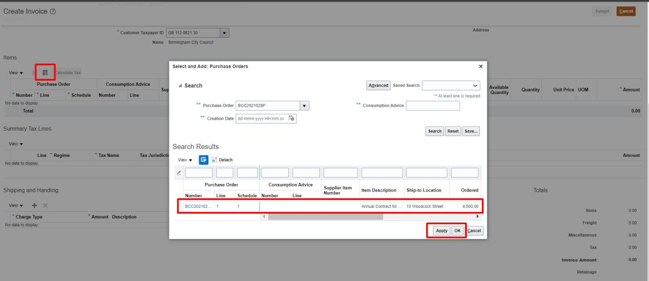
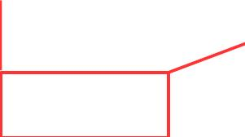
2| Create Invoice
Select the line and
click on Apply and
then OK.

Slide 22
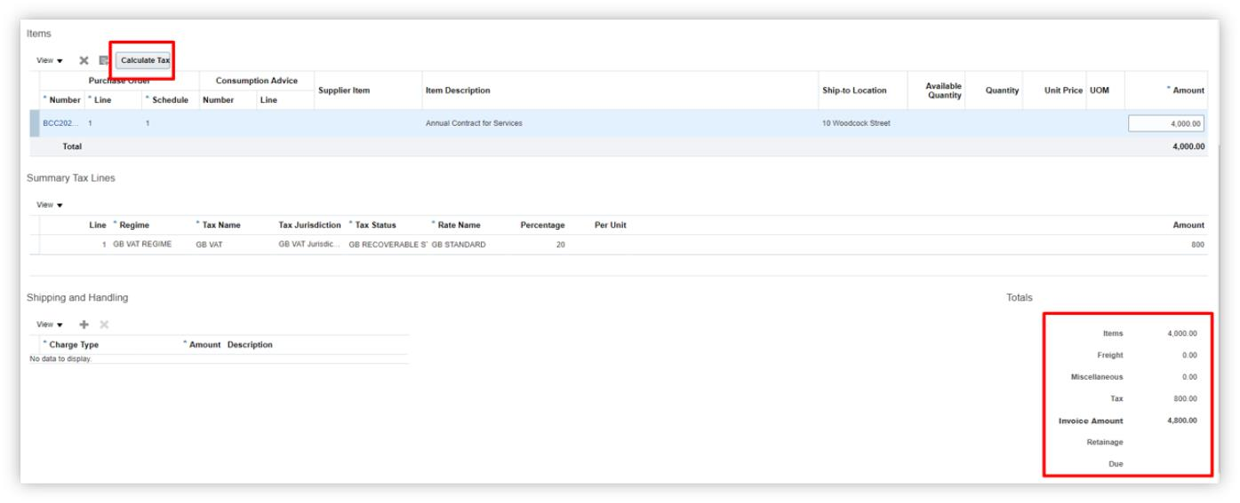
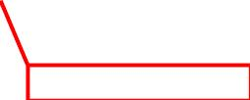

2| Create Invoice
The Purchase Order line will be added to the invoice document. System will automatically apply the tax amount on the invoice line.
Click on Calculate Tax
You can reduce the invoice amount.
(Note: You cannot increase the amount)
You can also adjust the tax amount if required. Please
contact Birmingham City Council’s Supplier Admin Team
if you are not able to add the Tax on your invoice.

Slide 23

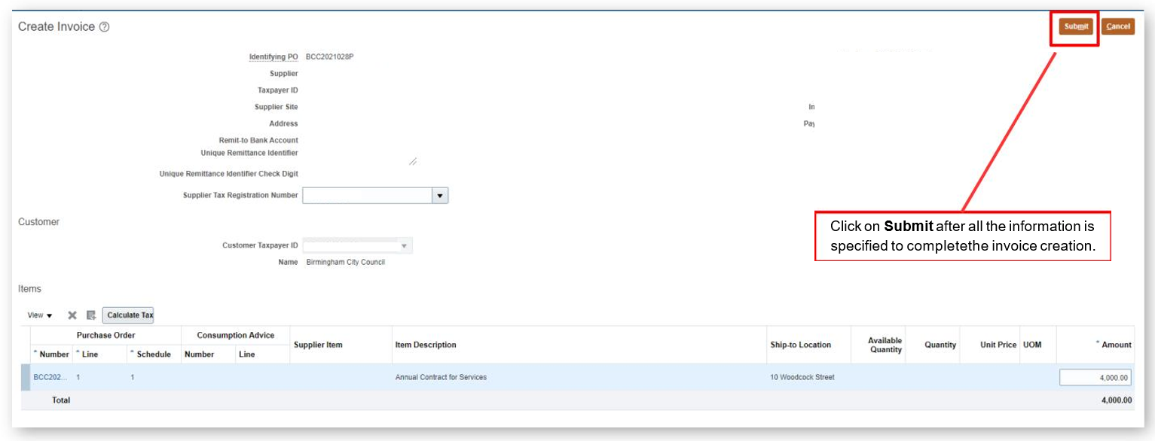

Submit Invoice
3|
Click on Submit after all the information is
specified to completethe invoice creation.

Slide 24
How to view invoices/track payments

Slide 25

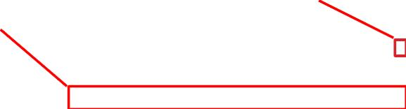


1 |Login to the Supplier Portal
1. Sign into Oracle Fusion by entering your username and password.
Screen print of Oracle on how to login to the supplier portal
2. Once signed in, you’ll be taken to the Home Page. You can sign out by clicking on your initials on the right-hand corner of the screen. There are several
key features to note:
Home Button: Returns
you to the main page
Favourites: You can save frequent
screens for quick access (for
example Submitting annual leave)
Navigator: You can
navigate to different areas
of the system
Bell notification: You will be notified
of any transactions including
approvals or actions required

Slide 26


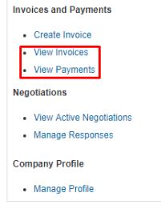

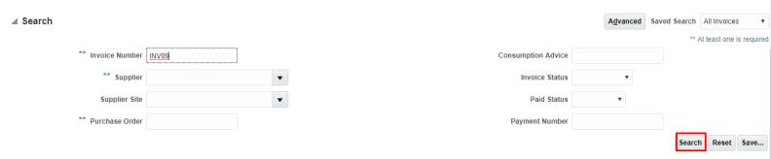
2 |View Invoice
Click on View Invoices / Payments from the left hand Tasks column.

Slide 27


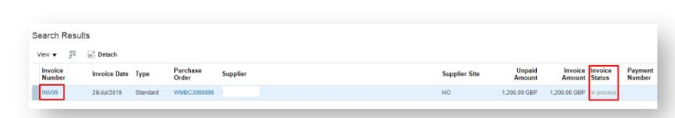

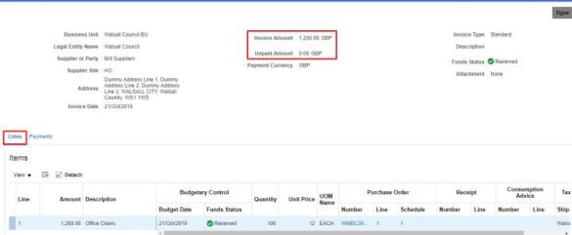

2 |View Invoice
Search results will show the details of the invoice, including the invoice status.
Under the Lines tab you can view the invoice line details.

Slide 28
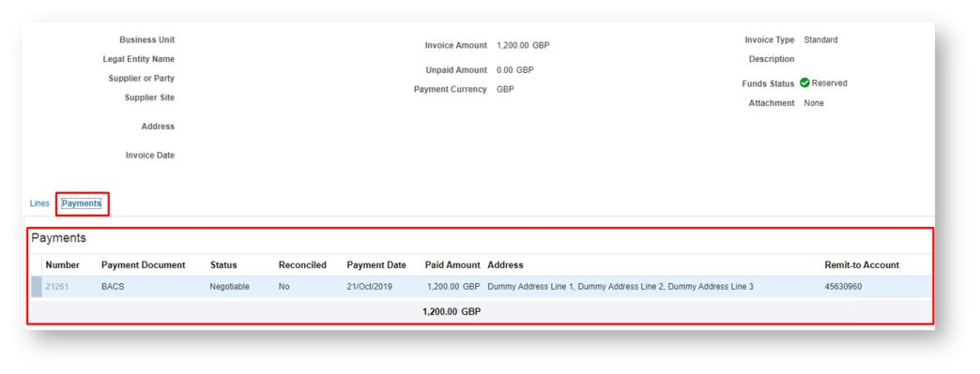
2 |View Invoice
Under the Payments tab, you can view payments made against the invoice.

Slide 29
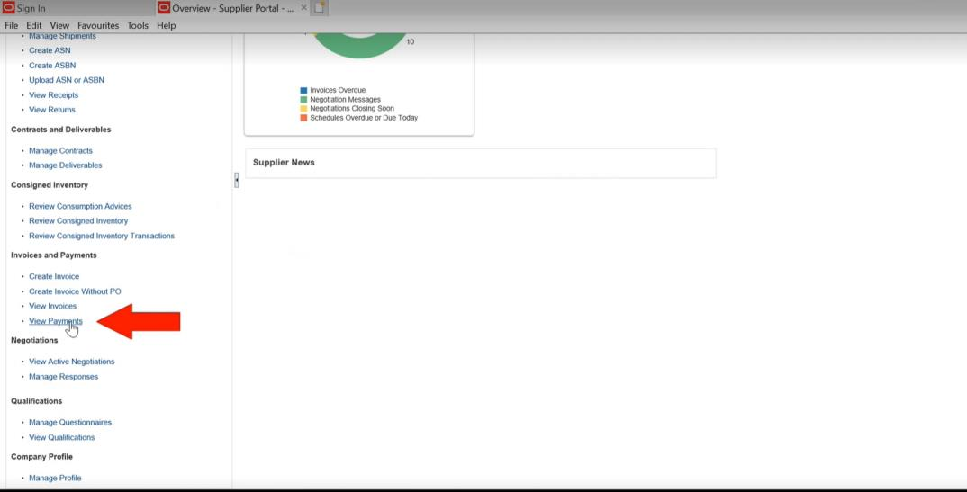
3 |Track Payments
Click on View Payments from the left hand Tasks column

Slide 30
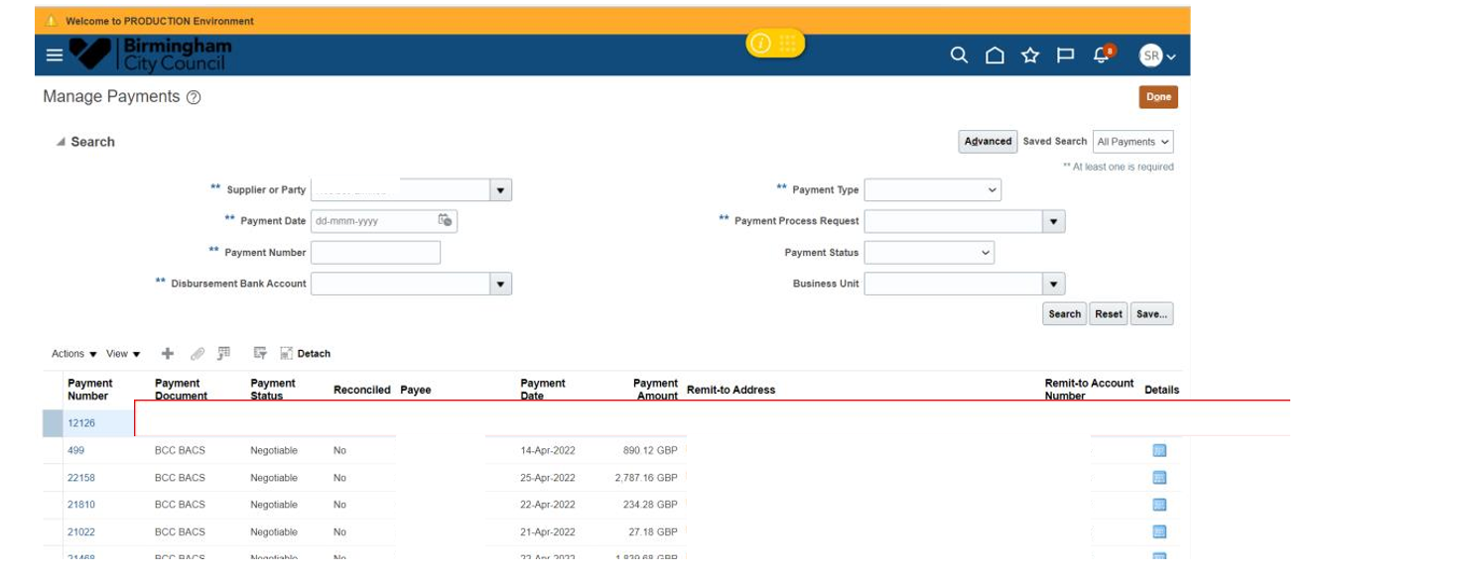
3 |Track Payments
Here, you can see all your invoices and where they are in their lifecycle e.g., whether it has been paid or not. By clicking on the payment number you can expand the
view.

Slide 31
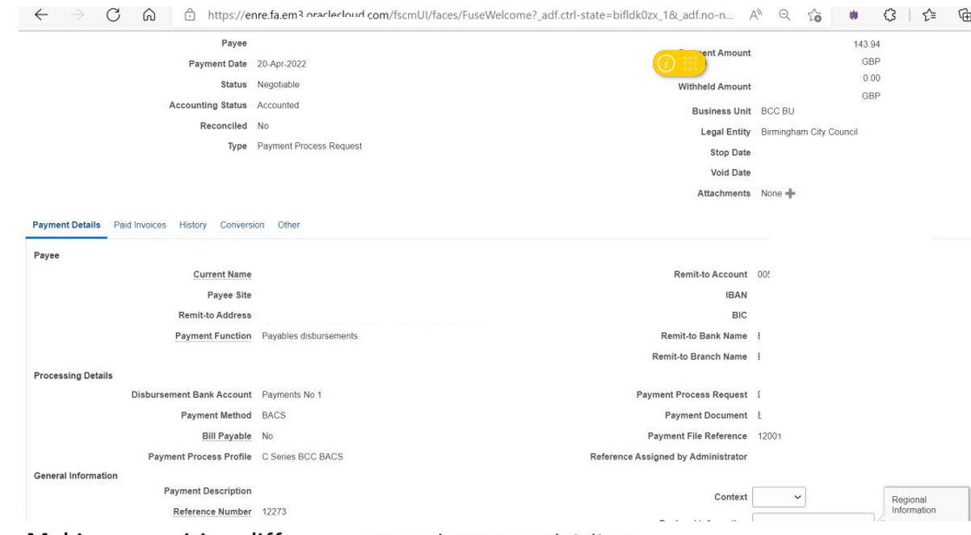
3 |Track Payments
This slide shows the expanded view of the payment details. You can also find paid invoice, history, conversion and other details by selecting the appropriate tab.

Slide 32
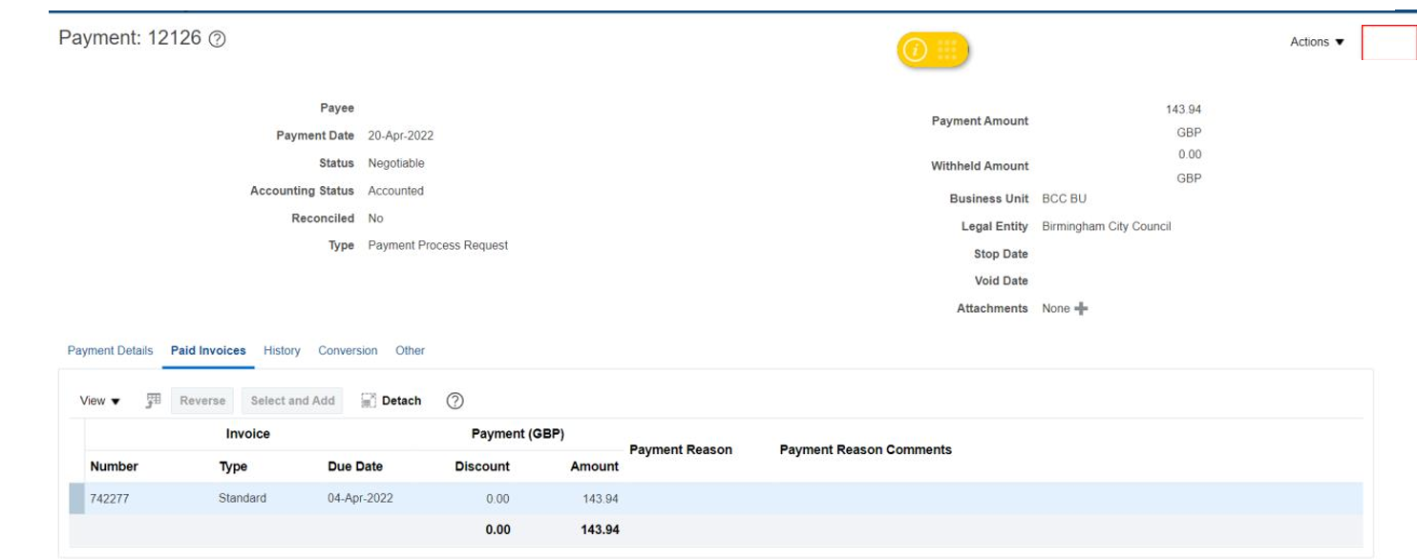

3 |Track Payments
This slide shows the details under the Paid invoice tab. To exit this page you would select Done.

Slide 33
How to respond to Tender

Slide 34
1 |Login to the Supplier Portal
1. Sign into Oracle Fusion by entering your username and password.
Screen print of Oracle on how to login to the supplier portal
2. Once signed in, you’ll be taken to the Home Page. You can sign out by clicking on your initials on the right-hand corner of the screen. There are several
key features to note:
Home Button: Returns
you to the main page
Favourites: You can save frequent
screens for quick access (for
example Submitting annual leave)
Navigator: You can
navigate to different areas
of the system
Bell notification: You will be notified
of any transactions including
approvals or actions required

Slide 35

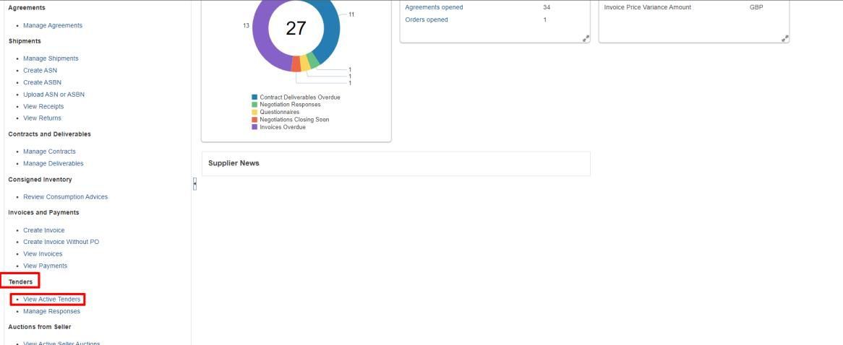
How to respond to Tender
1.
Navigate to Tasks, then select Tenders, followed by View Active Tenders.

Slide 36

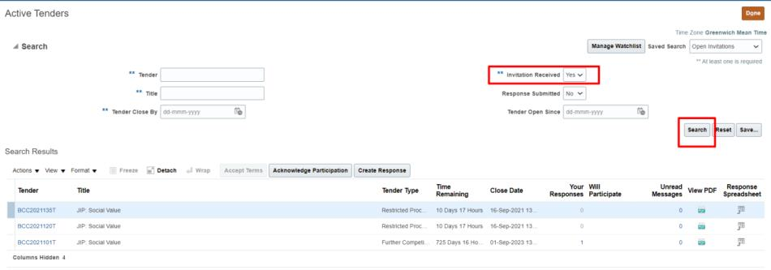
How to respond to Tender
2. Enter the search criteria for example, Invitation Received and click on Search. The search will result in tenders for which the invite has been received.
You can narrow down the search results by using the other search parameters.
Click on the tender to view the details of it. Any PDFs for the tender can also be downloaded by clicking on the View PDF icon.
If you want to submit the response using a spreadsheet, click on the Spreadsheet icon. This will download a zip file containing the tender requirements
and lines. You can fill the details in the spreadsheet and upload it to submit responses.
If the tender is not visible please ensure you select 'Invitation Received' as 'No' and Search again.

Slide 37
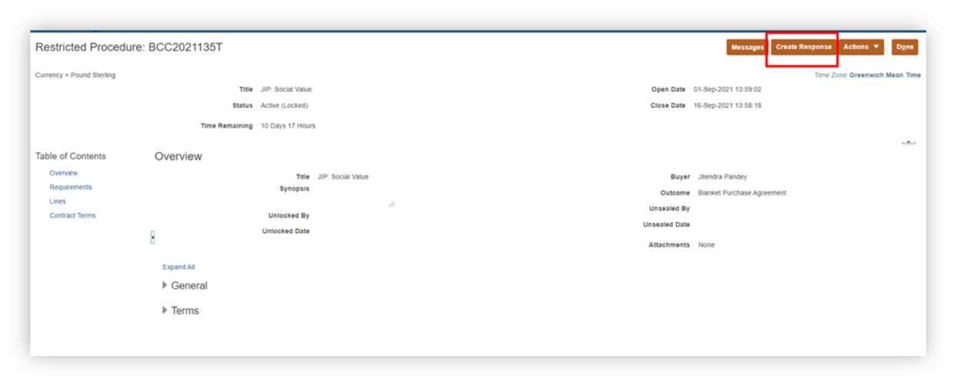
How to respond to Tender
3. To submit a response from the portal itself, click on the tender number and click on Create Response as shown below.

Slide 38

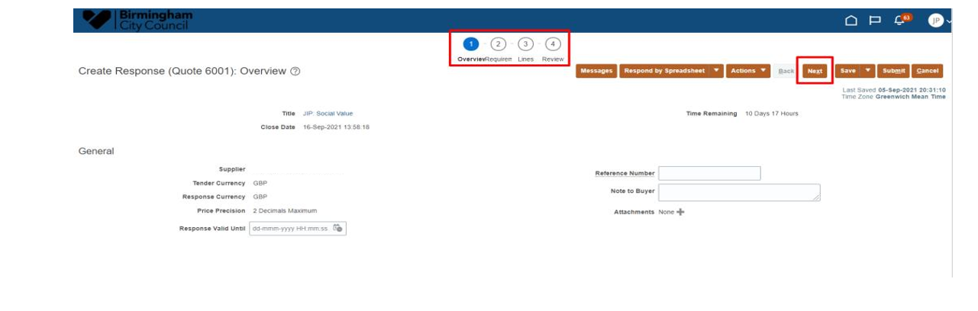
How to respond to Tender
This will open the response screen where you can fill in details on the requirements and the lines of the tender. Navigate through the different sections using the
Next button as shown below.
Fill out th
1. Response valid until: enter the date and time until which the response is valid in the format displayed in the box.
2. Reference number: enter this
3. Note to buyer: enter this as required
4. Attachments: click on the ‘+’ button to add attachments as required
Note: If you have any doubts or questions regarding the process/steps, you can use the online messaging feature provided by Oracle Fusion.
Click on Messages to see the correspondence history or to send a new message.

Slide 39
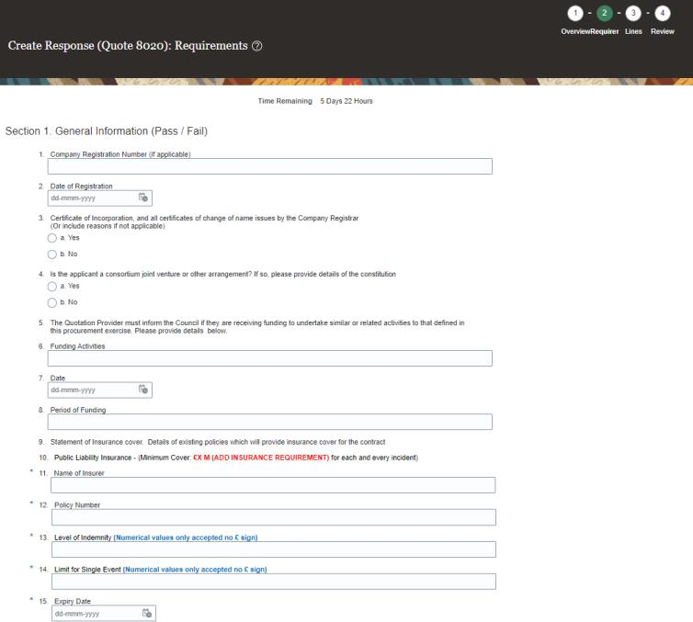
How to respond to Tender
Fill out the relevant fields in the Requirements screen

Slide 40
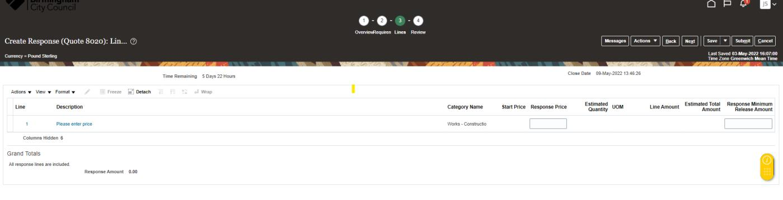
How to respond to Tender
Fill out the relevant fields in the Lines screen:
1. Response Price: suppliers need to enter the overall price although this is not evaluated

Slide 41
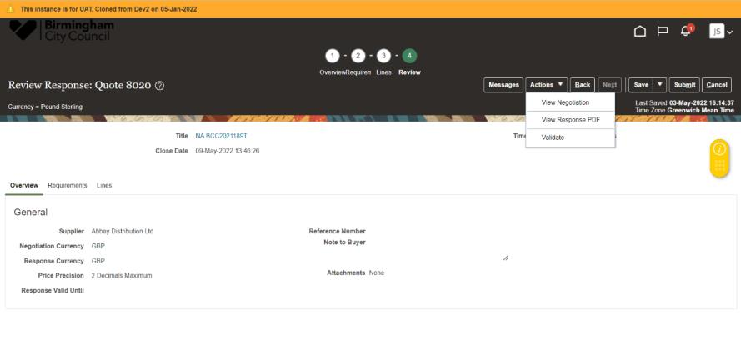
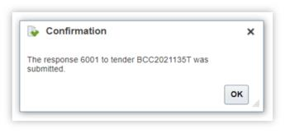
How to respond to Tender
Review all the information you’ve provided. Then, go to Actions -> Validate so that system tells you if there are any issues with the tender response.
Then, you can Submit the response.
You can also Save the response in case you want to submit it at a later point in time.
Please note, revision to responses is allowed.

Slide 42

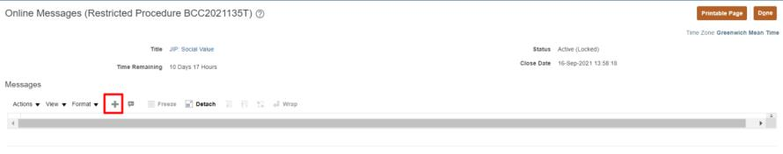

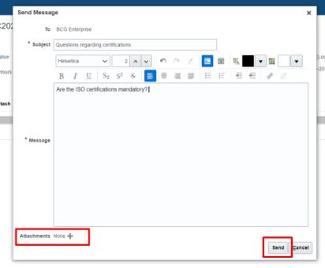
How to respond to Tender
5. Click on ‘+’ icon to add a new message.
Enter attachments for reference purposes. Click on Send to submit the message.

Slide 43

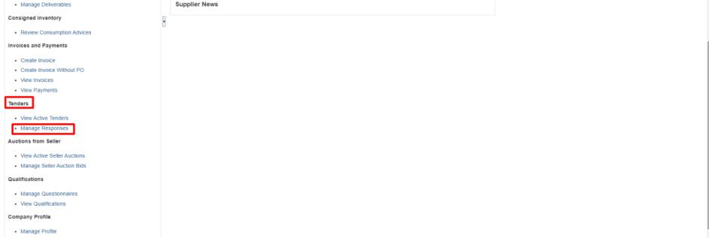
How to respond to Tender
7. To manage your responses, navigate to Tasks, then select Tenders, followed by Manage Responses.
Here you can see all the responses submitted for tenders and revise them if required.

Slide 44
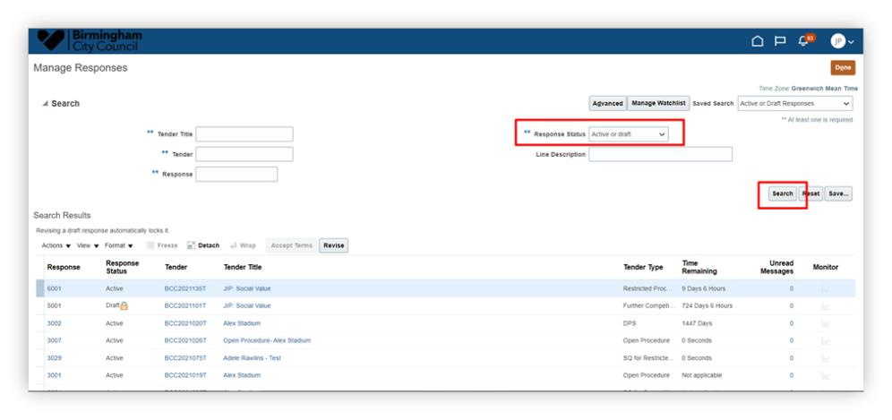

How to respond to Tender
8. To Revise Responses, enter search criteria for example, Response and click on Search.
The search will result in tenders for which the response is in either draft or active status. You can narrow the search results by increasing the search
parameters.
Click on Response Number to see the response history and download the response PDF. To revise the response, select the response line and click on
revise button.

Slide 45
How to manage contract deliverables

Slide 46
1 |Login to the Supplier Portal
1. Sign into Oracle Fusion by entering your username and password.
Screen print of Oracle on how to login to the supplier portal
2. Once signed in, you’ll be taken to the Home Page. You can sign out by clicking on your initials on the right-hand corner of the screen. There are several
key features to note:
Home Button: Returns
you to the main page
Favourites: You can save frequent
screens for quick access (for
example Submitting annual leave)
Navigator: You can
navigate to different areas
of the system
Bell notification: You will be notified
of any transactions including
approvals or actions required

Slide 47
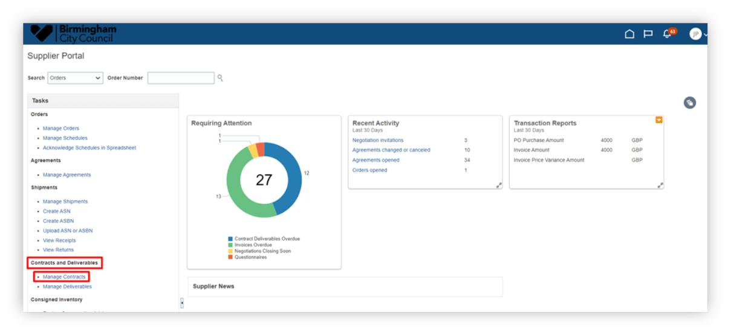
How to manage contract deliverables
1. To begin, navigate to Tasks, then select Contracts and Deliverables, followed by Manage Contracts.

Slide 48
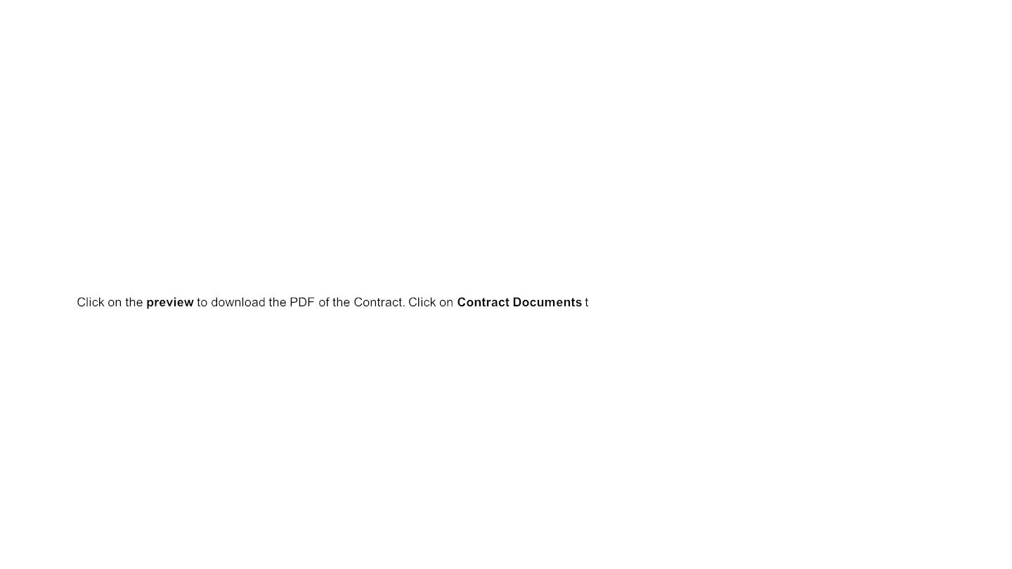

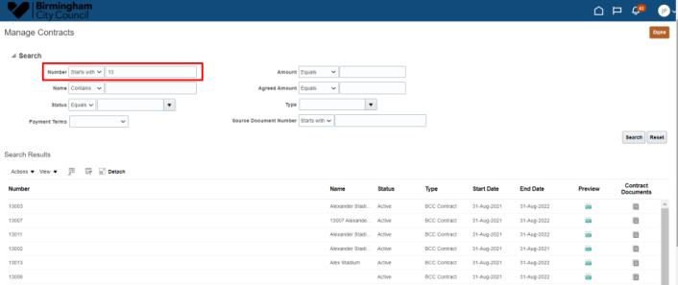
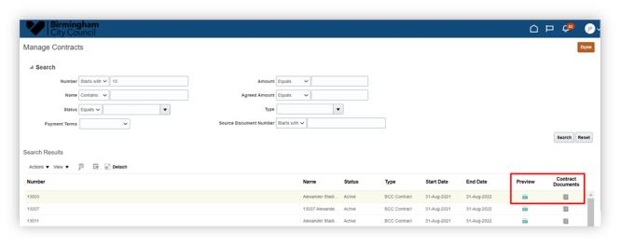
How to manage contract deliverables
2. Enter the search criteria for example, Number and click on Search. The search will result in contracts that starts with the number. You can narrow down the
search results by using the other search parameters.
o view the associated documents.

Slide 49
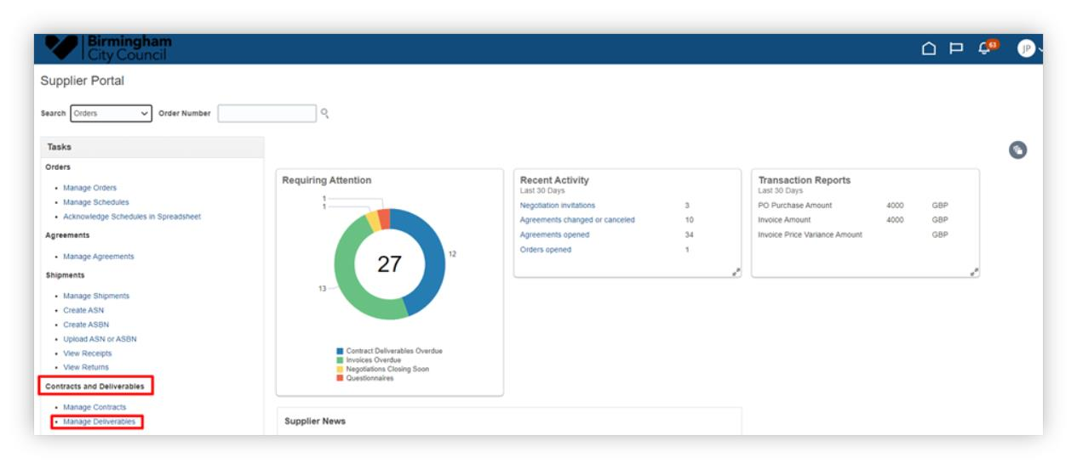
How to manage contract deliverables
3. To check and update the deliverables associated with a particular contract, navigate to Tasks. Then select Contracts and Deliverables, followed by
Manage Deliverables.

Slide 50
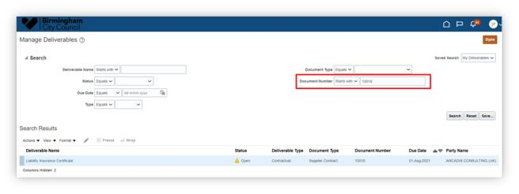
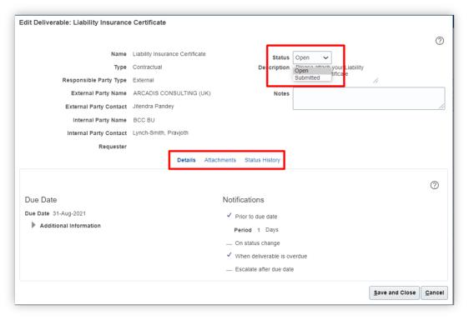
How to manage contract deliverables
4. Search with the Deliverable Name or Contract Number as shown below. Other search criteria can also be used.
5. Click on the deliverable to update it.

Slide 51
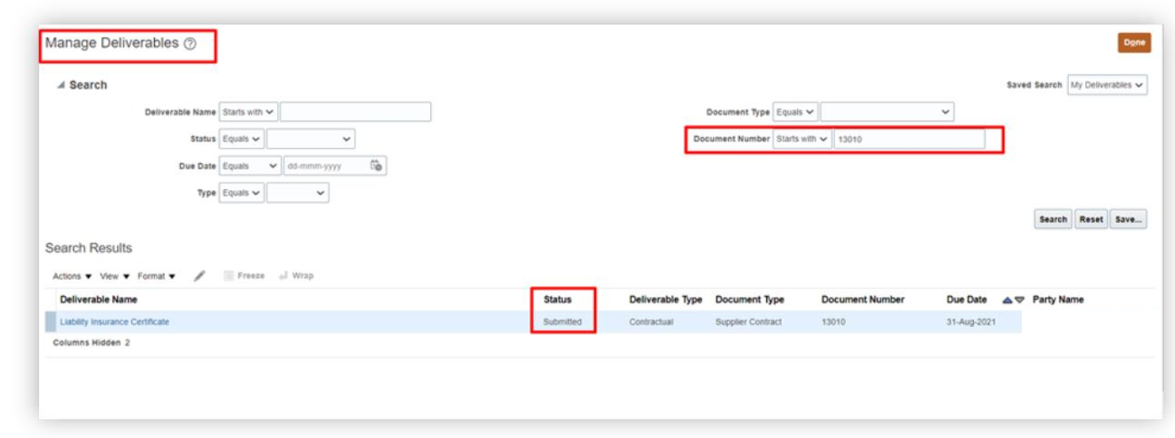
How to manage contract deliverables
6. Check the details of the deliverable and history. Once the deliverable is fulfilled, change the status from Open to Submitted. Save and Close the deliverable.
The status of the deliverable will change to Submitted.

Slide 52

Contact us:

