Slide 1
Covid Update - Educational Settings
Dr Justin Varney
Director of Public Health
06 January 2021

Slide 2
Situational Points
Omicron variant (VOV-21NOV-01)
  dominant variant of Covid-19 in the UK
  highly transmissible
  continues to grow rapidly in all regions of England.
Currently
  UK - 246,780
  England - 212,019
  Birmingham - 10,828 (2,650 confirmed, 11 possible and 8,167 probable cases)
Nationally, one in four (25%) of the omicron hospitalised cases are unvaccinated.

Slide 3
Policy Update
Booster jabs were offered to all adults (aged 18+) by the end of 2021 to tackle the growing wave of Omicron cases.
Children aged 12 to 15 can now get their second vaccine dose if it’s been more than 12 weeks since their first vaccine dose
The government advice is to work from home if you can.
NHS COVID Pass
  Not required in Educational settings unless holding specific events meeting attendance threshold
  Under 18s are exempt but should be counted towards attendance thresholds
  NOT be used as a condition for Education, childcare or related activities
UKHSA key message:
“The main things people can do to protect themselves right now is if you're not vaccinated, get vaccinated."

Slide 4

Policy Update (2)
Changes to Self-Isolation Period for Positive cases
From 22nd December anyone in England, who tests positive, can stop self-isolation if they:
  Take two consecutive LFD tests, at least 24 hours apart, with the first test on at least Day 6 of their self-isolation (not counting the ‘onset day’ i.e. Day 0).
  Obtain negative results on both these days
  Do not have a high temperature
Unvaccinated adults contacts still need to self-isolate for 10 days and get PCR test.
Under 5s who test positive do not need to self-isolate, their parents are advised to limit contacts with anyone at risk of getting Covid-19.
Fully vaccinated contacts and children between 5 - 18 years 6 months do not need to self-isolate but are advised to do daily LFD tests for 7 days.

Slide 5
Tests kits
Testing Capacity was significantly increased in December in response to Omicron and has continued to be increased in line with the expected prevalence
Schools should continue to order tests kits through the designated online ordering platform using their unique organisation number (UON) and call 119 for further advice or support
Parents should order their kit online or by calling 119.
Current public collection points (as stock lasts; i.e. closed at 13:30 yesterday)
  New Street Station
  Sainsburys Castle Vale
  Sainsburys Maypole

Slide 6


Spring term
 | Secondary School aged Children | Other Eligible students (e.g. college and universities) | Staff | Parents / Guardians and Visitors | Primary and Early years children
One onsite asymptomatic test
One LFD test before returning
Twice weekly LFD test (starting 3-4 days after first test)
LFD test before attending
Face coverings should be worn in classrooms and teaching spaces where students in year 7 and above are educated. The advice is short term only and will be reviewed on 26 January, in line with the review on Plan B measures.

Slide 7
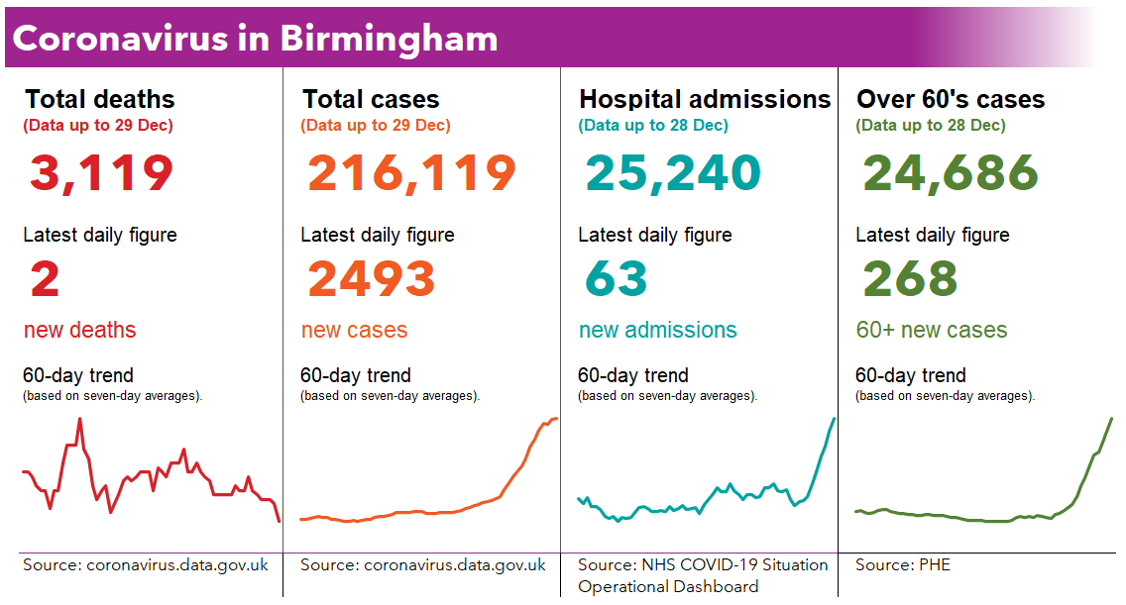
Covid-19 in Birmingham: Current situation and 60-day trend

Slide 8
% Priority Groups Vaccinated – updated 30/12/2021
12-15 years
  Eligible – 72k
  1st dose – 33.3%
16 years and over
  1st dose – 68.7%
  2nd dose – 63.7%
  Booster dose – 39.1%
16-49 years
  1st dose – 59.3%
  2nd dose – 52.6%
  Booster dose – 23.0%
50 years and over
  1st dose – 85.2%
  2nd dose – 83.4%
  Booster dose – 67.7%
65 years and over
  1st dose – 90.6%
  2nd dose – 89.5%
  Booster dose – 79.6%
Booster uptake
  All ages – 36.5%
  >80yrs – 80.7%
Clinically Extremely Vulnerable
  1st dose – 86.7%
  2nd dose – 83.5%
  Booster – 60.2%
COVID At Risk
  1st dose – 79.7%
  2nd dose – 75.0%
  Booster – 48.4%

Slide 9
Top Ten Ward Case Rates – Local Data
Ward | Previous week, 14th to 20th December |  | Current week, 21st to 27th December |  | Change between last two weeks | Absolute difference (comparing this week against last week)
 | Cases | Rate | Cases | Rate | % | Absolute difference
Sutton Wylde Green | 86 | 1,005.6 | 158.0 | 1,847.5 | 84% | 841.9 | ↑
Sutton Trinity | 107 | 1,153.9 | 165.0 | 1,779.4 | 54% | 625.5 | ↑
Northfield | 107 | 1,056.9 | 176.0 | 1,738.4 | 64% | 681.5 | ↑
Sutton Mere Green | 123 | 1,254.3 | 164.0 | 1,672.4 | 33% | 418.1 | ↑
Sutton Vesey | 193 | 989.1 | 312.0 | 1,598.9 | 62% | 609.8 | ↑
Sutton Four Oaks | 124 | 1,361.0 | 145.0 | 1,591.5 | 17% | 230.5 | ↑
Longbridge & West Heath | 139 | 694.3 | 309.0 | 1,543.5 | 122% | 849.2 | ↑
Brandwood & King's Heath | 170 | 918.9 | 283.0 | 1,529.7 | 66% | 610.8 | ↑
Sutton Walmley & Minworth | 180 | 1,139.0 | 234.0 | 1,480.6 | 30% | 341.7 | ↑
Ladywood | 354 | 1,166.6 | 435.0 | 1,433.6 | 23% | 266.9 | ↑
Source: UK Health Security Agency COVID-19 Situational Awareness Explorer

Slide 10
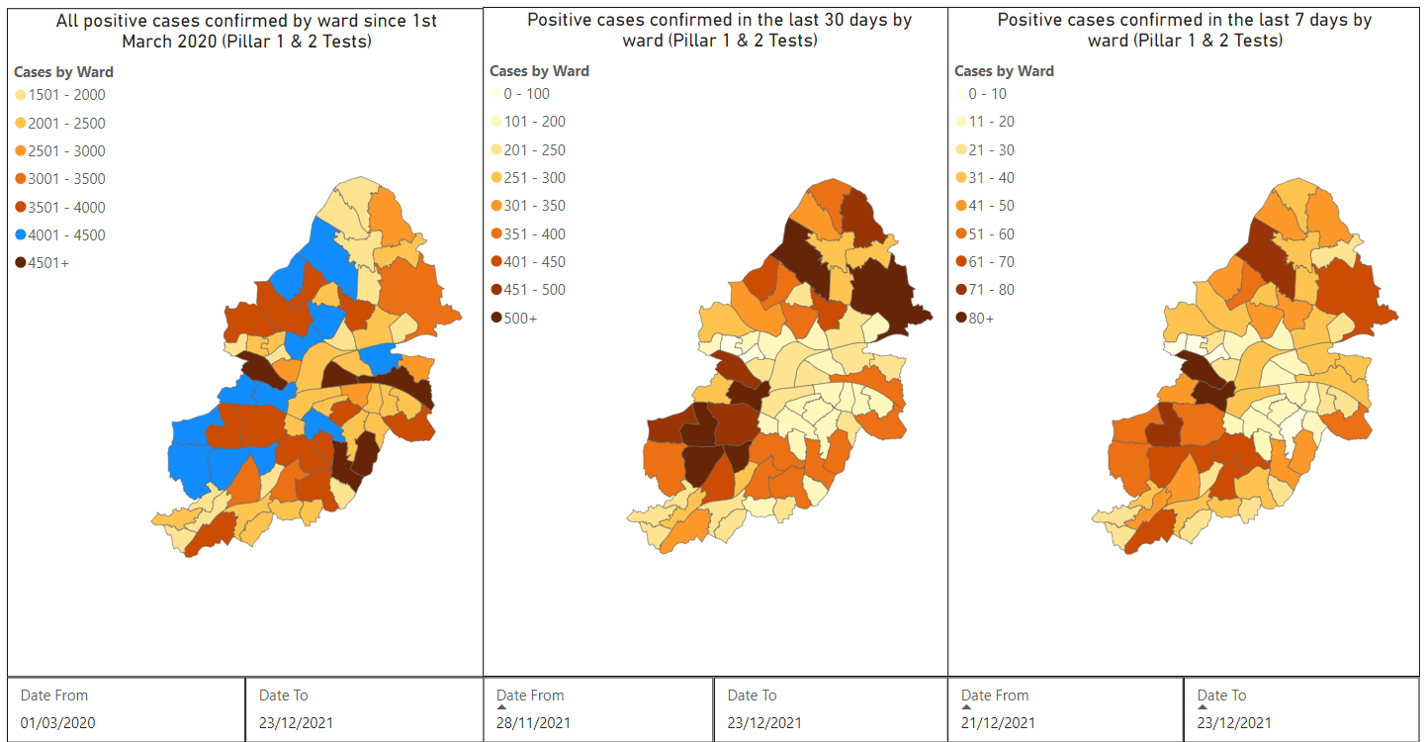
Cases by Ward: Total, Last Month & Last Week
Total
Last Month
Last Week
Source: UK Health Security Agency Covid-19 Situational Awareness Explorer

Slide 11
Notifying BCC Public Health of Covid-19 Cases
Do
Report all cases* (PCR and/or LFD) even those that we made you aware of.
Use latest Checklist / Case log from January 2022 as a running document and complete it fully and send to Contacttracing@birmingham.gov.uk.
Don’t
*Report initial ATS results
Send a fresh Checklist / case log for every case or group of cases
Follow process set out in Public Health Flowchart for School – Pathway for Educational Settings
Not share Personal Identifiable Information (PID) with us or parents

Slide 12
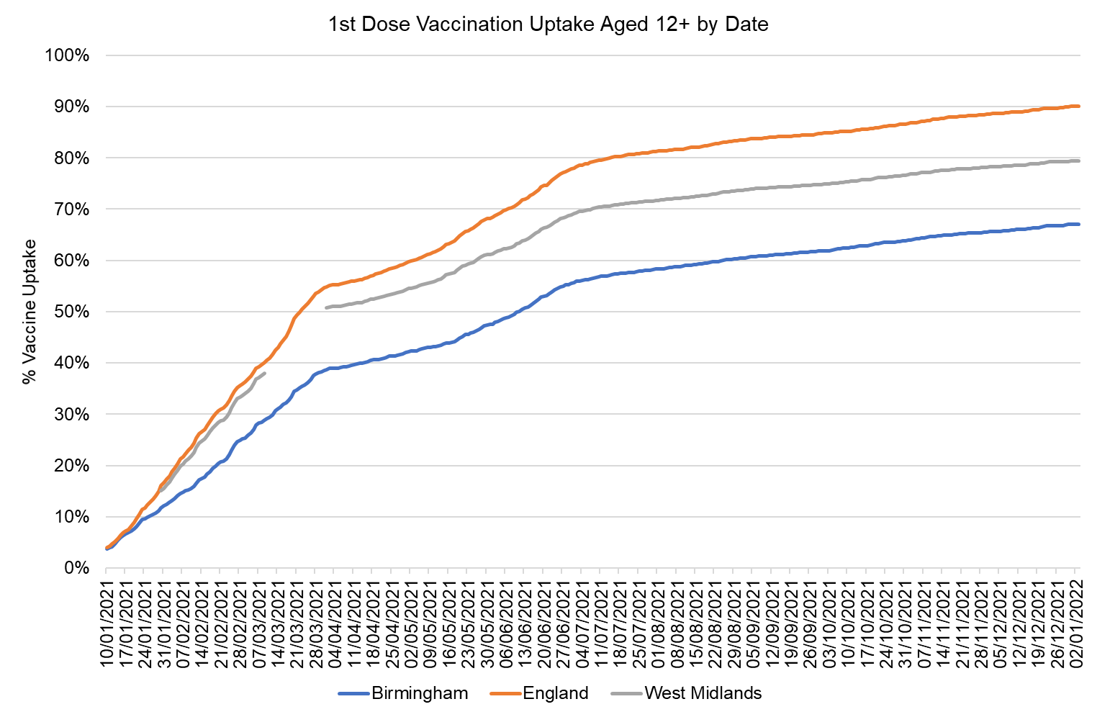
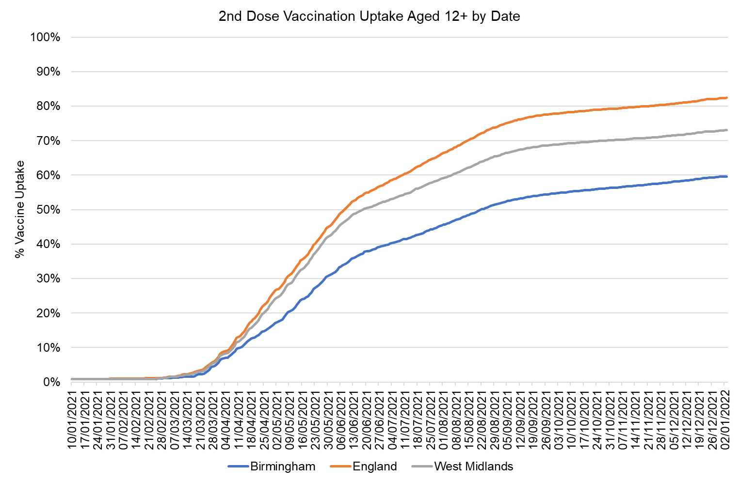
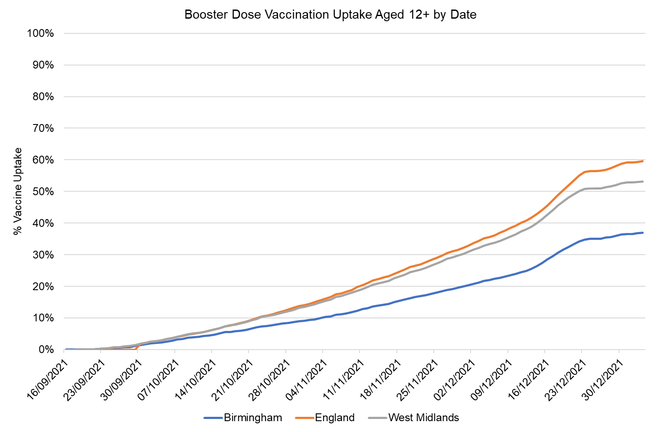
Uptake* by Date of Vaccination (updated 05/01/2022)
Uptake* of 1st dose has slowed since the end of June, whilst uptake of 2nd dose slowed in mid-August.
The current rate of uptake for the 1st, 2nd and booster doses in Birmingham residents aged 12 years and over (67.1%, 59.6%, 36.9%) is significantly lower than the rates for West Midlands (79.4%, 73.0%, 53.2%) and England (90.0%, 82.4%, 59.6%).
*The vaccination roll-out in the 12-15 age group would also likely impact the overall uptake figures, compared to uptake at age 16+.
The booster figures reported are significantly different from previous reports because of the change in the eligible population used as the denominator population. The eligible population used for booster uptake is the eligible population used for dose 1 and dose 2 uptake (as reported in the Gov.UK website) Previous reports were based on eligible populations of those who had been fully vaccinated
Source: GOV.UK

Slide 13
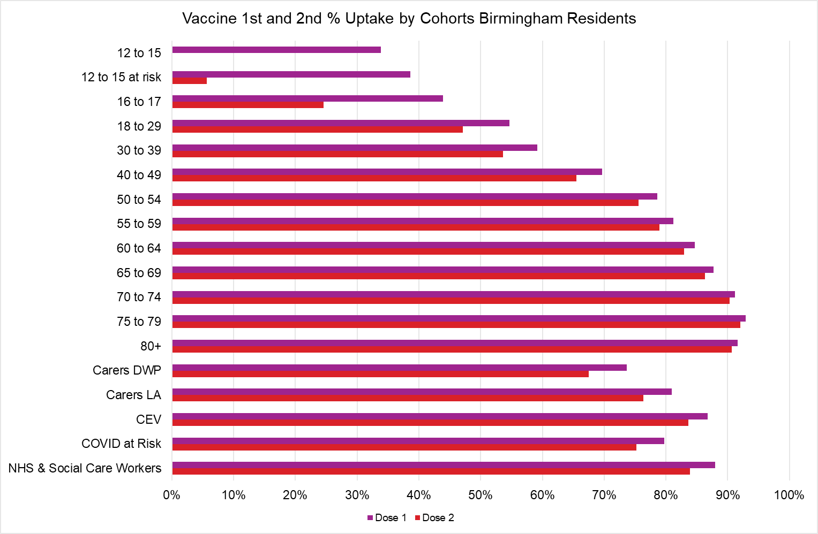
Uptake by Cohort in Birmingham Residents – 1st and 2nd doses
NIMS Data (Extracted 05/01/2022)

Slide 14
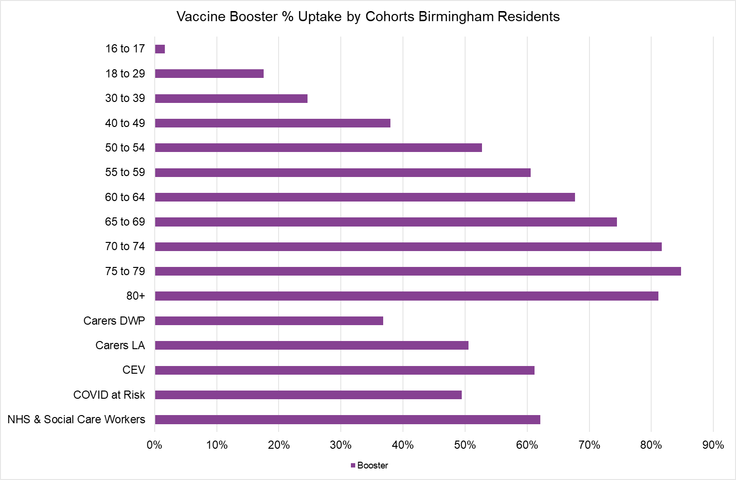
Uptake by Cohort in Birmingham Residents – Booster dose
NIMS Data (Extracted 05/01/2022)

Slide 15
Vaccine Uptake Booster Dose – 16+
(lowest uptake areas by wards)
(updated 05/01/2022)
Ward Name | Total Uptake 16+ | Total Uptake 16-49 | Total Uptake 50+
Alum Rock | 15.9% | 9.3% | 36.1%
Newtown | 16.9% | 10.8% | 38.9%
Sparkbrook & Balsall Heath East | 18.1% | 10.5% | 40.0%
Ward End | 18.7% | 9.3% | 44.7%
Bordesley Green | 19.2% | 11.6% | 41.3%
Sparkhill | 20.0% | 11.5% | 42.0%
Small Heath | 20.5% | 12.3% | 44.0%
Lozells | 20.9% | 13.8% | 43.6%
Aston | 21.1% | 12.8% | 45.5%
Birchfield | 21.1% | 11.5% | 45.2%
Nechells | 21.6% | 13.1% | 50.7%
Bordesley & Highgate | 22.1% | 15.8% | 46.0%
Heartlands | 22.1% | 12.6% | 48.0%
Holyhead | 22.5% | 12.7% | 48.1%
Balsall Heath West | 22.9% | 13.1% | 47.3%
Handsworth | 24.9% | 14.9% | 49.9%
Soho & Jewellery Quarter | 25.6% | 19.6% | 46.6%
Ladywood | 29.6% | 24.5% | 54.6%
North Edgbaston | 29.6% | 19.6% | 55.4%
Tyseley & Hay Mills | 29.9% | 15.8% | 60.2%
Yardley West & Stechford | 32.3% | 16.9% | 63.6%
Bromford & Hodge Hill | 32.7% | 16.1% | 62.4%
Gravelly Hill | 33.0% | 18.2% | 61.9%
Stockland Green | 33.3% | 17.7% | 62.1%
Glebe Farm & Tile Cross | 34.9% | 17.4% | 65.3%
Bournbrook & Selly Park | 35.7% | 29.5% | 76.0%
Garretts Green | 36.0% | 18.8% | 66.1%
Edgbaston | 38.1% | 26.4% | 73.8%
Handsworth Wood | 38.2% | 21.7% | 65.2%
Hall Green North | 39.1% | 22.5% | 68.1%
Perry Barr | 39.6% | 20.2% | 69.0%
Acocks Green | 40.1% | 22.9% | 68.9%
Kingstanding | 41.3% | 22.0% | 68.9%
Perry Common | 44.1% | 24.3% | 71.5%
Weoley & Selly Oak | 46.2% | 28.9% | 74.4%
Shard End | 46.6% | 25.3% | 76.6%
Yardley East | 46.9% | 24.4% | 73.7%
King's Norton South | 47.3% | 28.0% | 74.1%
South Yardley | 47.7% | 28.2% | 73.9%
Billesley | 48.0% | 29.5% | 73.5%
Up to 5th January 2022, vaccine uptake (booster dose) was below 60% in 59 (of the 69) wards except:
  Bournville & Cotteridge
  Sutton Reddicap
  Northfield
  Sutton Walmley & Minworth
  Sutton Vesey
  Sutton Trinity
  Sutton Roughley
  Sutton Mere Green
  Sutton Wylde Green
  Sutton Four Oaks

Slide 16
Financial support and information for parents
Local authorities can make £500 payments (‘main payments’) to people on means-tested benefits who are unable to work from home and will lose income as a result of self-isolation
Self-isolation Support: Practical, social and emotional support - It is designed to support councils in providing a triaging process and support package for individuals who are required to self-isolate and need practical, social, or emotional support to do so.
Household Support Fund.
  Part of this funding was used to provide for supermarket vouchers for families eligible for free school meals over the October half-term and Christmas school holidays.
  Information about the other support available to households using this funding is available at https://www.birmingham.gov.uk/HSF
Gov.uk (2021). Schools COVID-19 operational guidance.
Gov.uk (2021). Further education COVID-19 operational guidance.
Gov.uk (2021). Actions for early years and childcare providers during the COVID-19 pandemic.

Slide 17
Take Home Messages
  Vaccination/booster online –
    Online - https://www.nhs.uk/book-a-coronavirus-vaccination/do-you-have-an-nhs-number
    Walk-in - https://www.birminghamandsolihullcovidvaccine.nhs.uk/walk-in/
  Youth COVID-19 Champions – email/text to Juliet – senior Youth Peer support for young people; see awareness video and joining instructions: send worker Juliet.c.Faulkner@birmimgham.gov.uk
  COVID-19 Community Champion – help other residents find out more about COVID-19 and for their voices to be heard by signing up here: https://www.birmingham.gov.uk/COVID-19_Community_Champions
  Birmingham City Council Health Protection Response Team – Contacttracing@birmingam.gov.uk
  Notification of new cases - Please follow process in the Public Health Flowchart for Schools to notify us of new cases.

Slide 18
Thank you. Questions?

