Slide 1



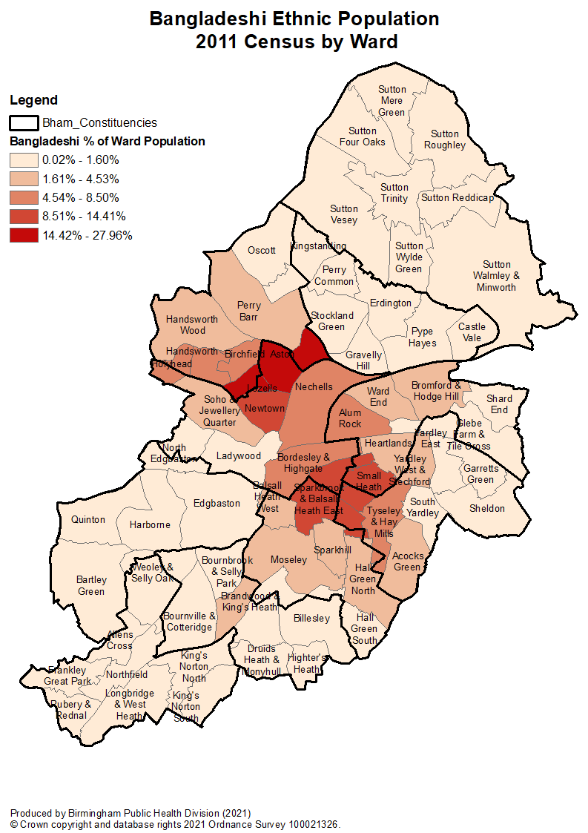





Slide 1
Bangladeshi Community Profile
Public Health, July 2021
Numbers have been rounded
International, National and Birmingham Context
Overview
Data form census in 2011 show that the largest proportions of Bangladeshis live in Lozells (31%) and Aston (21%) wards. No other wards had more than 14% of the Bangladeshi population.
451,529
38,300
Migration
People in the West midlands identify as Bangladeshi, with 32,532 in Birmingham. Birmingham has the largest Bangladeshi community in the west Midlands, and 3rd largest in the UK
British Bangladeshis are one the most homogenous groups, with most originating from the rural Sylheti region of Bangladesh. Large scale migration in significant numbers first took place in the 1960s and reached its peak in 1970s, with most men migrating to work in clothing & restaurant trades.
People in the UK identify themselves as Bangladeshi. Bangladeshis in the UK are largely a young population, heavily concentrated in the inner boroughs of London.
57%
Bangladeshis in
B’ham identify as
British,
significantly
higher than
those identifying as
With non-UK nationalities (11%).
Bangladeshis speak Sylheti, which is generally
considered a dialect of
Bengali. 70% of those
who speak Sylheti are proficient in English.
Of Bangladeshis in Birmingham were born in England, considerably higher proportion than those in the Middle East and Asia (43%); Africa (0.2%) and other parts of Europe (0.4%).
76%
400,000
Religion
11.7% of Bangladeshis in B’ham compared to 6.0% of the City’s female population,
11.1% of Bangladeshis in B’ham compared to 6.5% of the City’s male population.
90%
Muslim
0-4 yrs
1.5%
Christian, Other
3.6% of Bangladeshis in B’ham compared to 17.9% of the City’s female pop.
3.8% of Bangladeshis in B’ham compared to 15.7% of the City’s male population.
>65 yrs
1.3%
No religion
Celebrations
With a population exceeding 163 million people, Bangladesh is the eighth most densely populated country worldwide. Following Bangladeshi, Saudi Arabia has the 2nd largest Bangladeshi population, followed by United Arab Emirates, Kuwait, Malaysia, Oman, the U.K and the U.S.
Boishakhi mela
Bangladeshi New Year
2nd weekend of May
Independence Day
Independence day
March 26th
Please note that the most recent ethnicity data available at ward level is from the 2011 census, so any conclusions from using this data should be made with caution.

Slide 2






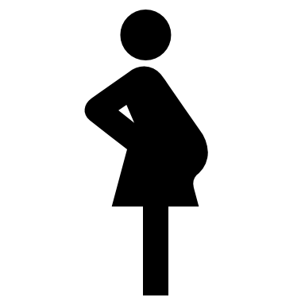








Slide 2
Bangladeshi Community Profile
Public Health, July 2021
Numbers have been rounded
Mental Health and Wellness
Healthy and Affordable Food
Active at every age & ability
Getting the best start in life
8.3%
Psychological Distress
Cooking Preferences
  PHYSICAL INACTIVITY
  <30 mins/week
  BY ETHNICITY
There is lack of visible sports role models in the UK from Bangladeshi heritage compared to some other South Asian cultures
Bangladeshi children <18 years (42%), which is a higher proportion compared to all children in Birmingham (26%)
13,619
Bangladeshis had the lowest prevalence of mental health illness out of any ethnic group.
5% more Bangladeshis reported higher levels of psychological distress vs
White counterparts.
94%
Of Bangladeshi men use extra salt in cooking, highest proportion
among men in minority ethnic groups
#1
Pakistani (37.4%)
Maternal mortality from mothers born in Bangladesh in 2016/18, which is 1.5 times the risk compared to UK born women. Bangladeshis are also 2.5 times more likely to have still births compared to British white mothers
Obesity Prevalence Range
13.2 per 100,000
  150 Minutes a Week of Moderate Physical Activity
Bangladeshis
General population
#2
B’deshi (34.3%)
Alcohol: Non-Drinkers
6-12%
18-23%
#3
Indian (28.5%)
30-35% of Bangladeshis meet physical activity recommendations, a lower proportion compared to Black Caribbean and Pakistani counterparts.
97% and 98% of Bangladeshi men and women reported ‘not drinking in the last 12 months’, compared to the general population (8% men
and 14% women).
15-17%
#4
Black Caribbean (27.5%)
Bangladeshi
All Children
28%
Of Bangladeshi male participants in the Health Survey England reported consuming one-of-five a day, which is similar to the general population
#5
13%
Obese reception children
10%
Drug Use
Smoking
White (24.0%)
Cannabis (Ganja, marijuana, weed, and spliff) was highlighted as the main drug of choice, but drug use is often not publicly acknowledged by the Bangladeshi community due to stigma.
Bangladeshi
women smoke less (0.9%), compared with White British women (21.6%). More Bangladeshi men smoke (40%) compared to Black African and Chinese men (21%)
30%
21%
Obese year
6 children
Bangladeshi Diet
Walking
Many traditional dishes are served with rice, including chicken, lentil (dahl), and fish. Another popular food is shatkora (a citrus and tangy fruit from Sylhet), used for flavourings in curries
Feasts, festivals, and social occasions are common, culturally important, and centre on eating
sweet and rich food
Bangladeshi men and women had reported
low rates of brisk walking (20%),
compared to 32% of men in the
general population.
MMR vaccinations
#1
Bangladeshi (96%)
Activity in Children
40%
Bangladeshis are 40% less likely to have reported ever having taking drugs compared to White people.
In 2007, 68% of Bangladeshi children aged 2 to
15 met the recommended level of physical
activity, an increase of 2% since 2002. More
boys (72%) than girls (63%) met the
Recommended level of physical activity.
#2
All other S.Asian (94.5%)
#3
White British (88%)

Slide 3




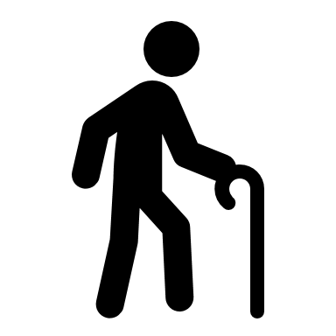













Slide 3
Bangladeshi Community Profile
Public Health, July 2021
Numbers have been rounded
Working and learning well
Protect and Detect
Ageing and Dying Well
57.3% (60% girls and 54% boys) of Bangladeshi pupils in
England got a grade 5 or above in English and maths GCSE,
better than the national
average (49.9%).
FEMALE CANCER SCREENING (NON-ATTENDEES)
Uptake of breast cancer screening among Bangladeshi women was lower than White population (37% compared to 60%)
DIABETES
DEMENTIA
Level 5+
Qualification
2 X Higher
The risk of developing diabetes is
at least 2 times higher among British Bangladeshis compared to
white counterparts.
Bangladeshi elderly migrants do not have an increased rate of schizophrenia-like psychosis (SLP) compared to indigenous elders.
In the one-year review there was a higher rate of referrals for organic disease in Bangladeshi men compared to Bangladeshi women and British-born men and women
#1
B’deshi (70.6%)
No
Qualification
More Bangladeshis reported having no qualifications compared to the general population (35%
compared 28%).
#2
Indian (66.0%)
Barriers to Cervical Screen
CARDIOVASCULAR DISEASE
#3
Issue of male doctor or nurse
End of Life
C’bean (62.1%)
CVD (cardiovascular disease) prevalence pattern in Bangladeshi men and women follows that of the general population, with an upward trend of age.
A report into end-of-life preferences amongst Oldham's Bangladeshi
showed a higher than national rate of those wanting to die at home.
#4
Pakistani (61.0%)
“Symptoms must be present”
87%
Bangladeshis are less likely to be economically active than the general B’ham population.
51.6% 48.4%
Active Inactive
#5
African (44.0%)
Fitting around family time
CANCER
General Birmingham population
3x
higher
59.2% 40.8%
The national cancer intelligence network reported that compared to White people, Bangladeshi men had similar incidence, rates of lung cancer 3x higher incidents rates for liver cancer for both sexes
Access to health care
HPV Vaccination
Sexual Health
Overcrowding
3x
Bangladeshis are more likely to be referred to sexual health clinics by GP’s, suggesting their knowledge of service provisions is low
Bangladeshi
women are
around 3 times
less likely to accept HPV vaccination
compared to White British women.
Research across ageing and dying well theme reported perceived barriers to accessing care to be…
Language and communication barrier
More Bangladeshis (18%) live in overcrowded households compared to the general population (4.2%)
COPD
Lack of knowledge
Working
43.1 per 100,000 Tuberculosis cases in Birmingham were from people of Bangladeshi heritage, higher compared to White (5.0) and Chinese (17.5) Mixed other (33.7), but lower than Black African (280), Pakistani (142) Indian (112) and Black Other (50)
There is little research on COPD exclusive to Bangladeshis. However, the limited evidence show that Bangladeshis have a lower risk of COPD compared to White people
31% Bangladeshis reported having never worked or unemployed long
term, twice as likely compared with the general population (12%)
Negative experience

Slide 4





Slide 4
Bangladeshi Community Profile
Public Health, July 2021
Numbers have been rounded
Closing the Gaps
Green and Sustainable Future
The provisional analysis for the period 2 March to 15 May 2020 by the Office of National Statistics has shown variation in the rate of death involving the coronavirus between self-identified religious groups, as reported in the 2011 Census, the table below shows that In the second wave of the pandemic, differences in COVID-19 mortality compared with the White British population increased for people of Bangladeshi and Pakistani ethnic backgrounds and decreased for people of Black African and Black Caribbean backgrounds. The table is categorised by susceptibility during the 2nd wave.
Deprivation
There is a lack of published research exclusive to British Bangladeshis and their contribution to green and sustainable future or the impact of these topics on them as a population in the UK
88.2%
1.0%
Ethnic Group | 1st wave Jan 20- Sep 20 | 2nd Wave Sep 20- Mar21
Bangladeshi | 2.1x | 4.4x
Pakistani | 2.2x | 3.5x
Indian | 2.5x | 3.1x
Black African | 3.8x | 2.9x
Other | 2.6x | 2.7x
Chinese | 2.6x | 2.4x
Black Caribbean | 2.4x | 2.2x
Mixed | 2.2x | 2.2x
Of all Bangladeshis in Birmingham are living
in 20% of the most deprived areas
vs
Bangladeshis in B’ham are less than 1% are likely to be living in 20% least deprived
Mitigating the impact of Covid
Long-Term Health Conditions
4 in 5
Compared with White British individuals over 60 years of age, people from Bangladeshi backgrounds are over 60% more likely to have a long-term health condition that makes them vulnerable to COVID-19
Linking deprivation with life expectancy, 4/5 of Bangladeshis in Birmingham can expect to live an average of 74 to 83 years and spend 20 years fewer years in good health
Disability-free life expectancy of British Bangladeshis is lowest compared to White people and all other ethnicities
People from Bangladeshi (43%) were the most likely to report loss of income since COVID-19 pandemic, compared to Black African groups (38%) and 22% of White people.
43%
Of the 25 leading causes of mortality as measured by years of lost life, and compared to the white ethnic group, Bangladeshis were…
Alcohol cirrhosis
Suicide
All cancers
Overcrowding was linked with
increased rates of mortality in a
hospital-based cohort. 30% of Bangladeshi households being the highest compared to 16% of Black African households, 18% of Pakistani households and 2% of White British households.
Stroke
Road injuries
Cirrhosis HepC
Source: Office for National Statistics – Coronavirus (COVID-19) related deaths by religious group.

