Slide 1
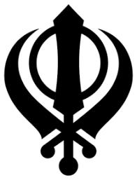
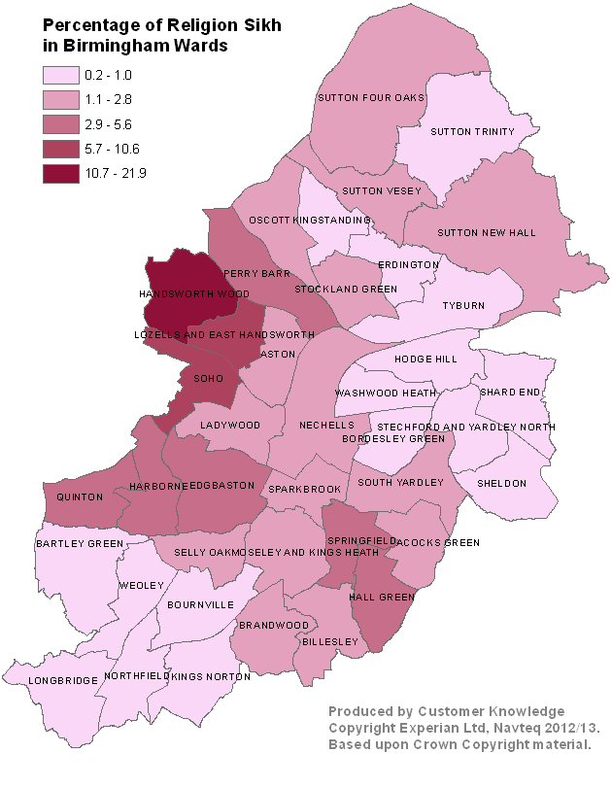
Sikh Community Profile
Public Health, April 2021
Numbers have been rounded
International, National and Birmingham Context
Sikh Origin
Data from the 2011 Census illustrates the distribution of Sikh population across Birmingham. It evidences that the highest proportion of Sikhs are located in Handsworth Wood (25%) and Soho (11.3%). Harborne, Hall Green, Lozells and East Handsworth have a Sikh population of approximately 6%, with the rest of the Sikh population being evenly distributed across other wards in Birmingham (<5%).
420,196
133,681
15th Century
People in England who identify themselves as Sikh. This is the 3rd largest minority religious group in the UK. London hosts the largest community in the UK.
People identify themselves as Sikh in the West Midlands, with 32,276 in Birmingham. This is the second largest minority religious group in the city (3%)
Founded Century of the Sikh faith, stated to be founded in Punjab province (Now in India and Pakistan after partition). Guru Nanak Dev Ji is the founder of the Sikh faith and the first of ten Sikh Gurus.
59.7%
63%
Place of Worship
Nearly 60% of Birmingham’s Sikhs had been born in England. This is considerably higher than those born in the Middle East or Asia (35%) and in Africa (4%).
Over 60% of Sikhs in B’ham identify as British, this was significantly higher than other identifications such as English (16%) and Non-UK (15%).
Sikhs practice their faith in Gurdwaras and at home. The religion includes prayer, meditation, Guru Granth Sahib ceremonies & festivals with a particular focus on Vaisakhi which is an initiation of a full baptised Sikh joining the Khalsa.
6.0% of Sikh population in B’ham compared to 7% of total female pop of the city
6.5% of Sikh population in B’ham compared to 8% of total male pop of the city
LANGAR
0-4yrs
Langar (free kitchen introduced by Guru Nanak) runs in every gurdwara & some serve to the homeless and the vulnerable. Free meals are offered to everyone, regardless of their caste, gender, wealth or faith to show their belief in oneness of humanity.
10% of Sikh population in B’ham compared to 14% of total female pop of the city
8% of Sikh population in B’ham compared to 11.5% of total male pop of the city
>65yrs
There are more than 22 million Sikhs in the world, with 90% living in India. The Sikh faith is the fourth largest religion in India and is concentrated in the state on Punjab. Following India, Canada has the 2nd largest Sikh population in the world, followed by the UK. Other countries with significant Sikh populations include the US, Australia, Malaysia, Kenya and Uganda.
5 K’s
Sikhs can be baptised at any age and be part of the Khalsa. They are given a new identity and will on their person the five K’s: Kesh, Kanga, Kacchera, Kara and Kirpan.
The above map uses the ward boundaries pre May 2018 due to the data being derived from the 2011 Census data. New Census data mapped onto the new wards is expected to be available in 2022.

Slide 2
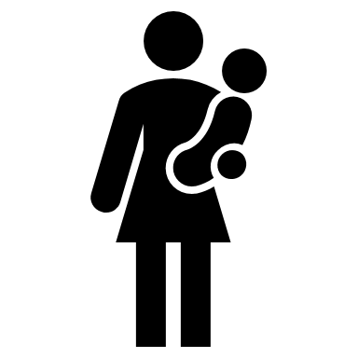
Sikh Community Profile
Public Health, May 2021
Numbers have been rounded
Mental Health and Wellness
Healthy and Affordable Food
Active at every age & ability
Getting the best start in life
77%
DRIVERS OF STRESS
3,216 KCAL
PHYSICALLY ACTIVE
>150 mins/week
BY RELIGION FOR ENGLAND
PHYSICALLY INACTIVE
<30 mins/week
BY RELIGION FOR ENGLAND
7,710
The number of children registered as Sikh in Birmingham (2.8%), higher than the English Sikh population (0.87% England)
Job 35%
Average Daily Energy Intake of 137 Sikh Punjabi Males aged 21 – 55 in the UK (Recommend 2,500 kcal).
Out of a survey completed by 2,000 Sikhs, stated that they found their lives stressful.
Family 27% Responsibilities
#1
Christian (61.7%)
Time 26% Pressures
OBESITY
#1
Muslim
(40.4%)
There is limited research regarding the number of Sikhs within the UK and in Birmingham who are classed as overweight or obese. However, there is published research which suggest obesity rates are higher in the South Asian population compared to the general population.
#2
Breastfeeding is positively encouraged in the Sikh faith, however local data is not available on breastfeeding uptake by faith.
Hindu (57.9%)
SUICIDE
#2
Hindu / Sikh (30.1%)
Sikhs have a high respect for life which is seen as a gift from God. The Sikh Gurus rejected suicide as an interference in God's plan.
#3
Jewish (56%)
WESTERINISATION
#3
Jewish
(30%)
MEASLES IMMUNISATION STATUS
BY ETHNICITY IN GLASGOW, SCOTLAND
#4
Buddhist (55.9%)
ALCOHOL
There is evidence of different dietary culture being dominate through different generations.
Older adults are more likely to desire primarily traditional Indian foods where as younger Sikh’s have a stronger desire for western convenience diets such as pizza, burgers and chips.
#5
Sikh (55.6%)
#4
Christian (26.4%)
#1
Sikh (93%)
61%
Sikhs stated that they at least drink occasionally, with 1 in 4 Sikhs reported having someone in their family with a drinking problem.
#2
Muslim (84%)
46%
Of 2,000 Sikh participants in the 2018 British Sikh Report survey stated they set aside time for exercise at least a few times per week.
SIKH DIET
#3
Hindu (84%)
ADULT SMOKING FIGURES
By Religion in England
Many Sikhs do not have any dietary restrictions.
However, Sikhs who have taken Amrit (baptised) are vegetarians. They do not eat eggs, fish and any ingredients with animal derivatives or cooked in animal fat from their diet, but do have milk or paneer
Only vegetarian food is served at Gurdwaras to allow everyone, regardless of their dietary restrictions, to eat.
#4
11%
5%
Hindu
Jewish
Sikh
Non-Asian (83%)
Christian
Of 137 Sikh Individuals in Kent, UK are engaged in ‘sedentary’ service type jobs. The same study also showed that all participants were classed as sedentary or involved in low levels of physical activity.
73%
There is both UK and international research that highlights the impact of bullying of Sikh children because of their religion.
Sikhs had tried cannabis, with only 3% having tried other recreational drugs. Only 10% of Sikhs had tried tobacco, due to the stigma attached to tobacco in the Punjabi culture.
BULLYING
5%

Slide 3
Sikh Community Profile
Public Health, May 2021
Numbers have been rounded
Working and learning well
Protect and Detect
Ageing and Dying Well
Level 4+
Qualification
3 IN 5
COVID-19 VACCINATION RATES AGE 70+
BY RELIGON
28% of Sikh population in B’ham compared to 23% of total pop of the city
PERCEIVED CAUSES OF
DEMENTIA
Risk of developing diabetes is between 2 to 6 times higher when compared to White Europeans within the UK.
DIABETES
Sikh Men failed to uptake colorectal cancer screening in Scotland
Christian (91.1%)
Jewish (88.8%)
Hindu (87.1%)
Sikh (87%)
Hindu (87.1%)
Muslim (72.3%)
No
Qualification
Research conducted in the understanding and awareness of dementia in the Sikh community found that participants perceived the cause of dementia to be…
Social Isolation
22% of Sikh population in B’ham compared to 28% of total pop of the city
ACCESS TO HEALTH CARE
Older immigrant Sikh men may encounter difficulty accessing the health care system due to language barriers and religious beliefs. This results in many failing to seek pre-diagnosis for diseases such as Coronary Heart Diseases.
Stress
Sikhs are more likely to be economically active than the general B’ham population.
65.7% 34.3%
REASONS FOR LOW COLORECTCAL CANCER SCREENING UPTAKE
Birmingham Sikh Community
‘Karma’
Active Inactive
Language Barriers
General Birmingham population
59.2% 40.8%
Reliance on younger family members
Ageing
Low awareness of colorectal cancer
82%
Of 321 Sikhs had voiced a preferred place of death, with the overwhelming choice being to be looked after and to die at home.
Living with
> 1 household
25% of Sikh population in B’ham compared to 11% of total pop of the city
1 IN 10
HPV VACCINATION HESITANCY
Of Sikh households have somebody living with dementia or Alzheimer’s. 62% of Sikhs with dementia or Alzheimer’s are also looked after by family members.
Single Person
Household
16% of Sikh population in B’ham compared to 32% of total pop of the city
Girls from Sikh backgrounds are less likely to accept the HPV vaccination compared to the general population. Also, there is a lack of awareness around how men can be affected by HPV and many are confused about the types of viruses, it’s link with cancer and how this develops.
END OF LIFE PLANNING
When asked about End of Life Care - Only 1 in 3 of 321 Sikhs understood the term ‘Advance Care Planning’
Occupation by Religion shows Sikhs are more likely to be Managers than the general B’ham population
12% 8%
27%
Birmingham Sikh Community
A lack of an emotional support network can lead to an increased likelihood of cardiovascular diseases
Research conducted into men’s perception of sexual health found that many thought STI’s were more of an issue for women, with some individuals not being aware of asymptotic cases. All individuals agreed that sexual health is a difficult topic of discussion with the community.
UK South Asian Males
Skilled
Traders
Managerial
According to the Sikh faith, death is a natural process, it’s only the physical body that dies and the soul lives on through transmigration and reincarnation. The purpose of life is to move closer to ‘Waheguru’ (Sikh name for God).
EMOTIONAL SUPPORT
General Birmingham Population
UK White Europeans
9% 10%
11%

Slide 4
Sikh Community Profile
Public Health, May 2021
Numbers have been rounded
Closing the Gaps
Green & Sustainable Future
The provisional analysis for the period 2 March to 15 May 2020 by the Office of National Statistics has shown variation in the rate of death involving the coronavirus between self-identified religious groups, as reported in the 2011 Census, including “No religion”. The below table shows the age-standardised mortality rates of deaths involving Covid-19 by religion per 100,000 population for those aged 9 years and over.
POPULATION IN BIRMINGHAM LIVING IN TOP 20% MOST DEPRIVED AREAS IN ENGLAND
BY RELIGION
CULTURAL BELIEFS
Sikhs honour Guru Ji’s wisdom, believing that all humans have an intrinsic sensitivity to the natural world and that a sustainable society is crucial to protect earth for future generations.
#1
Muslim (84.2%)
Religious Group | Males | Females
No Religion | 80.7 | 47.9
Christian | 92.6 | 54.6
Buddhist | 113.5 | 57.4
Hindu | 154.8 | 93.3
Jewish | 187.9 | 94.3
Muslim | 198.9 | 98.2
Sikh | 128.6 | 69.4
Other Religion or not stated | 84.2 | 49.2
#2
Buddhists (51.1%)
Mitigating the impact of Covid
#3
Christians (49.9%)
Of Sikhs were concerned with the high proportion of deaths in the Sikh community as a result of Covid-19.
96%
#4
Sikhs (45.7%)
#5
Hindus (45%)
According to primary research conducted by the Sikh Network, 47% of all Sikh deaths in the West Midlands were due to Covid-19 from January 2020 – March 2020. This is more than twice the national average.
Statistic derived directly from Sikh and Asian funeral directors and Sikh Gurdwaras.
#6
47%
Jewish (29.2%)
Only 938 Sikhs living in Birmingham live areas classified as the 20% less deprived areas. This is a significantly smaller proportion than Christians (4.4%) but is a larger proportion compared to Buddhists (2.1%)
There is a lack of published research which evidences exclusively the inequalities the Sikh population face within the UK. However, people living in the most deprived areas of Birmingham can expect to face nearly 20 fewer years in good health than those in the least deprived areas.
The Sikh population may have been disproportionately affected from Covid-19 due to their prevalence of living in large households compared to other religious groups.
Source: Office for National Statistics – Coronavirus (COVID-19) related deaths by religious group.

