Slide 1
COVID, Schools and Settings: Navigating a Changing Landscape
Dr Justin Varney, Director of Public Health
2 September 2021

Slide 2
Welcome and introductions
This session will be recorded and the recording will be sent out to all schools and settings later today
The slides will also be circulated to all schools and settings
There will be an opportunity for questions at the end of the session and they can also be put in the chat or by using the hand function on Teams

Slide 3
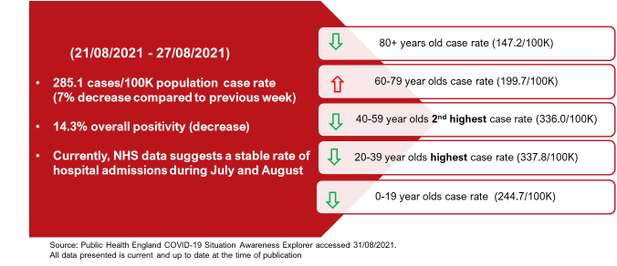
Current COVID situation in Birmingham

Slide 4
Birmingham Weekly COVID-19 Statistics Weekly report: 23rd – 29th August 2021
Author: Dr Justin Varney (Department of Public Health)
Source: SGSS, NHS Digital
New cases and the overall case rate have decreased in the 7 days leading up to 29th August. The % of positive tests has also decreased slightly, along with overall testing rates using PCR, LFD or both.
All adults are encouraged to do regular home testing using the rapid Lateral flow tests. The test kits are available at community sites and pharmacies across the city, or you can also order online for home delivery directly from the government for free by post or find a local collection site.
Spread appears to be primarily occurring through household, social and workplace interactions. Spread often happens in the home but it isn’t inevitable, and www.germdefence.org can help.
In hospitals across the city, admissions range between 31 and 45 new cases a day in the week ending 29th August (total = 263), a decrease of 14% when compared to last week’s admissions of between 29 and 56 new daily cases (total = 306). There were 19 deaths reported this week in Birmingham, an increase of 1 death compared to the previous week.
New cases
(Positive tests)
Rate of cases
(per 100k persons)
Rate of testing
(per 100k persons; Pillar 2, PCR & LFD)
Pillar 2 PCR & LFD total weekly tests:
64,628
Positive tests % (PCR only)
This week
This week
This week
This week
3,156
276.4
5,660
14.3
Last week
Last week
Last week
Last week
3,576
313.2
5,402
15.0
Number of cases since March 2020
Pillar 1: Cases in hospital or GP
Pillar 2: Cases in the community

Slide 5
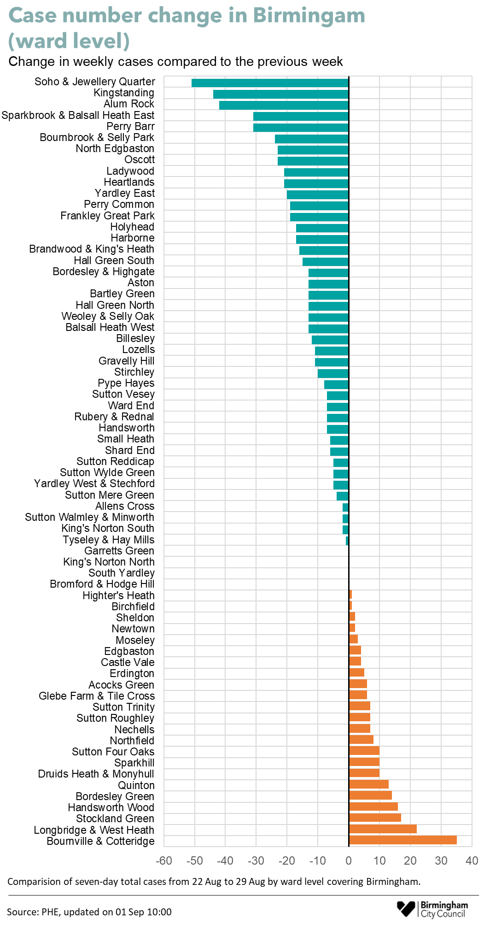
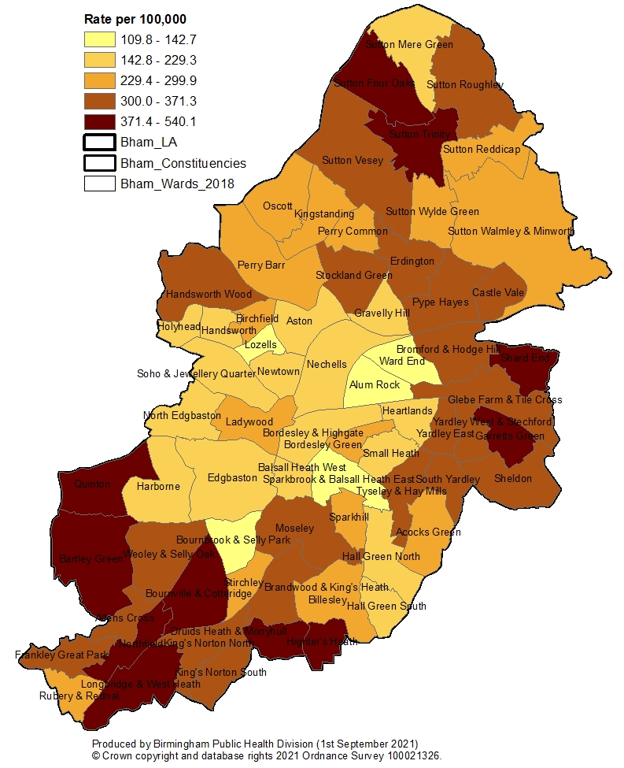
Birmingham Weekly COVID-19 Statistics Weekly report 23rd – 29th August 2021
Across Birmingham, the number of cases decreased this week by 420 cases (3,156 cases this week compared to 3,576 last week). All wards in Birmingham reported new cases this week.
These are the wards with the highest case rates (cases per 100,000 population) this week:
Sutton Trinity (540)
Northfield (441)
Bournville & Cotteridge (436)
Garretts Green (420)
Bartley Green (411)
Highter's Heath (408)
Druids Heath & Monyhull (399)
Shard End (398)
Longbridge & West Heath (397)
Sutton Four Oaks (393)
Cases increased in all age groups this week, except the 0-19 and 20-39 age groups, which decreased by 16% and 33% respectively. Cases decreased in all ethnic groups, except the Mixed/Other ethnic group which remained stable. The most notable decrease was seen in the Black ethnic group which decreased by 46%.
Confirmed Cases by Ward 23rd – 29th August 2021
(Pillar 1 & Pillar 2 Tests)

Slide 6
Key things to note
It is no longer recommend that it is necessary to keep children in consistent groups (‘bubbles’).
As part of contingency planning, all schools should have an outbreak management plan in place.
Close contacts will now be identified via NHS Test and Trace and education settings will no longer be expected to undertake contact tracing.
Individuals are not required to self-isolate if they live in the same household as someone with COVID-19, or are a close contact of someone with COVID-19, if they are;
fully vaccinated
below the age of 18 years and 6 months
previously or currently part of an approved COVID-19 vaccine trial
not able to get vaccinated for medical reasons
They will be contacted by NHS Test and Trace, informed they have been in close contact with a positive case and advised to take a PCR test.
Schools may be contacted in exceptional cases to help with identifying close contacts,.
Director of public health (DPH) and PHE health protection teams (HPTs) can recommend measures in individual education and childcare settings as part of their outbreak management responsibilities.

Slide 7
Schools thresholds for outbreak management
The thresholds, detailed below, can be used by settings as an indication for when to seek public health advice if they are concerned.
For most education and childcare settings, whichever of these thresholds is reached first:
5 children, pupils, students or staff, who are likely to have mixed closely, test positive for COVID-19 within a 10-day period; or
10% of children, pupils, students or staff who are likely to have mixed closely test positive for COVID-19 within a 10-day period
For special schools, residential settings, and settings that operate with 20 or fewer children, pupils, students and staff at any one time:
2 children, pupils, students and staff, who are likely to have mixed closely, test positive for COVID-19 within a 10-day period

Slide 8
Reporting cases to the local HPR Team
Educational settings actions
Report all cases even those we made you aware of – Please send the new Checklist to contacttracing@birmingham.gov.uk
The initial 2 tests undertaken at the start of term, for secondary schools (at home or at Asymptomatic Testing Setting Site), do not require reporting to local HPR team.
Do not share Personal Identifiable Information (PID) with local HPR or parents
Engage with us where threshold has been met to implement additional measures.
BCC HPR Team actions
Will respond to schools infections where;
threshold hasn’t been met but wrong information was supplied (e.g. inappropriate isolation) to advise setting
threshold has been met to advise on additional outbreak management measures
All additional measures will be emailed to setting
Public Health flowchart for schools

Slide 9
Guidance for schools
Earlier this week an outbreak management plan template and the updated Public Health flowchart were shared with schools
In addition, Public Health have produced a number of posters and other resources that will be shared with schools with the slides for this session (examples on the next slide)
The DfE has issued guidance on ventilation for schools and will be providing CO2 monitors to all state-funded education settings
BCC Education colleagues are organising a webinar on ventilation and details of this will be shared with schools shortly.

Slide 10
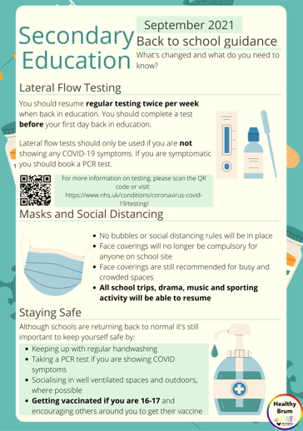
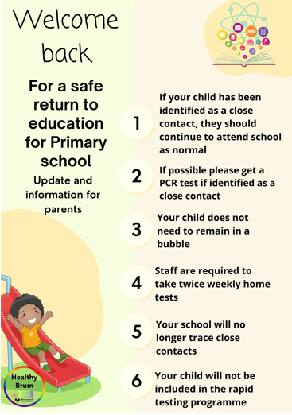
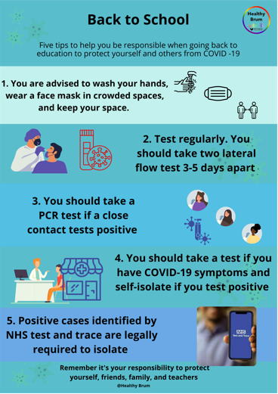
Posters for schools to use

Slide 11
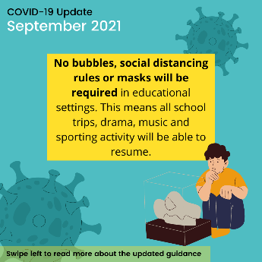
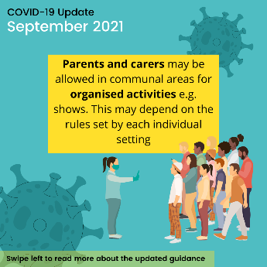
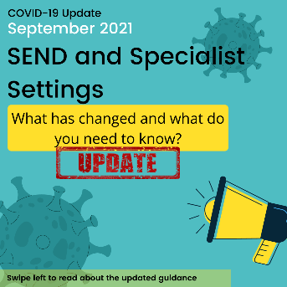
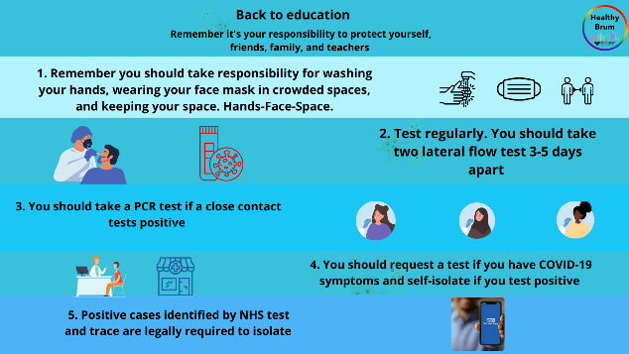
Social Media @HealthyBrum

Slide 12
Vaccination Programme: 16 and 17 year olds
All 16 and 17 year olds have been offered their first coronavirus vaccine dose
They are able to access the vaccine either by booking an appointment or by visiting a mobile vaccination site
Mobile sites are situated across the city and a list is available at https://www.birminghamandsolihullcovidvaccine.nhs.uk/walk-in/
So far over 20% of 16 and 17 year olds have received their first dose of the vaccine
Information about vaccine takeup by age group is contained on the next slide

Slide 13
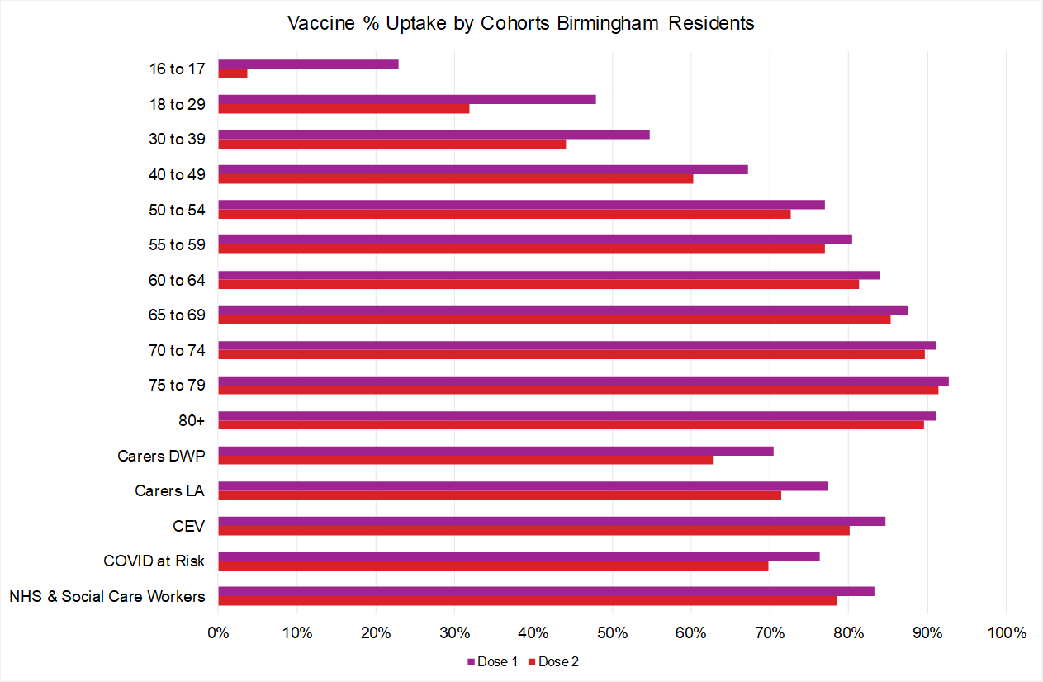
Birmingham COVID-19 Vaccine uptake Extracted 31st August 2021

Slide 14
Vaccination Programme: 12-15 year olds
The JCVI has approved the vaccination of 12–15 year olds with specific underlying health conditions that put them at risk of severe COVID-19
These young people have been contacted by their GP for vaccination
The government has asked the NHS to start preparing for the vaccination of all 12-15 year olds from this month
BCC has been working with colleagues in the NHS on preparations for a potential extension to the vaccination programme
As soon as an announcement regarding this is made by the JCVI, the NHS will be in touch with schools about arrangements.

Slide 15
Questions?

Slide 16
Contact Information
Should you require any further information or would like to discuss any of the points raised in today’s presentation, please contact:
BCC Education and Skills: edsi.enquiries@birmingham.gov.uk or education@birmingham.gov.uk
Public Health (general advice): BCCCOVID19@birmingham.gov.uk

Slide 17
Social media final slide

