Slide 1
COVID-19 Overview for Education Settings (Schools)
Modupe Omonijo, Consultant in Public Health
Birmingham City Council
23 June 2021

Slide 2
Plan for today’s session
Update on the current COVID position in Birmingham
Birmingham as an area of enhanced support
Implications for schools
Questions and answers

Slide 3
Birmingham COVID-19 UPDATE
Observed increasing infections with inequalities across the city affecting specific groups including by ward, age group and ethnic group who are facing higher infection rates, lower vaccine uptake and lower testing rates based on 3 indicators below since start of June.
7 day case rate per 100,000 population
7 day testing rate per 100,000 population
Vaccine uptake – 1st dose aged 50+
Focus wards: Alum Rock, Lozells, Bordesley & Highgate, Heartlands, Bordesley Green, Sparkhill, Birchfield, Small Heath, Ward End, Newtown, Sparkbrook & Balsall heath East, Aston, Nechells, Holyhead, Balsall Heath West.
80+ years old case rate
(11.3/100K)
60-79 year olds case rate (31.2/100K)
40-59 year olds case rate (97.0/100K)
20-39 year olds highest case rate (211.6/100K)
0-19 year olds 2nd highest case rate (147.9/100K)
(14/06-20/06)
135.5 cases/100K all population case rate (increase)
7.1 % overall PCR positivity (increase)
NHS data suggests steady increase in hospital admissions and ITU admissions.
Source: Public Health England COVID-19 Situation Awareness Explorer accessed 23/06/2021
More COVID-19 information here​: https://www.birmingham.gov.uk/downloads/download/3667/covid-19_community_champions​

Slide 4
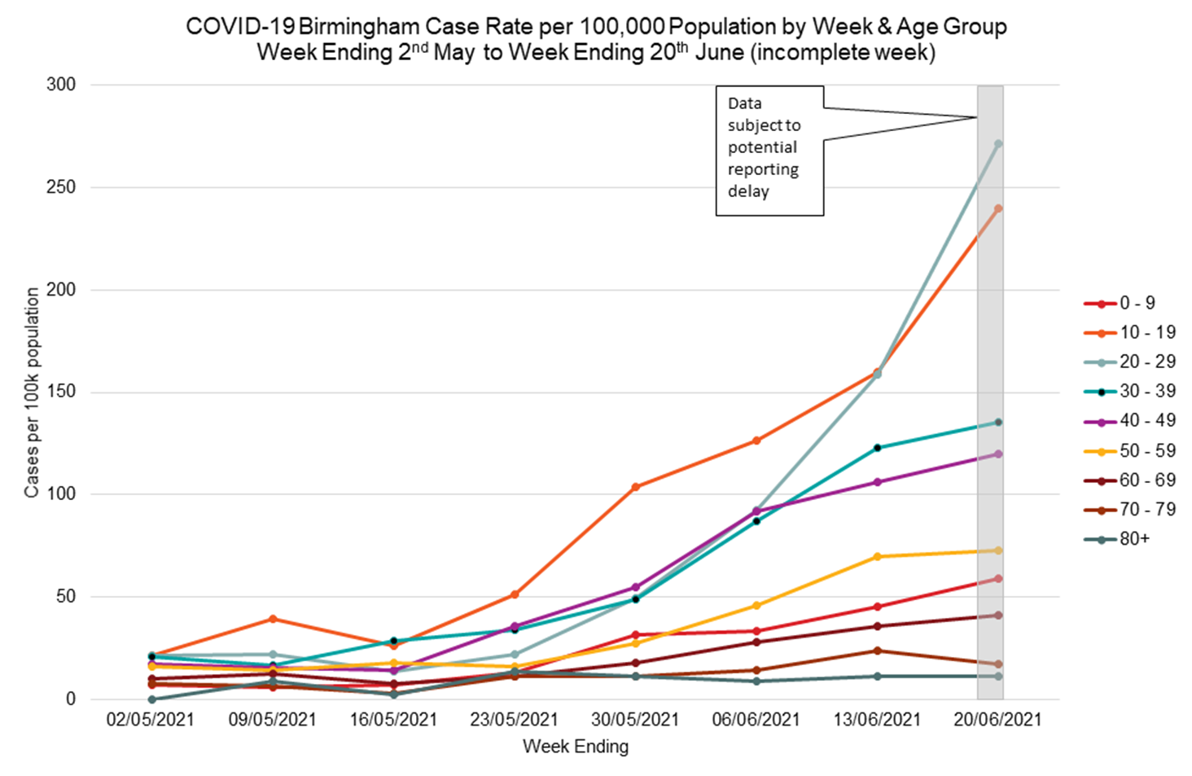
Birmingham COVID-19 UPDATE

Slide 5
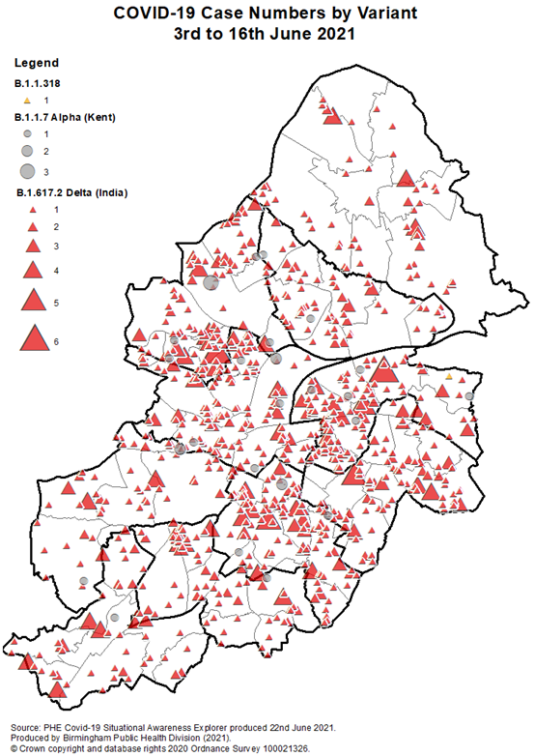
VOC distribution by Area
Birmingham COVID-19 UPDATE
Most cases are in West, Central and South East of the city.
Delta variant now appears to be dominant and widespread across the entire city.
Areas in the West of the city have low vaccine uptake and are therefore at a greater risk for cases resulting in severe illness.

Slide 6
Why Enhanced Support?
Birmingham became an area of enhanced support w/c 14th June.
Increasing overall COVID-19 rates across Birmingham with Delta variant of concern exceeding Alpha variant locally.
Delta VoC is 1.6 times more transmissible and affects younger generation with more illness
multiple areas with case rates >100 cases/100K, poor vaccination uptake, low testing, pivotal position nationally.
Learning from success of enhanced support measures in the Northwest of England and South London show success across 3 main areas: testing, isolation and vaccination.
Enhanced support package aims to suppress the spread of the Delta variant and break chains of transmission thereby stopping a rise in the number of cases

Slide 7
Enhanced support package – 1
Target safety measures across highest affected areas against a city-wide background of accelerated action on vaccination, home testing uptake and reinforcement of non-pharmaceutical interventions in line with national guidelines and advice.
Testing support and increase access
Reminders about twice-weekly home testing for households and bubbles of staff and students.
Door to Door lateral flow testing kits drop off across the city with demonstration sessions and pop-up tests planned.
Provision of more test kits to schools and further education providers in target wards.
PCR distribution to schools with outbreaks for home testing and universal offer return.
Self-isolation support and awareness
Encourage adherence to isolation guidance and answering queries.
Environmental Health Officers support compliance through enhanced contact tracing and isolation checks with signposting to support during isolation period via Birmingham City Council’s Emergency Response Hub.
Print and digital copies as well as accessible copies (translated and BSL) of isolation pack shared: https://www.birmingham.gov.uk/downloads/download/4207/self_isolation_support_pack
Vaccination support to increase uptake and maximise capacity
Encourage all eligible people to take up the vaccine offer PROMPTLY.
Target low uptake communities and wards with mobile vaccine van now available across the city.
Raise awareness using community voices and city-wide vaccination toolkit with useful information: https://www.birmingham.gov.uk/covid-19-vaccine-toolkit-download
Pop-up vaccination clinics and mobile vaccination van sites: updated schedule daily at https://www.birminghamandsolihullcovidvaccine.nhs.uk/walk-in/
Link to eligible vaccine age groups advertised: https://www.nhs.uk/conditions/coronavirus-covid-19/coronavirus-vaccination/book-coronavirus-vaccination/

Slide 8
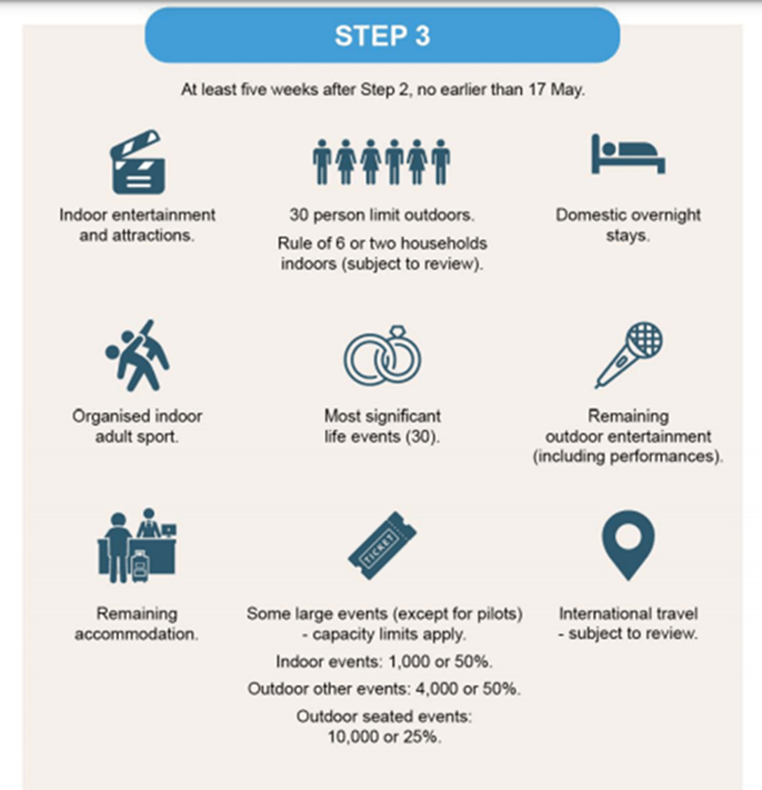
Enhanced support package – 2
Testing, isolation and vaccinations will help suppress and control the spread of the virus and variants in both the short and longer term, when used in combination with people following existing guidance such as hands, face, space and fresh air.
Extra guidance on minimising travel in and out of the affected areas, to keep their loved ones and their communities safe.
Wastewater testing samples being prioritised for sequencing;
Specialist communications support to increase awareness and focus engagement with disadvantaged groups;
Increasing local and targeted communications to reach different communities;
Reintroduction of face coverings in indoor communal areas and classrooms in schools is strongly advised by the Director of Public Health
Enhanced monitoring (genomic sequencing, genotype assay testing).
Other advice targeted at schools regarding transition day, open days another planned events including updated risk assessments and FAQs available: https://www.birmingham.gov.uk/downloads/download/3473/risk_assessment_for_schools
More than just Step 3 and need for additional vigilance and adherence to legislations and guidance across the City.

Slide 9
What this means for schools
Reintroduction of face coverings in indoor communal areas and classrooms in secondary schools is strongly advised by the Director of Public Health - schools with secondary pupils are advised to review their risk assessments
The council’s risk assessment template has been updated to support schools consider:
Transition events (Public Health advice is for these to be held virtually)
School trips (Government guidance is to minimize travel into and out of Birmingham)
Other planned events
Please continue to follow the process in the Public Health Flowchart for Schools to notify us of new cases.
Birmingham City Council Health Protection Team - Contacttracing@birmingham.gov.uk

Slide 10
Take Home Messages
Please click below to watch video with a message from our Youth Champion.
Support the city-wide package
Increase your community involvement through staff, parents and pupils support and feedback via champions and other key stakeholders
More peer support for young people through Youth COVID-19 Champions (see awareness video and joining instructions: send email/text to Juliet – senior Youth worker Juliet.C.Faulkner@birmingham.gov.uk
Parents and staff can become COVID-19 Champion to help other residents find out more about COVID-19 and for their voices to be heard by signing up here: https://www.birmingham.gov.uk/COVID-19_Community_Champions
Notification of new cases
Please follow process in the Public Health Flowchart for Schools to notify us of new cases.
Birmingham City Council Health Protection Team - Contacttracing@birmingham.gov.uk

