Slide 1

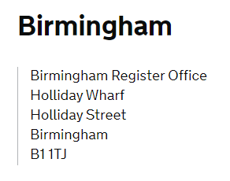
EUSS - ID SCANNING AND VERIFICATION SERVICE
If you don’t have access to a mobile device with the Near Field Communication (NFC) function, Birmingham City Council provides EUSS ID Scanning and Verification Service.
It is an appointment only service that the Council’s Register Office provides free of charge.
As a Local Authority we can also provide a manual verification
so you don’t need to send your documents to the Home Office
LOCATION
Book an appointment here:
https://www.birmingham.gov.uk/xfp/form/776

