Slide 1
PREVENT SCHOOL BRIEFING
The current situation in Israel/Palestine

Slide 2
Teacher note only: Resources to support discussions: This resource has some slides that can be adapted for use with pupils and some for teachers only. It contains some useful information and sources of support, including Unicef UK’s fundraising initiative. Please find links below to useful resources created by Solutions Not Sides:
https://solutionsnotsides.co.uk/blog/2021/avoiding-antisemitic-islamophobic-hate-speech
https://solutionsnotsides.co.uk/sites/sns.hocext.co.uk/files/2021-05/SNS%20TEACHER%20HANDBOOK.docx.pdf

Slide 3
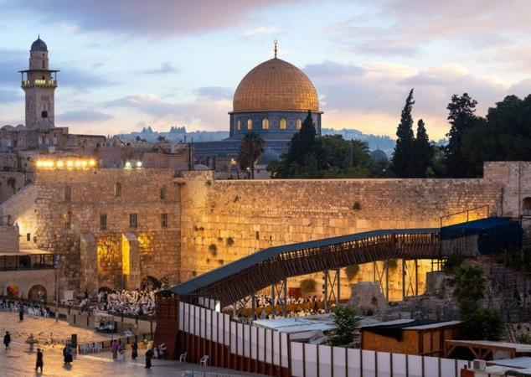
Why are there protests?
Jerusalem is often at the centre of protests because the city is very important for religious reasons, and has many of the most important sites for Judaism, Islam and Christianity.
After a war in 1948 the city of Jerusalem ended up being split. Jordan was left in control of East Jerusalem, and Israel in control of West Jerusalem.
But after another war in 1967, Israel took control of the entire city and regards the whole of Jerusalem as its capital.
However, Israel's right to Jerusalem is not recognised by many governments. According to a 1993 agreement between Israel and the Palestinians, the final status of Jerusalem is meant to be decided in peace talks.

Slide 4
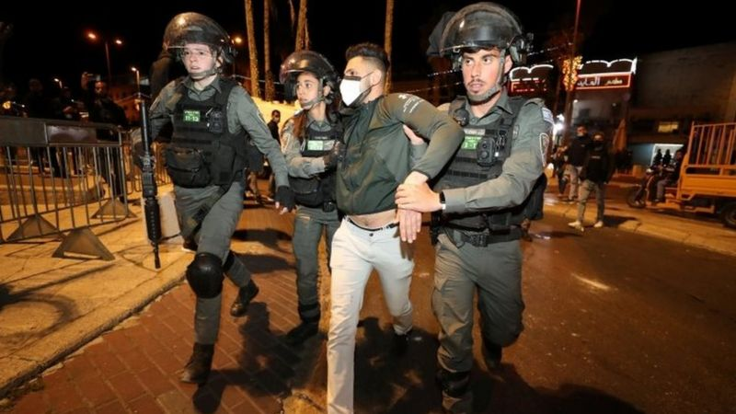
Tensions in East Jerusalem have risen since the start of the Muslim holy month of Ramadan on 13 April with many clashes between Palestinian groups, Israeli groups and police.
The latest rise in violence has come after Palestinians and Israeli police clashed in Jerusalem on Monday 10 May.
Palestinians accused the police of stopping them from congregating on steps outside Damascus Gate in East Jerusalem near to the Al-Aqsa mosque - which is an important holy site - to break their fast.
Police say the measures were intended to help pedestrian flow into the Old City.
Many people were injured in the violence. Palestinians then fired rockets into Israel and the Israeli army responded with air strikes on targets in Gaza.
Violence has now spread to other cities with more attacks from both sides.

Slide 5
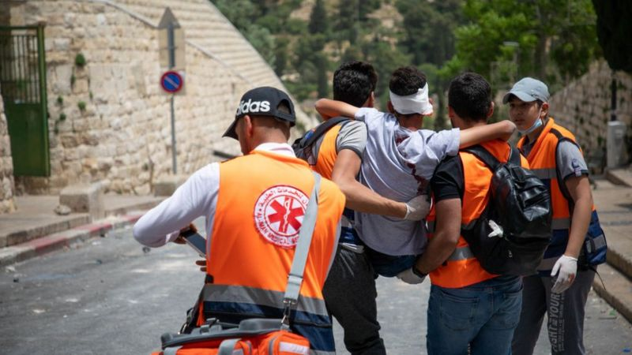
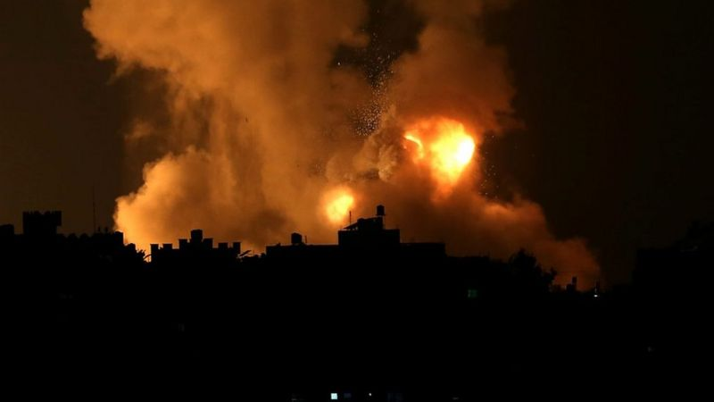
What have world leaders said?
The international community has urged both sides to end the escalation.
UK Prime Minister Boris Johnson urged Israel and the Palestinians to "step back from the brink".
"The UK is deeply concerned by the growing violence and civilian casualties and we want to see an urgent de-escalation of tensions," he said on social media.
US President Joe Biden expressed support for a ceasefire between Israel and Gaza’s militant rulers, Hamas, after a phone conversation with the Israeli prime minister, Benjamin Netanyahu.
The United Nations Security Council held an urgent meeting on Monday over the violence, with the UN's Middle East peace envoy, Tor Wennesland, saying he was worried the two sides were "escalating towards a full-scale war".
Notes:
Why is world peace important?

Slide 6
Why is this happening?
According to BBC Middle East expert Jeremy Bowen, there are long-standing reasons for the return of violence.
This was a crisis waiting to happen... Leaders on both sides have concentrated on safeguarding their own positions. The biggest challenge, of making peace, has not been addressed seriously for years.
Jeremy Bowen, BBC Middle East editor
It is part of the ongoing conflict between Jews and Arabs, which has gone on for generations, which largely began over who the land should belong to and how it should be divided up since the creation of the modern state of Israel in 1948.
https://www.bbc.co.uk/newsround/57068407

Slide 7
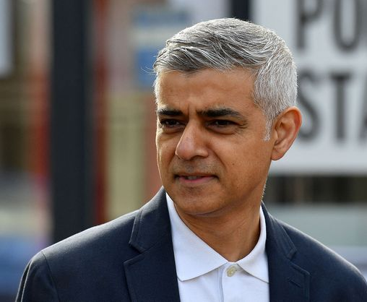
London Mayor Sadiq Khan urged people to report anti-Semitism to police, saying any alleged hate crimes would be taken seriously.
"Many of us are angry, upset, heartbroken by the events in Israel, the West Bank and Gaza….that's no excuse, though, for anti-Semitism.... we're not going to tolerate it in London," he told the BBC.
There has been a "deeply disturbing" upsurge in anti-Semitism in recent years, the Communities Secretary says.
Robert Jenrick told MPs incidents over the weekend in north London and Essex were "intimidatory, racist and extremely serious crimes".
https://www.bbc.co.uk/news/uk-57145232

Slide 8
UNICEF Humanitarian Action for Children Appeal
UNICEF’s Humanitarian Action for Children appeal helps support the agency’s work as it provides conflict- and disaster-affected children with access to water, sanitation, nutrition, education, health and protection services.
https://www.unicef.org/appeals/state-of-palestine

Slide 9
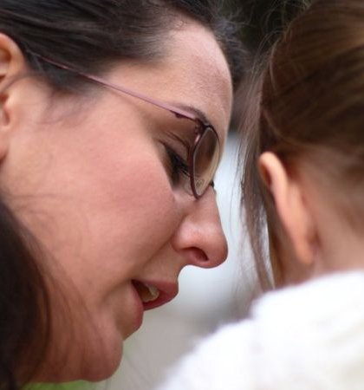
Advice for pupils if they are upset by the news
If you are upset by the news, it's important to know that you are not the only one and it’s okay to have those feelings.
This section gives you some tips about what to do if you are feeling sad about what you've seen, heard or read.
What to do if you're upset by the news?
Sometimes things that happen in the world can make us sad, anxious or confused.
It's important to remember that upsetting stories are in the news because they are rare - they don't happen very often.
But what can we do when the news makes us feel this way?
If the news has upset you, talk to an adult you trust about it. It's important to share what is troubling you.
Talking to an adult you trust is a good idea if you are worried about anything

Slide 10
It's important to remember that being sad, worried or angry about awful things that happen in the world around you is okay and perfectly normal
You won't be the only one who feels that way
Adults get sad and confused too, so there is nothing wrong with feeling like this
It's normal to feel upset
Do things that make you happy
Watch your favourite film, take your dog for a walk or read some of your favourite book.
Try to balance the news you read. If you read a sad story, then try and read a happy one before you go to bed
If being worried is making it more difficult to sleep or if you are having nightmares, it's really important to speak to an adult about this too.
Here are some things you can do if you are having worried thoughts when you go to bed:
remember things that make you happy and think about these as you're going to bed, so your head is full of positive thoughts
surround yourself with nice things by your bed - perhaps a happy photo that makes you smile - so this is the last thing you see before you sleep
read a book you love that will help to settle your thoughts
if you have bad dreams, talk about it to someone you trust
Keep things with you that make you feel secure - even if it is your old teddy bear that you keep hidden from your friends!

Slide 11
Don't forget - terrible things are on the news because they are rare and do not happen very often.
Although people are spending a lot of time talking about it, it is still very unlikely that events like this will affect you or your family.
The most important thing is that if you are feeling upset, don't keep what's troubling you about the news to yourself.
Talk to an adult about the issue in the news that is worrying you.
School INSERT your school contacts here:
Talking to an adult you trust could help you to feel better if there is anything in the news that is worrying you

Slide 12
Tell Mama is a confidential support service for those suffering from Islamophobia across the UK. Their website features a number of different ways to report anti-Muslim hate or Islamophobia, including via phone or WhatsApp: Report in Anti-Muslim Hate or Islamophobia (tellmamauk.org). The site also hosts useful resources, including on mosque security.
Solutions not Sides is a programme aiming to tackle antisemitism, Islamophobia, and polarisation around the issue of the Israel-Palestine conflict in the UK by promoting critical thinking and open discussions to encourage a solutions-focussed approach. The group have published a number of blogs on the current situation, as well as a teachers’ handbook and resources on fact-checking. Resources can be found here: SNS Resources on Israel-Palestine for Students & Teachers | SNS (solutionsnotsides.co.uk)
The Forum for Discussion of Israel and Palestine runs a ‘Tough Options’ programme for 14-19 year olds’, which looks at how difficult issues impact communities here in the UK. Their website has a number of useful resources, including information on how to engage with Tough Voices and their other programmes: FODIP | Forum for Discussion of Israel & Palestine

Slide 13
Useful websites
https://youngminds.org.uk
https://www.nspcc.org.uk
https://www.saferinternet.org.uk
Further curriculum resources
https://educateagainsthate.com/category/teachers/classroom-resources/
https://www.annafreud.org/schools-and-colleges/resources/

