Slide 1
COVID-19 Overview for Education Settings (Schools)
Modupe Omonijo, CPH, Birmingham City Council
14 May 2021

Slide 2
Return to school – Overview of guidance
Guidance and help
Testing
Twice-weekly testing for households and bubbles of staff
Testing in schools and colleges
Ordering home test kits for schools and further education providers
Exams
Have your say: consultation on the alternative to exams
Awarding qualifications in summer 2021
Managing a school or early years setting
Running a school during coronavirus
Running an early years setting during coronavirus
Guidance for special schools and other specialist settings
Out-of-school settings such as after-school clubs
Managing public transport to school or college
Recording attendance
Free school meals
Working safely
Contingency framework (not in place during the period of national restrictions)
Safe working in education, childcare and children’s social care
Safeguarding and remote education
Face coverings in education
Funding and support
Get technology support
Get financial support

Slide 3
Education COVID-19 Headlines
Change in education situations with the previous week
During the period 1st March to 9th May 2021* there were a Total of 406 Situations.
59% (243 situations) of all situations have been identified in an education setting
02/05/2021
25/04/2021
% Change
Primary School
54%
40%
14%
Secondary School
32%
31%
1%
77% of all education situations, (188 situations) were recorded in a Primary, Secondary and Special School setting.
Special School
5%
6%
1%
More COVID-19 information here
  https://www.birmingham.gov.uk/downloads/download/3667/covid-19_community_champions
*Situations are events reported to the health protection team where COVID-19 infection is involved, and these can be classified as clusters, exposures or outbreaks. The data is subject to change and cases may overlap due to lag in test date and reporting. Testing is voluntary so figures do not necessarily indicate all cases in a setting.
Notes:
BCU – Preparing for semester one https://www.bcu.ac.uk/student-info/preparing-for-semester-one

Slide 4
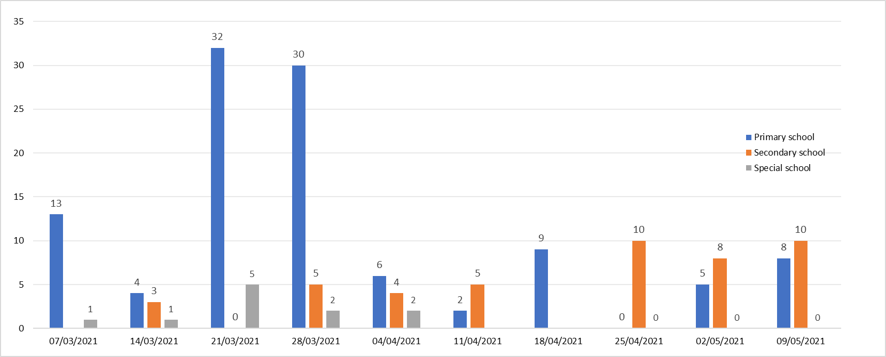
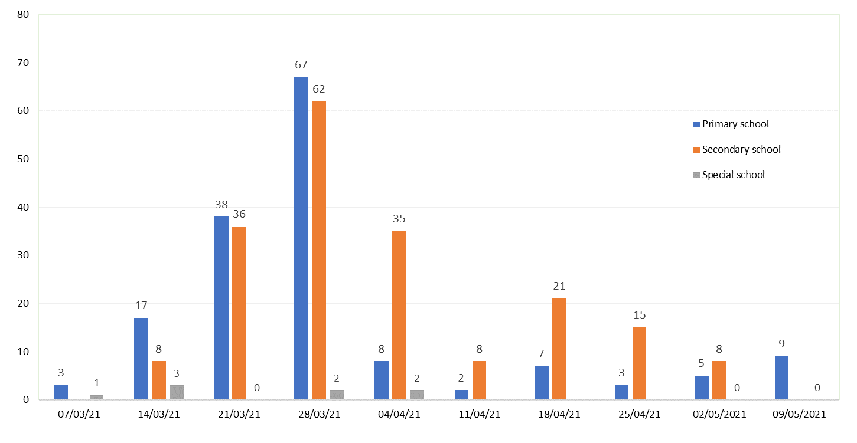
Education COVID-19 Headlines
Dates grouped by weekending date
Weekly breakdown of COVID-19 cases by Staff in Primary, Secondary and Special School Settings
1st March – 9th May 2021
Weekly breakdown of COVID-19 cases by Pupils in Primary, Secondary and Special School Settings
1st March – 9th May 2021
More COVID-19 information here
  https://www.birmingham.gov.uk/downloads/download/3667/covid-19_community_champions
*Situations are events reported to the health protection team where COVID-19 infection is involved, and these can be classified as clusters, exposures or outbreaks. The data is subject to change and cases may overlap due to lag in test date and reporting. Testing is voluntary so figures do not necessarily indicate all cases in a setting.
Notes:
BCU – Preparing for semester one https://www.bcu.ac.uk/student-info/preparing-for-semester-one

Slide 5
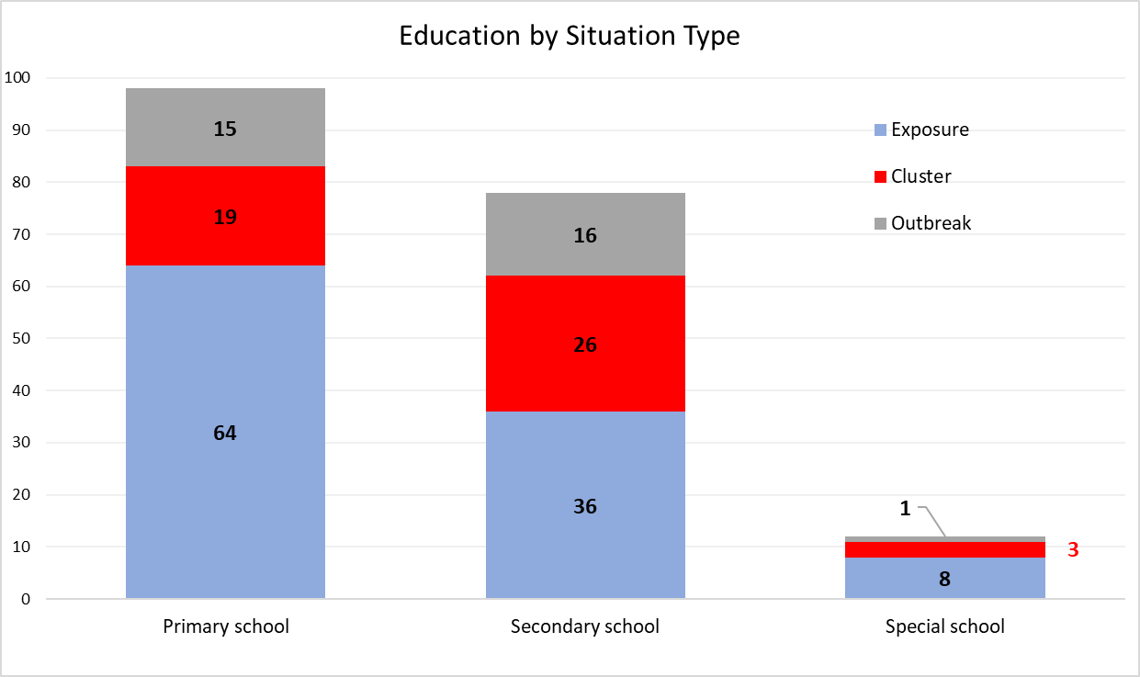
Education COVID-19 Headlines by Situation type
During the period 1st March to 9th May 2021
A total of 243 situations within Education settings. Of these 188 were reported in a Primary, Secondary and special school setting.
Exposures: 59% of all situations were recorded as Exposures (single case), which is a growth from previous week from 53%. 44% of all exposures in an education setting were found in Primary Schools, 25% in Secondary schools and 6% in Special schools.
Outbreaks: 17% of situations were recorded as outbreaks (42 situations). 76% of outbreaks were found in a primary and secondary schools. Special schools recorded one outbreak.
Clusters: 23% of situations were recorded as clusters (57 situations). 46% of clusters were found in Secondary schools and 33% in primary schools.
*Other includes Colleges, Holiday Clubs & Through School (Nursery/Yr1 - Yr13)
Notes:
BCU – Preparing for semester one https://www.bcu.ac.uk/student-info/preparing-for-semester-one

Slide 6
Control Measures – IMPORTANT POINT TO NOTE
IMPORTANT POINTS TO NOTE
Everyone MUST continue to follow good hand and respiratory hygiene, wear face coverings (where appropriate) and observe social distancing measures regardless of whether they have been tested or vaccinated.
Settings should follow guidance on isolation, ensure regular cleaning and good ventilation.
Anyone who tests positive or gets coronavirus symptoms should self-isolate quickly and follow advice/guidance and can contact Birmingham City Council team for any assistance
BCCCOVID19@birmingham.gov.uk
No test is 100% accurate
Schools and colleges should make it clear that a negative test result does not remove the risk of transmission.
In some cases, someone who has tested negative may still have the undetected disease and be infectious.
Testing is voluntary although participation in testing is strongly encouraged to support the control of infection transmission within education settings. LFD tests are for people without symptoms and PCR for those with symptoms.
Notes:
BCU – Preparing for semester one https://www.bcu.ac.uk/student-info/preparing-for-semester-one

Slide 7
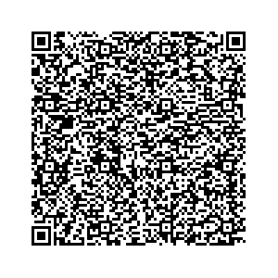
Join in on Healthy Brum's Tweetathon
We invite you all to join the Healthy Brum twitter channel's Tweetathon on Monday 17th May.
To mark the next step of the government's roadmap out of lockdown, we would like to encourage safe behaviours through our twitter channel to make sure to spread the word that we need to work together to keep moving in the right direction.
Getting a rapid test twice a week, washing your hands and wearing a mask are all simple steps that help. Please share and engage with our posts and polls on @healthybrum - use the hashtags #keepbrumsafe and #testandtweet. Why not give us a follow too if you haven't already?
Please share and engage with our posts - use the hashtags #keepbrumsafe and #testandtweet and follow us on twitter here.

Slide 8

Youth Covid Champions
Criteria for joining
Motivation to protect your loved ones
What you will do
Spread Covid messaging
Be the voice of young people
Attend Covid Briefing Meetings every two weeks on Microsoft Teams
What’s in it for you
Improve self-confidence
Improve self-esteem
Develop skills to use on school and beyond
Help keep your friends, family and communities safe
How to join
Tell us (email/text Juliet – senior Youth worker Juliet.c.Faulkner@birmimgham.gov.uk
Work Mobile Number 07917643383
Meet with us – join ashort Microsoft teams meeting to give you more information after which you can make your decision
Some forms to be filled by you and your parents/guardians
Join us on WhatsApp and Instagram – if you like

Slide 9
Useful contacts
Are you having issues with LFD test kits delivery?
  Contact DfE on 08000468687.
    DfE may place an emergency order for you. This may not appear on the delivery schedule immediately but re-check on Monday as this gets updated every Monday.
  Follow interim process by encouraging parents and staff to
    Order home test kits. Individuals can order 1 pack (of 7 kits) per household per day on https://www.gov.uk/order-coronavirus-rapid-lateral-flow-tests or by calling 119 (open 7am-11pm) (delivery is within two days, usually the next)
    find a pharmacy where they can collect tests
    find a local site where they can collect tests
DfE coronavirus helpline
  Telephone 0800 046 8687. If you have a query about coronavirus (COVID-19) relating to schools and other educational establishments, and children's social care, in England contact our helpline.
  Helpline opening hours: Monday to Friday from 8am to 6pm, Saturday and Sunday from 10am to 6pm.
Birmingham City Council Health Protection Team - Contacttracing@birmingham.gov.uk
Notification of new cases
  Please follow process in the Public Health Flowchart for Schools to notify us of new cases.
Become a COVID-19 Champion! Nearly 800 champions across the city and we recently launched the COVID-19 Youth Champions programme. Are you keen to help other residents find out more about COVID-19 and for your voice to be heard? Then do sign up and join the network. More information available here: https://www.birmingham.gov.uk/COVID-19_Community_Champions

