Slide 1
COVID-19 Overview for Education Settings (Schools)
Modupe Omonijo, CPH, Birmingham City Council
27 April 2021

Slide 2
Introduction
Return to school
Control measures
Headlines
Useful contacts

Slide 3
Overview of COVD-19 Education Guidance -
Guidance and help
Testing
Twice-weekly testing for households and bubbles of staff
Testing in schools and colleges
Ordering home test kits for schools and further education providers
Exams
Have your say: consultation on the alternative to exams
Awarding qualifications in summer 2021
Managing a school or early years setting
Running a school during coronavirus
Running an early years setting during coronavirus
Guidance for special schools and other specialist settings
Out-of-school settings such as after-school clubs
Managing public transport to school or college
Recording attendance
Free school meals
Working safely
Contingency framework (not in place during the period of national restrictions)
Safe working in education, childcare and children’s social care
Safeguarding and remote education
Face coverings in education
Funding and support
Get technology support
Get financial support

Slide 4
Education COVID-19 Headlines (1)
During the period 1st March to 25th April 2021* there were a Total of 384 Situations.
57% (217 situations) of all situations have been identified in an education setting
76% of all education situations, (165 situations) were recorded in a Primary, Secondary and Special School setting.
Change in education situations with the previous week
25/04/2021
18/04/2021
Change
Primary School
39%
41%
2%
Secondary School
31%
28%
3%
Special School
6%
6%
More COVID-19 information here
  https://www.birmingham.gov.uk/downloads/download/3667/covid-19_community_champions
*Situations are events reported to the health protection team where COVID-19 infection is involved, and these can be classified as clusters, exposures or outbreaks. The data is subject to change and cases may overlap due to lag in test date and reporting. Testing is voluntary so figures do not necessarily indicate all cases in a setting.
Notes:
BCU – Preparing for semester one https://www.bcu.ac.uk/student-info/preparing-for-semester-one

Slide 5
Education COVID-19 Headlines (2)
*Situations are events reported to the health protection team where COVID-19 infection is involved, and these can be classified as clusters, exposures or outbreaks. The data is subject to change and cases may overlap due to lag in test date and reporting. Testing is voluntary so figures do not necessarily indicate all cases in a setting.
Notes:
BCU – Preparing for semester one https://www.bcu.ac.uk/student-info/preparing-for-semester-one

Slide 6
Education COVID-19 Headlines by Situation type
During the period 1st March to 25th April 2021
Breakdown of the165 situations reported in a Primary, Secondary and special school setting by type.
Exposures: Half (50%) of all situations were recorded as Exposures (single case), this is slightly higher than the previous week (48%). 62% of all exposures in an education setting were found in Primary Schools, 28% in a secondary school and 10% in a special school.
Outbreaks: 19% of situations were recorded as outbreaks (30 situations). 50% of outbreaks were found in a primary setting and 47% in secondary schools. Special schools recorded one outbreak.
Clusters: 30% of situations were recorded as clusters (27 situations). The number of clusters increased by 1 since last week. 53% of clusters were found in Secondary schools and 40% in primary schools.
*Situations are events reported to the health protection team where COVID-19 infection is involved, and these can be classified as clusters, exposures or outbreaks. The data is subject to change and cases may overlap due to lag in test date and reporting. Testing is voluntary so figures do not necessarily indicate all cases in a setting.
Notes:
BCU – Preparing for semester one https://www.bcu.ac.uk/student-info/preparing-for-semester-one

Slide 7
Control Measures – IMPORTANT POINTS TO NOTE
No test is 100% accurate
Schools and colleges should make it clear that a negative test result does not remove the risk of transmission.
REMEMBER
Everyone MUST continue to follow good hand and respiratory hygiene, wear face coverings (where appropriate) and observe social distancing measures regardless of whether they have been tested or vaccinated.
Settings should follow guidance on isolation, ensure regular cleaning and good ventilation.
Anyone who tests positive or gets coronavirus symptoms should self-isolate quickly and follow advice/guidance and can contact Birmingham City Council team for any assistance
BCCCOVID19@birmingham.gov.uk
In some cases, someone who has tested negative may still have the undetected disease and be infectious.
Testing is voluntary although participation in testing is strongly encouraged to support the control of infection transmission within education settings. LFD tests are for people without symptoms and PCR for those with symptoms.
Notes:
BCU – Preparing for semester one https://www.bcu.ac.uk/student-info/preparing-for-semester-one

Slide 8
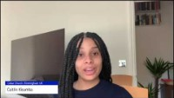
Supporting our community testing – How To Test at Home
On our HealthyBrum YouTube channel you can find a step-by-step guide on how to complete the LFD Test at home, recorded by Caitlin Kisumba.
The video is user friendly and suitable for all ages. Click Here
Make sure to check out all the other useful videos on the channel.
LFD Test at Home – Video Tutorial

Slide 9
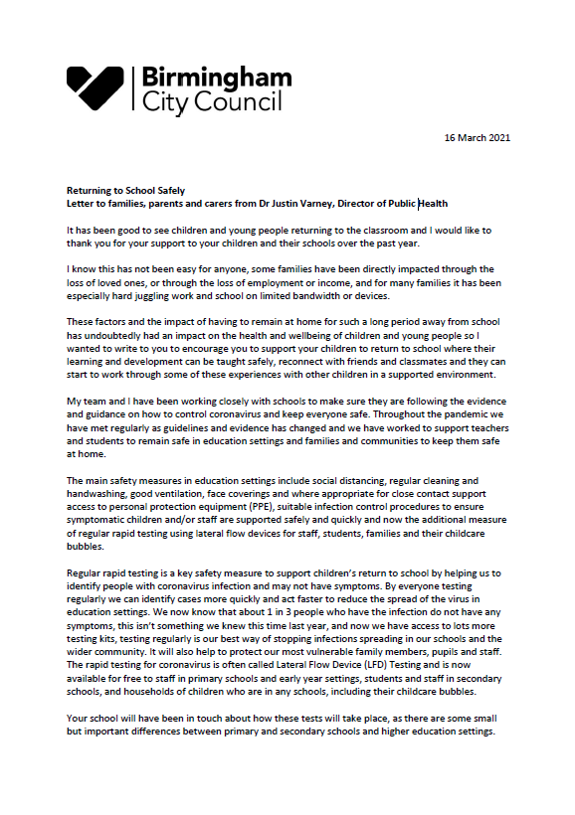
Supporting our Schools testing programme
“
Letter to households from the Director of Public Health Birmingham
Regular rapid testing is a key safety measure to support children’s return to school by helping us to identify people with coronavirus infection and may not have symptoms. By everyone testing regularly we can identify cases more quickly and act faster to reduce the spread of the virus in education settings.
- Dr Justin Varney Link to Director of Public Health Letter
”
Become a COVID-19 Champion! Nearly 800 champions across the city and we recently launched the COVID-19 Youth champions programme. Are you keen to help other residents find out more about COVID-19 and for your voice to be heard? Then do sign up and join the network. More information available here: https://www.birmingham.gov.uk/COVID-19_Community_Champions
Surge Testing for COVID-19 variant
  People 16 years and over in target areas offered PCR testing to monitor COVID-19 variant.
  Please continue using twice-weekly rapid testing alongside the PCR test.
  Check our website to confirm if your postcode falls under testing for the new variant – https://www.birmingham.gov.uk/info/50233/support_for_residents_during_the_coronavirus_covid-19/2319/extra_testing_to_monitor_and_suppress_spread_of_covid-19_variant

Slide 10
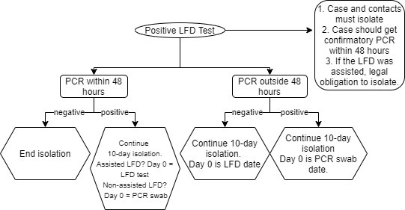
Updated Testing Guidance
Assisted test
Supervised by trained operator who processes test, reads and reports result.
Non-assisted test
Un-supervised (i.e. carried out at home) and self-reported: see link to self-report
See more on testing – Covid-19 LFD Testing Information (includes how to book PCR test, too)
Note – In all positive diagnosis, if a person has symptoms and has a test date within 5 days of the symptoms, day 0 is when symptoms started.

Slide 11
Useful contacts
Are you having issues with LFD test kits delivery?
Contact DfE on 08000468687.
    DfE may place an emergency order for you. This may not appear on the delivery schedule immediately but re-check on Monday as this gets updated every Monday.
Follow interim process by encouraging parents and staff to
    Order home test kits. Individuals can order 1 pack (of 7 kits) per household per day on https://www.gov.uk/order-coronavirus-rapid-lateral-flow-tests or by calling 119 (open 7am-11pm) (delivery is within two days, usually the next)
    find a pharmacy where they can collect tests
    find a local site where they can collect tests
DfE coronavirus helpline
Telephone 0800 046 8687. If you have a query about coronavirus (COVID-19) relating to schools and other educational establishments, and children's social care, in England contact our helpline.
Helpline opening hours: Monday to Friday from 8am to 6pm, Saturday and Sunday from 10am to 6pm.
Birmingham City Council team
BCCCOVID19@birmingham.gov.uk
Notification of new cases
Please follow process in the Public Health Flowchart for Schools to notify us of new cases.

