Slide 1
Budget 2021⁺ Briefing to Business Rate Payers
27 January 2021

Slide 2
Purpose of today’s briefing
Set out our long term strategy to improve the life chances of our citizens and support Birmingham’s economic recovery;
Outline the financial challenges facing the City Council
Discuss opportunities for economic growth to support the recovery from the Covid-19 pandemic

Slide 3
Overview: Setting the Context

Slide 4
Setting the context: Many Opportunities but significant challenges
Birmingham is ranked the 7th most deprived local authority in England,
490,000 of citizens estimated to live in the top 10% most deprived areas in England.
Birmingham's claimant unemployment rate stands at 15.3%; above both the West Midlands (9.1%) and the UK (7.8%) rates.
And now Covid-19 – severe impact on businesses and our economy and highlighted the inequalities within our city.

Slide 5
Our Priorities: What do we want to achieve?

Slide 6
Our Priorities: How will we deliver?
A new Delivery Plan, introduced in November last year sets out our priorities, actions and key commitments to May 2022.
Ambition to make Birmingham a fair and thriving city where all citizens have the opportunity to achieve their potential and share in the city’s success.
Key areas of focus include:
Reforming the way the Council operates
Shifting our focus from crisis to prevention
Increasing the pace and scale of economic growth
Notes:
Delivering new ways of working. Reforming and changing the way we work, including a more permanent move to agile working, which will generate financial savings with no adverse impact on frontline service delivery.
Shifting our focus from crisis to prevention. Increasing our efforts to help and support individuals and families at the early stages of an issue or crisis in their lives, delivering better outcomes for them and for the Council by reducing demand over the long term.
Increasing the pace and scale of growth, for those that need it the most, while delivering our climate change objectives. Focusing on infrastructure, including social and affordable housing, supporting our town centres and local high streets and creating opportunities for local people but with consideration of the climate and ecological emergency.

Slide 7
The budget challenge
Budget Consultation 2020+

Slide 8
Budget Challenges
Covid-19 presents a significant challenge to the Council’s Finances
Over the medium term it is increasingly difficult to predict what income we will achieve from business rates and Council Tax, it is also difficult to predict what the recovery from the pandemic will look like and cost
We are forecasting a significant gap between our income and spend on vital services

Slide 9
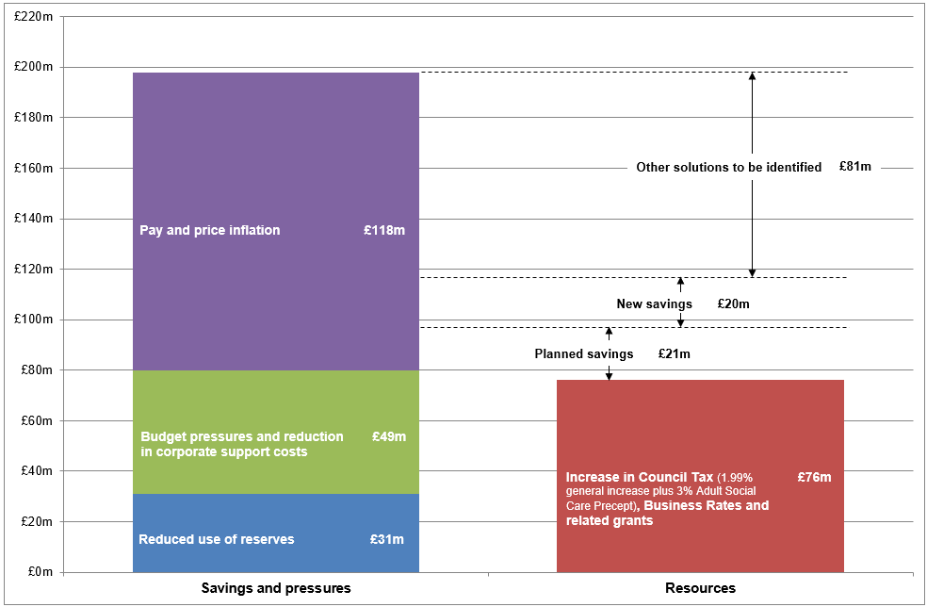
We have a resourcing gap through to 2024/25

Slide 10
Planned and New Savings
Planned savings £21m
Savings previously approved in February 2020 in the
Financial Plan 2020–2024
Adult Social Care – modernisation/early intervention £8.8m
ICT modernisation e.g. rationalising platforms £5.5m
Income from Council property £4.6m
Integrating transportation services £0.8m
Efficiencies across directorates £1.3m
New saving £20m
Reducing agency costs and vacancy management

Slide 11
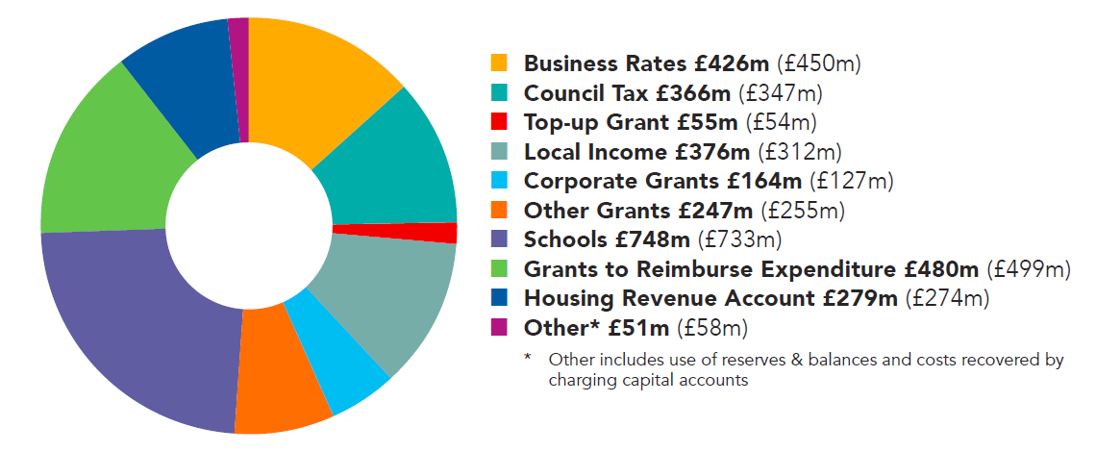
Where the money comes from 2020/21 - Total £3,192m (£3,109m) (2019/20 figures in brackets)

Slide 12
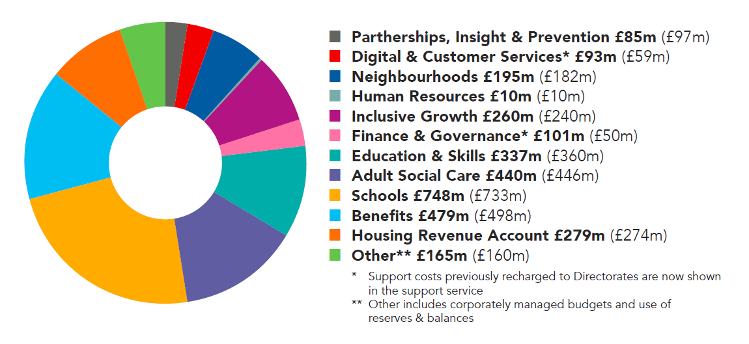
Where the money is spent 2020/21 - Total £3,192m (£3,109m) (2019/20 figures in brackets)

Slide 13
Medium Term Financial Plan
Budget proposals and the Medium-Term Financial Plan are being presented to City Council Cabinet for consideration on 9th February.
The immediate priorities of this financial plan are to help us bridge the financial gap within our budget and secure funding for those critical initiatives included in our Delivery Plan which will reduce costs, improve outcomes for our citizens and create greater prosperity in the City.

Slide 14
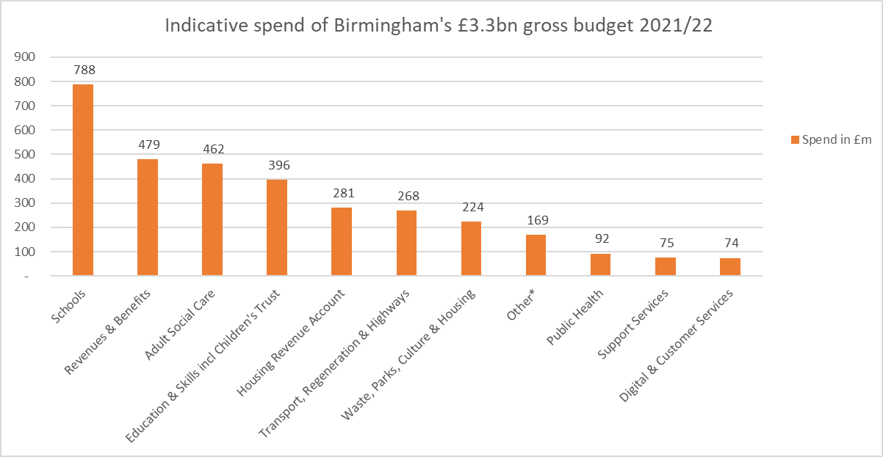
Indicative Spend 2021/22
*Other includes corporately managed budgets and use of reserves & balances

Slide 15
Supporting Birmingham’s economic recovery
Budget Consultation 2021+

Slide 16
Support for businesses infographic

Slide 17
COVID-19 Economic Recovery
Our priorities are based on the city council’s distinct role in place leadership and centre on:
Place development and management
Green recovery
Supporting people and businesses – especially protecting jobs and helping people find training and work
Unlocking and accelerating infrastructure investment
With a focus on initiatives that can be started in a 0-2 year timescale.
Sits alongside our work with West Midlands Combined Authority and with government.
Notes:
Draft went out for consultation in October last year, aiming to publish final draft in March.
Summarises the City Council’s contribution to supporting the economy of the city as it recovers from the COVID-19 crisis and adapts to changing conditions, including the challenges of leaving the European Union.
Aims to respond to the urgent problems facing the city, helping businesses to get through the crisis and people to find work and training but to also consider the longer-term issues of how our economy will change and what sort of city we want to see in the future.

Slide 18
Creating the conditions for economic growth - Urban Centres Framework
To provide clear strategic direction for the reinvigoration of our urban centres.
BCC will work with partners and funders to guide and deliver projects, maximising funding opportunities and attract investment into our urban centres.
By 2022 BCC and partners will have delivered projects in Urban Centres across themes including: new development (commercial and residential growth), public transport and active travel improvements, property improvements, creation or enhancement of public squares and spaces, and improved access to green spaces.

Slide 19
Business Growth Programme
A comprehensive package of support to develop and grow Small & Medium Enterprises (SME) businesses across the City and neighbouring areas.
Seeks to improve business confidence, stimulate business activity, encourage investment, develop new markets and new products, raise skill levels and create new jobs.
By 2022 we will have delivered the majority of our existing £77m Programme; providing a package of business support strengthening supply chain companies, stimulating innovation and growing existing SMEs.
Over three years this will have supported 1,000 SME's and created 2,000 new jobs.

Slide 20
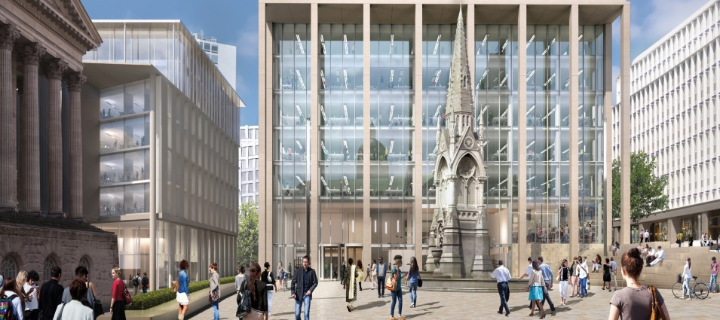
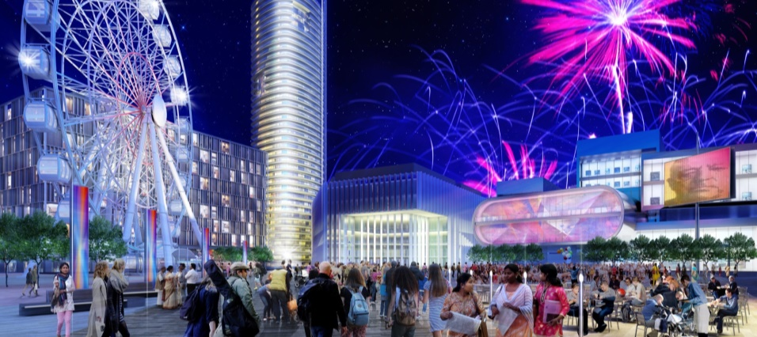
Creating economic growth in the city
The city centre enterprise zone
Parad
Paradise
Birmingham Smithfield
10,000 jobs
170,000sqm of Grade A office led mixed use space
4* hotel with up to 250 bedrooms
Phase 1 due for completion in Spring 2021
Vibrant retail markets, family-oriented leisure and entertainment and a residential neighbourhood
3,000 jobs
300,000sqm for new and existing businesses
£750m in additional GVA

Slide 21
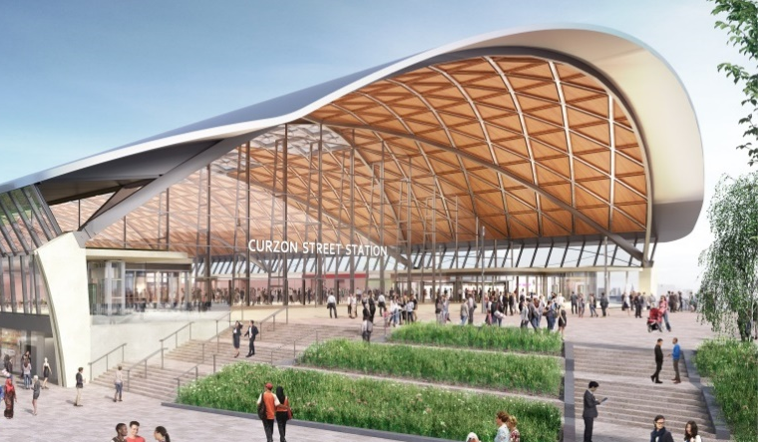
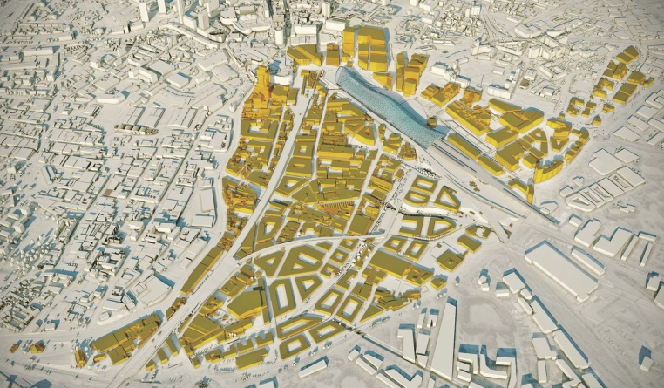
Creating economic growth in the city
Maximising the benefits of HS2
Birmingham Curzon
Our masterplan for the city centre terminus at Curzon St is a 25-year vision for what will be one of the biggest urban regeneration schemes in Britain transforming over 140 hectares of the city centre, which will create:
600,000 square metres of employment space
4,000 new homes
36,000 new jobs (net)
£1.3 billion in economic uplift.
Public sector investment programme of £724m will fund local infrastructure and unlock development around the HS2 city centre terminus at Curzon St.
Potential for growth

Slide 22
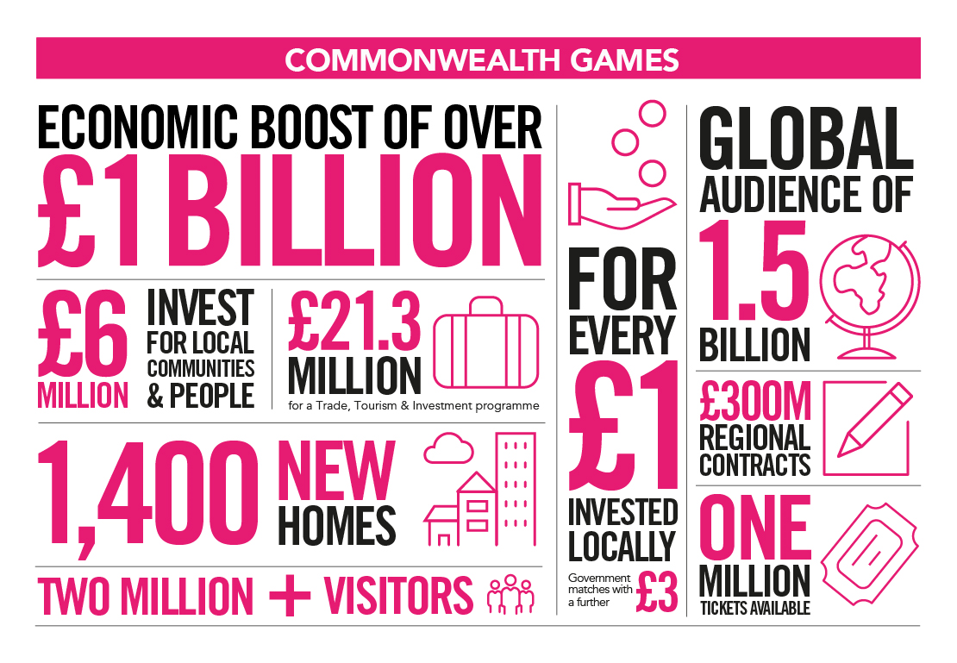
Commonwealth Games infographic
Notes:
Maximising the benefit of the Commonwealth Games. Ensuring we use this once in a lifetime event, witnessed by a global audience of over one billion people, to showcase the best of Birmingham and to drive investment in the city to benefit local people.

Slide 23
Question & Answer Session Budget will be presented at Full Council on 23 February 2021 You can submit any views prior to this date by emailing: Budget_Views@birmingham.gov.uk

