Slide 1
4 Pillars of Support
Birmingham City Council provides the following support to all employees
Get Support and Talk to Someone
wellbeingteam@birmingham.gov.uk
Employee Assistance Programme (EAP)
Phone: 0800 111 6387
Visit: https://my-eap.com/
Online Code – Bhamwell
All BCC staff have access to free, confidential, 24/7 access to the EAP.
Talk about: low mood, mental health support, financial wellbeing, bereavement, relationships, downloading from a bad day.
Access counselling services
Website: podcasts, downloadable guides on emotional wellbeing, personal resilience etc.
Dedicated Managers Support Helpline: 0800 1116385
EAP BCC Intranet Link
Mental Health First Aiders
BCC have 140 Mental Health First Aiders across the council, who have all attended comprehensive 2-day training. These colleagues are available, like a physical first aider, to support when people need it.
Our Mental Health First Aiders are volunteers, equipped to listen, provide initial support, and signpost towards support.
Mental health first aiders will listen, in a non-judgemental way, to what their colleague is feeling, and why.
Find a Mental Health First Aider on the Intranet to access this confidential and anonymised
Occupational Health
BCC have a SEQOHS accredited OH Service focused on promoting and protecting the health of our employees. The team are capable of providing a full range of services via the manager referral route.
Services include:
Manager Referrals
New Starter Pre-Placements
Health Surveillance
Physiotherapy
Psychological Therapies
Ill-Health Retirements
Provision of expert help and advice
Access the Occupational Health Intranet information
Advice can be accessed by email Occupational.Health@birmingham.gov.uk
Chaplains
Our Chaplains provide confidential & independent support for anyone, of any/no faith.
Support on family worries, health concerns, bereavement, work relationships, mental health.
Phone: 07746 299 676
peter@birminghamcouncilchaplains.co.uk
val@birminghamcouncilchaplains.co.uk
rachel@birminghamcouncilchaplains.co.uk
Our Chaplains also host mindfulness
sessions for BCC staff Monday-Thursday 12.45-13.15pm.
Access Chaplains Intranet information

Slide 2
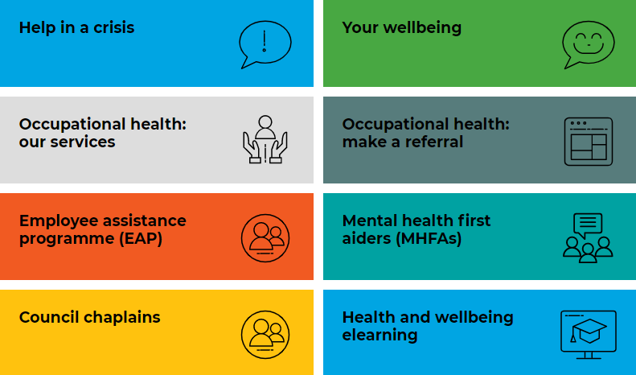
Internal Health & Wellbeing Support
For all Birmingham City Council staff, we are here to support you! wellbeingteam@birmingham.gov.uk
The Council’s Corporate Leadership Team is committed to employee health and wellbeing. Therefore with line manager approval, where there is an opportunity to engage with the mindfulness / e-learning / wellbeing content, you are able to access this during work time provided it does not impact on your essential duties.
BCC Intranet COVID-19 – www.birmingham.gov.uk/staffguidance
Organisational Development- Culture Change Team
wellbeingteam@birmingham.gov.uk
BCC Intranet Occupational Health & Wellbeing: https://intranet.birmingham.gov.uk/info/20203/occupational_health_and_wellbeing_service
Employee Assistance Programme (EAP)
Staff – 0800 111 6387
Managers – 0800 1116385 (Press 2)
https://my-eap.com/ - Code: Bhamwell
Recorded webinar of EAP service
BCC Chaplains – 07746 299 676
peter@birminghamcouncilchaplains.co.uk
val@birminghamcouncilchaplains.co.uk
rachel@birminghamcouncilchaplains.co.uk
BCC Mental Health First Aiders
Trained to spot signs, listen, & signpost. Access list:
https://intranet.birmingham.gov.uk/info/20276/ mental_health/878/mental_health_first_aiders

Slide 3
Internal Health & Wellbeing Support
For all Birmingham City Council staff, we are here to support you! wellbeingteam@birmingham.gov.uk
Yammer: internal social media platform
https://www.yammer.com (use BCC login)
Helpful groups to join:
All Company
Ask me anything
Employee Health & Wellbeing
Oodles of Doodles!
Rewards and Benefits
Birmingham Wellbeing
Your Development
Parents Community Group
Autism and Allies Network
Yoga and Meditation
Questions to ask each other:
“How are people coping?”
“What techniques are people using?”
“How can BCC support their staff?”
BCC e-Learning: Health & Wellbeing Modules: https://birmingham.learningpool.com/
learningmatters@birmingham.gov.uk
1. Life Transitions
2. Healthy Lifestyles
3. Introduction to Meditation
4. Nutrition Awareness
5. Personal Resilience
6. Stress Awareness (mandatory training)
7. Email Stress
Microsoft Teams – sign up with BCC email
https://products.office.com/en-gb/microsoft-teams/group-chat-software
Join the Health & Wellbeing organisational Team- search “Health &
Wellbeing”. Join the Wellbeing Team in the Coffee Shop, access recorded
Videos, Chaplains mindfulness, Parents Surviving Lockdown, EAP webinars.
Available events on MS Teams –
Parents Support: weekly chats and recorded videos
Meditation Sessions Monday-Thursday 12.45-13.15pm
EAP recorded webinar
Working Carers Group
BCC Public Health on social media
#healthybrum
My Birmingham Rewards:
http://www.mybirminghamrewards.co.uk/

Slide 4
External Health & Wellbeing Support
For all Birmingham City Council staff, we are here to support you! wellbeingteam@birmingham.gov.uk
Domestic Abuse Support
Mind Infoline - info@mind.org.uk
Telephone: 0300 123 3393 (9am-5pm Monday to Friday)
Birmingham & Solihull Women’s Aid (BSWAID)
0808 800 0028 between 9.15am and 5.15pm
www.bswaid.org for live webchat 10-2pm
Domestic Abuse Hub: 0808 169 9604
West Midlands Forced Marriage - 24hr helpline: 0800 953 9777
National Domestic Violence Helpline - 24hr helpline: 0808 2000 247
National Centre for Domestic Violence: 0800 970 2070 or Text NCDV to 60777
National LGBT+ Domestic Abuse helpline: 0800 999 5428
Rape Crisis England and Wales: 0808 802 9999
Men’s Advice Line: 0808 801 0327
Respect helpline (anyone worried about their own behaviour): 0808 802 0231
Women’s Aid: https://www.womensaid.org.uk
Samaritans - jo@samaritans.org Telephone: 116 123 (Free 24 hours a day)
NHS Live Well –https://www.nhs.uk/live-well/exercise/
Cruse Bereavement Services -https://www.cruse.org.uk/
Or call the free helpline: 0808 808 1677
Free Credit Score
https://www.clearscore.com/
NHS Every Mind Matters
https://www.nhs.uk/oneyou/every-mind-matters/

Slide 5
External Health & Wellbeing Support
For all Birmingham City Council staff, we are here to support you! wellbeingteam@birmingham.gov.uk
The Waiting Room Birmingham https://the-waitingroom.org/
Birmingham & Solihull health and wellbeing resources
Birmingham & Solihull Mental Health Trust
https://www.bsmhft.nhs.uk/about-us/news/covid-19-mental-health-
support-offer-for-birmingham-and-solihull/
- Key workers (7 days 9am-11pm) 0121 663 1217
- Over 18s in Birmingham and Solihull (7 days 9am-11pm)
0121 262 3555
- 0-18 year olds in Birmingham: 7 days a week (10am-6pm):
0207 841 4470 askbeam@childrenssociety.org.uk
The Silver Line - information, friendship & advice for older people
Telephone: 0800 4 70 80 90 (Free 24 hours a day)
Tough Enough to Care– supporting male mental health
https://toughenoughtocare.help//
Action for Happiness- resources for a happier kinder world
https://www.actionforhappiness.org/
Age Well UK- https://www.agewelluk.org.uk /
Supporting people to enjoy a better old age
Free app for social care workers
https://www.gov.uk/government/news/dedicated-app-for-
social-care-workers-launched
Crisis Text Line (Shout)- text SHOUT to 85258
https://www.crisistextline.uk/
24/7 crisis text line
Understanding Mental Health: Self-help Guides
http://www.selfhelpguides.ntw.nhs.uk/bsmhft/SelfHelp

