Slide 1
What is Grounding?

Slide 2
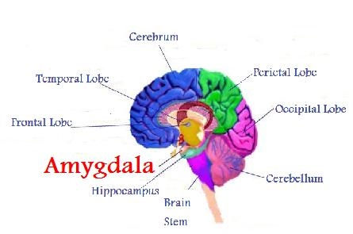
How does it work?

Slide 3
https://www.youtube.com/watch?v=8lM8pgMgjEs

