Slide 1
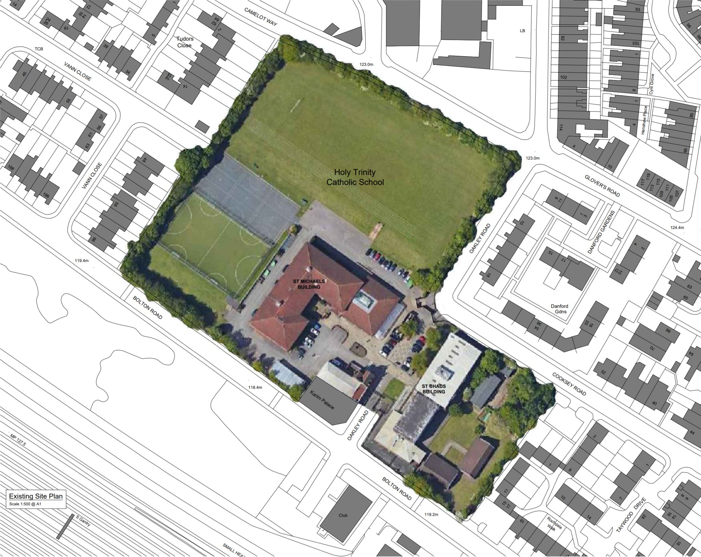
HOLY TRINITY CATHOLIC SCHOOL
Existing Site
Notes:
1

Slide 2
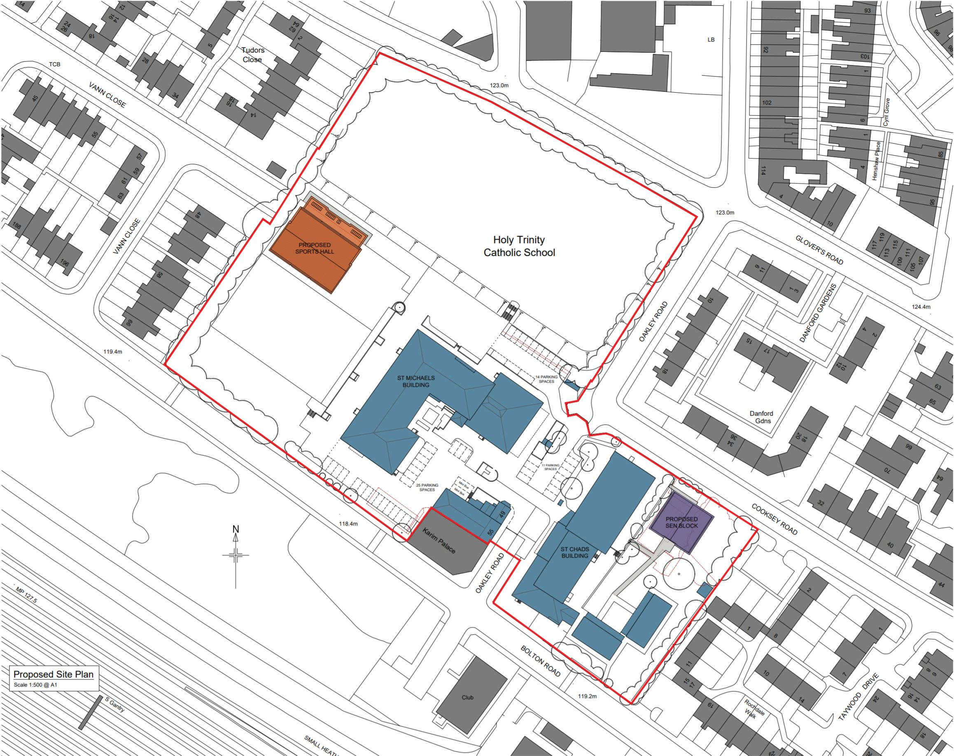
HOLY TRINITY CATHOLIC SCHOOL
Proposed Site Plan
Notes:
2

Slide 3
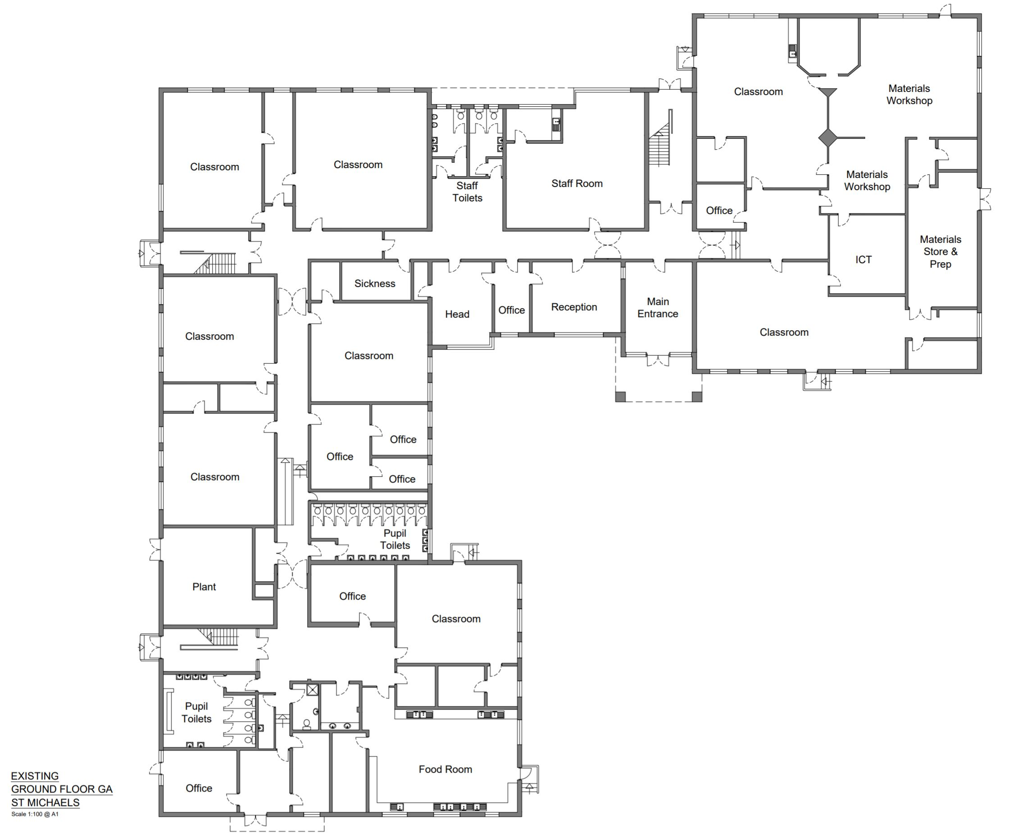
HOLY TRINITY CATHOLIC SCHOOL
St. Michaels - Existing Ground Floor
Notes:
3

Slide 4
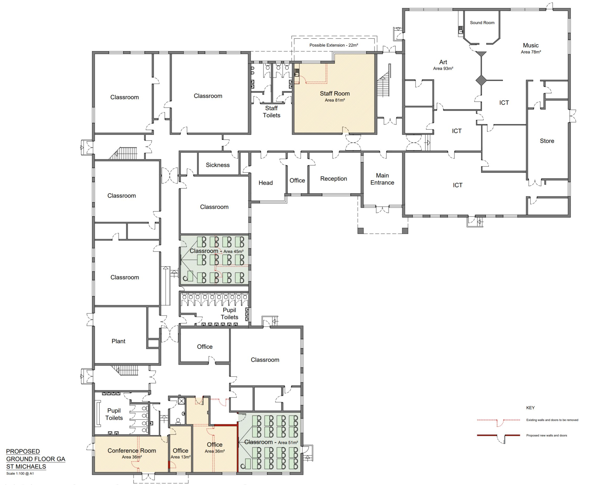
HOLY TRINITY CATHOLIC SCHOOL
St. Michaels - Proposed Ground Floor
Notes:
4

Slide 5
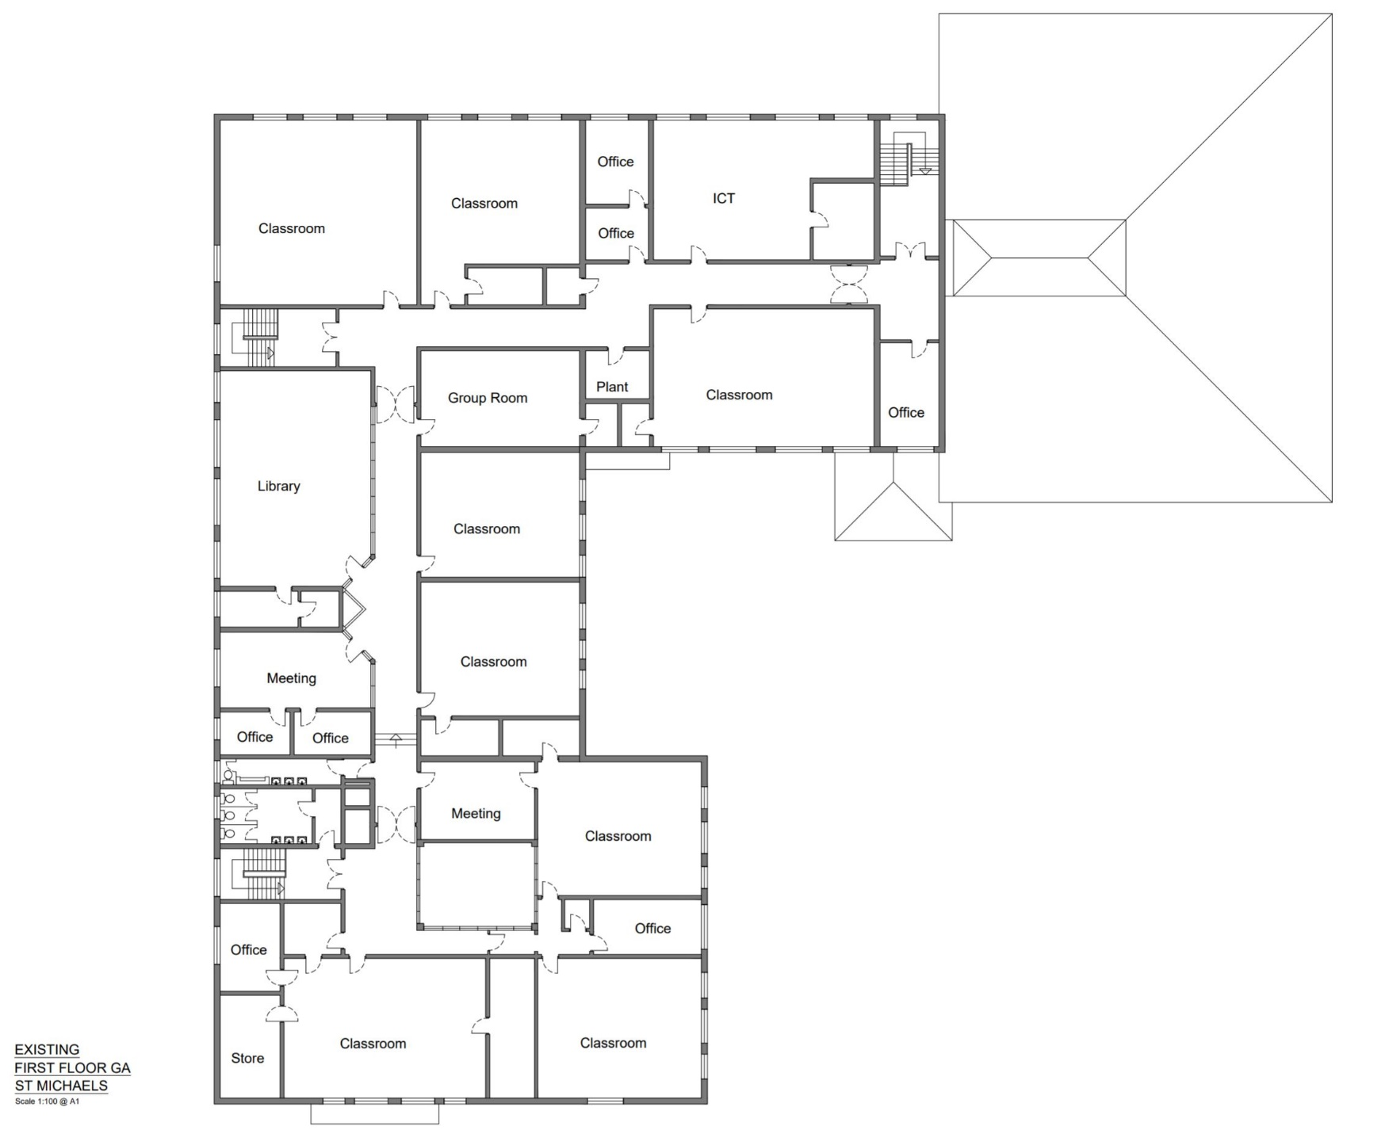
HOLY TRINITY CATHOLIC SCHOOL
St. Michaels - Existing First Floor
Notes:
5

Slide 6
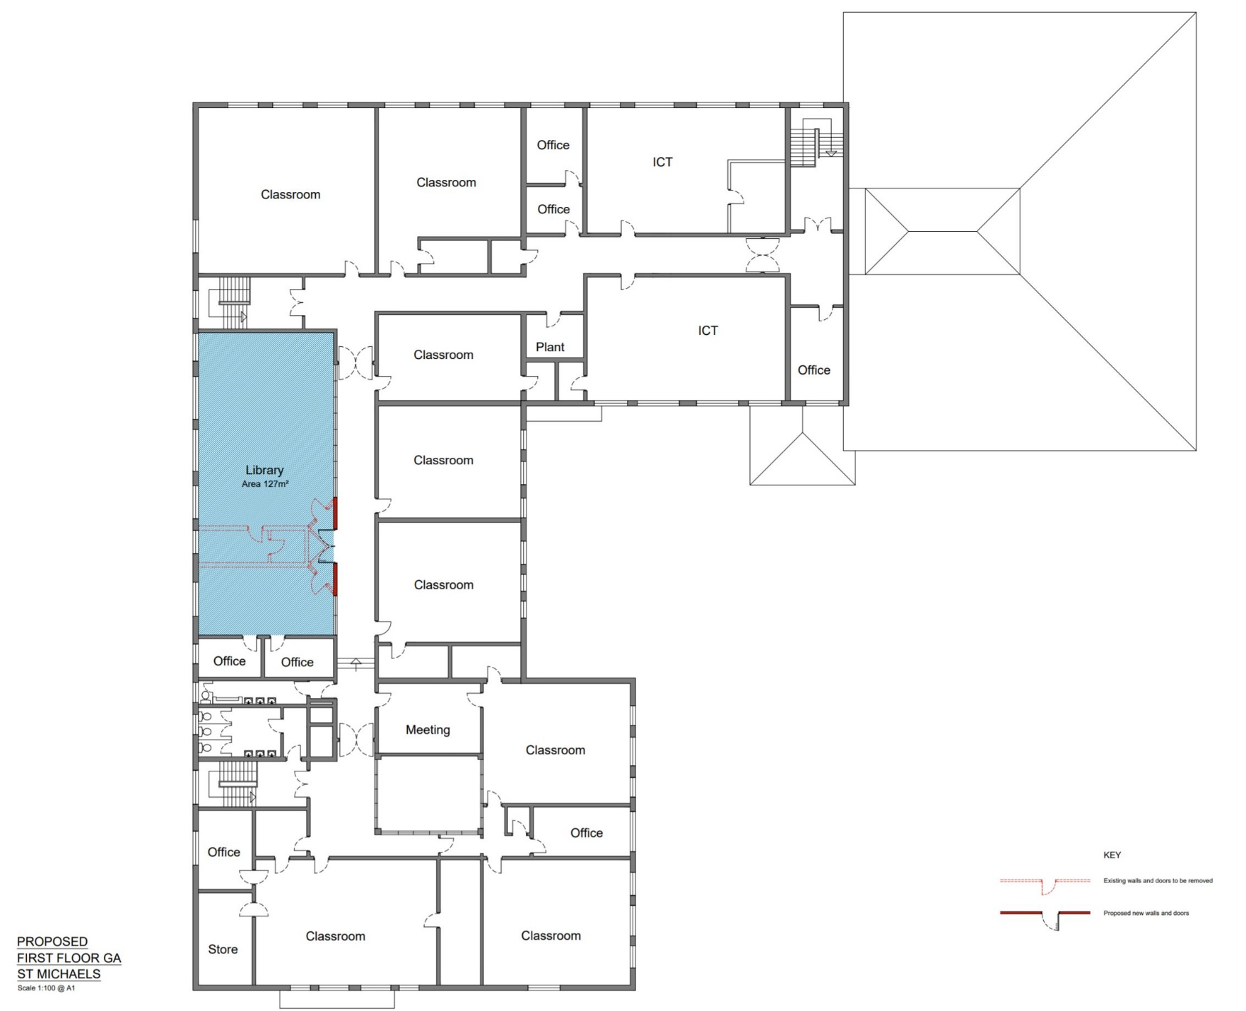
HOLY TRINITY CATHOLIC SCHOOL
St. Michaels - Proposed First Floor
Notes:
6

Slide 7
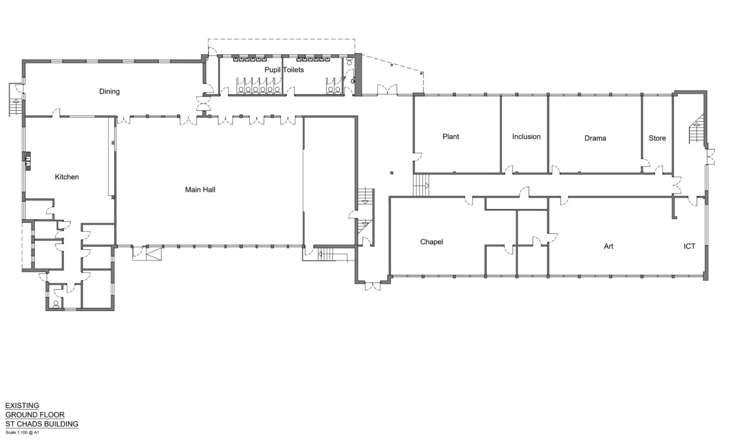
HOLY TRINITY CATHOLIC SCHOOL
St. Chads – Existing Ground Floor
Notes:
7

Slide 8
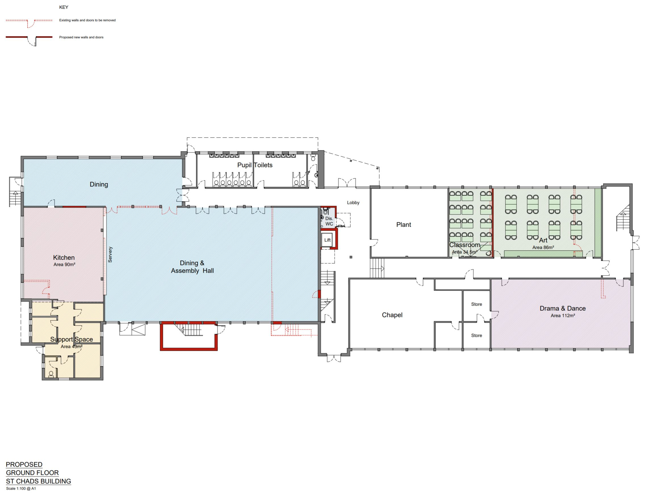
HOLY TRINITY CATHOLIC SCHOOL
St. Chads – Proposed Ground Floor
Notes:
8

Slide 9
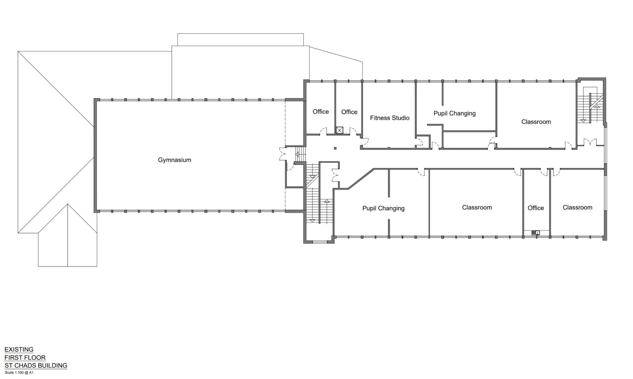
HOLY TRINITY CATHOLIC SCHOOL
St. Chads – Existing First Floor
Notes:
9

Slide 10
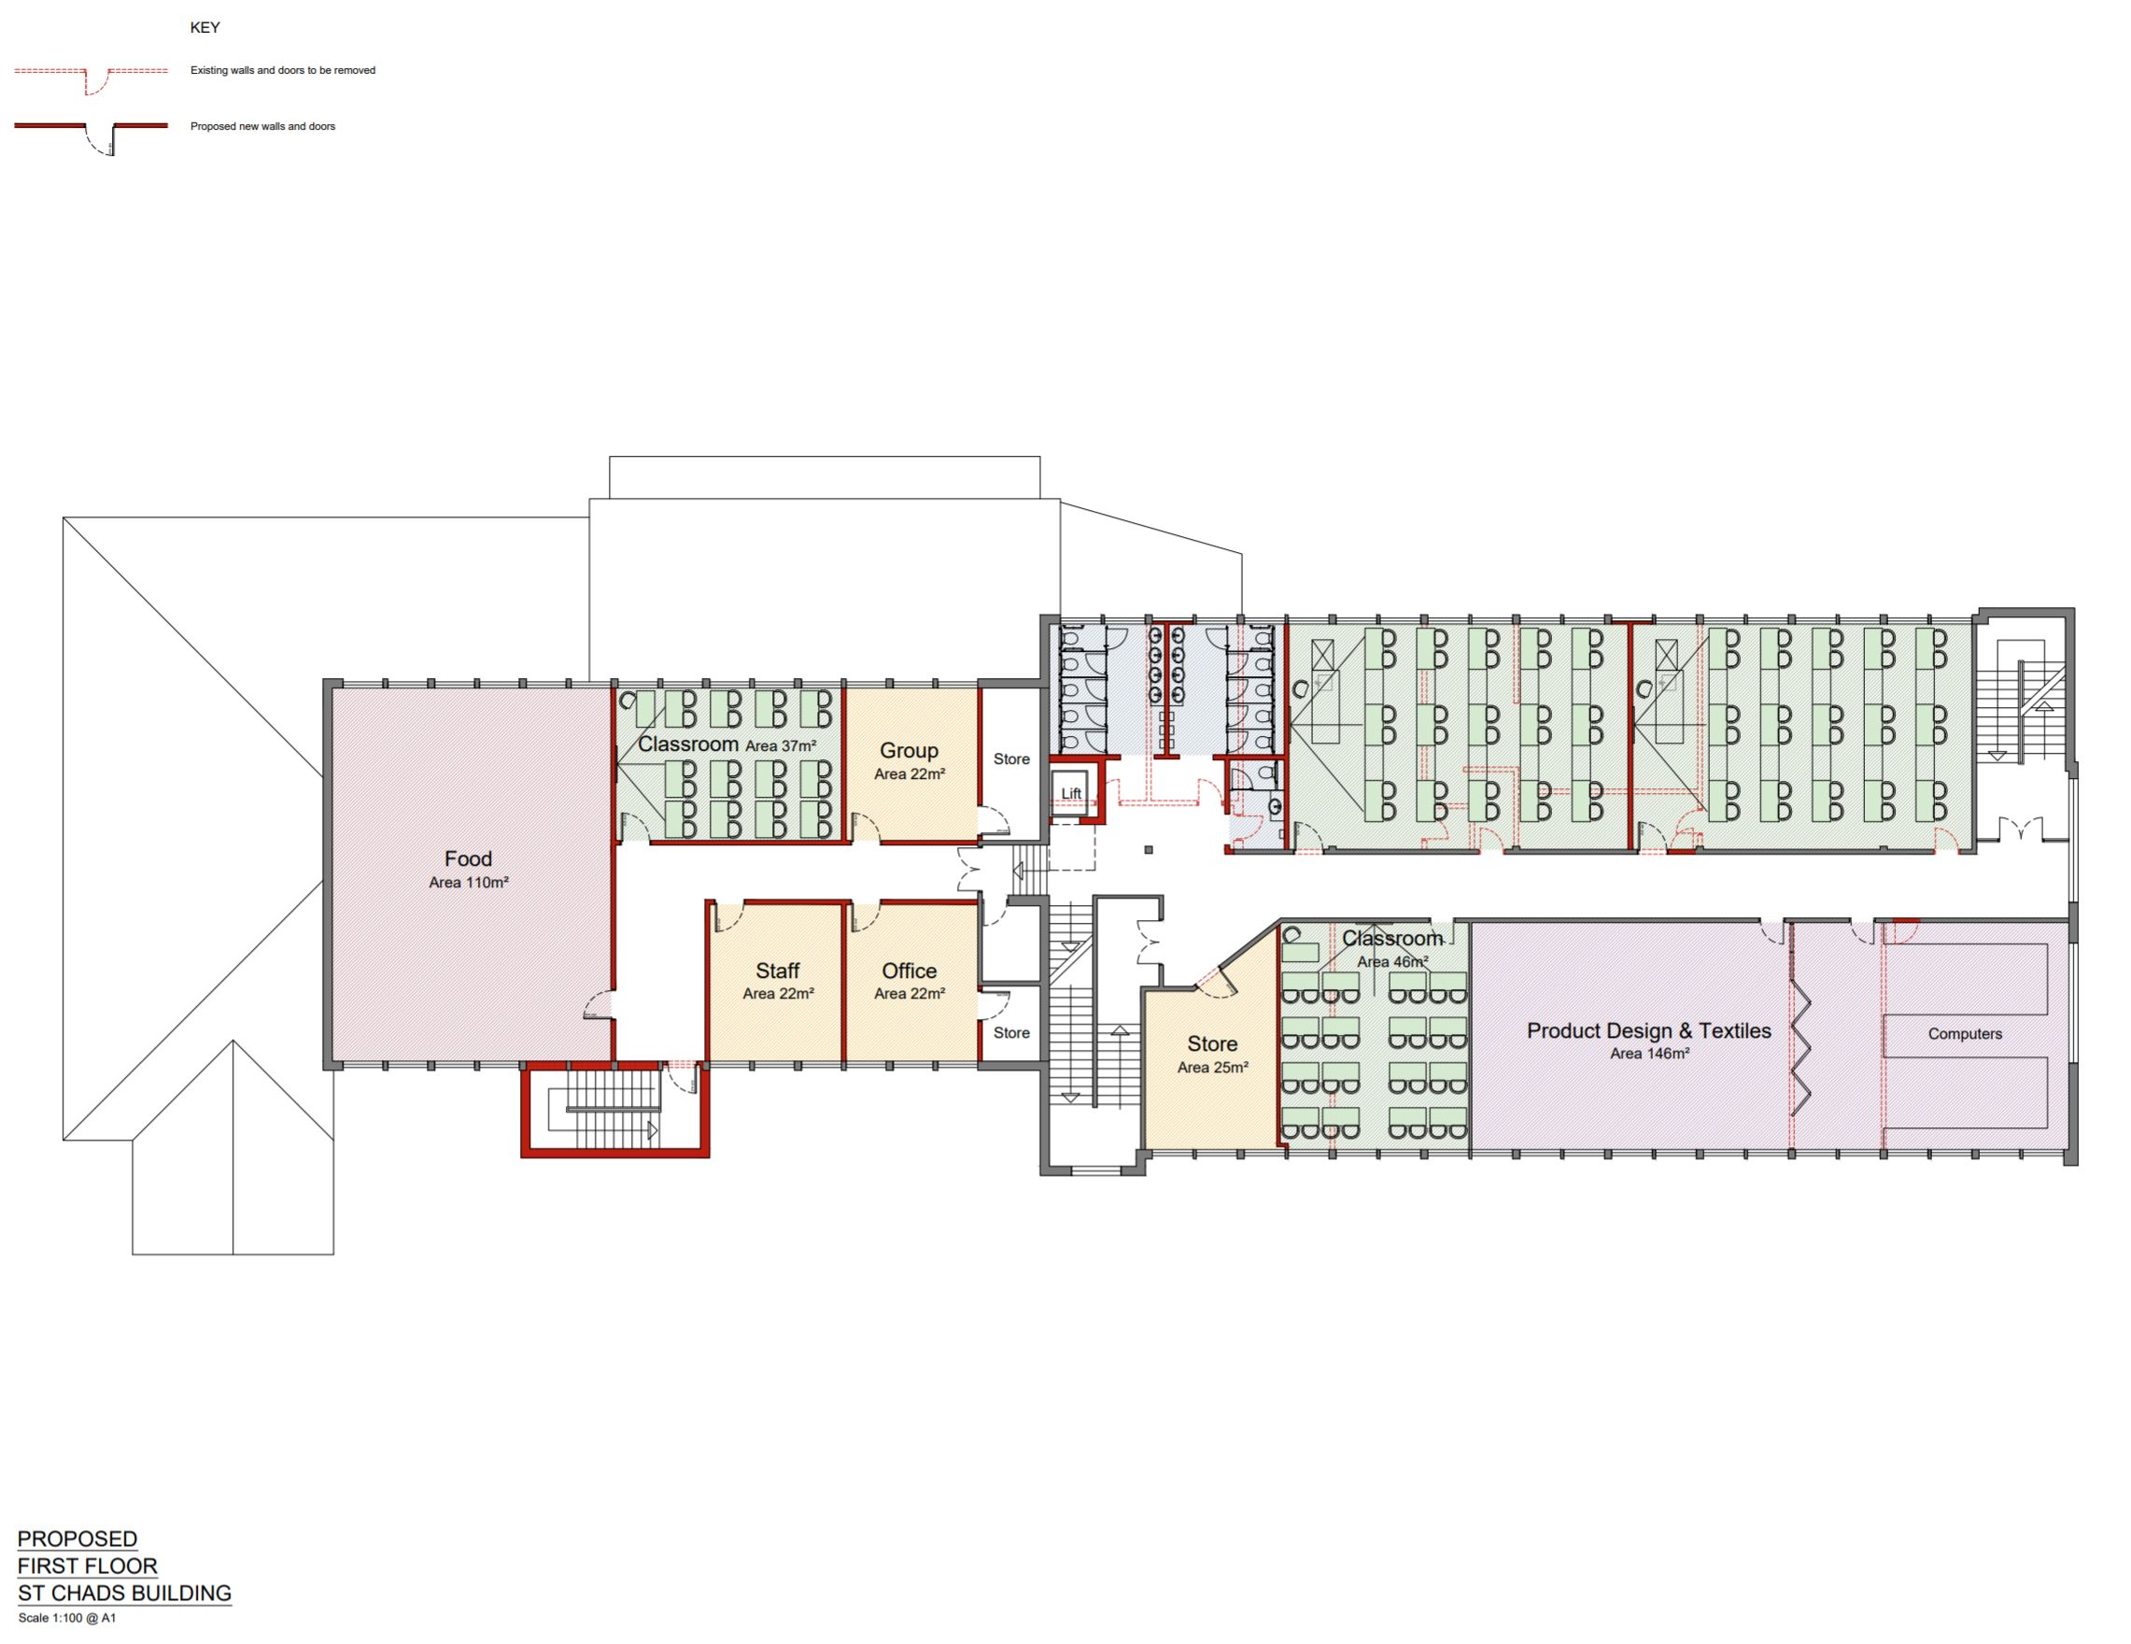
HOLY TRINITY CATHOLIC SCHOOL
St. Chads – Proposed First Floor
Notes:
10

Slide 11
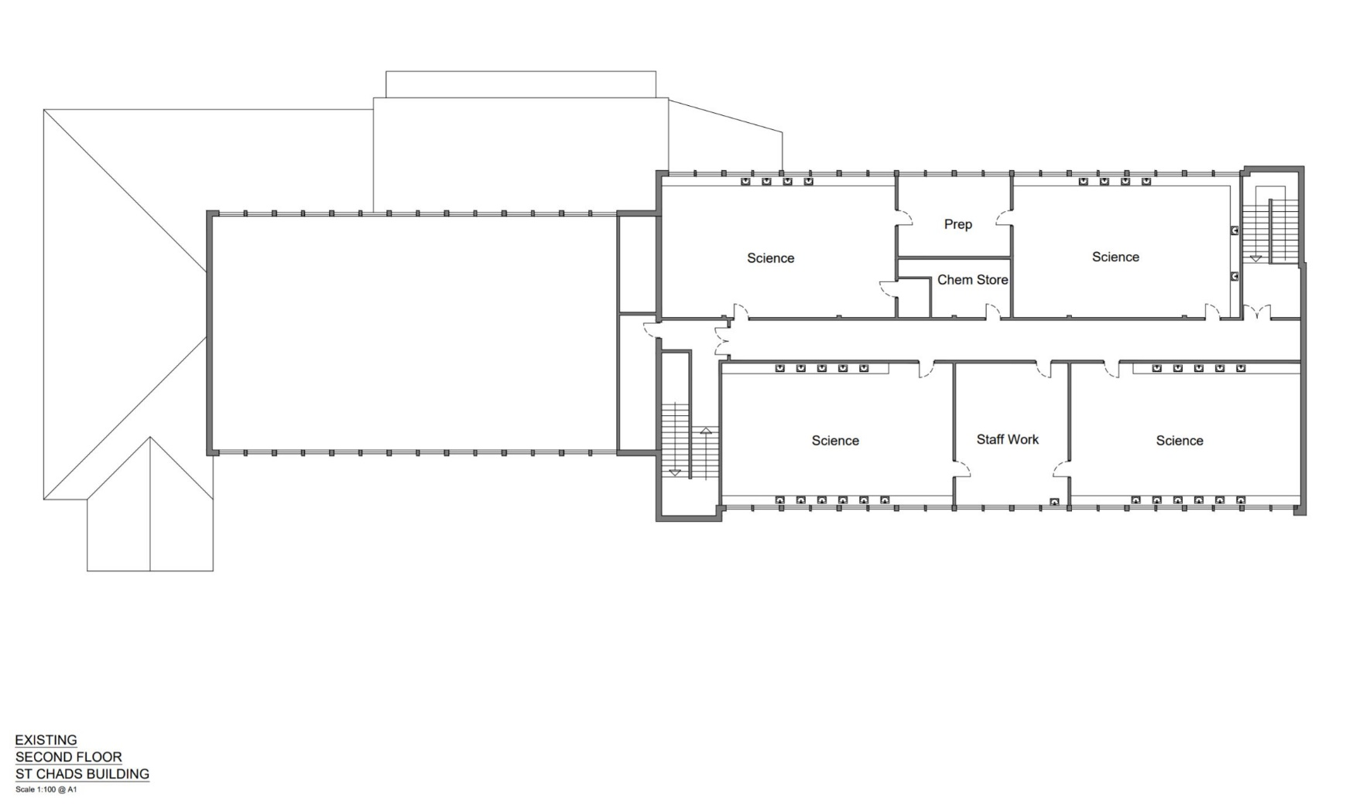
HOLY TRINITY CATHOLIC SCHOOL
St. Chads – Existing Second Floor
Notes:
11

Slide 12
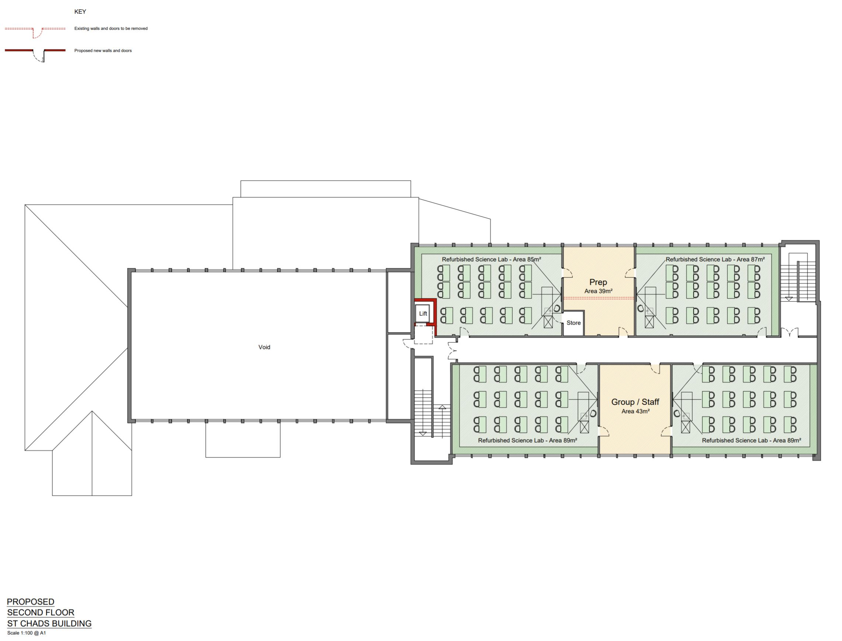
HOLY TRINITY CATHOLIC SCHOOL
St. Chads – Proposed Second Floor
Notes:
12

Slide 13
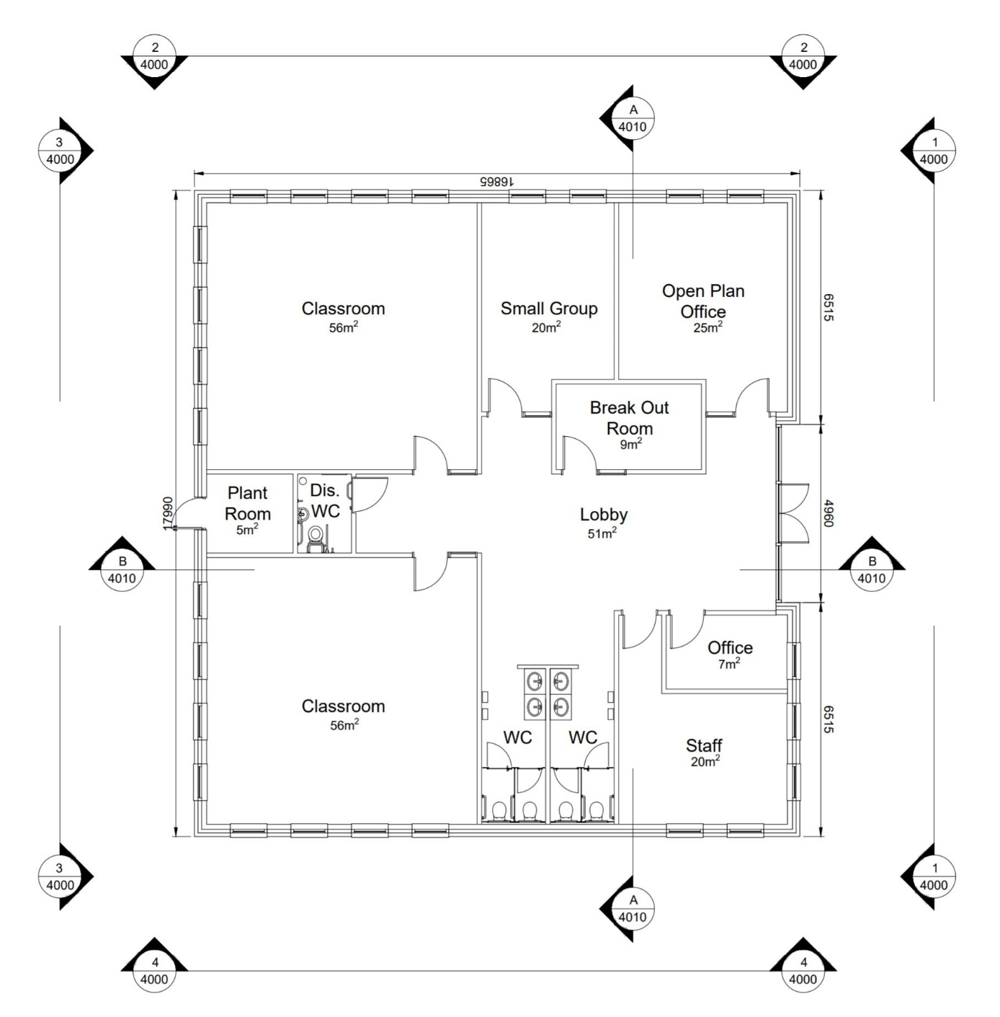
HOLY TRINITY CATHOLIC SCHOOL
Proposed SEN Teaching Block - Floor Plan
Notes:
13

Slide 14
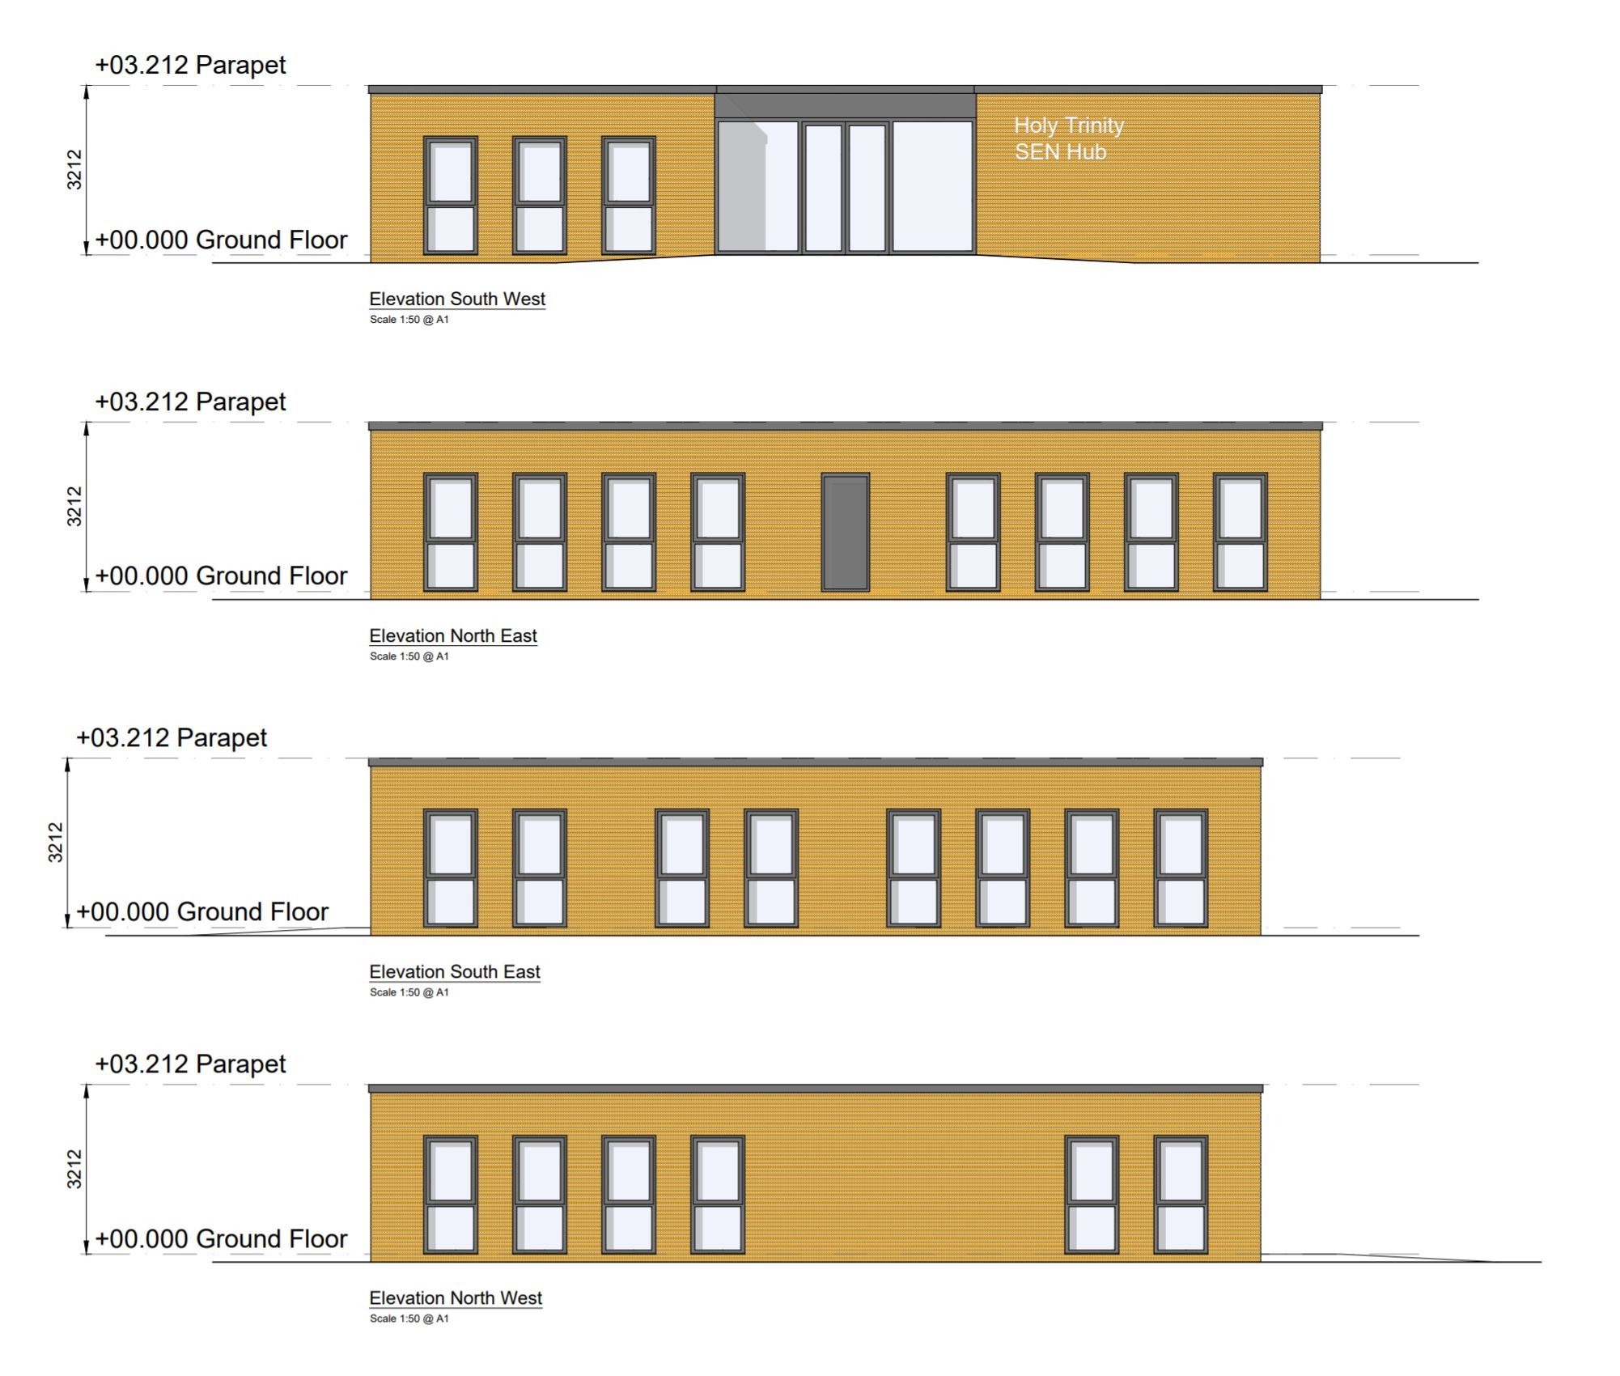
HOLY TRINITY CATHOLIC SCHOOL
Proposed SEN Teaching Block - Elevations
Notes:
14

Slide 15
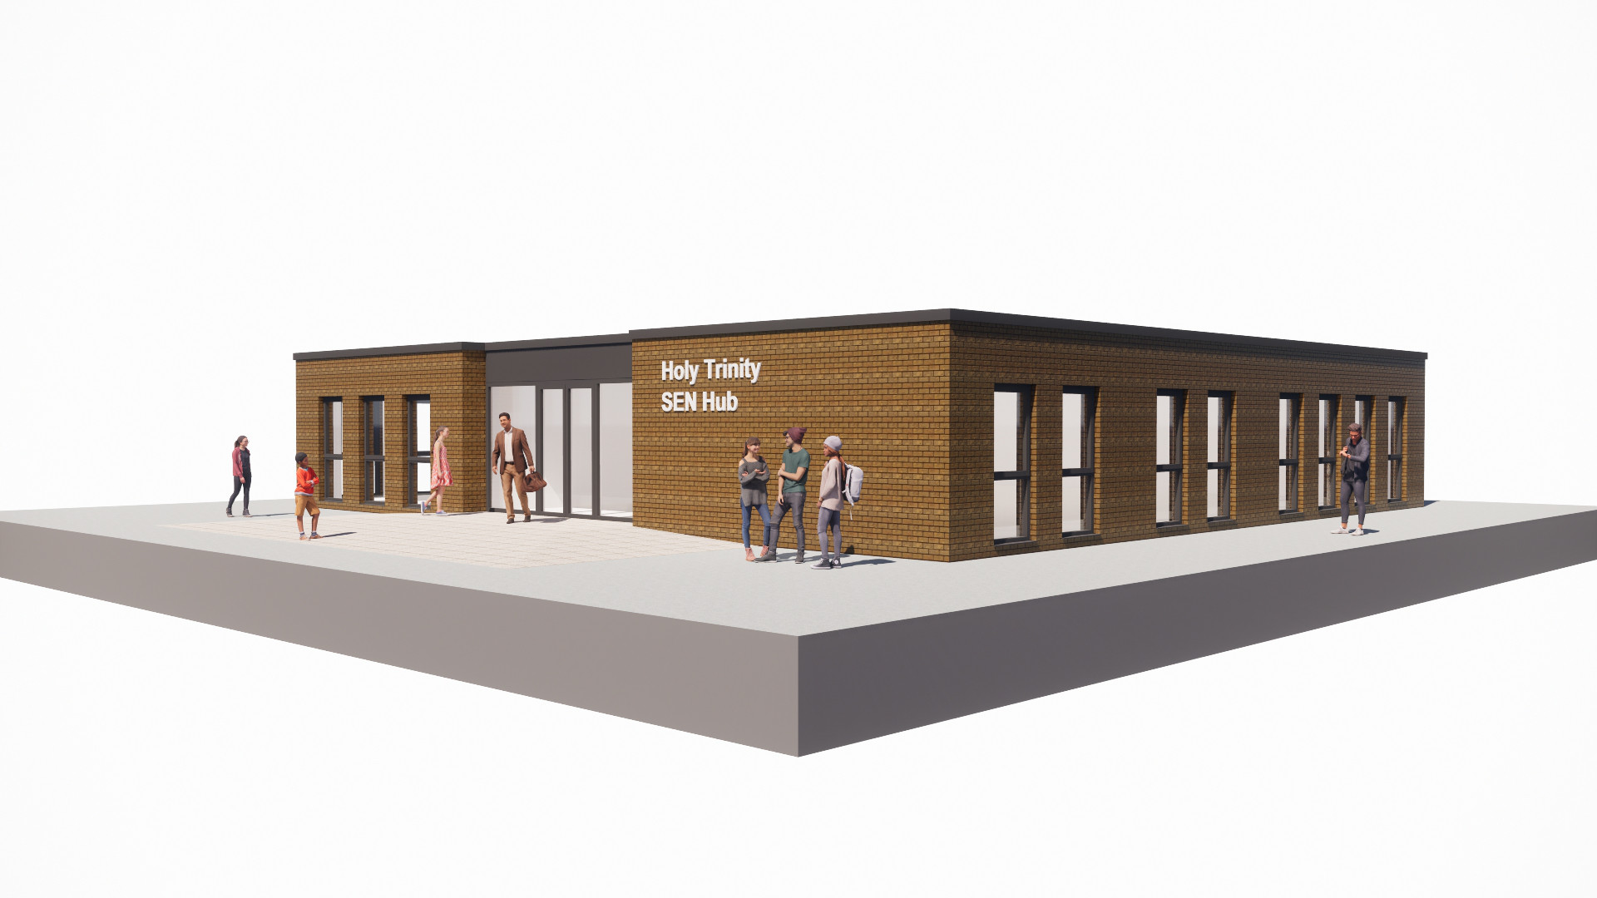
HOLY TRINITY CATHOLIC SCHOOL
Proposed SEN Teaching Block - Visualization
Notes:
15

Slide 16
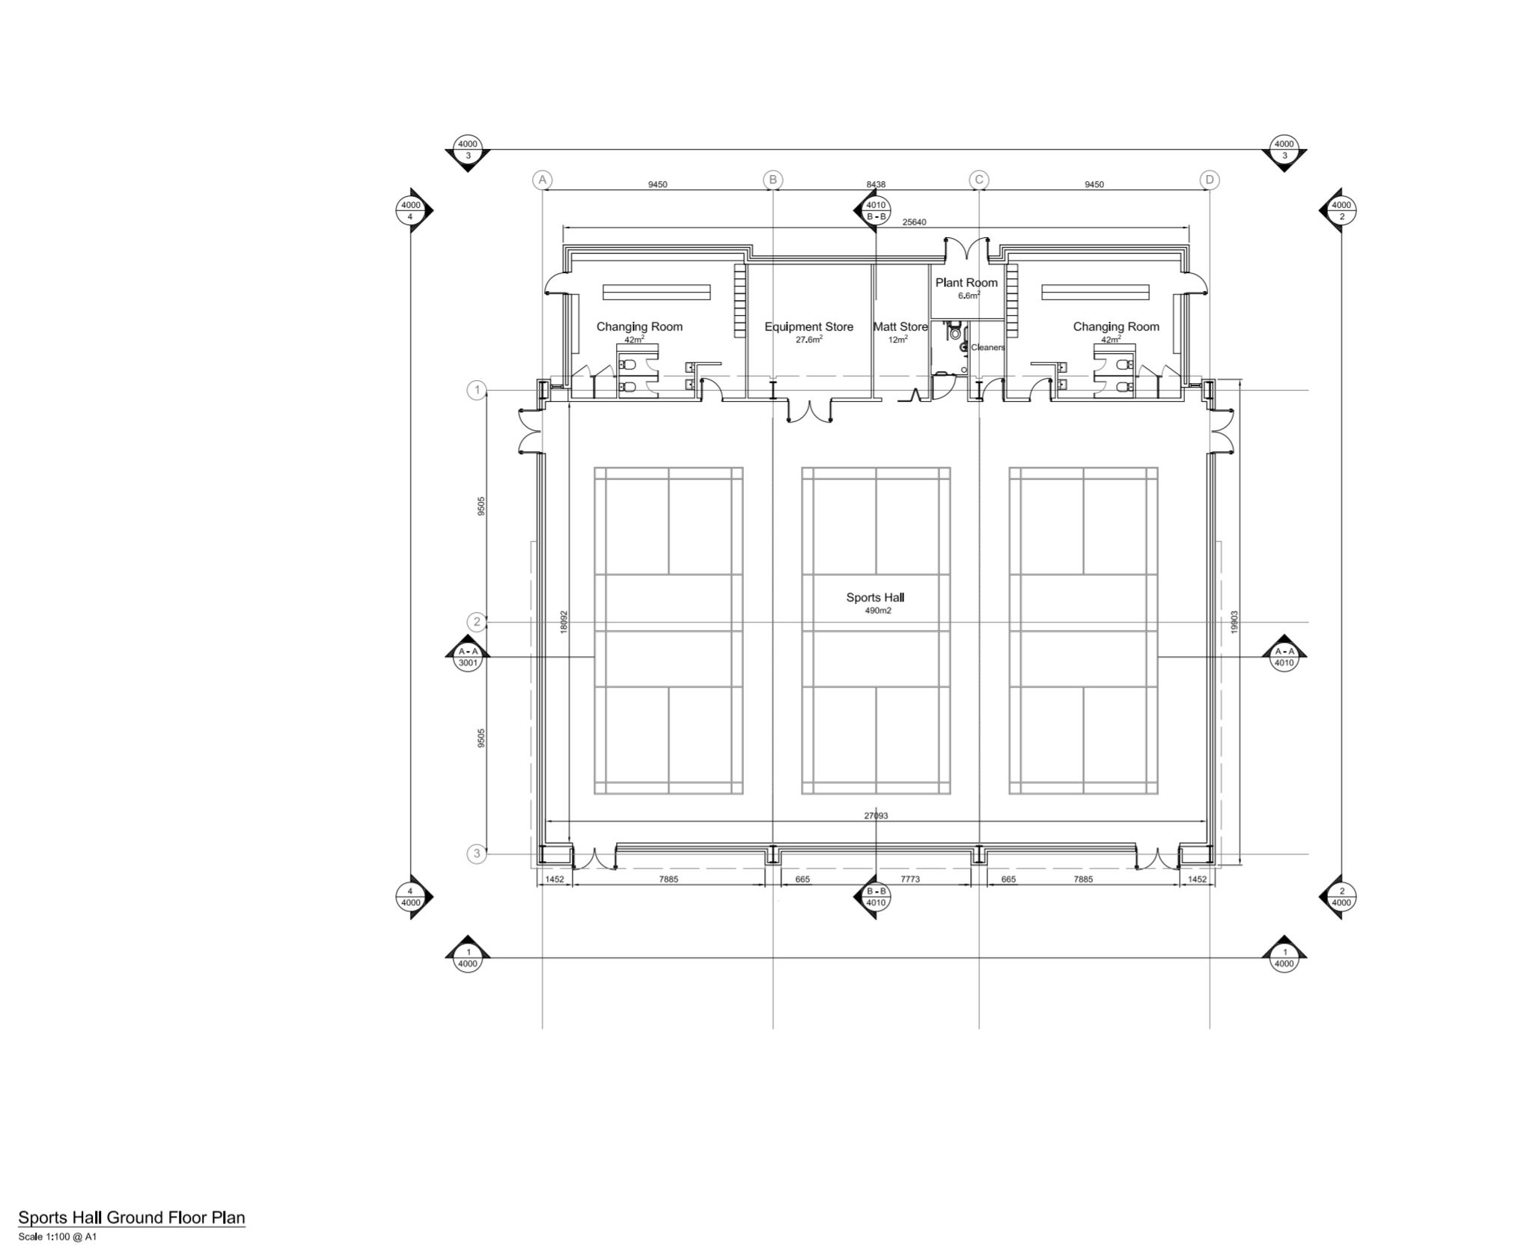
HOLY TRINITY CATHOLIC SCHOOL
Proposed Sports Hall - Floor Plan
Notes:
16

Slide 17
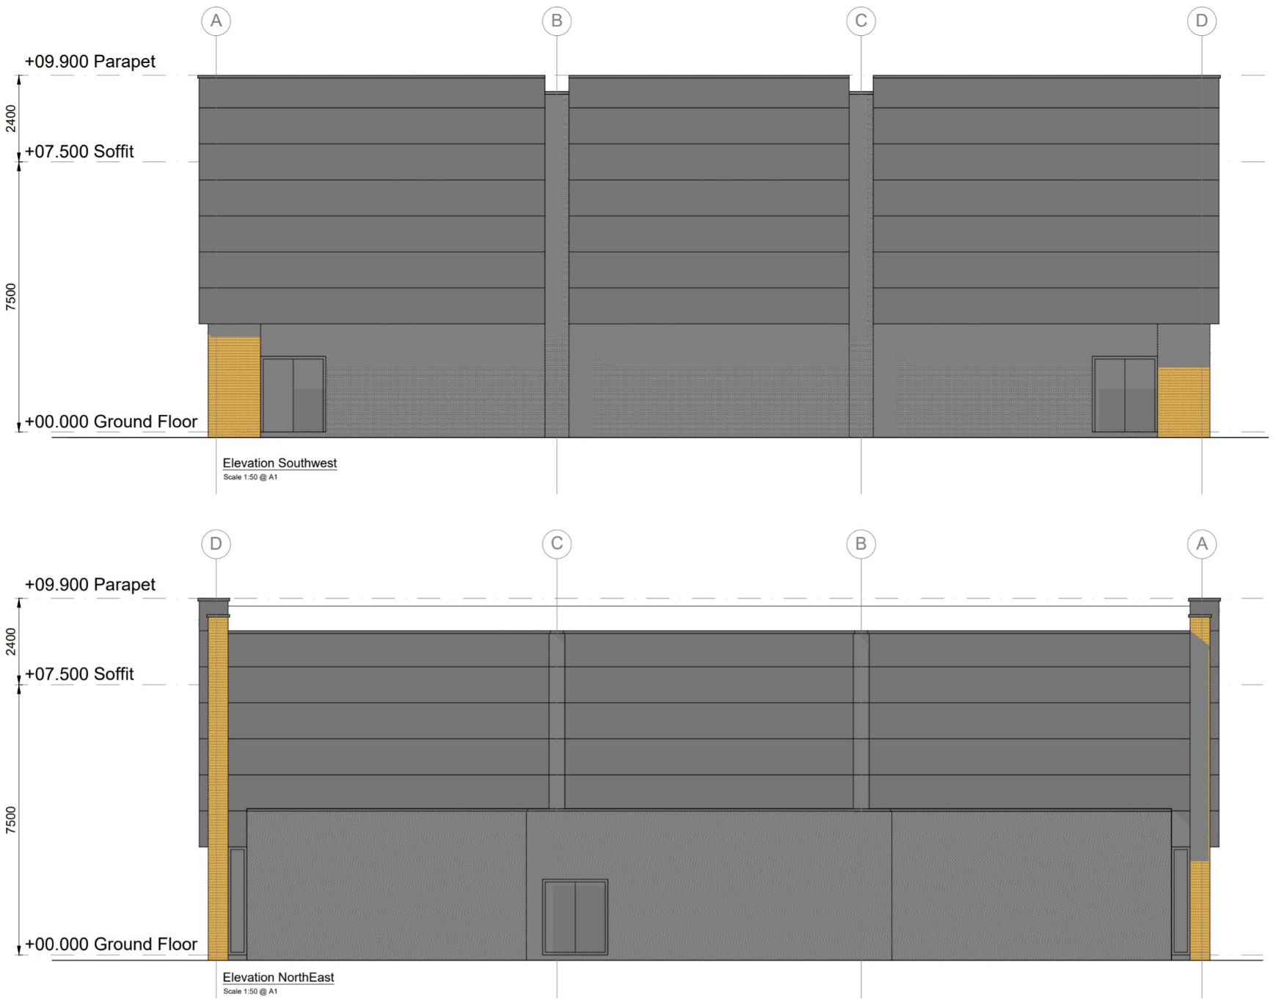
HOLY TRINITY CATHOLIC SCHOOL
Proposed Sports Hall - Elevations
Notes:
17

Slide 18
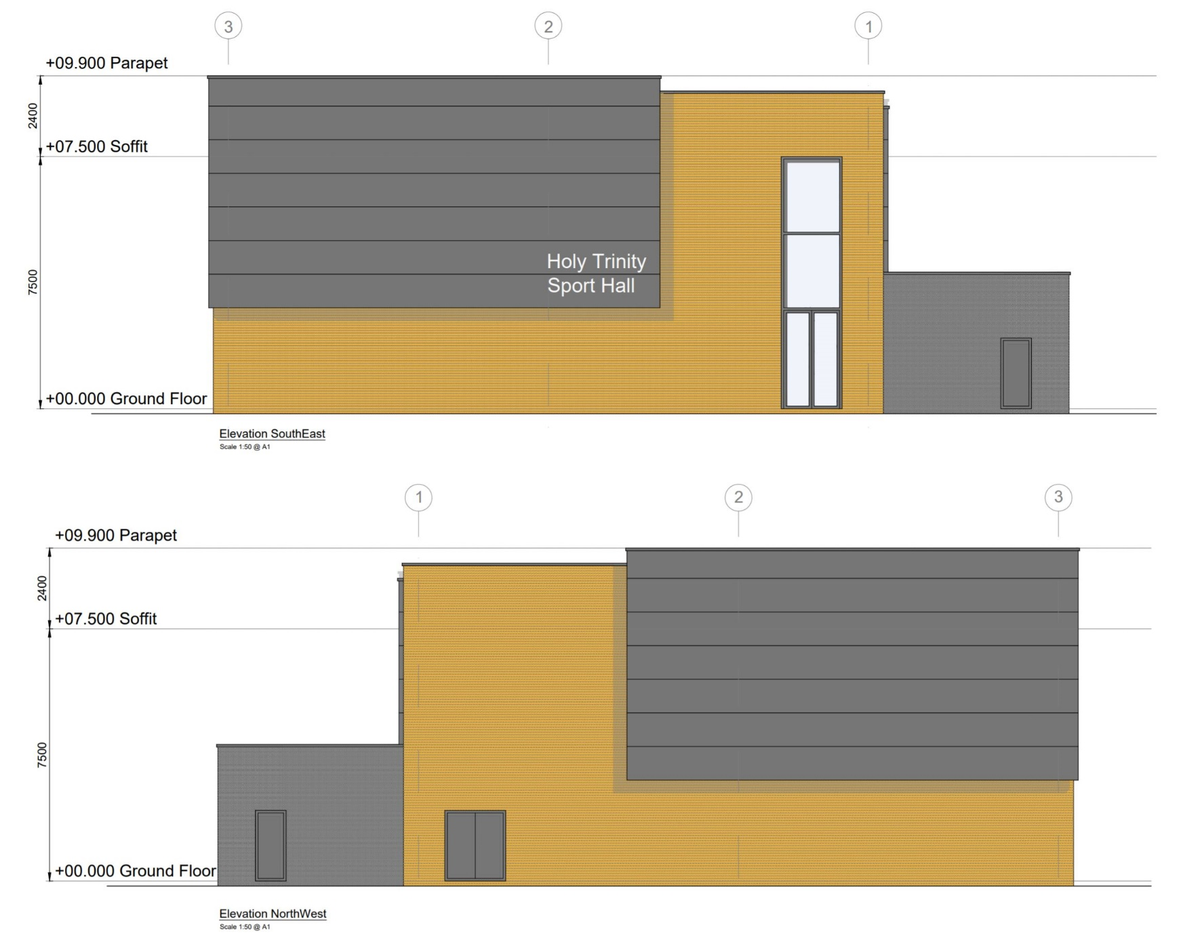
HOLY TRINITY CATHOLIC SCHOOL
Proposed Sports Hall - Elevations
Notes:
18

Slide 19
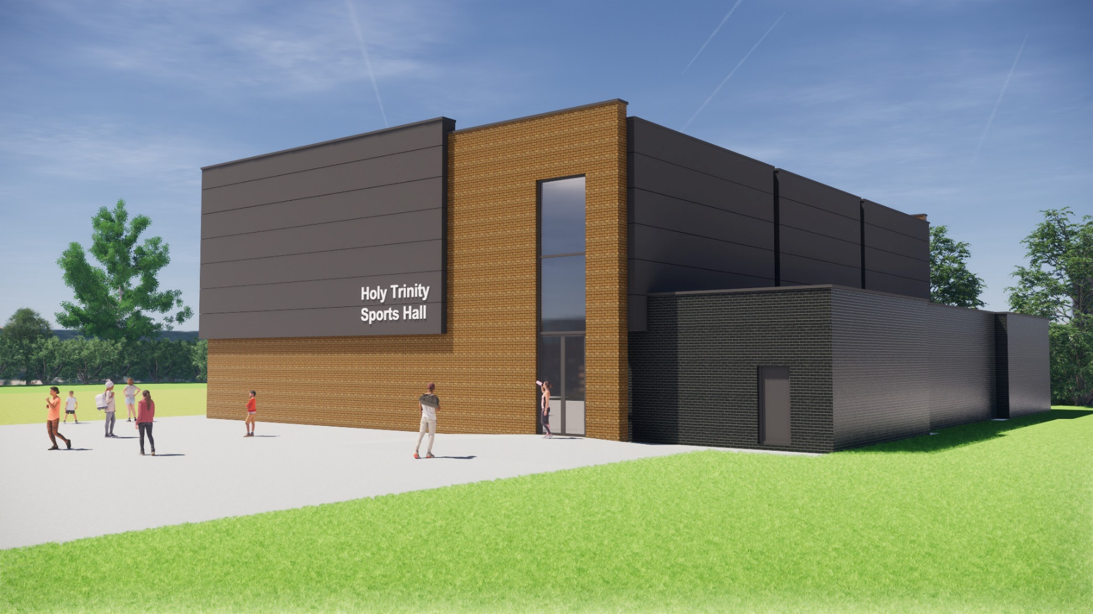
HOLY TRINITY CATHOLIC SCHOOL
Proposed Sports Hall - Visualization
Notes:
19

