Slide 1
Mental Health Support Offers During COVID Pandemic

Slide 2
Summary
The COVID 19 Pandemic is likely to place a strain on the mental health of the general public and key workers including those in the NHS.
Working with the Voluntary & Community Sector and NHS Providers we have put in place offers of support for adults, children and young people and for Key Workers
Psychological, emotional and social support will be provided by phone or online
A ‘no wrong door’ approach will be followed to make sure people get the support they need.
People with more complex mental health needs or higher levels of risk will be transferred to statutory services
NHS 111 will be able to divert to these offers
GPs can continue to refer people to mental health services as usual
Notes:
The new offer seeks to widen access to mental health support. The 18++18’s line can capture every level of need, but geared up to manage low level and has direct access to ongoing interventions. The lines will be going 24 hour hopefully by the end of the week and so there will be one number for adults over 18 and one number for young people. This new approach will hopefully start to reduce over reliability on use of secondary mental health services and addresses the needs of citizens who often fell between gap between primary and secondary mental health services and awaiting threshold of need assessments.

Slide 3
Offer 1 (BSOL): Aged 18+
0121 262 3555
Open: 9am-11pm
Screening and triage
Provided by Mind and Living Well Consortium
Access centre
MIND
Support, advice and guidance – housing, debt, signposting
Change
Brief Solution focussed Therapy
Living Well Consortium
Brief Counselling on anxiety / depression
2-3 telephone sessions
BSMHFT / LWC /
CWPT – Solihull
IAPT Telephone Service
FTB / BSMHFT
Advice guidance on management of risk
BSMHFT / FTB
URGENT CARE
Crisis Team / HTT
CMHT

Slide 4
Offer 2 (BSOL): Key Workers
Dedicated support line
Open: 9am-11pm
0121 633 1217
Screening and intervention
Provided by Living Well Consortium
Further counselling sessions with trauma / PTSD focus
Provided by Living Well Consortium
Follow up where necessary

Slide 5
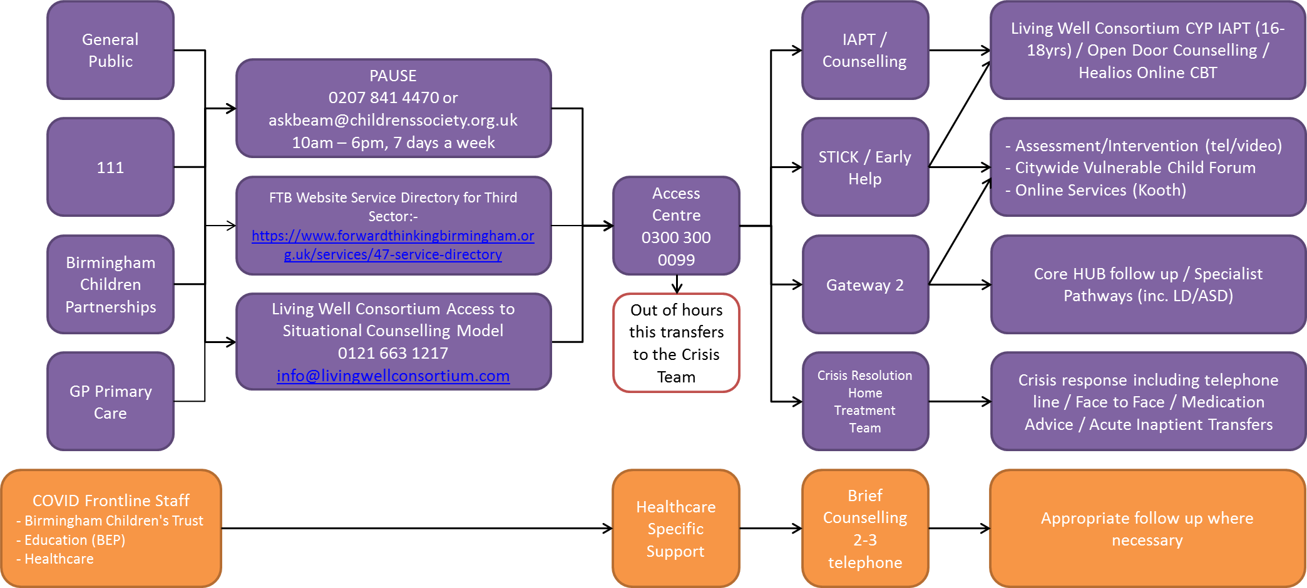
Offer 3 (Birmingham): Children and Young People (0-18)

Slide 6
Offer 3 (Solihull): Children and Young People (0-18)
Solar Crisis Support (monday - friday 8am-8pm)
0121 301 2750
(Weekends 8am-8pm)
0121 301 5500
(8pm – 8am Everyday)
0300 300 0099
Assessment
Community based mental health treatment and support
Counselling and Support 24/7
www.kooth.com

Slide 7
Key Messages for Primary Care
Non-complex/low risk access through the Support Line Offers Set out below. Where IAPT is appropriate it will be offered via these routes.
People experiencing emotional crisis can also contact these numbers
Complex/High risk cases should still be referred through existing single points of access
In the majority of cases contact and intervention will be via phone or online
Where patients are under secondary care they will have been contacted by there care team to confirm arrangements for ongoing care
Please note that Crisis Café’s and PAUSE Drop-In have been closed but the same support can be accessed via the Support Lines
Notes:
Improving Access to Psychological Therapies

Slide 8
Mental Health Access Points (information for Primary Care)
0-18 Birmingham
Patients needing more help or risk support will be triaged to FTB Access Centre
0-18 Solihull
Contact Solar (monday - friday 8am-8pm) 0121 301 2750
18+ BSOL
Mental Health Support and Crisis Line 0121 262 3555
Open: 9am-11pm
Screening and triage to a range of support
Key Workers
Patients should contact PAUSE on 0207 841 4470
(Weekends 8am-8pm) 0121 301 5500
(8pm – 8am Everyday) 0300 300 0099
Dedicated support line
Open: 9am-11pm
0121 633 1217
GP Referrals to BSMHFT Single Point of Access 0121 301 4000

