Slide 1
How to Connect to the Council Network without Broadband
Digital & Technology Services (DTS)

Slide 2
Contents Page
Please select one of the following links for the device that you are using
1. Purpose of this Guide
2. Tethering to your Mobile Phone - Android
2a. Connecting to NetMotion after you have tethered
3. Tethering to your Mobile Phone – Apple iPhone
3a. Connecting to NetMotion after you have tethered
4. Tethering to your MiFi Device
4a. Connecting to NetMotion after you have tethered
5. Disconnecting your Hotspot
6. Please remember

Slide 3
1. Purpose of this Guide
The purpose of this guide is to provide options for connecting to the internet and the Council’s network where access to broadband/Wi-Fi is unavailable. It outlines the steps to broadcast your phone's mobile signal as a Wi-Fi network, then connecting a laptop or any other Wi-Fi-enabled device up to it, to connect to the internet. Sharing a connection this way is called tethering or using a hotspot.
Where possible, we recommend that you connect to Wi-Fi as this will provide a much better connection and will not incur additional charges. To check the speed of your broadband connection: https://www.broadbandspeedchecker.co.uk/
No access to Wi-Fi
If you have no access to Wi-Fi and there is a good mobile signal in your area, it may still be possible to connect using one of the following methods.

Slide 4
1. Purpose of this Guide continued
Company-issued devices are connected via the O2 network. You can check the O2 connectivity in your area by entering your postcode on the coverage checker: https://www.o2.co.uk/coveragechecker
Other UK networks
You can check the connectivity in your area for the other UK mobile networks by entering your postcode on the following coverage checkers:
https://coverage.ee.co.uk/coverage/ee
https://www.three.co.uk/Discover/Network/Coverage
https://www.signalchecker.co.uk/networks/vodafone

Slide 5
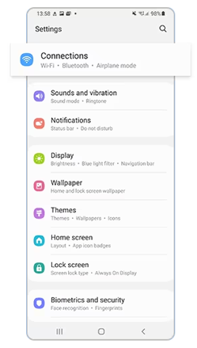
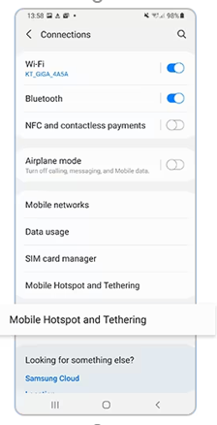
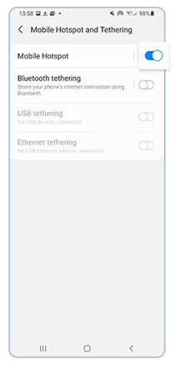
2. Tethering to your Mobile Phone - Android
1) Select settings and then select Connections
2) Tap Mobile Hotspot and Tethering
3) Tap the switch next to Mobile Hotspot to activate. The Mobile Hotspot icon appears on the status bar

Slide 6
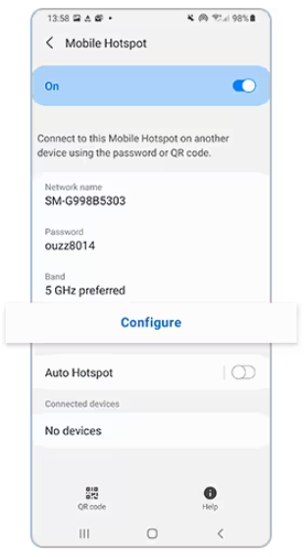
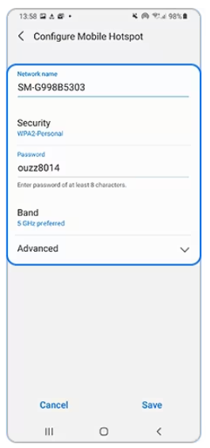
2. Tethering to your Mobile Phone – Android continued
4) Select Configure
5) Complete Network Name and Password
6) Search for the Wi-Fi network on your laptop and enter credentials

Slide 7
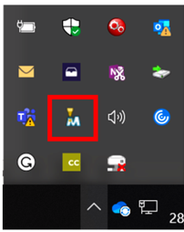
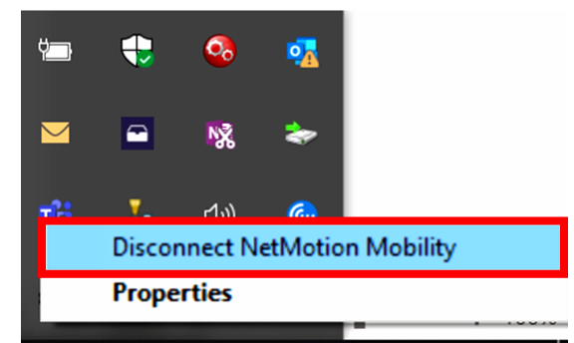
2a. Connecting to NetMotion after you have tethered
To access the Council’s applications – Outlook, Oracle, MS Teams, intranet etc you will need to connect to the NetMotion application.
1) On your laptop, within the Notification Area click the arrow icon
2) Select the NetMotion icon and right click to Connect NetMotion Mobility
3) To disconnect from NetMotion, right click and select Disconnect NetMotion Mobility

Slide 8
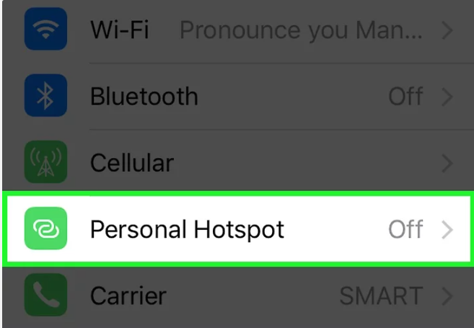
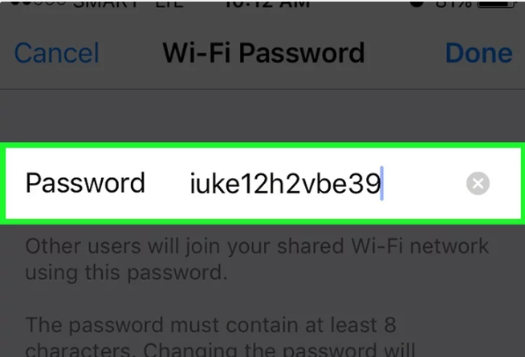
3. Tethering to your Mobile Phone – Apple iPhone
1) Select settings and then select Personal Hotspot
2) Tap the Wi-Fi button and change the password for your network
3) Enter a password for your wireless network/hotspot and then select Done

Slide 9
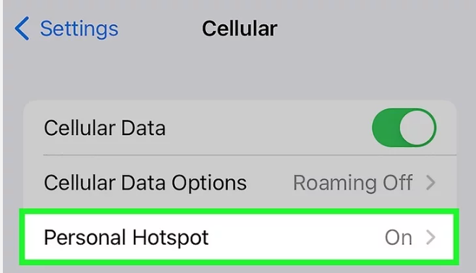
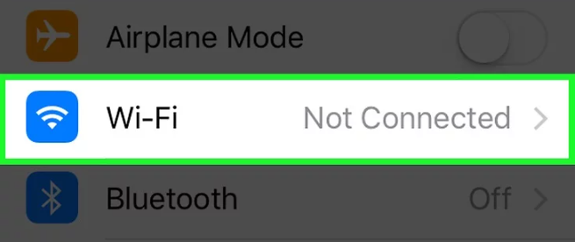
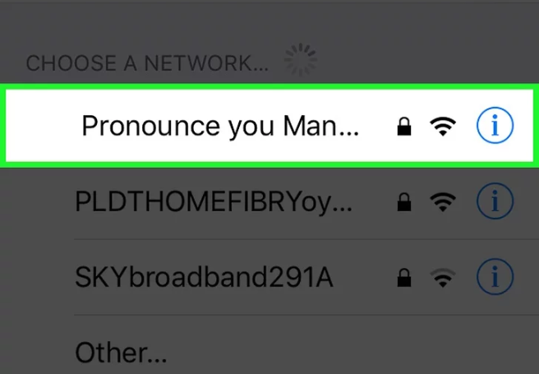
3. Tethering to your Mobile Phone – Apple iPhone cont.
4) From Settings, select Cellular and switch your Personal Hotspot on
5) Open the list of available networks.
6) Select your iPhone from the list of available networks. Enter you’re password (from step 3) when prompted.

Slide 10
3a. Connecting to NetMotion after you have tethered
To access the Council’s applications – Outlook, Oracle, MS Teams, intranet etc you will need to connect to the NetMotion application.
1) On your laptop, within the Notification Area click the arrow icon
2) Select the NetMotion icon and right click to Connect NetMotion Mobility
3) To disconnect from NetMotion, right click and select Disconnect NetMotion Mobility

Slide 11
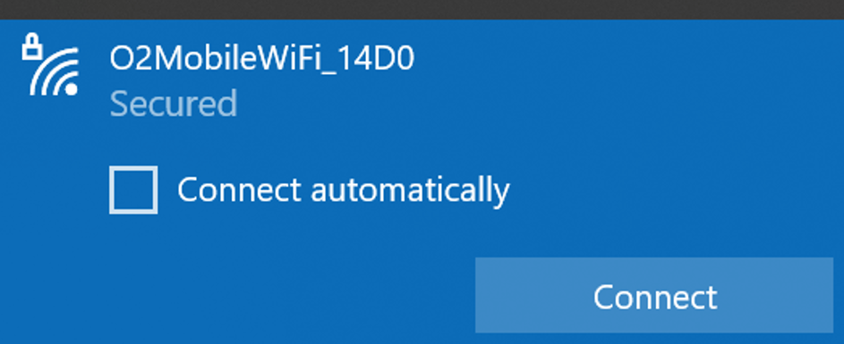
4. Tethering to your MiFi Device
The Mi-Fi device is a mobile Wi-Fi device which enables connection to the internet where no other access is available. It will allow up to 5 connections at any one time and will provide the same functionality as if tethering to a mobile phone
1) Make a note of the SSID and Password of your device, this can be found on the inside of the rear cover (if no sticker is visible on the back).
Hold the centre button to power on.
2) A list of connections appear. Select based on your device name/option starting with O2MobileWIFI_XXX and Connect
3) Enter the Password and you will be connected

Slide 12
4a. Connecting to NetMotion after you have tethered
To access the Council’s applications – Outlook, Oracle, MS Teams, intranet etc you will need to connect to the NetMotion application.
1) On your laptop, within the Notification Area click the arrow icon
2) Select the NetMotion icon and right click to Connect NetMotion Mobility
3) To disconnect from NetMotion, right click and select Disconnect NetMotion Mobility

Slide 13
5. Disconnecting your Hotspot
Remember to disconnect from your hotspot when you are finished and also turn off the tethering option on your mobile phone.
• Click on the Wi-Fi signal on the tool bar, select your device and Disconnect.
• You are now disconnected from your device.
• To turn off Mobile Hotspot on your smartphone, repeat the instructions above and Toggle off the mobile hotspot option.

Slide 14
6. Please remember
Only access via these methods documented where access to broadband is unavailable.
If connection to the mobile network in your location is poor, neither option will meet your needs.

Slide 15
Social media final slide

