Slide 1
Safeguarding and Child Protection training

Slide 2
We can provide bespoke in school training on Specific Safeguarding Issues from KCSIE
Bullying
Child Sexual Exploitation
Child Criminal Exploitation: County Lines; knife crime
Contextual safeguarding
Domestic Abuse
Faith abuse
So called ‘honour based violence (including Female Genital Mutilation and Forced Marriage)
Parental mental health
Peer on Peer Abuse
Sexual Violence and Sexual Harassment; Upskirting
Substance misuse
Notes:
This comes from KCSIE – whilst not technically bound by it, it is useful to know of it as it gives lots of advice about SG - in particular about specific issues – each of these is hyperlinked.
Children may not fully disclose but if you are concerned, you pass it on… i.e. an older sister goes on holiday without the rest of the family – is there a concern of FGM? You get a certain level of nosiness afforded to you because of your profession = professional curiosity = use it = and if parent view is different don’t automatically believe the parent – log the concern anyway. Lots of CP plans are in place due to ongoing issues not one event. It’s not just the obvious things – a parent addicted to online bingo could be neglecting their child.
Some of these issues can come as a surprise – but remember you don’t have to investigate or be the expert – you just have to be aware and know to pass it on or get advice.
Children missing from education – elective home education – about 850 in Bham, going up lots every year (by 65-80), worries about unregistered and illegal school.

Slide 3
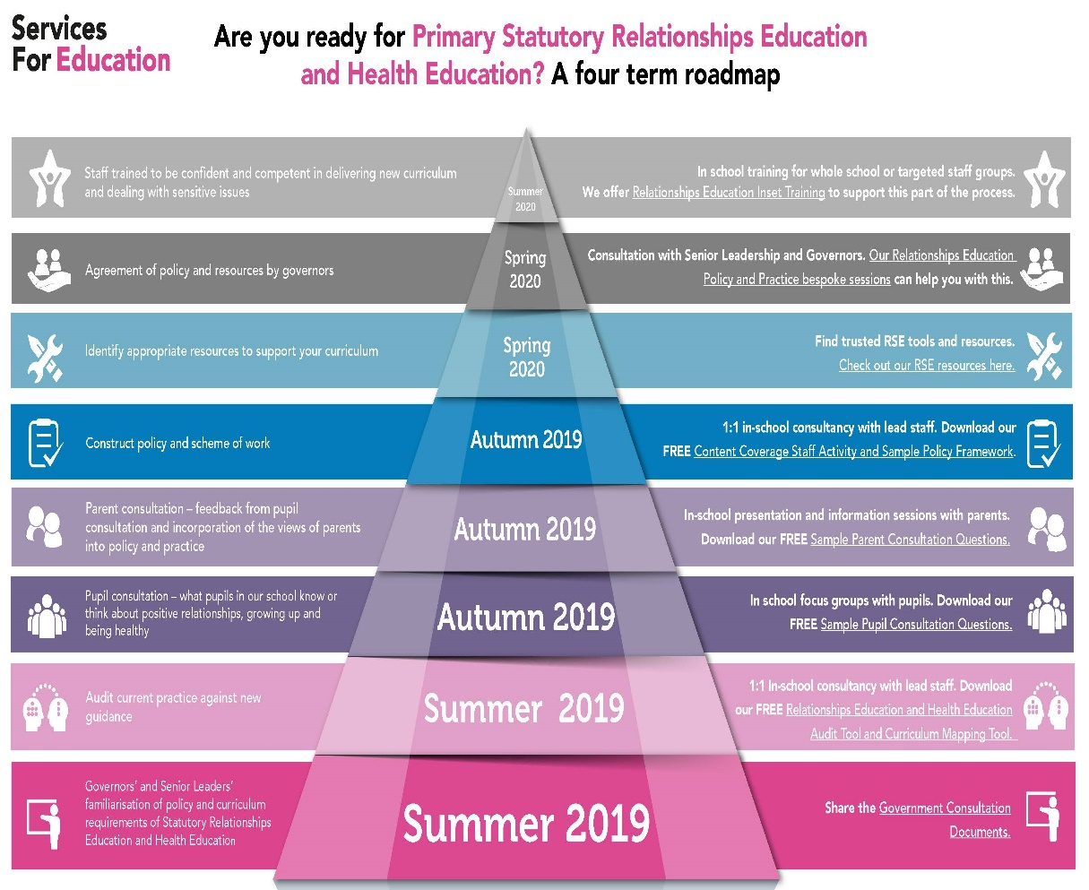
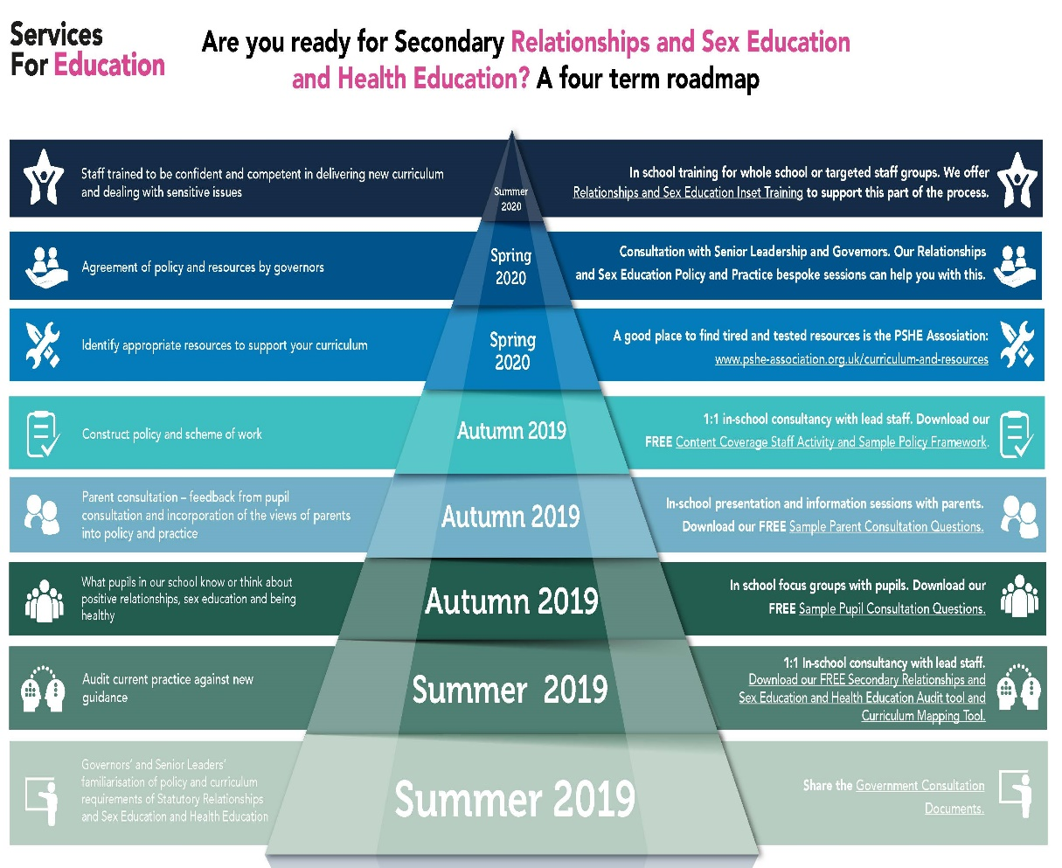
We can provide bespoke training and support on RSE including free webinars

Slide 4
We can provide bespoke training and support on
Safer working practice
DSL supervision
Safeguarding for governors
Safer recruitment

Slide 5
Contact us

hello@servicesforeducation.co.uk

0121 366 9950

www.servicesforeducation.co.uk
Intellectual Property: All training materials provided by Services For Education remain the intellectual property of Services For Education or its partners, who assert their right to worldwide copyright unless specifically agreed otherwise in writing.
© 2019 Services For Education
Notes:
Share vision / ethos of S4E re support and guidance throughout whole career – here to help
POSTCARDS

