Slide 1
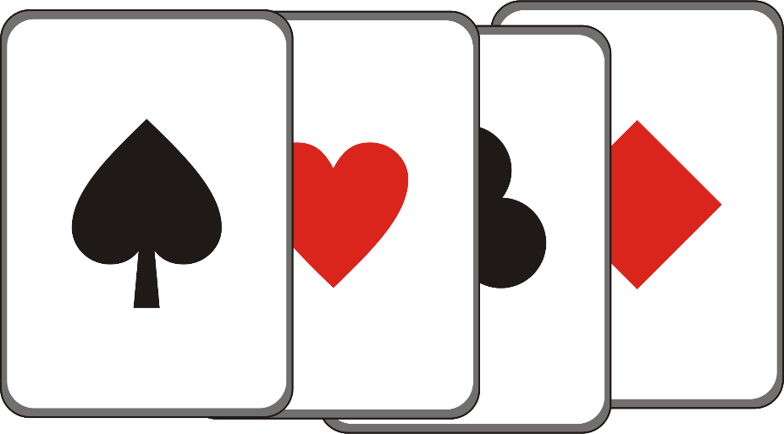
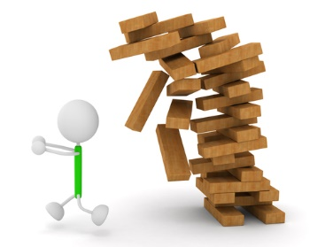
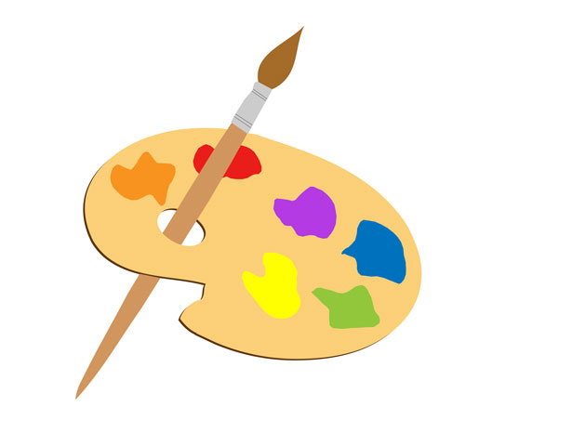
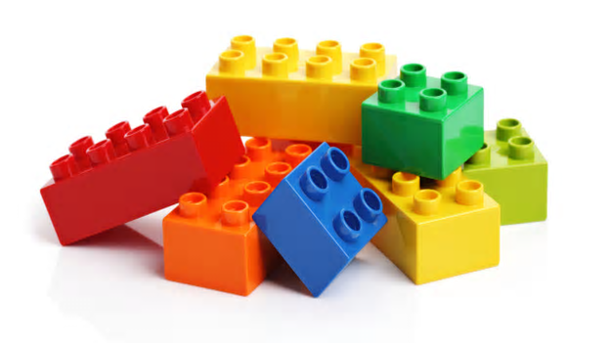
Support Through Play
Play is the universal language of childhood

Slide 2
It is through play that children understand each other and make sense of the world around them …
It teaches them social skills, self-discipline and tolerance of others …
It is an active process in which feeling and doing can flourish …
Crucially although play can be serious as well as joyous – errors do not have serious consequences.
It should have a safe boundary – providing time, space and permission so that children know when it begins and where it ends.

Slide 3
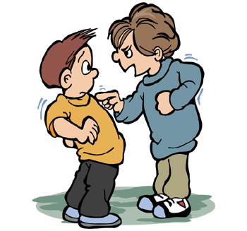
So how does support through play work?
It offers the child the opportunity to re-enact and repeat events and play out their feelings and fantasies – this way the children come to terms with them and achieve a sense of mastery. They can safely express anger and aggression without harming other people or without it rebounding to harm them.
When their anxiety is relieved and their inner harmony is
restored the child becomes ready to cope with events.
Through play children develop resilience and flexibility, which contributes to physical and emotional wellbeing.

Slide 4
Support through play – the process …
Issue identified – Professional / Adult voice
Assessment – The Three Signs of Safety and Wellbeing (Pupil Voice)
and here’s where the fun begins …
GOOD THINGS WORRIES DREAMS

Slide 5
The rules to supporting a child through play are simple … create a safe space, make sure the time boundary is clear, and be a sponge!
In other words – listen more than you talk and retain all the information given! Don’t forget to smile a lot … even if it makes your face ache!
NEVER MAKE A JUDGEMENT OR ASSUMPTION

Slide 6
ACTIVITIES:
Playing snap is an extraordinary way to help a child to understand many concepts including compassion, empathy, sportsmanship, sharing and many more – it takes little to no skill to play but can develop a character significantly
Jenga –
Feelings,Thoughts
Memories
… remember any tower that can tumble can be re-built
Lego – can be used in many ways … associating colours with feelings, memories or thoughts, the size of the bricks can be used to represent the importance or the depth of the feeling or memory
Create … paint and pictures tell their own story

Slide 7
So what happens after the assessment?
You’ve turned yourself into a sponge, you’ve listened to the child and established what the issues are for them …
What’s next?
As a professional there are many avenues for us to choose once we have identified what the issues are for the family but not many of these actually support the child’s feelings … and sadly we are all too aware of the limited resources available …
Example – Issue V Child’s voice
Domestic Violence – “I don’t want to hear Mummy hit my Daddy or see her with a knife … it scares me”
Acrimonious Parental Splits – “it hurts when they argue cause Mummy pulls my t-shirt sleeve on one side and Daddy pulls on the other – it feels like they’re splitting me in half!”
Mental Health Issues – “I don’t know why my Mum keeps eating her pills … they make her sick … it smells disgusting”
Drug/Alcohol Abuse – “Sometimes he’s lots of fun and everything is like really fast, but then he gets sick and I have to phone my Mum to get her to find us and bring me home – its frightening”

Slide 8
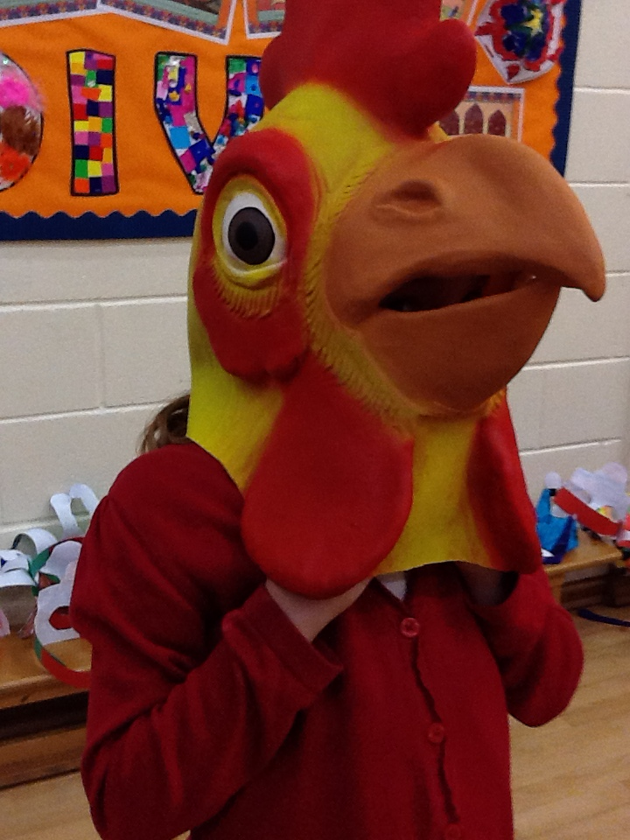
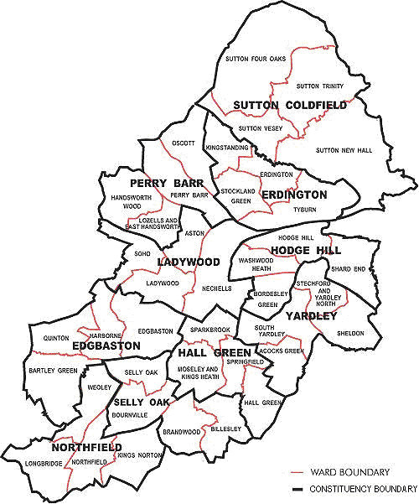
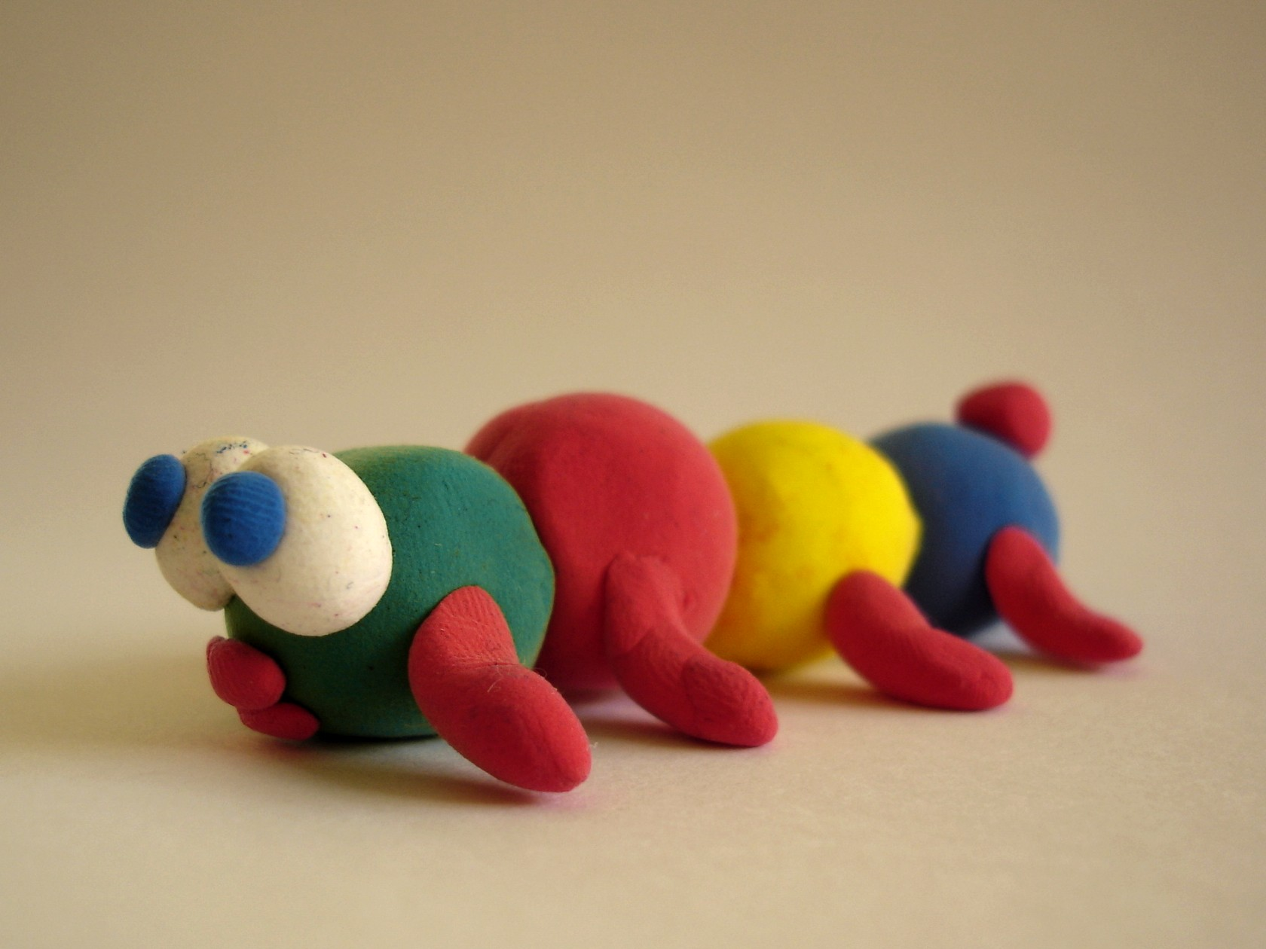
What my world looks like
My tree - my roots, my leaves, my fruit
My Map - where I want to go, why and who do I want to see when I get there …
Role Play - the greatest fun … as long as you're not an adult
Play doh - make it yourself!

Slide 9
How often we support the child depends on many variables …
However these activities can be done in small groups, 1:1 or within a whole class setting …
It is essential that no matter the outcome of the initial assessment that a review must be done to ensure that the child feels supported and safe. Choosing a follow on activity depends on the original needs identified.
What we have to remember is that we are just part of this child’s story … each page is written on by people whom become part of their tale.
And whilst our Intervention may help to resolve the problems that have been identified within their family / home it may not have changed how they feel … they may still be sad, angry or frightened … play it out … until they don’t feel that way anymore!
Cathy Lomas – Pastoral Manager / DSL
Marsh Hill Primary School

