Slide 1
ADVERSE CHILDHOOD EXPERIENCE
Andy Wright
Head teacher of Birmingham Virtual School
& Social and Emotional Health Partnerships
March 2017

Slide 2
Identified Influences On Health & Wellbeing Of Children

Slide 3
Early Life Experience and The Brain

Slide 4
Adverse Childhood Experiences
Physical Abuse
Sexual Abuse
Verbal Abuse
Parental Seperation
Domestic Violence
Mental Illness
Alcohol Abuse
Drug Abuse
Incarceration

Slide 5
How Many ACE’s?

Slide 6
ACE’s and impact on life

Slide 7
The Impact of Adverse Childhood Experiences on ADULT DISEASE

Slide 8
Intergenerational Cycles

Slide 9
WHAT SHOULD WE DO?

Slide 10
Intergenerational Cycles

Slide 11
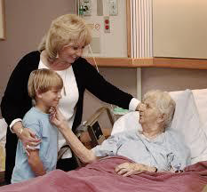
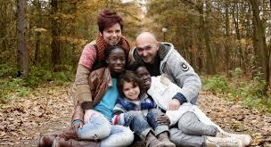
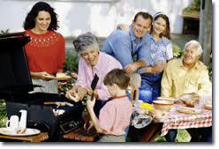
What should we do?
ATTACHMENT

Slide 12
WHY SHOULD WE DO THIS?

Slide 13
Who Is Involved - Agencies & Partnerships
Schools & Educational Settings – All phases
Educational Psychologists
Forward Thinking Birmingham
Third Sector Emotional Health Providers
West Midlands Police
Youth Offending Service
Community Groups

Slide 14
Helping To Find Solutions
NewStart
West Midlands Police – TIPT
West Midlands Health Prevention Project
Virtual School/Educational Psychology Service – Attachment Aware Training Programme
Sustaining Inclusion – A Strategic Approach Across Secondary School Collaborations
SEMH Pathfinder Project
Education & Emotional Well-Being Strategy Group

Slide 15
A
Andy Wright
@bhamcitycouncil
/birminghamcitycouncil
Andrew.wright@birmingham.gov.uk

