Slide 1
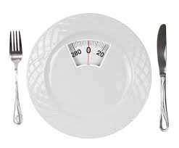
Eating Disorders
Safeguarding conferences for Birmingham schools
16th March 2017, 30th March 2017, 4th April 2017
Dr Newman Leung, PhD, CPsychol, AFBPsS
Consultant Clinical Psychologist
Birmingham & Solihull Mental Health NHS Foundation Trust
Honorary Lecturer
University of Birmingham
Honorary Visiting Fellow
University of Loughborough Research Centre into Eating Disorders

Slide 2
Overview
Myths about Eating Disorders
Types of Eating Disorders
Common psychological and social risk factors
Effect of starvation (what happens when you are not eating well)
Early signs of Eating Disorders (or disordered eating)
How to support young people with ED and their peers
  Potential topics for PSHE
Other resources and information

Slide 3

What Eating Disorders are not…..

Slide 4
Myths about Eating Disorders
Eating disorders are a lifestyle choice
Eating disorders are young girls (and boys) want to look nice and slim
Eating disorders are a cry for attention or a young person ‘going through a phase’
Eating disorders only affect white, middle class females, particularly adolescent girls
Getting better is just a question of eating.
People at a normal body weight cannot have an eating disorder.

Slide 5
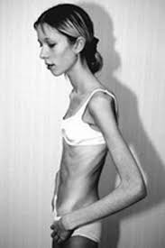
An Eating Disorder is
A serious psychological / emotional disorder (formally classified as a psychiatric illness), which has significant medical and psychological consequences
Anorexia nervosa has the highest mortality rate amongst psychiatric illnesses

Slide 6
Types of Eating Disorders
Anorexia Nervosa
Bulimia Nervosa
Binge Eating Disorder
Other Specified Feeding and Eating Disorder (OSFED) – formerly known as EDNOS

Slide 7
Anorexia Nervosa
Restriction of energy intake relative to requirements, leading to a significant low body weight
Intense fear of weight gain, or persistent behaviour that interferes with weight gain
Body image disturbance
Self-evaluation based on weight/shape

Slide 8
Bulimia Nervosa
Recurrent episodes of binge eating (once a week for 3 months on average)
Recurrent use of purging behaviour (e.g., self-induced vomiting, laxatives, diuretics) and compensatory behaviour (e.g., extreme dieting, exercises)
Sense of lack of control over eating
Self evaluation based on body shape/weight

Slide 9
Binge Eating Disorder
Recurrent episodes of binge eating (once a week for 3 months on average)
Sense of lack of control over eating
Marked distress associated with binge eating
Absence or infrequent use of inappropriate compensatory behaviour

Slide 10
Common psychological risk factors
Personality traits
  Interpersonal hypersensitivity – naturally shy, reserved and tends to “take things to heart”
  Perfectionism – highly self-driven and tends to set unrelenting standards (usually associated with a strong fear of failure)
  Emotional inhibition – tendency to suppress feelings rather than talking about them
  Low self-esteem
History of traumatic experience

Slide 11
Common social risk factors
Media influence
  Portrayal of the thin body ideal
    Consistent glorification of slimness
      Images of celebrities in popular magazines
      Social media, e.g., “hot or not” site
    Early “sexualisation” of children
      Trends in fashion
      Beauty pageants for children

Slide 12
Common social risk factors
Media influence
  Over-emphasis on healthy eating
    Inaccurate nutritional information in popular magazines
    Well-intended health messages from Department of Public Health hijacked by food industry
    Biased messages in advertising (e.g., chocolates = ‘guilty pleasure’ or a ‘treat’)

Slide 13
Common social risk factors
Peer pressure
  Focus in physical appearance (e.g., competing to be the slimmest)
  Competition in academic performance, sporting achievements, etc.
  Intense pressure to conform to certain behaviour (e.g., dieting)

Slide 14
Common functions of ED symptoms
Emotional regulation
  Emotional suppression (providing focus)
  Emotional expression (showing psychological pain)
Regaining sense of control
Sense of achievement
Coping with family dynamics
Tips: Teachers could be well-placed to understand what might be going on, e.g.,
  Academic pressure
  Problems with peers, etc.

Slide 15
An eating disorder is about emotions
and not about food

Slide 16
Effects of Starvation
Physiological starvation happens when the body is not receiving “the right nutrients at the right time”
Semi-starvation occurs about 3 – 4 hours after we have last eaten
Understanding such effects provides a context to identification of early warning signs

Slide 17

Minnesota experiment (Keys, 1950)
Nov 1944 - WW2 coming to end
Allies entering cities encountered starving emaciated civilians
Ancel Keys (University of Minnesota) recruited to find out:
  How affected by starvation
  Best way to rehabilitate them
36 healthy young men selected from 12,000 conscientious objectors
Final sample deemed to be psychologically ‘normal’
First 3 months ate normally (~3200 kcals)
6 month semi-starvation (~1800 kcals)
Final 3 months nutritional rehabilitation
Understanding that starvation dramatically affects – personality, the mind and the body

Slide 18
Minnesota experiment (Keys, 1950)
Changes during restrictive phase:
  Preoccupation with food
  Changes in eating behaviours
  Emotional changes, including anxiety, irritability
  Cognitive changes, including impaired concentration, comprehension and judgement
  Social changes: including social isolation
  Physical changes, including decreased need for sleep, headaches, dizziness, GI discomfort, etc.

Slide 19
Minnesota experiment (Keys, 1950)
Important message learnt from this study:
  Many symptoms experienced by anorexic and bulimic patients (as well as individuals with disordered eating behaviour) are a result of food restriction rather than the illnesses themselves
  Need to take all these changes into account when treating or supporting people with eating difficulties.

Slide 20
Identifying early signs of ED
Change in character
  Being more quiet and isolated
  Reduction in level of interest
  Decrease in performance
Change in eating behaviour
  Eating very little
  Stop eating with peers or in public
  Go to toilet after meals

Slide 21
Identifying early signs of ED
Mood changes
  Low mood and tearfulness
  Anxiety and irritability
Physical changes
  Tiredness and fatigue
  Lack of concentration
Social changes
  Isolated and withdrawn

Slide 22
Other ‘tell-tale’ signs
Also look out for…..
  Sudden increased focus on (or even obsession with) academic work / sports / exercises
  May appear to be overly matured and sensible
  Putting on brave front – appear to be coping well

Slide 23
If you know someone with an eating disorder (or disordered eating)…
Offer support
  Don’t focus on food
  Encourage to talk about what really bothers them
Provide “pointers”
  B-eat website (https://www.b-eat.co.uk)
  Self-help materials
Encourage to seek professional help

Slide 24
For young people under 25 in Birmingham….
Refer to Forward Thinking Birmingham (FTB)
https://forwardthinkingbirmingham.org.uk/
FTB accept referrals from professionals, individuals and third parties (such as schools or colleges) in relation to 0-25s, and 0-35s for first episode psychosis, registered with a Birmingham GP

Slide 25
Don’t forget the peers!
It is often difficult for peers to witness their friend(s) demonstrating signs of ED or disordered eating
  Not knowing what to say or do, feeling awkward
  Emotional response
    Feeling helpless
    Feeling guilty
    Feeling angry
  Impact on own body image and eating behaviour

Slide 26
Suggested topics for PSHE
(if not happening already)
Media scrutiny
  Challenging unhealthy messages around body image / physical appearance
    e.g., “thin is beautiful”, etc.
  Scrutinise portrayal of beauty in media
    Use of air-brushing, computerised modified images
    Useful resource: Dove evolution video clips on YouTube
    https://www.youtube.com/watch?v=iYhCn0jf46U

Slide 27
Suggested topics for PSHE
(if not happening already)
Providing balanced healthy eating messages
  Help young people to under the rationale and target audience of government health messages
    Low fat / low sugar diet (who actually needs it?)
Exploring ‘emotional intelligence’
  Discussing importance of emotional expression
  Highlighting problems with emotional suppression
Dealing with peer pressure

Slide 28

Other information you may find useful…..

Slide 29
On-line training for schools on ED
A short course designed and taught by Professor Caroline Meyer (University of Warwick)
https://www2.warwick.ac.uk/fac/sci/wmg/idh/study/shortcourses/understandingeatingdisorders/

Slide 30
On-line training for schools on ED
Aims of Course (taken from website)
  To inform teachers and other school employees of some up-to-date evidence about eating disorders and dispel any myths
  To give them confidence and help them to feel empowered to spot early warning signs, approach pupils and also to evidence-based information to pass on to parents/peers etc.
  To help them to consider important ways in which schools might help

Slide 31

On-going research that you might like to be part of…
Collaborations for Leadership in Applied Health Research & Care - West Midlands
Professor Max Birchwood & Dr Charlotte Connor

Slide 32

SchoolSpace
Network of schools who want to participate in early intervention youth mental health research in collaboration with CLAHRC-WM (University of Warwick)

Slide 33
SchoolSpace: a population based cohort online screening study of disordered eating behaviour in young people over 2 years
Charlotte Connor, Max Birchwood, Colin Palmer & Sunita Channa, Anna Lavis & Newman Leung
Preliminary findings:
Overall 784 young people (13 – 15 years) completed the online study measures at least once during the 24-month period
14% reported having engaged in some disordered eating behaviour
626 completed at least 2 surveys
8% transitioned to disordered eating at some point during the study
Had higher levels of dieting behaviour, difficulties with emotional regulation, depression and anxiety prior to transition

Slide 34
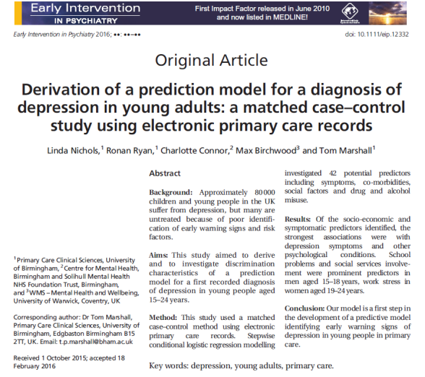
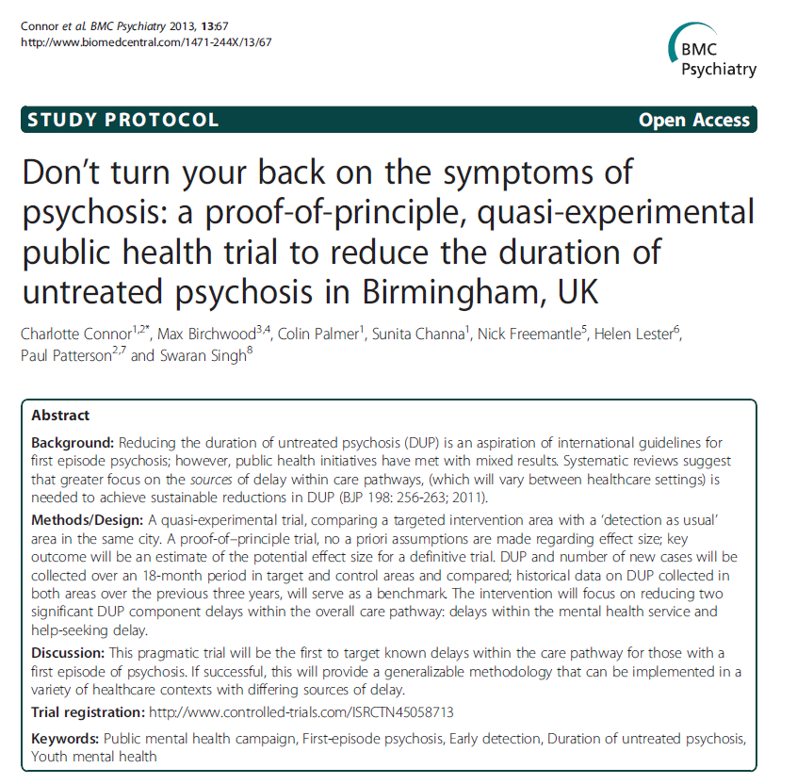
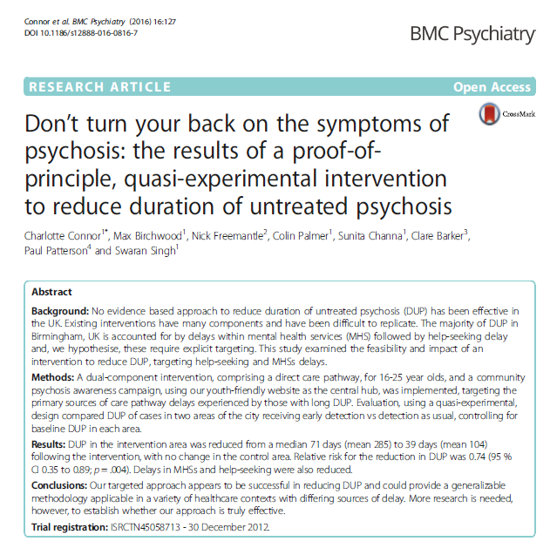
Research in development
Use of Mindfulness app in primary care for young people at risk of developing depression
Peer support intervention to improve resilience in vulnerable young people during school transition
Reducing the duration of untreated eating disorders (DUED) (modelled on our work to reduce duration of untreated psychosis in first-episode psychosis)
RCT to test the effectiveness of a digital stepped care intervention for eating disorders in schools

Slide 35
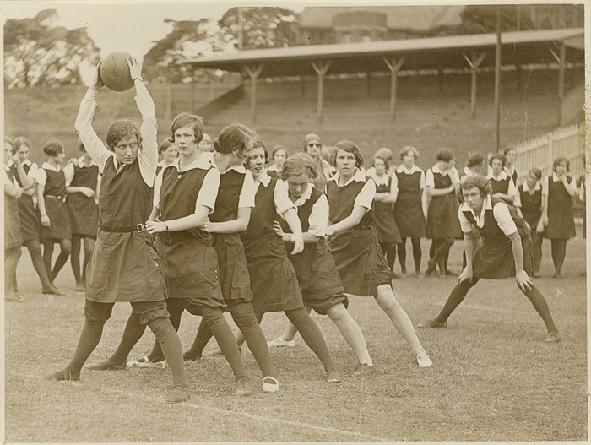
Want to find out more or join SchoolSpace?
Colin.palmer@bsmhft.nhs.uk

Slide 36
Contact details:
newman.leung@bsmhft.nhs.uk
For general information only (cannot offer advice on individual cases)

Slide 37

Any questions?

