Slide 1
Mindfulness in school
Our attention can be vast…
Mindfulness in schools
Notes:
STAFF SESSION START.
NOTE: The first 5 slides correspond to Staff session only.

Slide 2
wHAT DO SCHOOL’S TEACH?
(TWO WORDS)
Notes:
Ask the slide question with open discussion over the subject, you may find responses such as:
“Tickbox Education” “Obedience/ Discipline” “Not enough” “too much”

Slide 3
WHAT DO YOU WISH FOR OUR CHILDREN?
(ONE OR TWO WORDS)
Notes:
Ask the slide question with open discussion over the subject, you may find responses such as:
“Belief themselves” “Fulfillment” “calm/peace” “happy healthy” “safe”

Slide 4
tHE PURPOSE OF EDUCATION IS…
(ONE WORD)
Notes:
Ask the slide question with open discussion over the subject, you may find responses such as:
”Wellbeing” “ learn”

Slide 5
Mindfulness
…means paying attention to what is happening in the present moment.
Notes:
Facilitate the following exercise using the description below as your script:
Take your left arm and hold it out in front of you. Now take 3 fingers on your right hand and gently move them up and down your left arm…Notice how it feels…now we are not thinking about how it feels we are actually feeling it, just noticing and paying attention to how it feels. Now try it really lightly/ now hard and fast
So that was being mindful right there. So its actually very simple and easy – just paying attention to the present moment and hey presto here we are! But the funny thing is – a lot of the time our mind isn’t in the present moment. A lot of the time out mind runs into the past or future wand when this happens sometimes it’s not good!
Eg – during the summer holidays you might be playing with friends and having lots of fun and then your mind might jump back to the thought that you’ll be going back to school in a week and you end up feeling down about it. You might not want to go back, you might want the summer holidays to last longer. The more you think about it the more you feel down and as a result you might not be able to really enjoy playing with friends because your mind has run into the future. You miss the opportunity to enjoy the present moment
Sometimes we might want to concentrate on our school work so that we can do our best, but our mind wanders into daydreams. It leaves the present moment and so we can sometimes sit for 20 or 30 mins and hardly get anything done.
When we learn Mindfulness though, we TRAIN OUR MIND to be in the present moment, and so rather than being lost in daydreams we can decide to put our attention – to place our mind – where we want to place it!

Slide 6
How are you today?
Notes:
How are you today? Facilitate this from the workshop pack.

Slide 7
Mindfulness
…means paying attention to what is happening in the present moment.
Notes:
Facilitate the following exercise using the description below as your script:
Take your left arm and hold it out in front of you. Now take 3 fingers on your right hand and gently move them up and down your left arm…Notice how it feels…now we are not thinking about how it feels we are actually feeling it, just noticing and paying attention to how it feels. Now try it really lightly/ now hard and fast
So that was being mindful right there. So its actually very simple and easy – just paying attention to the present moment and hey presto here we are! But the funny thing is – a lot of the time our mind isn’t in the present moment. A lot of the time out mind runs into the past or future wand when this happens sometimes it’s not good!
Eg – during the summer holidays you might be playing with friends and having lots of fun and then your mind might jump back to the thought that you’ll be going back to school in a week and you end up feeling down about it. You might not want to go back, you might want the summer holidays to last longer. The more you think about it the more you feel down and as a result you might not be able to really enjoy playing with friends because your mind has run into the future. You miss the opportunity to enjoy the present moment
Sometimes we might want to concentrate on our school work so that we can do our best, but our mind wanders into daydreams. It leaves the present moment and so we can sometimes sit for 20 or 30 mins and hardly get anything done.
When we learn Mindfulness though, we TRAIN OUR MIND to be in the present moment, and so rather than being lost in daydreams we can decide to put our attention – to place our mind – where we want to place it!

Slide 8
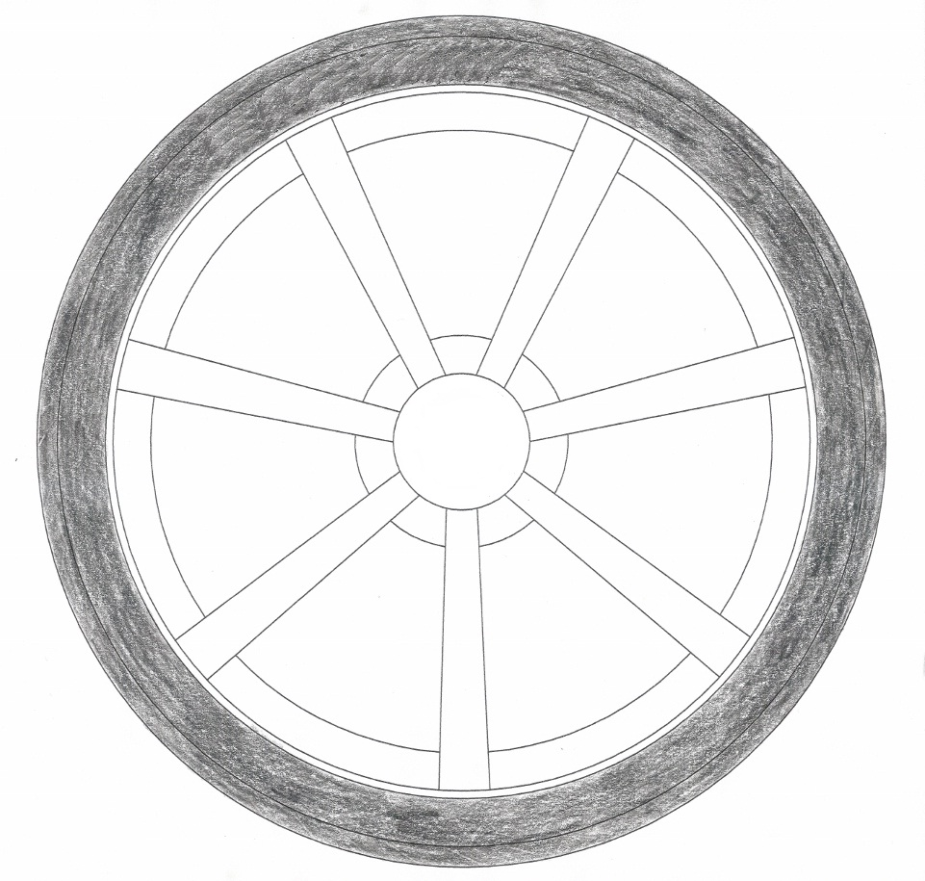
Wheel of mindfulness
emotions
sights
thoughts
sounds
mind
sensations / touch
tastes
smells
Notes:
Exercise :
As each sense arrives on the screen ask the group to give an example of one these expereiences
This is an exercise of awareness.

Slide 9
“welcome to our super mind machine”
MIND TRAINING

Slide 10
Notes:
Explain to the children to look at this for a moment and ask them
What do they see?
What do they think the colour’s represent?
What do they think the person is doing in both?
Description
Left is before exercise sitting for 20 mins. Right is after a 20 min exercise.
Tell the children that the brain on the left is an inactive brain and on the right is an active or engage brain and the colour’s are
“energy and electrons which are producing brain cells”
A brain cell is a memory in your head for when you have learnt something new
Mindfulness (is like the right brain) it stimulates your brain and engages it giving it a chance to explore how you feel, learn which creates new memories and new brain cells.
Now move into yout “BRAIN TRAIING” as we have now proved to the class and teachers that this works!

Slide 11
Lesson 13
Lesson 13
Lesson 13
The more we resist the worse it gets
Notes:
Partner 1 – Is the Mind
Paretner 2 – Is the Emotions
Describe that when their palms are together – if they are at force with each other. The mind can’t think about anything else other than the build up of pressure and emotion. By using breathing you can let go and focus on other things – relieving the pressure and reducing build up of emotion.

Slide 13
We all want to be happy
Nobody wants to be unhappy
We will all feel both happy and unhappy at times
Given this, what’s the best way to treat ourselves and others?
Notes:
This is what we al have in common!

Slide 14
“Three things in human life are important:
The first is to be kind;
The second is to be kind;
The third is to be kind.”
Notes:
KINDNESS SLIDE

Slide 15
May I be happy
May I enjoy life
May I have fun
May I have the strength to handle difficult times
Notes:
May I be happy

Slide 16
Looking Forward

